Slide 2
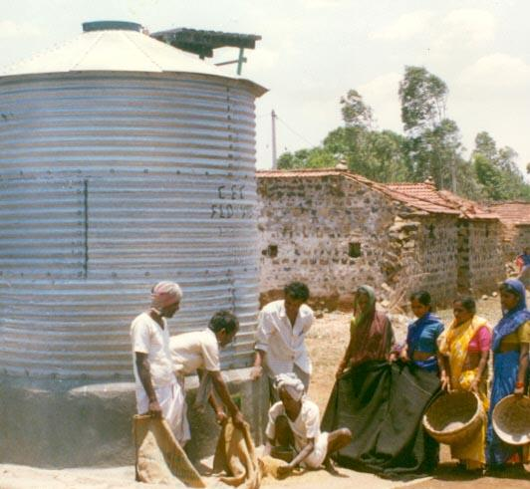
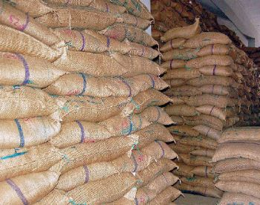
PREACUTIONS FOR SAFE STORAGE OF GRAINS

Slide 3
Introduction
To cope with the current and future demand of the increasing population for the food grains, it is emphasized to reduce the loss of seeds during and after harvest.
Seeds are stored for varying periods to ensure proper and balanced public distribution throughout the year.
Post-harvest losses in India are estimated to be around 10 per cent, of which the losses during storage alone are estimated to be 6.58 per cent.

Slide 4
Best storage performance
1. The produce must be thoroughly cleaned and graded. 2. Dried to the safe storage moisture level of 10-12 % for cereals and
7-9% for oilseeds (on wet basis) for a safe storage period of 6-12
months. 3. Storage structures should to be properly repaired, cleaned and disinfected. 4. Structures should bear the load of seeds stored and do not permit contact/ exchange with outside humid air. 5. Structures should be constructed in the coolest part of the house/ farm.

Slide 5
Ideal storage facility should satisfy the following requirements
1. It should provide maximum possible protection from ground moisture, rain, insect pests, moulds, rodents, birds, fire etc., 2. It should provide the necessary facility for inspection, disinfection, loading, unloading, cleaning and reconditioning. 3. It should protect grain from excessive moisture and temperature favourable to both insect and mould development. 4. It should be economical and suitable for a particular situation.

Slide 6
STORAGE STRUCTURES
Different types storage structures
Conventional storage structures
Improved rural - level storage structures
Community storage structures

Slide 7
Conventional storage structures
Structures | Make | Stored items | Capacity | Remarks
1. Bamboo structures | Split bamboo woven in the form of a cylinder with wide base and narrow mouth | Paddy, wheat and sorghum | 500 kg | Life 4-5 years. Weight loss due to insect attack is 5 % in paddy and 15% in sorghum.
2. Mud and earthen structures | Clay, straw and cow dung- 3:3:1. Earthen structures are made, sun dried and then burnt in fire | Paddy, wheat, sorghum,oil seeds and pulses | 5 to 10 q | Life 8- 10 years. During rainy season develop cracks and moisture absorption followed by insect and mould infestation.

Slide 8

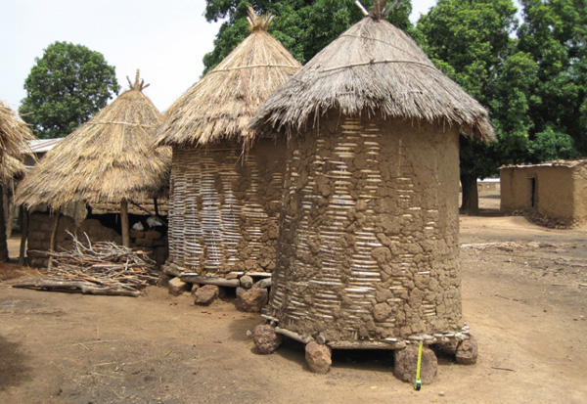
Bamboo structures
Mud and earthen structures

Slide 9
3. Wooden structures | Local wood is painted black. At the top, 30 cm x 20 cm in let and at the bottom 30 cm x15cm outlet is provided. | Paddy | 10 q | 15- 20 years. Neither airtight nor moisture proof.
4. Brick structures | Rectangular, structures built as part of the house, with brick in cement or lime mortar having a wall thickness of 40 –50 cm. At the top 50x 50 cm inlet and at bottom 15 x15cm outlet is provided. | Paddy, sorghum and wheat | 25- 30 q | 25- 30 years. High initial cost, not insect and moisture proof.

Slide 10
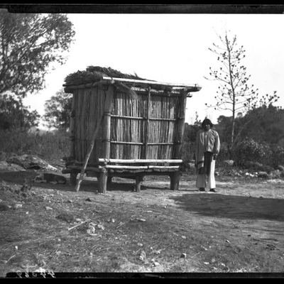
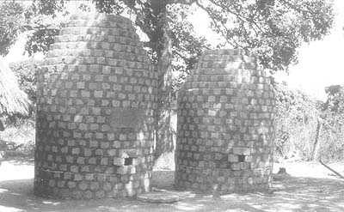
Wooden structures
Brick structures

Slide 11
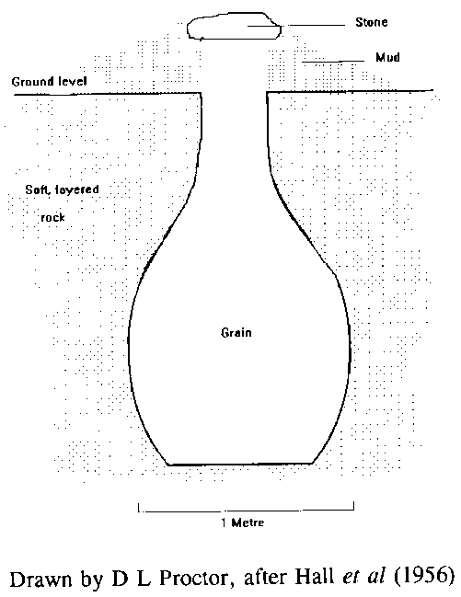
5.Underground structures | Circular pits vary from 100– 400cm in depth and 50 – 100 cm dia at neck and 250 – 300 cm at the bottom. For filling and emptying there is an opening at the top. Before filling the sides and bottom are packed with straw and husk. After filling the pit is again covered with straw and stone, the finally with mud. | Cereals | 100 –200 q | Safe against insects but, loss of seed viability and handling difficulties made it out of date.

Slide 12
6.Miscellaneous plant materials a. Paddy straw b. Stem of vitex and pigeon pea stalks c. Bottle gourd shells | a. paddy straw is wound in the form of rope to varying diameter b. stems wound like a bin and both sides are plastered with mud and cow dung c. empty shells are used | Paddy, other cereals and pulses Paddy and other cereals Pulses, gourd seeds | 30–100q 1-2 q 2-5 kg | Not insect and rat proof Temporary Only small quantity of seed lots.

Slide 13
7. Metal corrugated G.I. sheets | Sheets of about 3 m high are held vertically along one edge and edges of the other sheets are overlapped and bolted to each other. Thus the circle with 2-4 m dia. It is completed with many such sheets. They are covered on the top with the plain M.S. or G.I. sheets. | Various types of seeds | Vary | Vary Temporary
8. Hessian cloth bags
9. Gunny bags

Slide 14
THANK YOU

