Slide 1
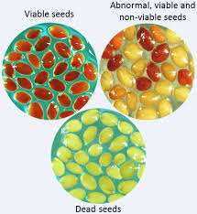
Centurion university of technology and management
M.S.Swaminathan school of agriculture
Topic : seed vigour –its significance and testing methods.

Slide 2
What is Seed Vigour?
Seed vigour, a single concept reflecting several characters determines the seed quality and uniform emergence potential of plants in field under variable range of environments
Importance of Seed Vigor Testing
Vigor testing does not only measure the percentage of viable seed in a sample, it also reflects the ability of those seeds to produce normal seedlings under less than optimum or adverse growing conditions similar to those which may occur in the field.
Seeds may be classified as viable in a germination test which provides optimum temperature, moisture and light conditions to the growing seedlings; however, they may not be capable of continuing growth and completing their life cycle under a wide range of field conditions.
Generally, seeds start to lose vigor before they lose their ability to germinate; therefore vigor testing is an important practice in seed production programs.
Testing for vigor becomes more important for carryover seeds, especially if seeds were stored under unknown conditions or under unfavorable storage conditions

Slide 3
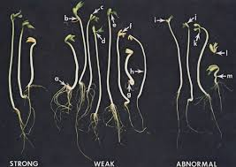
Methods of measuring seed vigor
The general strategy of determining seed vigor is to measure some aspects of seed deterioration or weaknesses, which is inversely proportional to seed vigor.
Cold test, accelerated aging test, electric conductivity test, seedling vigor classification, and seedling growth rate are among the tests that are used to measure seed vigor. In addition, the tetrazolium (TZ test) can be used as a vigor test by classifying the pattern of stained seeds into high, medium and low quality.
The AOSA Seed Vigor Testing Handbook is a good source of information on seed vigor testing.
Below is a brief description for some of the most common seed vigor tests that are used for various crops including corn, soybean, field beans, peas, grasses, vegetable seeds, and other crops.

Slide 4
ACCELERATED AGING TEST (AAT)
The principle of this test is to stress seeds with high temperatures of (40-45°C/130-139°F) and near 100% relative humidity (RH) for varying lengths of time, depending on the kind of seeds, after which a germination test is made. High vigor seeds are expected to tolerate high temperatures and humidity and retain their capability to produce normal seedlings in the germination test.
When can the AAT test be used?
Can be used to determine the seed vigor of many crops.
Useful in predicting the potential storability of a seed lot.
Cold Germination Test
Cold germination tests assess the seedlings’ ability to withstand the low temperature stress (5 C to 7 C) typically experienced in early spring planting.
This test helps you better assess early season risk. In other words, if test results show the seed is susceptible to cold stress, you can adjust your seeding dates accordingly.
The cold germination test results are reported in two categories:
Emergence is the percentage of seedlings that developed normally and rapidly under cold conditions.

Slide 5
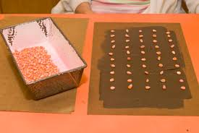
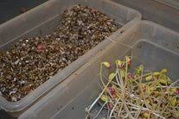
Controlled Deterioration Test
Also used to predict storage and field planting potential, the controlled deterioration test is similar to the accelerated aging test in that it imposes a stress factor on the seed.
In this case, seeds are brought to 20% moisture and held at this value constantly during the deterioration period. Again, the seeds are transferred to the growth chamber and the germination potential assessed.
Electrical Conductivity Test
This test is used to determine when seed should be planted, and applies mainly to pulses and large seeded legumes, but can also be used on canola.
The test evaluates the integrity of cell membranes and their ability to repair themselves during the “soak period.” Seed is soaked in de-ionized water for a short period of time, allowing sugars, starches and amino acids to leach from the seed.

Slide 6
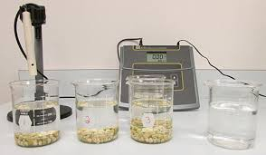
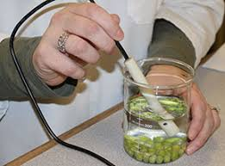
Seedling Growth Rate Test
This test is closely related to the standard germination test and is useful to figure out field planting potential under optimal or near ideal conditions.
Seeds are planted under optimum conditions and are allowed to grow for an extended period of time, usually several days past the typical germination period. The seedlings are evaluated by their growth characteristics, such as stem length, leaf development or root branching.
The measurements determining strong or poor vigour are highly dependant on the particular cultivar being tested. Some varieties of lentil, for example, may naturally be longer than others. It means our seed analysts have to get very familiar with a lot of different growth characteristics!

Slide 7
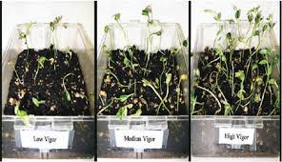
3. Hiltner Test (Brick gravel test)
Principle: The test was developed by Hiltner in Germany in 1917. He observed that the seeds of cereal crops affected by Fusarium disease were able to germinate in regular test but were not able to emerge from brick gravels of 2-3 mm size. Compared to this, healthy seeds were able to emerge from the brick gravel (Robersts, 1972). in principle is that the weak seedlings are not able to generate enough force to overcome the pressure of brick gravels, so this method can be used to differentiate vigour levels in cereal seeds. Perry (1984b) found this method reproducible and associated with field emergence in case of wheat.
Apparatus and equipment: Germination box, aluminium tray, sand, sand marker brick gravel of 2-3 mm size, germinator, seed sample.
Procedure: The sand is seived, moistured and filled in the germination box leaving about 3 cm empty at the top. One hundred seeds are 'placed in each box in the impressions made by a sand marker. After this 2-2.5 em of porous brick gravel is spread over the seeds

Slide 8
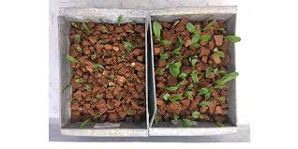
The box is kept in the germinator at appropriate temperature. Afterthe period required for germination, the box is removed and the seedlings which have emerged through the brick gravel layer are counted. The percentage of emerged seedlings are used to com petre seed vigour of different lots. The test should be repeated 3-4 times to get authentic value.

Slide 9
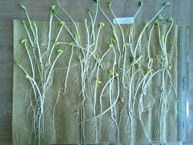
Thank you

