Slide 1
21 Code of Federal Regulations Part 11

Slide 2
Contents
Introduction
21CFR11 History
Important aspects of 21CFR11
Parts of 21CFR11
References

Slide 3
Introduction
Decoding 21CFR11 :
CFR = ‘‘Code of Federal Regulations’’ 21 = ‘‘Title 21’’
= Foods and Drugs
21CFR58 = GLP
21CFR210 = GMP, Drugs (General) 21CFR211 = GMP, Drugs (Finished Products) 21CFR312 = Inv. NDA (GCP)
21CFR820 = GMP, Devices
21CFR11 = Electronic Records and Electronic Signatures

Slide 4
What is 21CFR11
21CFR11 is a section in the Code of Federal Regulations (CFR) that sets forth the United States Food and Drugs Administration (FDA) guidelines on using electronic records and electronic signatures.
Each title of the CFR addresses a different regulated area, 21CFR relates to Pharmaceuticals and Medical Devices and Part 11 being applicable to electronic records and electronic signatures.

Slide 5
Why we need 21CFR11?
21CFR11 is a law that ensures that companies and organizations implement good business practices by defining the criteria under which electronic records and signatures are considered to be accurate, authentic, trustworthy, reliable, confidential, and equivalent to paper records and handwritten signatures on paper.
Part 11 essentially allows any paper records to be replaced by an electronic record, and allows any handwritten signature to be replaced by an electronic one.

Slide 6
21CFR11 History
In the early 1991, key groups who operated within the pharmaceutical industry met the FDA to determine how the industry would deal with electronic record keeping systems that felt within the age old GMP regulations.
Over the next few years these groups alongside the FDA started to build out the early versions of the rules we are governed by today, with the final rule becoming effective on August 20th, 1997.
From the year 2000, the FDA stated that alongside the released criteria, they would consider electronic records to carry the same compliance requirements as paper records, and including electronic signatures as an equivalent to the traditional wet ink handwritten signatures.
From the year 2000 to now, the FDA has released a number of guidance papers in response to the changing landscape in an effort to clarify the rule and how it should be interpreted.

Slide 7
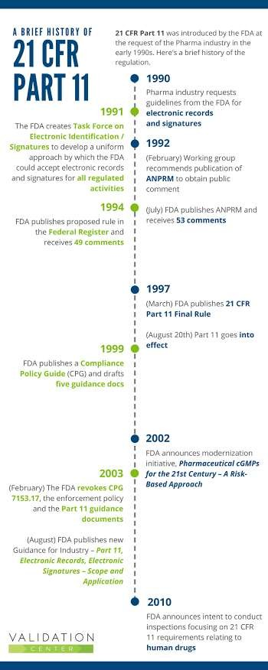

Slide 8
Important aspects of 21CFR11
Definitions:
Act means the Federal Food, Drug, and Cosmetic Act.
Agency means the Food and Drug Administration.
Biometrics means a method of verifying an individual’s identity based on measurement of the individual’s physical feature(s) or repeatable action(s) where those features and/or actions are both unique to that individual and measurable.
Closed system means an environment in which system access is controlled by persons who are responsible for the content of electronic records that are on the system.
Digital signature means an electronic signature based upon cryptographic methods of originator authentication, computed by using a set of rules and a set of parameters such that the identity of signer and the integrity of the data can be verified.
VI. Electronic record means any combination of text, graphics, data, audio, pictorial, or other information representation in digital form that is created, modified, maintained, archived, retrieved, or distributed by a computer system.
Electronic signature means a computer data compilation of any symbol or series of symbol executed, adopted, or authorized by an individual to be the legally binding equivalent of the individual’s handwritten signature.
V.
VII.
VIII.
Handwritten signature means the scripted name or legal mark of an individual handwritten by that individual and executed or adopted with the present intention to authenticate a writing in a permanent form.
IX. Open system means an environment in which system access is not controlled by persons who are responsible for the content of electronic records that are on the system.

Slide 9
Parts of 21CFR11
Sec. 11.10 Controls for closed systems.
Validation of systems to ensure accuracy, reliability, consistent intended
performance, and the ability to discern invalid or altered records.
The ability to generate accurate and complete copies of records in both human readable and electronic form suitable for inspection, review, and copying by the agency.
Protection of records to enable their accurate and ready retrieval throughout the records retention period.
Limiting system access to authorized individuals.
Use of secure, computer-generated, time-stamped audit trails to independently record the date and time of operator entries and actions that create, modify, or delete electronic records.
Use of operational system checks to enforce permitted sequencing of steps and events, as appropriate.
Determination that persons who develop, maintain, or use electronic record/electronic signature systems have the education, training, and experience to perform their assigned tasks.
The establishment of, and adherence to, written policies that hold individuals accountable and responsible for actions initiated under their electronic signatures, in order to deter record and signature falsification.

Slide 10
Sec. 11.30 Controls for open systems.
Persons who use open systems to create, modify, maintain, or transmit electronic records shall employ
procedures and authenticity,
controls designed to
ensure the
the
integrity, and as appropriate,
confidentiality of electronic records from the point of their creation to the point of their receipt. Such procedures and controls shall include those identified in 11.10, as appropriate, and additional measures such as document encryption and use of appropriate digital signature standards to ensure, as necessary under the circumstances, record authenticity, integrity, and confidentiality.

Slide 11
Sec. 11.50 Signature manifestations.
Signed electronic records shall contain information associated with the signing that clearly indicates all of the following:
The printed name of the signer;
The date and time when the signature was executed; and
The meaning (such as review, approval, responsibility, or authorship) associated with the signature.

Slide 12
Sec. 11.70 Signature/record linking.
Electronic signature and handwritten signatures executed to electronic records shall be linked to their
respective electronic
signatures cannot be
records to ensure that the excised, copied, or otherwise
transferred to falsify an electronic record by ordinary means.

Slide 13
Subpart C – Electronic Signatures
Sec. 11.100 General requirements.
Each electronic signature shall be unique to one individual and shall not be reused by, or reassigned to, anyone else.
Before an organization establishes, assigns, certifies, or otherwise sanctions an individual’s electronic signature, or any element of such electronic signature, the organization shall verify the identity of the individual.
Persons using electronic signatures shall, prior to or at the time of such use, certify to the agency that the electronic signatures in their system, are intended to be the legally binding equivalent of traditional handwritten signatures.
Persons using electronic signatures shall, upon agency request, provide additional certification or testimony that a specific electronic signature is the legally binding equivalent of the signer’s handwritten signature.

Slide 14
Sec. 11.200 Electronic signature components and controls.
Electronic signatures that are not based upon biometrics shall:
Employ at least two distinct identification components such as an
identification code and password.
When an individual executes a series of signings during a single, continuous period of controlled system access, the first signing shall be executed using all electronic signature components; subsequent signings shall be executed using at least one electronic signature component that is only executable by, and designed to be used only by, the individual.
When an individual executes one or more signings not performed during a single , continuous period of controlled system access, each signing shall be executed using all of the electronic signature components.
Be used only by their genuine owners; and
Be administered and executed to ensure that attempted use of an individual’s electronic signature by anyone other than its genuine
owner requires collaboration of two or more individuals.
14

Slide 15
Sec. 11.300 Controls for identification code/passwords.
Persons who use electronic signatures based upon use of identification codes in combination with passwords shall employ controls to ensure their security and integrity. Such controls shall include:
Maintaining the uniqueness of each combined identification code and password, such that no two individuals have the same combination of identification code and password.
Ensuring that identification code and password issuances are periodically checked, recalled, or revised.
Following loss management procedures to electronically deauthorize lost, stolen, missing, or otherwise potentially compromised tokens, cards, and other devices that bear or generate identification code or password information, and to issue temporary or permanent replacements using suitable, rigorous controls.
Use of transaction safeguards to prevent unauthorized use of passwords and/or identification codes, and to detect and report in an immediate and urgent manner any attempts at their unauthorized use to the system security unit, and, as appropriate, to organizational management.
Initial and periodic testing of devices, such as tokens or cards, that bear or generate identification code or password information to ensure that they function properly and have not been altered in an unauthorized manner.

