Slide 1
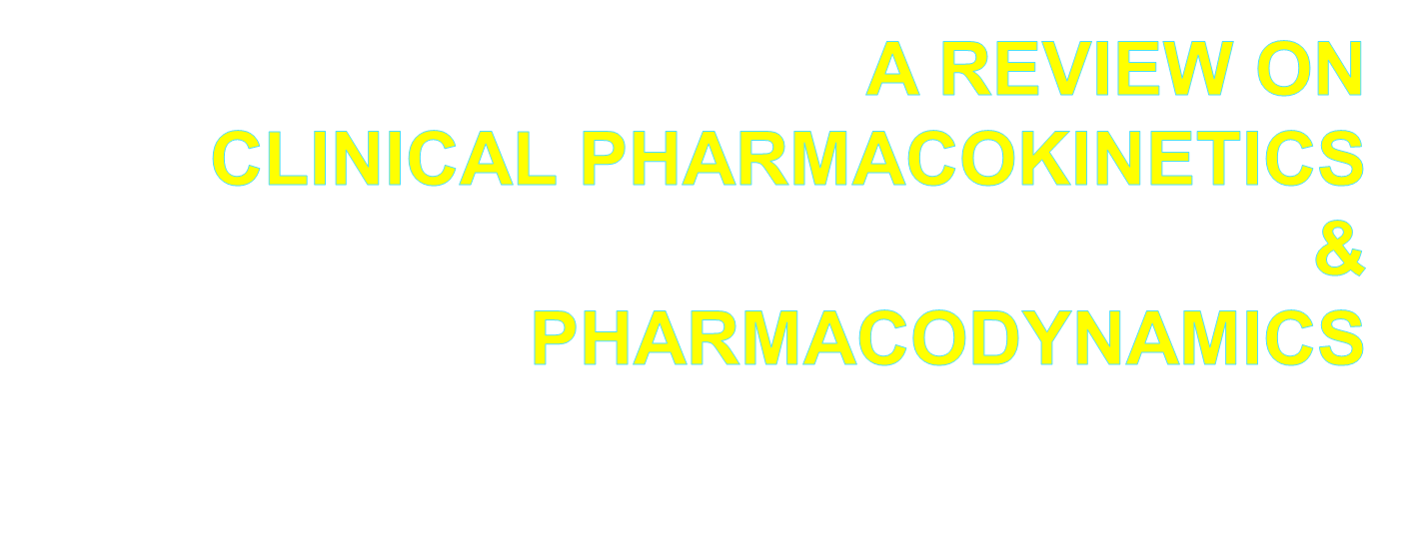

Slide 2
LEARNING OBJECTIVES-
To explain concept, measurement and significance of half life
·
To explain concept, measurement and significance of steady state conc.
·
To explain concept, measurement and significance of clearance and kinetics of drug elimination
·

Slide 3
Pharmacokinetics
·
Drug molecules interact with target sites to produce effects-
The drug must be absorbed into the bloodstream and then carried to the target site(s)
·
Pharmacokinetics is the study of drug absorption, distribution within body, and drug elimination over time

Slide 4
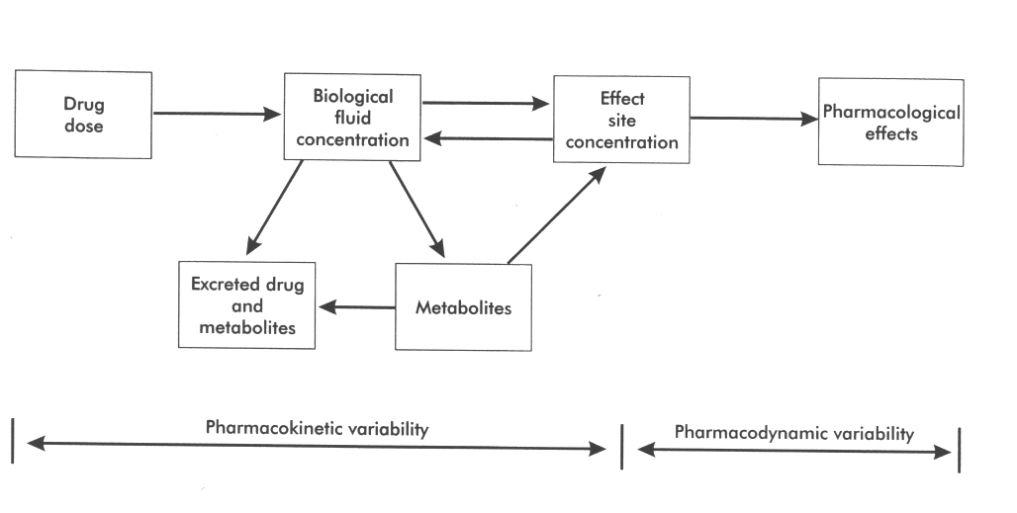
Overview

Slide 5
Half-Life
Half-life is the time taken for the drug concentration to fall to one half of its original value
·
·
The elimination rate constant (k) is the fraction of drug in the body which is removed per unit time

Slide 6
Plasma half life (t_{1/2}) of drug
Generally, it is measured by –
·
The time ….
·
To decline the plasma concentration of a drug to…. 50% from the peak plasma concentration (PPC / Tmax)

Slide 7
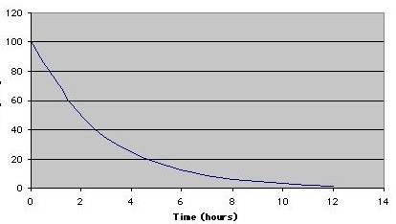
Plasma half life (t_{1/2}) of drug
·
·
Time to decline conc. from 100 to 50 = 2 hr So, t_{1/2} of this drug is 2 hr

Slide 8
Plasma half life (t_{1/2}) of drug
·
Generally, a drug will be completely eliminated after 6 half lives-
After 1 half-life the conc. will be 50% After 2 half-lives it will be 25%
After 3 half-lives 12.5% and
After 4 half-lives 6.25%
After 5 half-lives 3.125%
After 6 half-lives 1.56%
·
·
·
·
·
·

Slide 9
Plasma half life (t_{1/2}) of drug
·
Generally, a decline to 6.25% will usually be far below the therapeutic threshold
·
For this reason it is usually said that drugs no longer have a pharmacological effect 4 half-lives after the last dose

Slide 10
Why is half-life important ?
Half-life is a major determinant of :
The duration of action after a single dose
The time required to reach steady state
The dosing frequency

Slide 11
Importance of t _{1/2}
A) Estimation of dosing schedule
·
It defines the time interval between doses, and is very important in the design of infusion systems

Slide 12
B) Estimation of time to drug elimination
·
It gives the idea to estimate the time to total drug elimination
·
Generally, most drugs will be eliminated in approximately six half-lives

Slide 13
Plasma half-life (t_{1/2}) of some drugs:
·
·
·
·
·
Benzylpenicillin: 30 min
Amoxicillin: 1 hr
Paracetamol: 2 hr
Atenolol: 7 hr
Diazepam: 40 hr

Slide 14
Elimination half life (t_{1/2})
·
Is the time taken for plasma concentration of a drug to reduce by 50% of its initial value
After 4 half lives, elimination is 94% complete
kel = the log of 2 divided by the t_{1/2} = 0.693/t_{1/2}
Likewise,
Cl = kel x Vd
so, Cl = 0.693 Vd/t_{1/2}
t_{1/2} = 0.693 x Vd / Cl
·
·
·
Kel = elimination constant

Slide 15
Pharmacokinetic Principles
·
Steady State: the amount of drug administered is equal to the amount of drug eliminated within one dosing interval resulting in a plateau or constant serum drug level
Drugs with short half-life reach steady state rapidly
Drugs with long half-life take days to weeks to reach steady state
·
·

Slide 16
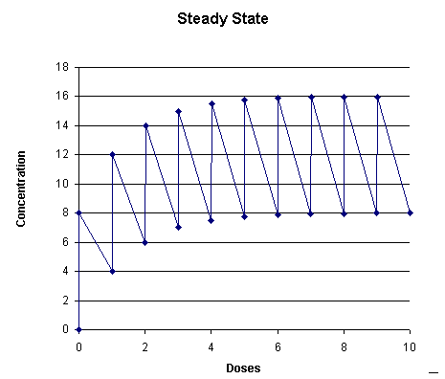
Steady state

Slide 17
Order of Kinetics

Slide 18
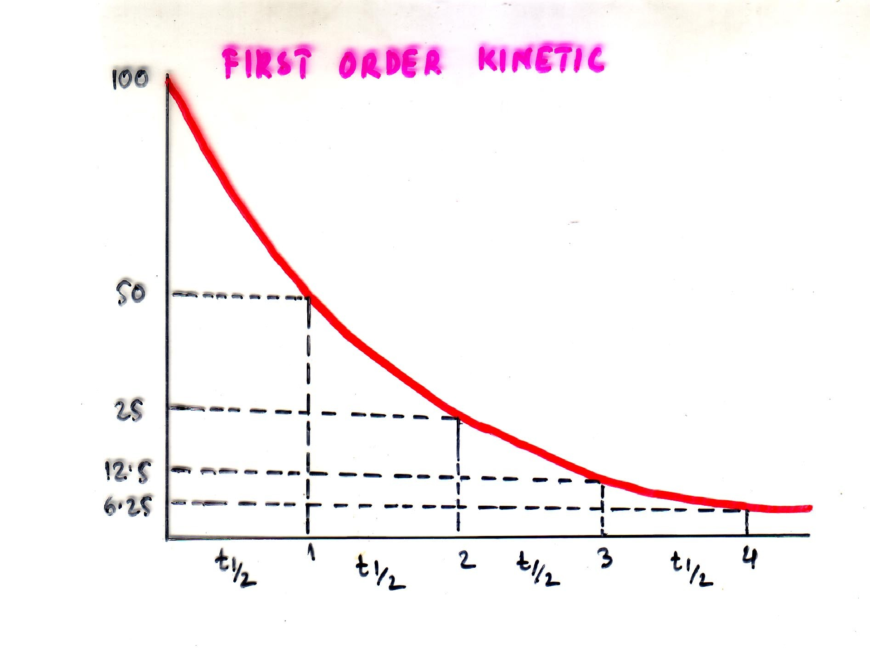

Slide 19
First Order Kinetics
Absorption, distribution, biotransformation and excretion processes are mostly occurring at rates proportional to the conc. of drug in the plasma
A constant fraction of drug is absorbed, distributed, biotransformed and excreted per unit time
These processes increase in rate with increase in conc. and decrease with falling conc.
·
·
·

Slide 20
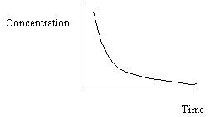
First Order Kinetics:
·
A constant fraction of the drug in the body is eliminated per unit time
The rate of elimination is proportional to the amount of drug in the body
The majority of drugs are eliminated in this way
·
·

Slide 21
70
60
50
40
30
20
10
Velocity
(ng/g tissue/min)
0
0 10 20 30 40 50 60 70
[Drug] mM
D:\summer1\Kmx1.pzm

Slide 22
80
70
60
50
40
30
zero order metabolism
Velocity
(ng/g tissue/min)
20
10
first order metabolism
0
0 5 10 15 20 25 30 35 40 45 50 55 60
[Drug] mM
Kmx2.pzm

Slide 23
First Order Metabolism
A drug may be given in doses that produce blood concentrations less than the Km of the enyzme for the drug.
v = Vmax [C]
Km + [C]
When
Km >>> [C],
then
v = Vmax [C] ,
Km
and v α [C]
Metabolism of the drug is a first order process. A constant fraction of the remaining drug is metabolized per unit time. Most drugs are given at concentrations smaller than the Km of the enzymes of their metabolism.

Slide 24
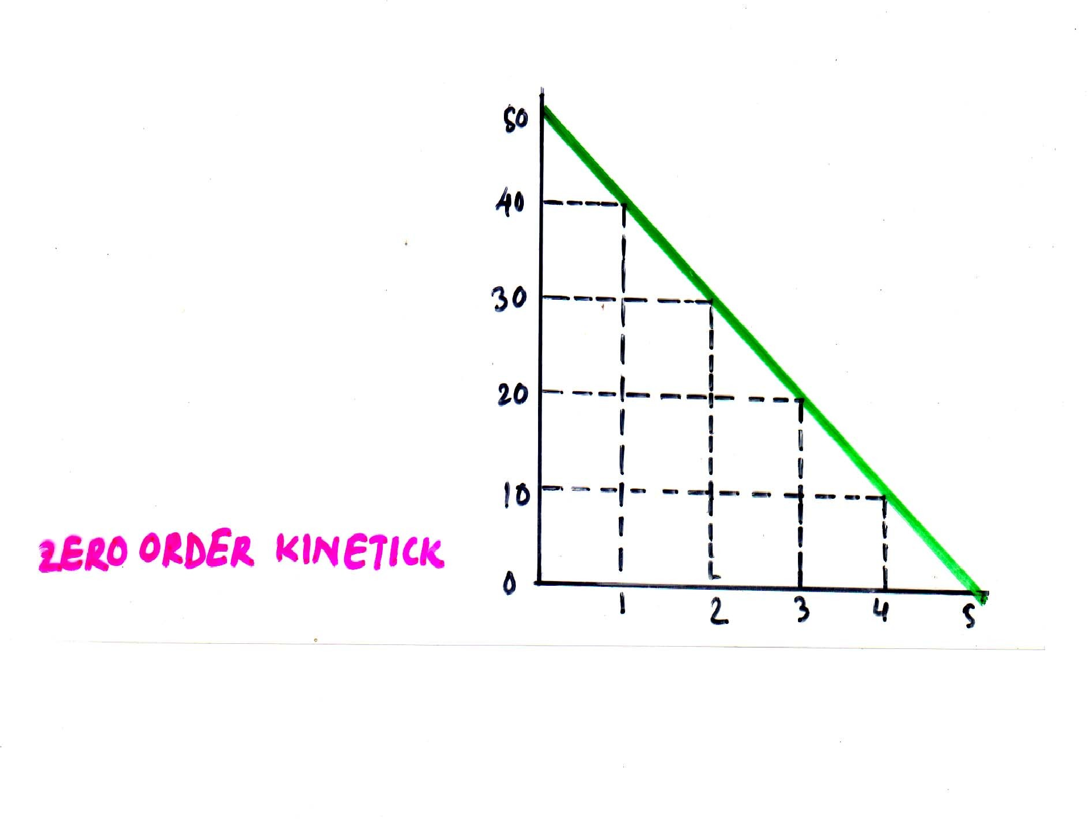

Slide 25
Zero order kinetics
A constant amount of drug is eliminated per unit time
Supply of enzymes are limited in the body
So, with increasing dose a time will come when the supply of enzymes get saturated
At this point no elimination occur
Biotransformation or excretion remains constant at this point
·
·
·
·
·

Slide 26
Zero order kinetics cont..
So, rate of processes or reaction is not proportional to the conc. or dose
·
Processes showing such kinetics are known as – Rate limited or zero order or saturation kinetics
Some times clinically called non-linear kinetics
·
·

Slide 27
Zero order kinetics
·
All enzyme mediated processes show
this type of kinetics
·
Passive diffusion like processes do not show this type of kinetics
e.g. aspirin, ethanol, phenytoin etc.

Slide 28
70
60
50
40
30
zero order metabolism
Velocity
(ng/g tissue/min)
20
10
first order metabolism
0
0 5 10 15 20 25 30 35 40 45 50 55 60
[Drug] mM
Kmx2.pzm

Slide 29
Zero Order Metabolism
A drug may be given in doses that produce blood concentrations greater than the Km of the enyzme for the drug.
v = Vmax [C]
K m + [C]
When
[C] >>> Km,
then
v = Vmax [C] ,
[C]
and v = Vmax
Metabolism of the drug is a zero order process. A constant amount of the remaining drug is metabolized per unit time. Phenytoin undergoes zero order metabolism at the doses given.

Slide 30
70
60
50
40
30
zero order metabolism
Velocity
(ng/g tissue/min)
20
10
first order metabolism
0
0 5 10 15 20 25 30 35 40 45 50 55 60
[Drug] mM
Kmx2.pzm

Slide 31
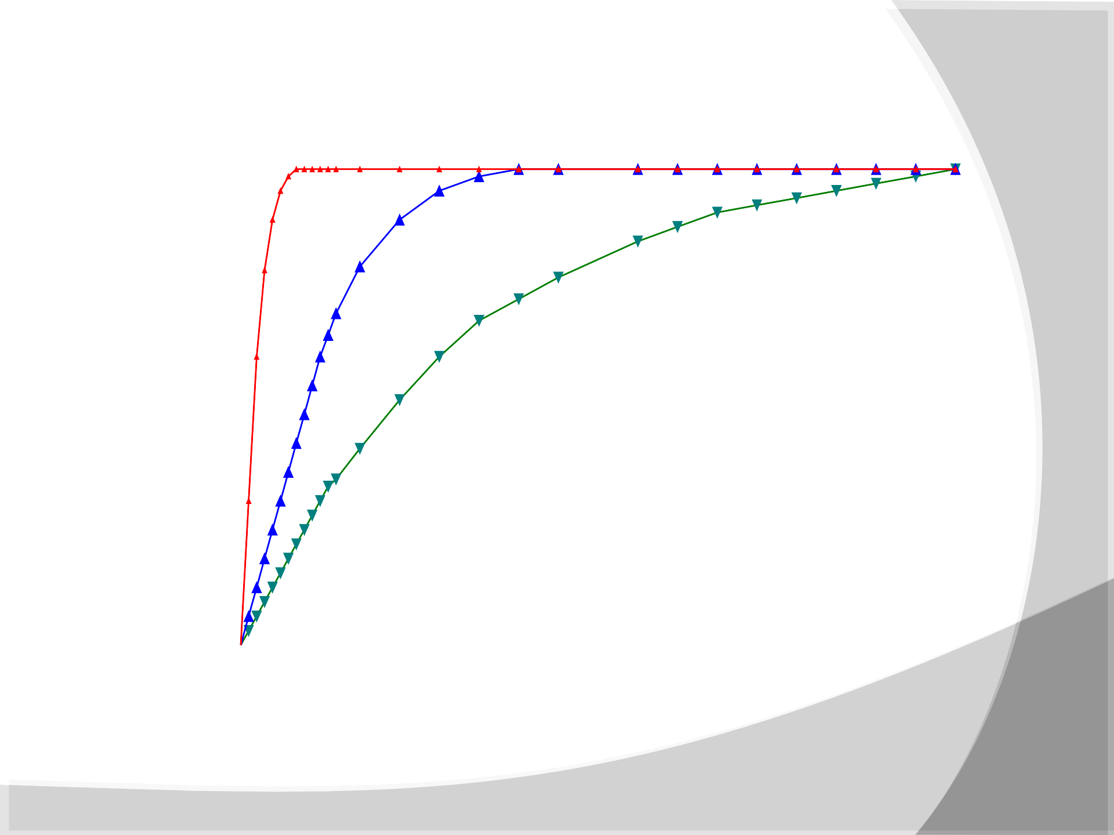
70
60
50
)
Velocity
(ng/g tissue/min
Drug A Drug B Drug C
40
30
20
10
0
0 10 20 30 40 50 60 70 80 9
[Drug] mM

Slide 32
Types of Kinetics Commonly Seen
Zero Order Kinetics
First Order Kinetics
Rate = k C C = C_{o} e^{-kt}
Rate of elimination proportional to plasma concentration
Constant fraction of drug eliminated per unit time
Conc. vs. time graph is NOT linear, decaying exponential
Log Conc. vs. time graph is linear
·
·
·
·
·
·
Rate = k
C = C_{o} - kt
Constant rate of elimination regardless of
^{[D]}plasma
Conc. vs. time graph is LINEAR
·
·
·
·

Slide 33
Clearance
For most drugs, clearance is constant over the concentration range
·
·
Elimination is not saturable
The rate of drug elimination is directly proportional to concentration
·
This is usually referred to as first-order elimination
·

Slide 34
Clearance
·
When clearance is first-order, it can be estimated by calculating the area under the curve (AUC) of the time-concentration profile after a dose
·
Clearance is calculated from the dose divided by the AUC

Slide 35
Clearance (CL)
·
Ability of organs of elimination (e.g. kidney, liver) to “clear” drug from the bloodstream
·
Volume of fluid which is completely cleared of drug per unit time
·
Units are in L/hr or L/hr/kg
·
Pharmacokinetic term used in determination of maintenance doses

Slide 36
Clearance
Clearance is not the measure of the re- equilibration of the drug within various body compartments but rather the actual removal of drug from the body with time
(usually by hepatic metabolism and/or renal excretion)
·
·

Slide 37
Clearance
·
“Volume of blood in a defined region of the body that is cleared of a drug in a unit time”
·
Clearance is a more useful concept in reality than t _{1/2} or k_{el} since it takes into account blood
flow rate
·
Clearance varies with body weight
·
Also varies with degree of protein binding

Slide 38
LEARNING OUTCOMES-
To discuss the clinical significance of half life with examples
To discuss the clinical significance of steady state conc. with examples
To discuss the clinical significance of clearance and kinetics of drug elimination with examples
At the end of the lecture the pupils will be able to-
·
·
·

