Slide 1
BIOMOLECULES
Biomolecules are the chemical compound found in living organism, involved in the maintenance and metabolic process of living organism.
Cells are basic structural and functional units of living organisms, are highly organized and constant source of energy, required to maintain the life.
Biochemical organization of Cell: Atoms are organized into molecules, molecules into organelles, organelles into cells, cell organized to form tissue, tissue organized to form organ, organ to organ system and organ system organized to form organism.
Biomolecules are defined as any organic molecule present in a living cell. Biomolecules are
mainly composed of major six elements, carbon, hydrogen, oxygen and nitrogen, sulphur and phosphorus. The next major elements are sodium, chlorine, potassium, calcium and magnesium. These make up to 3-5 % of living thing. Trace elements present at low level (1%) of living cell includes iron, iodine, manganese, molybdenum, selenium, silicon, tin, vanadium, boron, chromium, cobalt, copper and fluorine.
Each Biomolecules is essential for body functions. They have wide range of size, structure and perform various types of function.
The four major types of Biomolecules are:
CARBOHYDRATES
LIPIDS
PROTEIN
NUCLEIC ACID

Slide 2







Bioelements
Major elements (95-97 %)
C, H, O, N
Minor elements (3-5 %)
Na, K, Ca, S, P, Cl, Mg
Trace element (1%)
(Fe, Cu, Zn, Mo, B, Mn)
Organized to form
BIOMOLECULES
MICRO MOLECULE
Water
Mineral
Monosaccharide
Disaccharide
Fatty acid
Amino acid
Nucleotide
MACRO MOLECULE
Polysaccharide(Carbohydrate)
Protein
Fat/Lipid
Nucleic acid
Cell organelles and Cytoplasm
Cell
Organ
Tissue
Organ system
Organism
Ft inisgelluingre1: Biochemical organization of cell

Slide 3
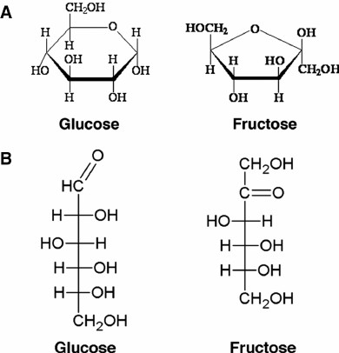
CARBOHYDRATE
Carbohydrate are hydrate of carbon contain C, H, O. Chemically Carbohydrates are Polyhydroxy aldehyde or Polyhydroxy ketone
Carbohydrates are naturally occurring organic compounds containing carbon, hydrogen, oxygen elements. Chemically Carbohydrates are Polyhydroxy aldehyde or Polyhydroxy ketones or the compounds that produce these on hydrolysis. Carbohydrates are also referred as saccharide.
On the basis of sugar unit carbohydrate are classified into three major classes:
Monosaccharides
Oligosaccharides
Polysaccharides
Mono saccharides:
Mono saccharides contain Single sugar unit. Also called simple sugars, cannot be hydrolyzed into smaller units. Depending upon no. of carbon in a unit, mono saccharides are subdivided into a dioses to decoses. More common subclasses of mono saccharides are:
Aldoses: Contain aldehyde as Funtional group
Aldotrioses e.g. Glycerose,
Aldotertroses e.g. Erythrose,
Aldopentoses e.g. Ribose,
Aldohexoscs e.g. Glucose (dextrose), Galatose (present in milk)
Aldoheptose e.g. Glucoheptose.
Ketoses: Contain Ketone as functional group
Ketotrioses e.g Dihydroxyacetone,
Ketotetroses e.g Erythrulose,
Ketopentoses e.g Ribulose,
Ketohexoses e.g. Fructose present in fruits honey
Ketoheptose e.g. Scdoheptulose.

Slide 4
Properties of Mono saccharides:
Muta-rotation
Glycoside Formation
Reducing Power
Reduction
Oxidation with mild and strong oxidizing agent
Methylation / Esterification
Dehydration
Form osazone with phenyl hydrazine
2. Oligosaccharide: Oligosaccharides are polymers of mono saccharides containing two to ten mono saccharides:
OLIGOSACCHARIDES
Disaccharide
Trisaccharide
Tetrasaccharide
Disaccharides: Yield two mono saccharides on hydrolysis.
Reducing Disaccharides: Contain hemiacetal or hemiketal group
Example: Maltose (Glucose + Glucose) Germinating grain (used to make beer) Lactose (Galactose + Glucose), other examples are Isomaltose.
Non Reducing Disaccharides: Contain no hemiacetal groups Example: Sucrose (Glucose + Fructose)
2. Tri saccharides:
Example: Raffinose (Glucose + Fructose + Galactose) found in cotton seed and sugar beet.
3. Tetra saccharides: Yield 4 mono saccharides on hydrolysis.
Example: Stachyose (Glucose + Fructose + Galactose + Galactose) (only tetra saccharide known to exist in plant e.g. Whole grains, peas, lentils)
3. Polysaccharides: Polysaccharides are polymer of monosaccharides. The long chain polymers are either straight chain or branched. They are also called glycanes. On hydrolysis produces monosaccharides. They are Nonsugar and tasteless. General formula (C₆H₁₀O₅)_{n} Insoluble in water and form colloids with water.
Example: Starch, Cellulose, Pectin

Slide 5
Classification of Polysaccharides:
On the Basis of Function:
Storage
Example: Starch, Plant store glucose as starch. The cereal grain (wheat, rice, corn, oat, barley) as well as tuber (potato) rich in starch. Glycogen storage form of glucose
in animal and human which is analogous to the starch in plant. Glycogen is synthesized and stored mainly in the liver and muscles.
Structural
Example: Cellulose, Pectin
On the basis of composition:
Homo polysaccharides
Hetero polysaccharides.
Homo Polysaccharides: On hydrolysis gives single monosaccharide units Pentosan: Contains pentoses
Hexosans: Contains hexoses subdivided in to
Glucosans: Polymer or glucose e.g. Starch, Glycogen Fructosans: Polymer or fructose e.g. Inulin Galactans: Polymer of galactose e.g. Galactan Mannans: Polymer of mannose e.g. Mananas.
Hetero Polysaccharide: e.g. Hyaluronic acid, Chondroitin sulphates. Gum: Consist of arabinose, rhamnose, galactose and glucoronic acid.
Agar: The sulphuric acid esters of galactans consists of galactose, galactouronic acid. Pectins: Fundamental unit is pectic acid, consist of arabinosc, galactose, galactouronic
acid.
Functions of Polysaccharides:
They serve as structural components of the cells
They serve as stored form of energy.
They serve as nutrient.
BIOLOGICAL ROLE OF CARBOHYDRATE
Most abundant dietary source of energy (4cal/g).
Serve as storage form of energy (glycogen) to meet the immediate energy demand of the body.
Precursor for synthesis of many compounds (Fatty acid and Amino acid).
Glycolipid and Glycoprotein participate in structure of cell membrane and cell function, cell growth, adhesion (cell to cell attachment), fertilization.

Slide 6
Structural component of many organisms. Cellulose in plant cell wall. Chitin in Exoskeleton of some insects. Cell wall of microorganism
Structural component: Pentose sugar (Deoxy ribose and ribose sugar) in DNA and RNA

Slide 7
CLASSIFICATION OF CARBOHYDRATE (CHEMICAL NATURE)
MONOSACCHARIDES
OLIGOSACCHARIDES
POLYSACCHARIDES
Contain only one sugar molecule
Polymers of monosaccharide contain 2-10 sugar units (molecules)
Long chain polymer of monosaccharide either straight chain or branched
Cannot be hydrolyzed
Disaccharide
Trisaccharide
Tetrasaccharide
Homo polysaccharide
Hetero polysaccharide
Aldoses
Ketoses
Yield two monosaccharide on hydrolysis
Yield three monosaccharide on hydrolysis
Yield four monosaccharide on hydrolysis
On hydrolysis gives single monosaccharide unit
On hydrolysis gives multiple monosaccharide unit
Contain Aldehyde
Contain Ketone
E.g. Galactose Ribose, Glucose
E.g. Ribulose, Fructose
E.g. Maltose (Glucose + Glucose),
Sucrose
(Glucose + Fructose)
E.g. Raffinose (Glucose + Fructose + Galactose)
E.g Stachyose (Glucose + Fructose + Galactose + Galactose)
E.g. Starch, Glycogen
E.g. Hyaluronic acid
CLASSIFICATION OF PROTEIN
(Physical and chemical nature)
SUGAR
NON SUGAR
Reducing sugar
Non reducing sugar
Non sweet and insoluble in water.
Donot Reduce Fehling and Benedict reagent.
Sweet and soluble in water. Reduce Fehling and Benedict reagent.
Sweet and soluble in water. Donot Reduce Fehling and Benedict reagent.
E.g. Starch, Glycogen, Cellulose
E.g. Glucose, Fructose, Lactose, Maltose
E.g. Sucrose

Slide 8

LIPIDS
INTRODUCTION
The lipids are a heterogeneous group of organic compounds relatively insoluble in water, soluble in organic solvent (alcohol, ether, benzene, chloroform).
While carbohydrates or proteins only provide 4 kcal/g of energy, fatty acids provide more than twice the energy per unit weight of 9 kcal/ g.
Fatty acid
Fatty acids are carboxylic acid with long hydrocarbon chain.
Formula: R–COOH where R is a hydrocarbon chain.
Lipids are not a polymer. Fatty acids are the building block of the most of the lipid and important source of energy. Fatty acids are important components of all of these lipids.
Example: Palmitic acid (16C), Stearic acid (18C). They may be saturated or unsaturated.
Fatty Acids
Saturated fatty acid
Unsaturated fatty
Saturated fatty acids do not have any double bonds. Saturated fatty acids are solids at room temperature. Animal fats are a source of saturated fatty acids.
Saturated fatty acid chain, Stearic acid CH₃–CH₂ – CH₂ – (CH₂)₁₄ –COOH
Example: Palmitic acid, Stearic acid.
Unsaturated fatty acids have one or more double bonds along its hydrocarbon chain.
Unsaturated Fatty Acids
facebook group and then go to file section
Mono unsaturated fatty acid
Poly unsaturated fatty acid
Monounsaturated fatty acid: A fatty acid with one double bond.
Example: Palmitoleic acid, Oleic acid
Oleic acid CH₃– (CH₂)₇ –CH = CH – (CH₂) ₇ –COOH
Polyunsaturated fatty acids. A fatty acid contains two or more double bonds. Plants are the source of unsaturated fatty acids.
Example: Linoleic acid, Linolenic aid
Linoleic acid: CH₃– (CH₂)₄ –CH = CH – CH₂ –CH = CH – (CH₂) ₇–COOH

Slide 9
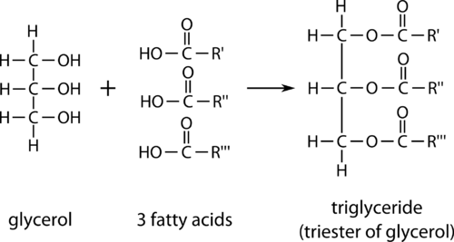
Lipids can be divided in two major classes on the basis of Saponification properties:
Saponifiable lipids:
A saponifiable lipid contains one or more ester groups allowing it to undergo hydrolysis in the presence of an acid, base, or enzyme.
Example: triglycerides, waxes, phospholipids, and sphingolipids.
Nonsaponifiable lipids:
A nonsaponifiable lipid cannot be broken up into smaller molecules by hydrolysis.
Example: Steroids, prostaglandins, and terpenes.
Lipids can be divided in two classes on the basis of polarity:
1. Nonpolar lipids (Neutral lipid): The lipids which are uncharged such as triglycerides (Triacylglycerols), are used for energy storage and fuel. Triglycerides are the esters of glycerol and fatty acid.
Example: Gycerides (Mono, di and triacylglycerols), Cholesterol, Cholesterylester.
2. Polar lipids: Lipids form barrier with an external membranes.
Example: Glycerophospholipids and Sphingolipids
water environment is used in
Essential fatty acids
If a fatty acid can only be obtained from the diet (for humans) then the fatty acid is an
essential fatty acid. Two fatty acids cannot be synthesized in the human body and are therefore essential. Example: Linoleic and linolenic fatty acids, which are both unsaturated.
Nonessential fatty acids
Nonessential fatty acids can be made by the human body and so do not need to be obtained from diet alone. These are made from carbohydrates and proteins or from other fatty acids.
PROPERTIES OF TRIGLYCERIDES (TG)/TRIACYLGLYCEROL (TAG)
Structurally triglycerides contain three fatty acid molecule esterified to the three hydroxyl group of the glycerol. Simple triglycerides contain only one type of fatty acids while mixed triglycerides contain two or three different types of fatty acid.
Figure 1: Structure of Triglycerides

Slide 10
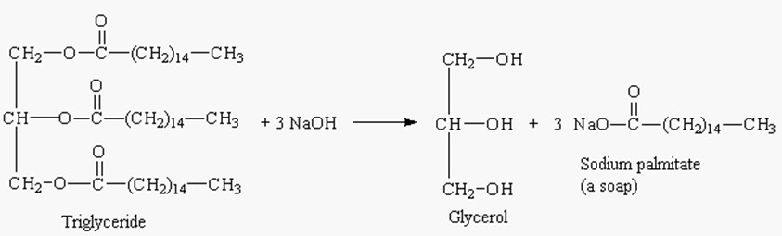
Hydrolysis: TAG undergoes step wise enzymatic hydrolysis to finally liberate free fatty acids and glycerol. The process of hydrolysis catalyzed by lipases.
Saponification: Hydrolysis TAG by alkali to produce glycerol and Soap (sodium or potassium salt of fatty acid).
Triacyl glycerol + 3NaOH 3R-COONa (Soap) + Glycerol
Figure 2: Saponification reaction
Rancidity: The deterioration of fat and oils resulting in an unpleasant taste and odour occur when fats and oil exposed to air, moisture, light, bacteria etc. Hydrolytic rancidity occurs due to partial hydrolysis of TAG due to bacterial enzyme.
Lipid Peroxidation in vivo: Lipids undergo oxidation to produce peroxides in living cell to produce peroxides and free radicals which can damage the tissue. Antioxidants (Vitamin E, urate and superoxide dismutase prevent lipid peroxidation).
BIOLOGICAL ROLES OF LIPID
Energy source (Fatty acid): This food reserve can provide energy for life during periods of starvation.
Energy storage (Triglycerides): Triglycerides are the main storage forms of fatty acids.
Structural component of cell membrane (Phospholipids and Sphingoglycolipid Cholesterol): Phospholipids are the main lipid constituents of membranes.Cholesterol is a combination of a steroid and an alcohol. Provides a rigid hydrophobic structure that helps boost the rigidity of the cell membrane.
Eicosanoids & Emulsifiers (Bile salts): Phospholipids precursor for the synthesis of Eicosanoids (Prosaglandins, Prostacyclins, Thromboxanes) and act as emulsifiers (Bile salts).

Slide 11
Fat soluble vitamins: Source of fat soluble vitamins (A, D, E and K).
Hormones (Steroid): The basis for the synthesis of other steroids, including the sex hormones estradiol and testosterone, as well as other steroids such as cortisone and vitamin D.
Protection and Insulation: Lipid protects the internal organ, serve as insulating material and give shape and smooth appearance to the body. Fat is stored in adipose tissue, where it also serves as a thermal insulator in the subcutaneous tissues and around certain organs.
Transporting lipids (lipoproteins): Combinations of lipid and protein (lipoproteins) are important cellular constituents, occurring both in the cell membrane and in the mitochondria, and serving also as the means of transporting lipids in the blood.
Understanding many important biomedical areas: Knowledge of lipid biochemistry is necessary in e.g., obesity, diabetes mellitus, atherosclerosis and the role of various polyunsaturated fatty acids in nutrition and health.
To survive in colder temperatures (body fat): Triglycerides can provide insulation for animals in the form of body fat, which allows them to
Insulating cover (Cholesterol): Cholesterol functions as an for the transport of electric impulses in the nerve tissue.

Slide 12
CLASSIFICATION OF LIPID
SIMPLE LIPID
COMPLEX/COMPOUND LIPID
PRECURSOR &DERIVED LIPID
MISCELLANEOUS
Ester of fatty acids with alcohol
Ester of fatty acids with alcohol containing additional group
Derived from Simple and Compound lipid
Show characteristic of lipid
These include fatty acids, glycerol, steroids, fatty aldehydes, and ketone bodies, hydrocarbons, lipid soluble vitamins & hormones
Fat/Oil
Wax
Phospholipid
Glycoolipid
Lipoprotein
Esters of fatty acids with glycerol
Esters of fatty acids with long chain alcohol (e.g. Cetyl alcohol)
Fatty acids, an alcohol,
Fatty acid, Sphingosine
Lipid & Protein
a phosphoric acid
(alcohol), carbohydrate & nitrogenous base
residue & nitrogen
containing base
E.g. Present in Arachies oil,
E.g. Bees wax, Carnauba wax used in cosmetic and ointment.
E.g. Lecithin, Cephalin, Sphingomylein
E.g. High density Lipoprotein (HDL), Low density lipoprotein (LDL)
E.g. Carotenoids,
Sqalene, hydrocarbon
E.g. Cerebroside, Ganglioside
hydrocarbon,
Coconutoil, Butter
(Pentacosane in bees wax)

Slide 13

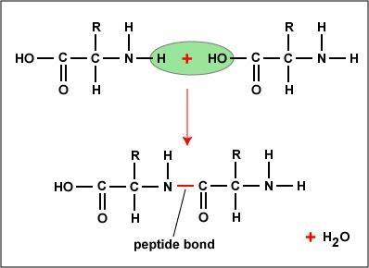
PROTEIN
Proteins are nitrogenous organic compounds of high molecular weight which play a vital or prime role in living organisms.
INTRODUCTION
The proteins are most abundant macro molecules in the cells and they constitute over half the dry weight of most of the organism. They are made up of 20 standard a-amino acids. They are mainly composed of C, H, O, N elements. Some proteins also contain S, P element also.
Chemically proteins are polymers of L-α-amino acids. Amino acids are polymerized through formation of number of peptide linkages. Protein molecule consists of very long chains having about 100-1000 amino acids unit joined by Peptide linkages. Cell contains 100 or 1000 of different protein, each with different function and biological activity.
PROPERTIES OF PROTEIN
1. Solubility: Form colloidal solution in water
Molecular weight: Majority of amino acid consist of 40-4000 amino acid. Molecular weight (4000- 44000).
Shape: Globular (Insulin, enzymes), Oval (Albumin), Fibrous/Elongated (Fibrinogen).
Isoelectric pH: Protein exists as Zwitter ion or dipolar ion. The pH at which a protein has equal number of positive and negative charges is known as isoelectric pH. When subjected to an electric field the proteins do not move either towards anode or cathode, hence this property is used to isolate proteins. The proteins become least soluble at

Slide 14
Isoelectric pH and get precipitated. The Isoelectric pH of casein is 4.5 and at this pH the casein in milk curdles producing the curd.
Precipitation of protein: By dehydration or neutralization.
Precipitation by salting out: Sodium sulphate and ammonium sulphate.
Precipitation by heavy metal: Pb²⁺, Hg²⁺, Fe²⁺ ,Zn^{2+,} Cd²⁺.
Precipitation by anionic or alkaloidal reagent: Tannic acid, Trichloro acetic acid and
sulphosalicylic acd etc.
Denaturation: Partial or complete unfolding (disorganization) of the native (natural) protein structure is known as denaturation. This is caused by heat, acids, alkalies, alcohol, acetone, urea, beta- mercaptoethanol.
Coagulation: When proteins are denatured by heat, they form insoluble aggregates known as coagulum. All the proteins are not heat coagulable, only a few like the albumins, globulins are heat coagulable.
CLASSIFICATION OF PROTEINS:
Proteins are classified based upon:
Solubility
Structural complexity
Classification based upon Solubility:
Fibrous proteins: These are insoluble in water. They include the structural proteins. They
have supportive function (e.g., collagen) and/or protective function (e.g., hair keratin and fibrin).
Globular proteins: They are soluble in water. They include the functional proteins, e.g., enzymes, hemoglobin, etc.
Classification based upon Structural Complexity:
Simple
Conjugated
Derived proteins

Slide 15
1. Simple proteins: Proteins which are made up of amino acids only are known as simple proteins.
They are further sub-divided into:
Albumins:
They are water soluble, heat coagulable and are precipitated on full saturation with ammonium sulphate,
Example: Serum albumin, lactalbumin and ovalbumin.
Globulins:
They are insoluble in water, but soluble in dilute salt solutions. They are heat coagulable and precipitate on half-saturation with ammonium sulphate.
Example: erum globulin and ovo-globulin.
Glutelins:
They are insoluble in water and neutral solvents. Soluble in dilute acids and alkalis. They are coagulated by heat,
Example: Glutelin of wheat.
d. Prolamines:
Water insoluble but soluble in 70% alcohol,
Example: Gliadin of wheat, proteins of corn, barley, etc.
Histones:
Water soluble, basic in nature due to the presence of arginine and lysine, found in nucleus. They help in DNA packaging in the cell. They form the protein moiety of nucleoprotein.
Protamine’s:
Water soluble, basic in nature, not-heat coagulable. Found in sperm cells, hence component of sperm nucleoprotein.
Globin’s:
They are water soluble, non-heat coagulable. Example: Globin of haemoglobin.
h. Albuminoids or scleroproteins:
Insoluble in all neutral solvents, dilute acids or alkalis, Example: keratin of hair and proteins of bone and cartilage.
Conjugated proteins: Proteins which are made up of amino acids and a non-amino acid/protein substance called the prosthetic group are known as conjugated proteins.
The various types of conjugated proteins are:
Chromo proteins: The non-protein part is a colored compound in addition to the protein
part. Example: Haemoglobin has heme as the prosthetic group and cytochromes also have heme.

Slide 16
Nucleoproteins:
These proteins are bound to nucleic acids. Example: chromatin (histones + nucleic acids).
Glycoproteins: When a small amount of carbohydrate is attached to a protein it is known as glycoproteins,
Example: mucin of saliva.
Phosphoprotein: Phosphoric acid is present with the protein.
Example: Milk casein and egg yolk (vitellin).
e. Lipoproteins: Proteins in combination with lipids, Example: LDL, HDL.
f. Metalloproteins: They contain metal ion in addition to the amino acids, Example: hemoglobin (iron), ceruloplasmin (copper).
3. Derived proteins: They are the proteins of low molecular weight produced from large molecular weight proteins by the action of heat, enzymes or chemical agents.
Proteins → Proteans → Proteoses → Peptones → Peptides → Amino acids
Nutritional classification of protein:
Complete protein: Have all the ten essential amino acids. Promote good growth. Example: Albumin (egg), Casein (Milk)
Partially complete protein: Partially lack one or more essential amino acid. Can promote moderate growth.
Example: Wheat and rice protein (lack Lysine and threonine)
Incomplete protein: Completely lack one or more essential amino acid. Do not promote growth.
Example: Gelatin (lack tryptophan), Zein (lack tryptophan, lysine)
BIOLOGICAL ROLE OF PROTEIN
1. Structural function
Structural protein: They give biological structure, strength or protection to the body tissue system.
Example: Collagen, Gelatin, in bones and tendon, Elastin in ligaments and Keratin in epidermal tissue (skin, hair, nails)
Contractile Proteins: Fibrous protein functioning in the contractile system of skeletal
muscles Example: Myosin

Slide 17
Dynamic Function: Protein acting as enzyme, hormones, blood clotting factor, immunoglobulin.
Enzymes : Highly specialized protein, catalyze most of the chemical reactions of organic
Biomolecules in cell, tissue and systems Example: Pepsin, trypsin, hexokinase
Transport protein: Carry specific ions or molecules from one organ to another. Example: Hemoglobin: carrier of oxygen and carbon dioxide.
Lipoprotein (Serum albumin): carrier of lipids from liver to the other organ. Myoglobin (hemoglobin, serum albumin): Molecules and ions from one organ
to the other.
Nutrient and storage protein: They store and provide nutrients.
Example: Seed protein of wheat, corn and rice, albumin of egg white, casein of milk.
Defense protein: They defend (protect) the body from harmful foreign organisms,
(bacteria, virus, foreign substance) Example: Immunoglobulin’s
e. Regulatory protein: They help to regulate cellular or physiological activity, Example: Hormones like insulin, Pituitary, parathyroid, growth hormones etc.

Slide 18
CLASSIFICATION OF PROTEIN
(Chemical nature & Composition)
SIMPLE PROTEINS
“Solution-Pharmacy” believes in SHARING, not in selling Available on- YouTube-Facebook (Group and Page) & Instagram
CONJUGATED PROTEINS
DERIVED PROTEINS
YouTube Link- https://www.youtube.com/c/SOLUTIONpushpendra
You can download all of our uploaded study materials by joining our "Solution-Pharmacy" facebook group and then go to file section
Composed of only amino acid residues
Composed of prosthetic group (non protein group) with amino acids
Denatured or degraded product of hydrolysis of simple & conjugated protein
Globular proteins
Scleroprotein
Glycoproteins
Phosphoproteins
Chromoproteins
Primary
Secondary
Albumins, Globulin Glutelin, Histones, Prolamines, Globin, Lectins, Protamines
Collagens, Elastins, Keratins
Prosthetic group is carbohydrate
Prosthetic group is Phosphoric acid
Prosthetic group is iron pigments
Coagulated protein Proteans Metaproteins
Proteoses Peptones Polypeptides Peptides
E.g. Mucin (saliva)
E.g. Casein (milk)
E.g. Haemoglobin
Other conjugated protein: Nucleoprotein, Mucoprotein, Lipoprotein, Metalloprotein
CLASSIFICATION OF PROTEIN
(Physical nature)
FIBROUS PROTEINS
GLOBULAR PROTEINS
Molecule is fiber shaped Insoluble in water
Structural component of the body
Molecule is globular or spherical Soluble in water
Regulation and maintenance of life process
E.g. Keratin, Myosin, Gelatin, Collagen
E.g. Enzymes, Hormones, Haemoglobin

Slide 19
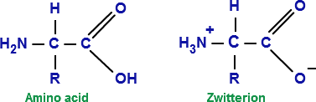
AMINO ACIDS
Amino acids are a group of organic compound contains two functional groups: Amino- NH₂ (Basic) and Carboxyl group-COOH (Acid).
Amino acids exist as Zwitterions ion in biological system. Chemically proteins are polymers of L-α-amino acids. Amino acids are polymerized through formation of number of peptide linkages.
CLASSIFICATION OF AMINO ACID
On the basis of polarity:
Non polar amino acid - No charge on R group, hydrophobic (water hating). alanine, leucine, isoleucine, valine, methionine, phenylalanine, tryptophan, proline.
Polar amino acid with no charge on R group: Glycine, serine, threonine, cysteine, glutamine, asparginine, tyrosine.

Slide 20
On the basis of structure:
Amino acid with aliphatic side chain: Glycine, alanine, valine, leucine and isoleucine
Hydroxyl group containing amino acid: Serine, threonine, tyrosine
Sulfur containing amino acid- Cysteine, cystine, methionine
Acidic amino acid and their amides: Aspartic acid, asparginine, glutamic acid, glutamine
Basic amino acid: Lysine, arginine, histidine
Aromatic amino acid: Phenylalanine, tyrosine and tryptophane
Imino acid: Proline

Slide 21
Polar amino acid with positive charge on R group: Lysine, arginine, histidine.
Polar amino acid with negative charge on R group: Glutamic acid, aspartic acid
On the basis of Nutritional requirement:
20 amino acids are required for the synthesis of variety of protein.
Essential Amino acids:
Amino acid cannot be synthesized by the body and need to be supplied from the diet is called essential amino acid. The 10 essential amino acids are (A.V. HILL, MP, T.T.) arginine, valine, histidine isoleucine leucine and lysine, methionine phenylalanine, threonine, tryptophane. Arginine and histidine (semi essential amino acid, synthesized by
adult not by growing children).
Non Essential amino acids: The body can synthesize about 10 amino acids to meet the biological need and need not to be consumed from the diet are called non essential amino acid. Glycine, alanine, serine, tyrosine, cystine, asparginine, glutamic acid, glutamine, aspartate, and proline.
On the basis of their metabolic fate:
Glycogenic amino acid: Serve as precursor for formation of glucose or glycogen. Example: Alanine, aspartate, glycine, methionine.
Ketogenic amino acid: Amino acids which synthesize fat. Example: Leucine and Lysine
PROPERTIES OF AMINO ACID
Physical Properties of amino acid
Solubility: Usually soluble in water insoluble in organic solvent
Melting point: Melt at higher temperature.> 200oC
Taste: Sweet (Glycine, alanine, valine), Bitter( Arginine, Isoleucine), Tasteless( Leucine)
Optical properties : Except glycine
Ampholytes: Contain both acid and basic group. Donate proton and accept proton.
Zwitter ion or dipolar ion: Contain positive and negative ionic group
Chemical properties of amino acid:
1. Amino acid react with base to form salt (-COONa)

Slide 22
Amino acid react with alcohol to form ester (-COOR)
Decarboxylation: Produce corresponding amines
Amino acid reacts with ammonia to form Amide.
Aspartic acid + NH₃ Asparginine
React with ninhydrin reagent gives purple (Ruhemann’s purple), blue or pink color
Amino acid + Ninhydrin
Ketocaid + NH₃ + CO₂ + Hydrindantin
Purple
Hydrindantin + NH3 + Ninhydrin
Transamination: Transfer of an amino acid group from an amino acid to a ketoacid to form a new amino acid.
Oxidative deamination: Liberate ammonia

Slide 23

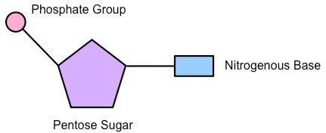
NUCLEIC ACID
Nucleic acid is a complex organic substance present in living cells, especially DNA or RNA, whose molecules consist of many nucleotides linked in a long chain.
Nucleic acids are the Biomolecules that allow organisms to transfer genetic information from one generation to the next. Nucleic acids are long-chain polymeric molecules, the monomer of nucleotides. Nucleic acids are also referred to as polynucleotides.
Nucleotides contain three parts
A Nitrogenous Base
A Five-Carbon Sugar
A Phosphate Group
Nucleotide = Nitrogenous base + Sugar (5C) + PO₄ group
Figure 1: Nucleotide
Nucleotides are linked together to form polynucleotide chains. Nucleotides are joined to one another by covalent bonds between the phosphate of one and the sugar of another. These linkages are called phosphodiester linkages.
Nucleic acid base are of two types
Purine: Adenine and Guanine
Pyrimidine: Cytosine and Thymine (in DNA)/ Uracil (in RNA)

Slide 24
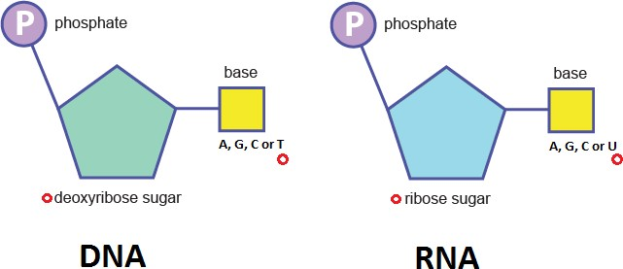
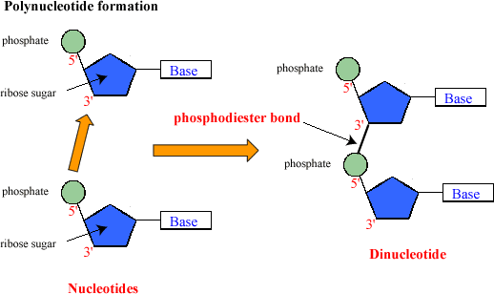
TWO MAJOR TYPES OF NUCLEIC ACID:
Deoxyribonucleic acid (DNA): DNA is a more stable double stranded form that stores the genetic blueprint for cell.
Ribonucleic acid (RNA): RNA is a more versatile single stranded form that transfers the genetic information for decoding
DNA and RNA are responsible for the inheritance and transmission of specific characteristics from one generation to the other. Phosphodiester linkages form the sugar-phosphate backbone of both DNA and RNA.
Figure 2: DNA and RNA
Figure 3: Formation of polynucleotide

Slide 25
Deoxyribonucleic Acid (DNA)
DNA is composed of a phosphate-deoxyribose sugar backbone and the nitrogenous bases adenine (A), guanine (G), cytosine (C) and thymine (T). DNA is composed of a pentose
sugar, phosphoric acid and some cyclic bases containing nitrogen.
Nitrogenous Bases: Adenine, Guanine, Cytosine, and Thymine Five-Carbon Sugar: β-D-2-deoxyribose.
These bases and their arrangement in the molecules of DNA play an important role in the storage
of information from one generation to the next one. DNA has a double strand helical structure in which the strands are complementary to each other. In double stranded DNA, adenine pairs with thymine (A-T) and guanine pairs with cytosine (G-C).
Ribonucleic Acid (RNA)
RNA is composed of a phosphate-ribose sugar backbone and the nitrogenous bases adenine (A), guanine (G), cytosine (C) and uracil (U). RNA most commonly exists as a single stranded molecule. In RNA the fourth base is different from that of a DNA.
Nitrogenous Bases: Adenine, Guanine, Cytosine, and Uracil Five-Carbon Sugar: β-D-ribose
There are three types of RNA molecules, each having a specific function:
Messenger RNA (m-RNA)
Ribosomal RNA (r-RNA)
Transfer RNA (t-RNA)
Messenger RNA (mRNA): Encodes amino acid sequence of a polypeptide. Messenger RNA is translated to form proteins.
Transfer RNA (tRNA): Brings amino acids to ribosomes during translation of mRNA in protein synthesis.
Ribosomal RNA (rRNA) is a component of ribosomes and is also involved in protein synthesis.
BIOLOGICAL ROLE OF NUCLEIC ACID
Nucleic acids are responsible for the transmission of inherent characters from parent to the offspring.
DNA is organized into chromosomes and found within the nucleus of our cells. It contains the "programmatic instructions" for cellular activities. When organisms produce offspring, these instructions in are passed down through DNA. DNA commonly exists as a double stranded molecule with a twisted double helix shape.

Slide 26
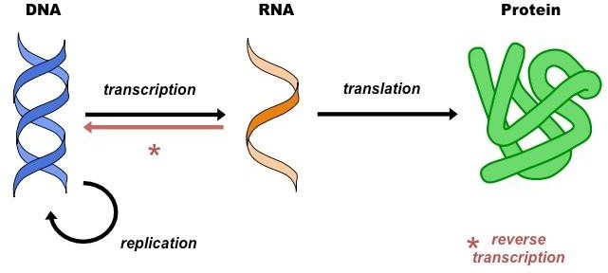
It has also played a major role in studies regarding biological evolution and genetics. DNA is the cellular molecule that contains instructions for the performance of all cell functions.
DNA fingerprinting is a method used by forensic experts to determine paternity. It is also used for identification of criminals.
RNA is essential for the synthesis of proteins. Information contained within the genetic code is typically passed from DNA to RNA to the resulting proteins. There are several different types of RNA.
Figure 4 : Central Dogma of life

