Slide 1
BIOMOLECULES
Biomolecules are the chemical compound found in living organism, involved in the maintenance and metabolic process of living organism.
Cells are basic structural and functional units of living organisms, are highly organized and constant source of energy, required to maintain the life.
Biochemical organization of Cell: Atoms are organized into molecules, molecules into organelles, organelles into cells, cell organized to form tissue, tissue organized to form organ, organ to organ system and organ system organized to form organism.
Biomolecules are defined as any organic molecule present in a living cell. Biomolecules are
mainly composed of major six elements, carbon, hydrogen, oxygen and nitrogen, sulphur and phosphorus. The next major elements are sodium, chlorine, potassium, calcium and magnesium. These make up to 3-5 % of living thing. Trace elements present at low level (1%) of living cell includes iron, iodine, manganese, molybdenum, selenium, silicon, tin, vanadium, boron, chromium, cobalt, copper and fluorine.
Each Biomolecules is essential for body functions. They have wide range of size, structure and perform various types of function.
The four major types of Biomolecules are:
CARBOHYDRATES
LIPIDS
PROTEIN
NUCLEIC ACID

Slide 2







Bioelements
Major elements (95-97 %)
C, H, O, N
Minor elements (3-5 %)
Na, K, Ca, S, P, Cl, Mg
Trace element (1%)
(Fe, Cu, Zn, Mo, B, Mn)
Organized to form
BIOMOLECULES
MICRO MOLECULE
Water
Mineral
Monosaccharide
Disaccharide
Fatty acid
Amino acid
Nucleotide
MACRO MOLECULE
Polysaccharide(Carbohydrate)
Protein
Fat/Lipid
Nucleic acid
Cell organelles and Cytoplasm
Cell
Organ
Tissue
Organ system
Organism
Ft inisgelluingre1: Biochemical organization of cell

Slide 3

LIPIDS
INTRODUCTION
The lipids are a heterogeneous group of organic compounds relatively insoluble in water, soluble in organic solvent (alcohol, ether, benzene, chloroform).
While carbohydrates or proteins only provide 4 kcal/g of energy, fatty acids provide more than twice the energy per unit weight of 9 kcal/ g.
Fatty acid
Fatty acids are carboxylic acid with long hydrocarbon chain.
Formula: R–COOH where R is a hydrocarbon chain.
Lipids are not a polymer. Fatty acids are the building block of the most of the lipid and important source of energy. Fatty acids are important components of all of these lipids.
Example: Palmitic acid (16C), Stearic acid (18C). They may be saturated or unsaturated.
Fatty Acids
Saturated fatty acid
Unsaturated fatty
Saturated fatty acids do not have any double bonds. Saturated fatty acids are solids at room temperature. Animal fats are a source of saturated fatty acids.
Saturated fatty acid chain, Stearic acid CH₃–CH₂ – CH₂ – (CH₂)₁₄ –COOH
Example: Palmitic acid, Stearic acid.
Unsaturated fatty acids have one or more double bonds along its hydrocarbon chain.
Unsaturated Fatty Acids
facebook group and then go to file section
Mono unsaturated fatty acid
Poly unsaturated fatty acid
Monounsaturated fatty acid: A fatty acid with one double bond.
Example: Palmitoleic acid, Oleic acid
Oleic acid CH₃– (CH₂)₇ –CH = CH – (CH₂) ₇ –COOH
Polyunsaturated fatty acids. A fatty acid contains two or more double bonds. Plants are the source of unsaturated fatty acids.
Example: Linoleic acid, Linolenic aid
Linoleic acid: CH₃– (CH₂)₄ –CH = CH – CH₂ –CH = CH – (CH₂) ₇–COOH

Slide 4
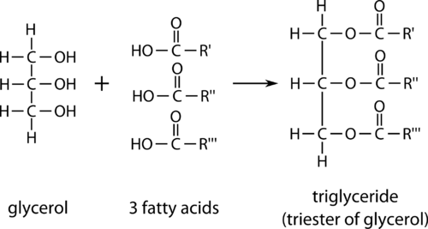
Lipids can be divided in two major classes on the basis of Saponification properties:
Saponifiable lipids:
A saponifiable lipid contains one or more ester groups allowing it to undergo hydrolysis in the presence of an acid, base, or enzyme.
Example: triglycerides, waxes, phospholipids, and sphingolipids.
Nonsaponifiable lipids:
A nonsaponifiable lipid cannot be broken up into smaller molecules by hydrolysis.
Example: Steroids, prostaglandins, and terpenes.
Lipids can be divided in two classes on the basis of polarity:
1. Nonpolar lipids (Neutral lipid): The lipids which are uncharged such as triglycerides (Triacylglycerols), are used for energy storage and fuel. Triglycerides are the esters of glycerol and fatty acid.
Example: Gycerides (Mono, di and triacylglycerols), Cholesterol, Cholesterylester.
2. Polar lipids: Lipids form barrier with an external membranes.
Example: Glycerophospholipids and Sphingolipids
water environment is used in
Essential fatty acids
If a fatty acid can only be obtained from the diet (for humans) then the fatty acid is an
essential fatty acid. Two fatty acids cannot be synthesized in the human body and are therefore essential. Example: Linoleic and linolenic fatty acids, which are both unsaturated.
Nonessential fatty acids
Nonessential fatty acids can be made by the human body and so do not need to be obtained from diet alone. These are made from carbohydrates and proteins or from other fatty acids.
PROPERTIES OF TRIGLYCERIDES (TG)/TRIACYLGLYCEROL (TAG)
Structurally triglycerides contain three fatty acid molecule esterified to the three hydroxyl group of the glycerol. Simple triglycerides contain only one type of fatty acids while mixed triglycerides contain two or three different types of fatty acid.
Figure 1: Structure of Triglycerides

Slide 5
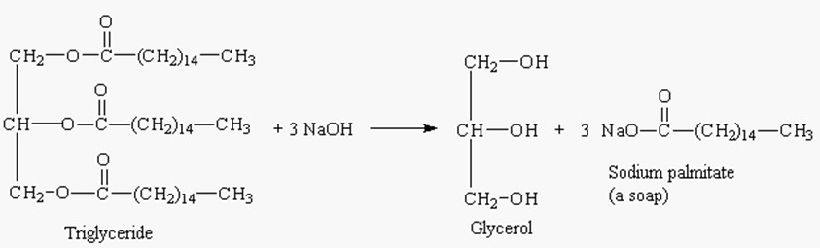
Hydrolysis: TAG undergoes step wise enzymatic hydrolysis to finally liberate free fatty acids and glycerol. The process of hydrolysis catalyzed by lipases.
Saponification: Hydrolysis TAG by alkali to produce glycerol and Soap (sodium or potassium salt of fatty acid).
Triacyl glycerol + 3NaOH 3R-COONa (Soap) + Glycerol
Figure 2: Saponification reaction
Rancidity: The deterioration of fat and oils resulting in an unpleasant taste and odour occur when fats and oil exposed to air, moisture, light, bacteria etc. Hydrolytic rancidity occurs due to partial hydrolysis of TAG due to bacterial enzyme.
Lipid Peroxidation in vivo: Lipids undergo oxidation to produce peroxides in living cell to produce peroxides and free radicals which can damage the tissue. Antioxidants (Vitamin E, urate and superoxide dismutase prevent lipid peroxidation).
BIOLOGICAL ROLES OF LIPID
Energy source (Fatty acid): This food reserve can provide energy for life during periods of starvation.
Energy storage (Triglycerides): Triglycerides are the main storage forms of fatty acids.
Structural component of cell membrane (Phospholipids and Sphingoglycolipid Cholesterol): Phospholipids are the main lipid constituents of membranes.Cholesterol is a combination of a steroid and an alcohol. Provides a rigid hydrophobic structure that helps boost the rigidity of the cell membrane.
Eicosanoids & Emulsifiers (Bile salts): Phospholipids precursor for the synthesis of Eicosanoids (Prosaglandins, Prostacyclins, Thromboxanes) and act as emulsifiers (Bile salts).

Slide 6
Fat soluble vitamins: Source of fat soluble vitamins (A, D, E and K).
Hormones (Steroid): The basis for the synthesis of other steroids, including the sex hormones estradiol and testosterone, as well as other steroids such as cortisone and vitamin D.
Protection and Insulation: Lipid protects the internal organ, serve as insulating material and give shape and smooth appearance to the body. Fat is stored in adipose tissue, where it also serves as a thermal insulator in the subcutaneous tissues and around certain organs.
Transporting lipids (lipoproteins): Combinations of lipid and protein (lipoproteins) are important cellular constituents, occurring both in the cell membrane and in the mitochondria, and serving also as the means of transporting lipids in the blood.
Understanding many important biomedical areas: Knowledge of lipid biochemistry is necessary in e.g., obesity, diabetes mellitus, atherosclerosis and the role of various polyunsaturated fatty acids in nutrition and health.
To survive in colder temperatures (body fat): Triglycerides can provide insulation for animals in the form of body fat, which allows them to
Insulating cover (Cholesterol): Cholesterol functions as an for the transport of electric impulses in the nerve tissue.

Slide 7
CLASSIFICATION OF LIPID
SIMPLE LIPID
COMPLEX/COMPOUND LIPID
PRECURSOR &DERIVED LIPID
MISCELLANEOUS
Ester of fatty acids with alcohol
Ester of fatty acids with alcohol containing additional group
Derived from Simple and Compound lipid
Show characteristic of lipid
These include fatty acids, glycerol, steroids, fatty aldehydes, and ketone bodies, hydrocarbons, lipid soluble vitamins & hormones
Fat/Oil
Wax
Phospholipid
Glycoolipid
Lipoprotein
Esters of fatty acids with glycerol
Esters of fatty acids with long chain alcohol (e.g. Cetyl alcohol)
Fatty acids, an alcohol,
Fatty acid, Sphingosine
Lipid & Protein
a phosphoric acid
(alcohol), carbohydrate & nitrogenous base
residue & nitrogen
containing base
E.g. Present in Arachies oil,
E.g. Bees wax, Carnauba wax used in cosmetic and ointment.
E.g. Lecithin, Cephalin, Sphingomylein
E.g. High density Lipoprotein (HDL), Low density lipoprotein (LDL)
E.g. Carotenoids,
Sqalene, hydrocarbon
E.g. Cerebroside, Ganglioside
hydrocarbon,
Coconutoil, Butter
(Pentacosane in bees wax)

