Slide 1
PHARMACEUTICAL VA LIDATION
Calibration
Validation
Scope-Homogenous Product Development
1

Slide 2
Contents:
Definition
Scope of calibration
Scope of validation
Frequency of calibration
Importance/ purpose of calibration
Importance/ advantages of validation
Difference between calibration & validation
2

Slide 3
Definition:
Validation:
A “documented programme”, which provide a high degree of assurance that a specific process will consistently produce, a product meeting its pre-deter mined specification and a quality attributes.
Types of validation:
1. Process validation:
Prospective validation
Concurrent validation
re-validation
Retrospective validation
Cleaning validation
Validation of analytical methods or AMV
3

Slide 4
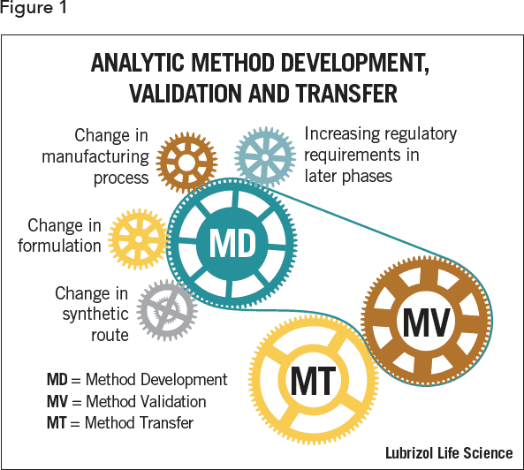
AMV

Slide 5
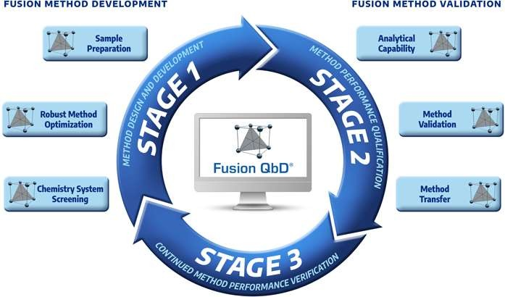
FUSION QBD software for better results during AMV

Slide 6
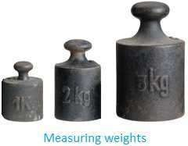
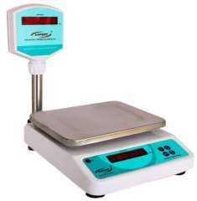
Calibration:
Definition: Calibration is a process where a comparis on is made between two entities, one whose value has to be measured and the other entity, known as the stan dard, which is used as the reference in the comparison.
Methods for calibration:
Standard Calibration
Calibration with Data
ISO 17025 Accredited ation
Calibr
Pharmaceutical validation
6

Slide 7
Methods used for calibration:
Standard Calibration: This method is mostly preferred for calibrating instrument that are non-critical to quality or not required for accreditation and license purposes
Calibration With Data: Procedure for calibration with data are similar to that of accredited calibration. Only exception being that these procedure are not accredited to the ISO standard. Moreover, they not accompanied by data on measurement uncertainties.
ISO 17025 Accredited Calibration: This has to be a strictest method of calibration. Generally it requires a measurement reports which has the details of the measurement that are maid against the standard of "as found" (before calibration is started) & "as left" (once the calibration is completed). If the calibration is done bye service provider they must issue a certificate of the
5
same.
Pharmaceutical validation

Slide 8
Qualification
Definition: Qualification is a process of assurance that the sp ecific system, premises or equipment are able to achieve the predetermined acceptance criteria to confirm the attributes wh at it purports to do.
Qualification can be considered to be a part of the validation proc
ess. It can be further divided into:
Design qualification
Installation qualification
Operation qualification
Performance qualification
1. Design qualification(DQ): It is documented evidence that propo sed design of the facilities, system and equipment is suitable for i ntended use.
Purpose: To ensure that all the requirements for the final system have been clearly defined at the start.
8

Slide 9
Continue…
2. Installation Qualification (IQ):It is documented evidenc e that the premises, supporting utilities, the equipment have be en built and installed in compliance with design specifications.
Purpose: To check the installation site/ environment & verifies the condition of installed equipment. Also to ensure that all aspe ct of equipment installed correctly and complies with the original design.
3.Operation Qualification (OQ): It is the process of demo nstrating that an instrument will function according to the its ope rational specification in the selected environment.
Purpose: To ensure that all the dynamic attributes comply wit
h original design.
9

Slide 10
Continue…
4. Performance Qualification (PQ): It is the process t hat ensure the process under anticipated conditions, co nsistently produces a product which meets all pre-deter mined requirements.
Purpose: It is ensure that the instrument is performing within specified limits.
Scope/ Purpose of calibration:
Calibration can be performed for the following purpose:
To make sure that the readings of equipment or instrume nts are consistent with other measurements and display t he correct readings every single time.
1
0

Slide 11
Continue…
To determine the accuracy, precision, reliability and deviat
ion of the measurements produced by all the instruments.
Accuracy: Closeness to the test results obtained by that
method to the true value.
Precision: Degree of agreement among individual results when the method is applied repeatedly to multiple sampli ng of a homogeneous sample.
Reliability: Degree to which an assessment tool produce
stable & consistent result under the same condition.
1
1

Slide 12
Continue…
Deviation: Is a measured difference between observed value & expected or std. value for a process or product.
To establish the reliability of the instrument being used and whether it can be trusted to deliver repeatable results each time.
To map the ‘drift’ as documented. Instruments have a tendency to produce inaccurate measurements over a period of time, following repeated use.
dddddd
12

Slide 13
Frequency of calibration:
Calibration interval may be based on calendar.
The frequency of calibration depends on following factor s:
What is level of accuracy desired?
What is the recommendation of manufacturer?
The interval between calibration varies as:
Weakly
Monthly or bi-monthly
Annually or semi-annually
After every heavy usage of equipment or instrument.
Pharmaceutical validation

Slide 14
Importance of calibration:
Calibration is responsible for defining the
accuracy of an
y measurement
and its quality that is recorded by any ins
trument.
Regularly calibration of any equipment
can eliminate the
draft at its building stage instead of allowing it to grow till
it affects
the measurement in significant ways.
Calibration helps in quantifying and controlling errors and uncertainties within various measurement process to an acceptable level.
Further, it helps in improving the accuracy of the measuri ng device, which in turn improves the quality of the FPP.
Pharmaceutical validation

Slide 15
Continue…
In short regular calibration allows pharmaceutical compa nies to have confidence in there result which they can re cord monitor and control.
Calibration are not optional but needed for regulatory compli
ance
Pharmaceutical validation

Slide 16
Scope of validation:
Analytical test methods: (eg. Accuracy, precision, specifi
city, limit of detection, linearity etc...)
Instruments calibration: (eg. Temp., Weight, pH, humidity
etc)
Process utility services: (eg. Water, steam, HVAC system etc)
Raw materials & Packaging materials: (eg. Specification, vendor certificate)
Equipment: Equipment qualification programme start wit h Users Requirement Specifications & Functional Requir ement Specifications these two requirements will result i n to the Design Qualification.
Pharmaceutical validation

Slide 17
Continue…
Facilities: (eg. Construction, building maintenance,
certificate of constricted facilities etc)
Manufacturing operations: (eg. Tablet mfg.)
Product design: (F&D, package compatibility, define specification for RM/PM, Define process & test method etc)
Cleaning: (equipment & process containers, product containers & closures, facility etc)
Operators: (knowledge, skills & attitude)
Pharmaceutical validation

Slide 18
Importance/ advantages of validation:
The four major advantages of validation includes:
Reduction of quality cost
Process optimization
Assurance of quality &
safety
1817

Slide 19
Difference in Calibration & Validation
 | CALIBRATION | Validation
1 | Calibration assures accuracy of measure ments. | Validation provides proof of consistency across all the processes, batches of products or meth ods being used.
2 | Calibration is a process that ensures that accuracy is maintained in the measurem ents produced by your equipment. | Validation is a documented process that provid es assurance that a product, service or system consistently provides results within the accept able criteria.
3 | Calibration performance of any equipme nt is compared against a reference stand ard. | There are no reference standards used in valid ation.
4 | It should be performed as per calibration SOP. | It should be performed as per the validation pr otocol.
5 | You must periodically calibrate your instr uments. Identify if there is a ‘drift’ in the measurements and eliminate it through calibration. | There are no such requirements for validation. It should be performed when you make any ch ange in the existing system or when the revalid ation period has reached.
1917

Slide 20
Thanks...
Pharmaceutical validation
18

