Slide 1
Introduction to CTD
(Common Technical Document)

Slide 2
Table of Contents:
Introduction
Need of CTD
Origin of CTD
Overview of CTD
Modules of CTD
Significance of CTD
Impact of CTD
References

Slide 3
CTD (Common Technical Document)
CTD is a joint effort of 3 major regulatory authorities.
1. European Medicine Agency (EMEA, Europe, EU)
2. US-Food and Drug Administration (FDA)
3. Ministry of Health, Labour and Welfare (MHLW, Japan)
Canada and Switzerland has also adopted CTD.

Slide 4
Need of CTD
Prior to implementation of CTD three major regulatory authorities EU, USA and Japan has their own set of guidelines and procedures for the submission of the regulatory dossiers to get the marketing approval of the drug.
Some countries in EU also had their internal guidelines and formats which making the dossier submission in different countries a very time consuming and repetitive process.
Keeping in view all the complication, the representatives from these authorities designed a common set of guidelines, format and contents for the drug registration in all the three regions under the same umbrella of ICH.

Slide 5
Origin of CTD
ICH
In July 2003, the CTD became the mandatory format for new drug applications in the EU and Japan, and the strongly recommended format of choice for NDAs submitted to the FDA.
EWG
Status of CTD
Guidelines were presented in Nov 2000, in 5th ICH Conference in San Diego.
Implemented in May 2001 in ICH meeting in Tokyo
Guidance made available to industry in October16, 2001 by FDA.
CTD

Slide 6
1
Overview of CTD:
The agreement to assemble all the Quality, Safety and Efficacy information in a common format (called CTD - Common Technical Document ) for submission of drug application for human use to get marketing approval in different ICH regulatory authorities.
2
3
₄ • It is organized into five modules
All modules are harmonized except Module-1 (Region Specific)
It’s not the “Global Dossier”
CTD incorporate ICH Guideline

Slide 7
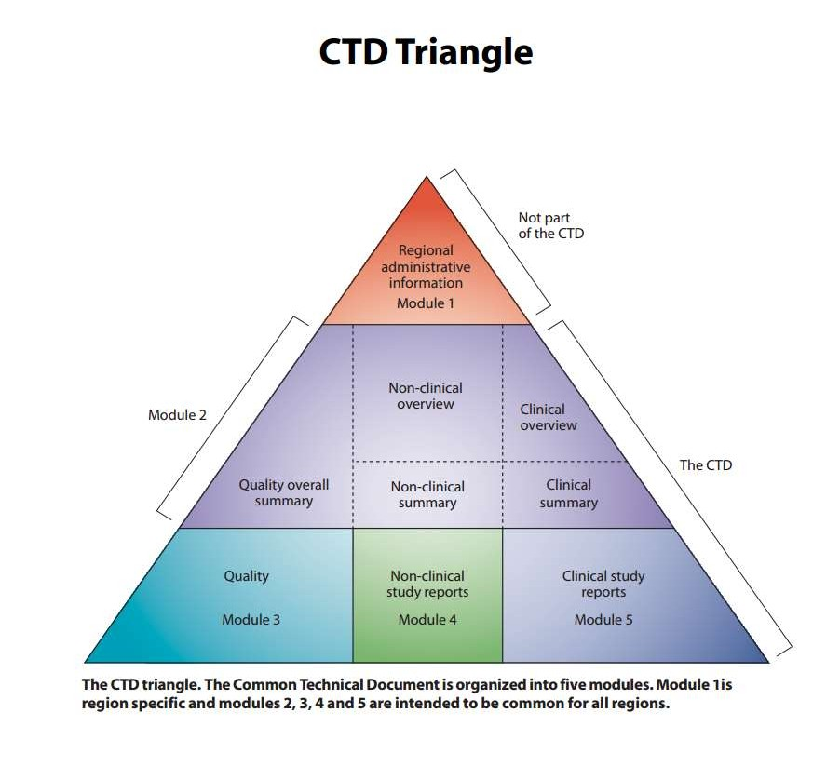
The CTD format consists of 5 modules
Module 1 :is region specific not part of the CTD. (Module 2 to 5 is a common format for the 3 ICH regions and Canada)
Module 2: consists of A Quality, non clinical and clinical summary and nonclinical and clinical overviews
Module 3: detailed information on quality
Module 4: information on nonclinical study reports (safety)
Module 5: info on clinical study reports (ICH guideline defines the format for these reports)
Summaries: provide factual cross-study analyses and integration of results (comparisons and analysis of results across studies)
Overviews: are discussion documents on critical issues (identifying unresolved issues or limitations encountered during clinical and non-clinical studies. Overview should explain why this drug should be marketed in Canada.

Slide 8
Module 1
(Administrative / General Information
Documents specific to Region
Application Form/ proposed label for use in region.
Administrative Information
FSC, COPP
DML
COAs
Registration Certificates
Form-29 etc

Slide 9
Module-2
(Common Technical Document Summaries)
General Introduction to pharmaceutical, including:
Pharmacological class
Mode of action In general it should not exceed 1 page
Proposed clinical use.
Section of Module-2
CTD Table of Contents
CTD Introduction
QOS
Non-Clinical Overview
Clinical Overview
Non-Clinical Summaries
Clinical Summary
M-2 contains summaries from Quality, Efficacy and Safety Section of the CTD:
Details are discussed in :
M4Q: The CTD-Quality- Module 3
M4S: The CTD- Safety- Module 4
M4E: the CTD- Efficacy-Module 5

Slide 10
Module 3 Quality
This Section of CTD provide a harmonized structure and format for presenting CMC ( Chemistry, Manufacturing, Controls) information of the dossier
Module 3 Contents:
3.1: Module 3 table of contents
3.2: Body of Data
3.3: Literature References

Slide 11
Module 3 Cont...
3.2. | Body of Data
3.2.S. | DRUG SUBSTANCE
3.2.S.1. | General Information (Name, Manufacturer )
3.2.S.1.1. | Nomenclature( Name, Manufacturer)
3.2.S.1.2. | Structure (Name, Manufacturer)
3.2.S.1.3. | General Properties
3.2.S.2. | Manufacturer of Drug Substance (Name, Manufacturer)
3.2.S.2.1. | Manufacturer (Name)
3.2.S.2.2. | Description of manufacturing process and process controls
3.2.S.2.3. | Control of materials
3.2.S.2.4. | Control of critical steps and intermediates
3.2.S.2.5. | Process validation /Evaluation
3.2.S.2.6. | Manufacturing Process Development

Slide 12
Cont...
3.2.S.3. | Characterization of Drug Substance
3.2.S.4. | Quality Control of Drug Substance
3.2.S.5. | Reference Standard or Material
3.2.S.6. | Container Closure System
3.2.S.7. | Stability of Drug Substance
3.2.P. | Drug Product
3.2.P.1. | Description and Composition of Drug Product
3.2.P.2. | Pharmaceutical Development
3.2.P.3. | Manufacture of Drug Product
3.2.P.4. | Control of Excipient
3.2.P.5. | Control of Drug Product
3.2.P.6. | Reference standard or Material
3.2.P.7. | Container Closure System
3.2.P.8. | Stability of Drug Product

Slide 13
Module 4
Non-Clinical Study Report
Contains Non-Clinical Study reports.
Presented in the order described in M4-S ICH Guidance for
industry.
Literature References

Slide 14
Module 5
Clinical Study Report
It explains clinical study reports
Studies on human and related information
Presented in the order described in M4-E ICH Guidance for industry.
Literature References

Slide 15
Significance of CTD
More “reviewable” applications
Complete, well-organized submissions
More predictable format
More consistent reviews
Easier analysis across applications
Easier exchange of information
Facilitates electronic submissions

Slide 16
Impact of CTD
The ICH CTD represents one of the most ambitious and successful international harmonization activities undertaken
It will significantly reduce time and resources needed by industry to compile applications for global registration.

Slide 17
Thank you

