Slide 1
UNIT 1
INTRODUCTION TO REGULATORY SCIENCE

Slide 2
CONTENTS
INTRODUCTION TO REGULATORY SCIENCE
VARIOUS REGULATORY AUTHORITIES
DRUG DISCOVERY PROCESS, phases
STAGES OF DRUG DISCOVERY & DEVELOPMENT
PRE-CLINICAL AND CLINICAL STUDIES

Slide 3

REGULATORY SCIENCE :
Regulatory Science is a comparatively new profession which developed from the desire of governments to protect public health by controlling the safety and efficacy of products in areas including pharmaceuticals, veterinary medicines, medical devices, pesticides, agrochemicals, cosmetics and complementary medicines.

Slide 4
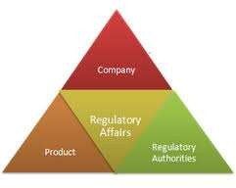
REGULATORY AFFAIRS :
11/1/2015
Regulatory affairs

Slide 5



REGULATORY AFFAIRS :
Regulatory affairs (RA), is a profession within regulated industries. Regulatory affairs also has a very specific meaning within the healthcare industries.
The companies responsible for the discovery, testing, manufacture and marketing of these products also want to ensure that they supply products that are safe and make a worthwhile contribution to public health and welfare.

Slide 6

REGULATORY AFFAIRS :
Regulatory Affairs ensure the Quality and Saftey
○ S

Slide 7

REGULATORY AFFAIRS :
Regulatory Affairs Professionals Responsibility
The regulatory professional’s job is to keep track of the ever-changing legislation in all the regions in which the company wishes to distribute its products. They also advise on the legal and scientific restraints and requirements, and collect, collate and evaluate the scientific data their research and development

Slide 8




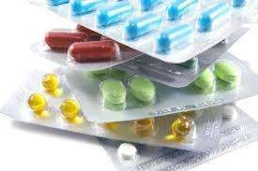
REGULATORY AFFAIRS :
Regulatory Affairs manage the Scientific Data :

Slide 9



REGULATORY AFFAIRS :
Regulatory Affairs manage the Scientific Data :

Slide 10




REGULATORY AFFAIRS :
Regulatory Affairs Professionals Responsibility :
They are responsible for the presentation of registration documents to regulatory agencies, and carry out all the subsequent negotiations necessary to obtain and maintain marketing authorization for the products concerned.
They give strategic and technical advice at the highest level in their companies, right from the beginning of the development of a product, making an important contribution both commercially and scientifically to the success of a development programme and the company as a whole.

Slide 11
Different Regulatory bodies and its significance in Product Development
Every country has its own regulatory authority, which is responsible to enforce the rules and regulations and issue the guidelines to regulate drug development process, licensing, registration, manufacturing, marketing and labeling of pharmaceutical products.
USFDA(USA), MHRA(UK), TGA(Australia), CDSCO(India), HEALTH CANADA(CANADA), MCC(South Africa),ANVISA (Brazil) , EMEA (European Union), SFDA (China),NAFDAC(Nigeria), MEDSAFE(Newzeland), MHLW(Japan), MCAZ(Zimbabwe), SWISSMEDIC(Switzerland), KFDA(Korea), MoH (Sri Lanka) are the few regulatory agencies and organizations established in respective countries.
Regulatory agencies and organizations play a vital role to meet the requirements of legal procedures related to drug development process in a country.

Slide 12
The major challenges of these regulatory agencies and organizations around the world are to ensure the safety, quality and efficacy of medicines and medical devices, harmonization of legal procedures related to drug development, monitoring and ensuring compliance with statutory obligations.
World Health Organization (WHO), Pan American Health Organization (PAHO), World Trade Organization (WTO), International Conference on Harmonization (ICH),
World Intellectual Property Organization (WIPO) are some of the international regulatory agencies and organizations which also play essential role inall aspects of pharmaceutical regulations related to drug product registration, manufacturing, distribution, price control, marketing, research and development, and intellectual property protection.

Slide 13

CDSCO

Slide 14
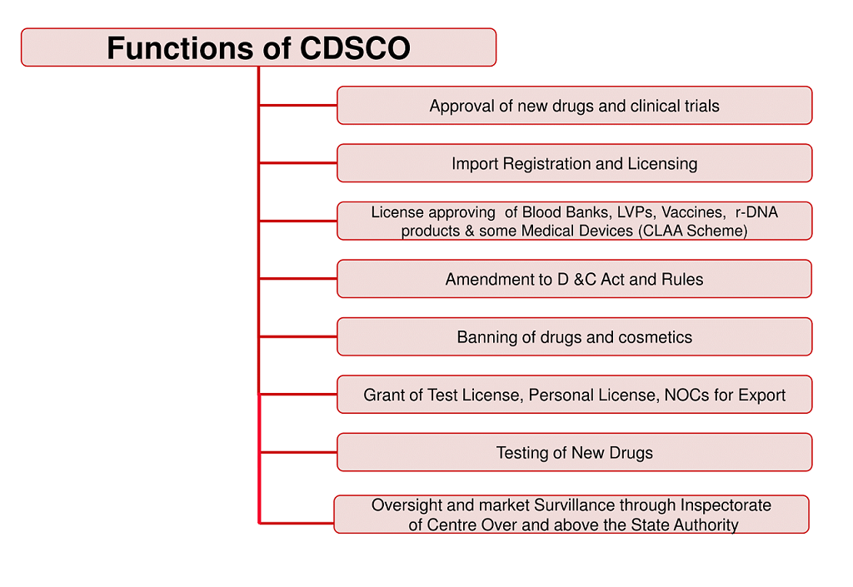
CDSCO

Slide 15


REGULATORY AFFAIRS :
Regulatory Affairs Professionals Responsibility :
Registration Documents :

Slide 16


REGULATORY AFFAIRS :
Regulatory Affairs is a legal adviser :

Slide 17

REGULATORY AFFAIRS :
Healthcare Regulatory Affairs (RA) :
The regulatory function in healthcare industries is vital in making safe and effective healthcare products available worldwide. Individuals who ensure regulatory compliance and prepare submissions, as well as those whose main job function is clinical affairs or quality assurance are all considered regulatory professionals.
Regulatory professionals are employed in industry, government and academia and are involved with a wide range of products, including:
pharmaceuticals
medical devices
in vitro diagnostics
biologics and biotechnology
nutritional products
○ cosmetics

Slide 18
PHASES OF DRUG DEVELOPMENT
Drug Development Phases
Phase 1: Discovery and Development.
Phase 2: Preclinical Research.
Phase 3: Clinical Research.
Phase 4: FDA Review.
Phase 5: FDA Post-Market Safety Monitoring.

Slide 19
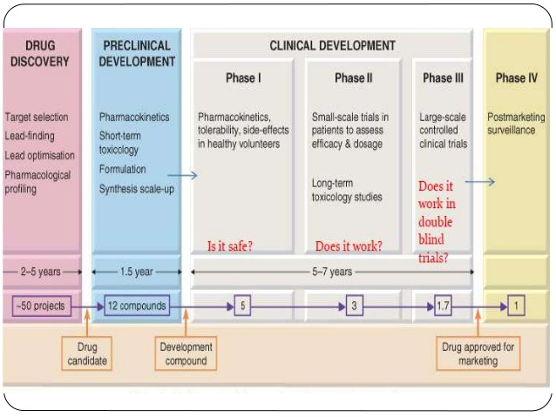
Stages of drug development

Slide 20
Clinical trials are a way to test new methods of diagnosing, treating, or preventing health conditions. The goal is to determine whether something is both safe and effective.
A variety of things are evaluated through clinical trials, including:
medications
medication combinations
new uses for existing medications
medical devices
Before doing a clinical trial, investigators conduct preclinical research using human cell cultures or animal models. For example, they might test whether a new medication is toxic to a small sample of human cells in a laboratory.
If the preclinical research is promising, they move forward with a clinical trial to see how well it works in humans. Clinical trials happen in several phases during which different questions are asked. Each phase builds on the results of previous phases

Slide 21
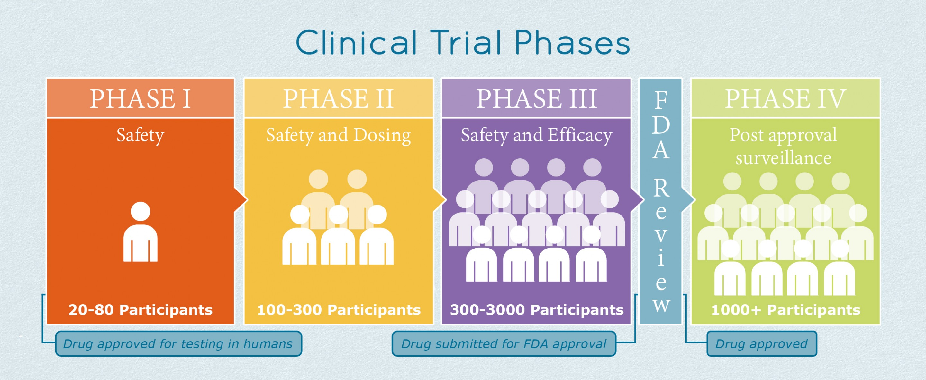

Slide 22
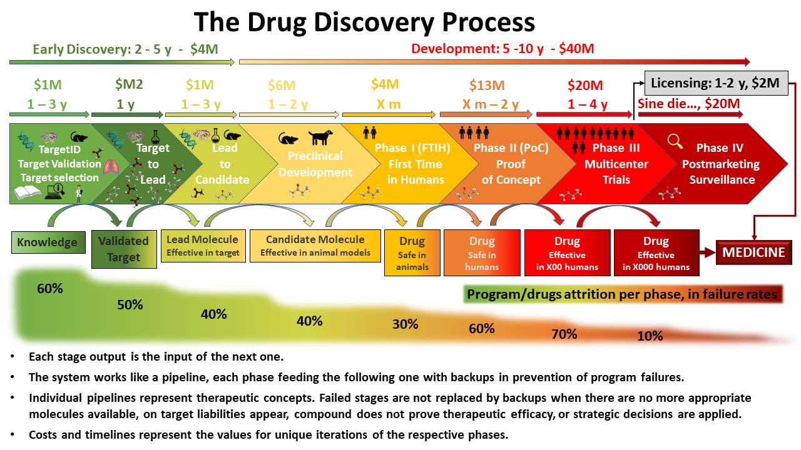

Slide 23


REGULATORY AFFAIRS :
Regulatory Landscape and Product development (R&D) :
The regulatory strategy and the development plan are evolving documents. They should be reviewed and updated on a regular basis during the product development process.
Step 1:
Properly classify your healthcare product
(i.e., as a drug, a biologic, a medical device or
a combination product) so that you know which regulatory path to take. If in doubt, contact the appropriate regulatory body to confirm the product type and how your product is regulated.
Step 2
Identify the claim of your healthcare product so that you know what types of studies to conduct to support the claim and your product label. For instance, changing your claim.
May change the medical device classification which can lead to different regulatory oversight .
14

Slide 24





REGULATORY AFFAIRS :
Regulatory Landscape and Product development (R&D) :

Slide 25
REGULATORY AFFAIRS :
Regulatory Landscape and Product development (R&D) :
Step 3:
Determine your healthcare market. This will guide you to the requirements that are specific to each jurisdiction. It is important to identify jurisdiction-specific requirements upfront.
so that they can be included early in the product development plan.
Step 4:
Develop your regulatory strategy by identifying the specific regulatory requirements as well as the possible pathway(s) to take. A thorough understanding of these requirements will guide the development of your regulatory strategy.

Slide 26
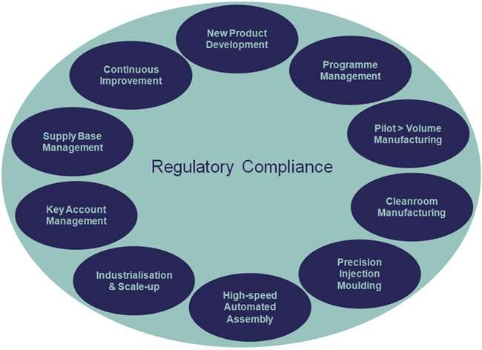
REGULATORY AFFAIRS :
Regulatory Landscape and Product development (R&D) :
11/1/2015
Prepared By : Naila Kanwal

Slide 27
REGULATORY AFFAIRS :
Regulatory Landscape and Product development :
Step 5:
Establish a healthcare product development plan.
so that the product requirements can be translated into action i.e., who does what and by when and for how much. Such plan should be established collaboratively with input from different functional groups. It should include key milestones, critical paths and periodic reviews for “go and no-go” decisions and be updated periodically.
Step 6:
Execute the product development plan It is subject-matter experts who possess knowledge of the investigational product who must carry out (and be responsible for) the corresponding manufacturing, quality, regulatory, non-clinical and clinical programs, as well as any coordination with third parties

Slide 28

REGULATORY AFFAIRS :
Regulatory Landscape and Product development :
19

Slide 29

REGULATORY AFFAIRS :
Regulatory Landscape and Product development (R&D) :
Step 7:
Execute the clinical plan
. If a clinical program is required in support of the licensing
application, these studies should be conducted according to good clinical practices (GCP) and country-specific requirements, such as ethics approvals and/or necessary regulatory approvals or conducting the clinical trial(s). Often, it helps to have a pre-submission meeting with the regulatory agency prior to submitting a clinical trial application in order to address specific
Step 8:
Collect your data for regulatory submission .Once the data from the product design and the manufacturing, quality, non-clinical and clinical programs are available, these data and reports should be collected for inclusion in the regulatory submission.
20

Slide 30
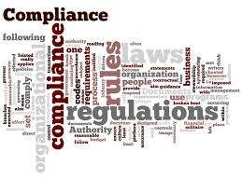

REGULATORY AFFAIRS :
Regulatory Landscape and Product development (R&D) :

Slide 31

REGULATORY AFFAIRS :
Regulatory Landscape and Product development (R&D) :
Step 9:
Collate your regulatory submission according to applicable regulatory requirements specific to your type of submission. Ensure the completeness of the submission and anticipate the resources needed to address questions from the agency during the submission review. For an innovative healthcare product, it is often recommended to have a
pre-submission meeting with your agency prior to submitting the licensing application.
Step 10:
Ensure post-marketing compliance.
Make sure to fulfill all necessary post-marketing obligations.

Slide 32
REGULATORY AFFAIRS :
Quality Management System and Regulatory Compliance Management :
A quality management system (QMS) is a collection of business processes focused on achieving quality policy and quality objectives to meet customer requirements. It is expressed as the organizational structure, policies, procedures, processes and resources needed to implement quality management as per regulatory requirement.
Electronic document management
SOP management
Regulatory submission management eCTD management
CAPA management Change control Deviation management Complaints management Audit management
Learning management and training

Slide 33

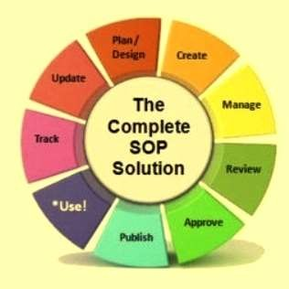




REGULATORY AFFAIRS :
Quality Management System and Regulatory Compliance Management :
.
24

Slide 34

REGULATORY AFFAIRS :
Manufacturing and Regulatory Compliance :
Manufacturing compliance comprises the technical, legal and corporate requirements, regulations and practices manufacturers must comply with in order to produce and market products.
The risk of non-compliance has become an increasingly major concern in recent years, particularly for manufacturers with operations in multiple countries and jurisdictions.
This development has been further heightened by the increasing role of governmental regulatory bodies in industry sectors, along with the emergence of global standards to address the increasingly global nature of manufacturing.

Slide 35






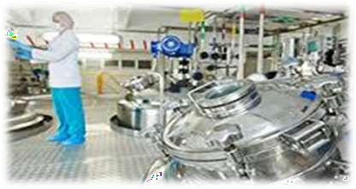
REGULATORY AFFAIRS :
Manufacturing and Regulatory Compliance :

Slide 36
REGULATORY AFFAIRS :
Manufacturing and Regulatory Compliance :
The core mandate guiding FDA regulatory oversight is consumer safety. As a result, the FDA has defined Good Manufacturing Practices (GMP) for both device and drug manufacturers that dictate the necessary measures that must be taken to ensure that quality systems and processes are in place to consistently produce safe, quality products. Therefore, manufacturers in these sectors seek a manufacturing certificate of compliance indicating that they meet GMP.
Meeting the challenge of manufacturing regulatory compliance requires
establishing a consistent top-down strategy for ensuring compliance
across the enterprise. Software developers have responded to this need
by creating solutions for managing regulatory compliance within manufacturing execution systems (MES).
27

Slide 37




REGULATORY AFFAIRS :
Manufacturing and Regulatory Compliance :
28

Slide 38
REGULATORY AFFAIRS :
Manufacturing and Regulatory Compliance :
For those in manufacturing sectors regulated by the FDA, these solutions must be compliant with Title 21 CFR Part 11 and Part 820. Part 11 requires pharmaceutical manufacturers, medical device manufacturers, biotech companies, biologics developers, contact research organizations, and other FDA-regulated industries (with some specific exceptions) to implement controls. These controls include audits, system validations, audit trails, electronic signatures, and documentation for software and systems involved in processing electronic data that are (a) required to be maintained by the FDA predicate rules or (b) used to demonstrate compliance to a predicate
rule.

Slide 39




REGULATORY AFFAIRS :
Manufacturing and Regulatory Compliance :

Slide 40
REGULATORY AFFAIRS :
Marketing and advertising
In most product areas where regulatory requirements are imposed, restrictions are also placed upon the claims which can be made for the product on labeling or in advertising.
The regulatory affairs will take part in the development of the product marketing concepts and is usually required to approve packaging and advertising before it is used commercially.

Slide 41
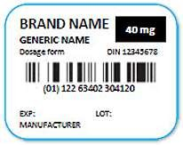

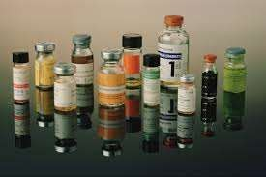
REGULATORY AFFAIRS :
11/1/2015
Drug Labeling approvals:
Prepared By : Naila Kanwal

Slide 42
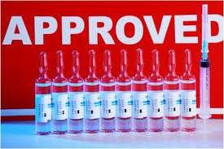


REGULATORY AFFAIRS :
Drug Marketing approvals:

Slide 43
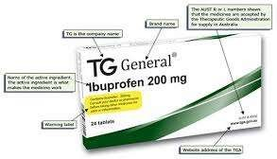
REGULATORY AFFAIRS :
11/1/2015
Drug Marketing approvals:
Prepared By : Naila Kanwal

Slide 44

REGULATORY AFFAIRS :
11/1/2015
Regulatory submission processes:
  Before a new drug or biologic can go to market, a submission must be compiled and filed with all relevant regulatory
agencies to seek a review and, ultimately, regulatory approval.
1- Review and approval procedures :
Pre-submission meeting
Pre-submission activities
Administrative review
Agency review and sponsor response
Activities prior to the agency’s decision
Decision
Prepared By : Naila Kanwal

Slide 45

REGULATORY AFFAIRS :
Unlicensed and licensed products:
Advertising and promotion
No advertising or promotion allowed Internationally, regulations exist prohibit the
advertising or promotion of unlicensed health care products. In Canada, Section 9(1) of the Food and Drugs Act states that “no person shall label, package, treat,
process, sell or advertise any drug in a manner that is false, misleading or deceptive or is likely to create an erroneous impression regarding its composition, merit or safety.”Since the terms and any proposed indication of unlicensed healthcare products have not been established, advertising such products is not permitted Similar provisions are laid out in the US Code of Federal Regulations (CFR), Title 21, section 312.7(a) and 812.7(a)the promotion of any investigational drug or medical device (including a new use under investigation for an existing device) is expressly prohibited.
`

Slide 46




REGULATORY AFFAIRS :
Unlicensed and licensed products:
Advertising and promotion
Why the promotion or advertising of unlicensed healthcare products is prohibited ?
The primary concern about the promotion or advertising of unlicensed healthcare products or off- label uses is that a healthcare provider may form an opinion about a product’s use on the basis of the claims made by its company before it receives regulatory approval, and that opinion may be incorrect relative to the pending regulatory approval. Such an erroneous opinion on the part of the healthcare provider could lead to incorrect use of the licensed product, thus using the product off-label.

Slide 47


REGULATORY AFFAIRS :
a) Advertising licensed healthcare products
According to the Section 2 of Canada’s Food and Drugs Act, an advertisement includes “any representation by any means whatever for the purpose of promoting directly or indirectly the sale or disposal of any food, drug, cosmetic or device.
Promotion can take on many forms, including
Press releases Meetings or symposia
38

Slide 48


REGULATORY AFFAIRS
Different regulatory bodies have different views on advertising healthcare products :
Regulatory systems are in place to safeguard the public from false and misleading advertising of healthcare products. However, among jurisdictions, these systems differ on what constitutes advertising and promotional activities, and thus their regulations and enforcement vary as well. To ensure you comply with industry regulations, understand the local requirements.
In Canada, advertising is primarily self-regulated and materials are submitted for preclearance on a voluntary basis. Health Canada is ultimately responsible for enforcement (e.g., in cases when advertising may present a significant health hazard such as when a prescription drug is illegally advertised to the general public or an unauthorized health product is promoted

Slide 49

REGULATORY AFFAIRS :
SOPs to keep advertising in compliance with
regulations:
Promotional activities should be consistent with the product labelling that has been cleared or approved.
Promotional claims should be reliable, accurate, truthful, informative, fair,
balanced and up-to-date, and you must be able to substantiate them.
The information should not contain misleading or unverifiable statements or omissions likely to induce medically unjustifiable product use or to give rise to undue risks.
Any comparison of products should be factual and fair, and you must be able to substantiate it.

