Slide 1
Investigational New Drug Application [INDA]
1

Slide 2
Introduction
What is an IND ?
An IND is a submission to the food and drug administration (FDA) requesting permission
to initiate a clinical study of a new drug product.
The Federal Food , Drug and Cosmetic act requires that drugs have an approved marketing application before they can be shipped in interstate commerce.
The IND application allows a company to initiate and conduct clinical studies for their new drug products.
The IND application provides the FDA with the data necessary to decide whether the new
drug and the proposed clinical trial pose a reasonable risk to the human subjects
participating in the study.
2

Slide 3
What is an IND ?
FDA's role in the development of a new drug begins when the drug's sponsor has screened the new molecule for pharmacological activity and acute toxicity potential in animals, wants to test its diagnostic or therapeutic potential in humans
The molecule changes in legal status under the Federal Food, Drug, and Cosmetic Act and
becomes a new drug subject to specific requirements of the drug regulatory system
Drug is to be the subjected to an approved marketing application before it is transported or distributed across state lines
IND- notice of claimed investigational exemption for a new drug must be filed with regulatory body.
3

Slide 4
Importance of INDA
An IND is required any time I want to conduct a clinical trial of an unapproved drug.
An IND would be required to conduct a clinical trail if the drug is
a new chemical entity , not approved for the indication under investigation in a new dosage form.
Being administered at a new dosage level.
in combination with another drug and the combination is not approved.
All clinical studies where a new drug is administered to human subjects , regardless of whether the drug will be commercially developed , require an IND.
4

Slide 5
When you don’t need an IND
An IND is not required to conduct a study if the drug :
It is not intended for human subjects , but is intended for in vivo testing or lab
research animals (non clinical studies).
It is an approved drug and the study is within its approved indication for use.
5

Slide 6
TYPES OF IND
Investigator IND
Submitted by a physician who both initiates and conducts an investigation, and under
whose immediate direction the investigational drug is administered or dispensed.
Physician might submit a research IND to propose studying an unapproved drug, or an approved product for a new indication or in a new patient population
Emergency Use IND
Allows FDA to authorize use of an experimental drug in an emergency situation
Does not allow time for submission of an IND in accordance with 21CFR , Sec. 312.23 or
Sec. 312.34
Treatment IND
Submitted for experimental drugs showing promise in clinical testing for serious or immediately life-threatening conditions while the final clinical work is conducted and the FDA review takes place
6

Slide 7
CLASSIFICATION OF IND
Commercial
Permits sponsor to collect data on clinical safety and effectiveness needed for application for marketing in the form of NDA
Research (non-commercial)
Permits the sponsor to use drug in research to obtain advanced scientific
knowledge of new drug
No plan to market the product
7

Slide 8
CONTENT OF IND
In three broad areas:
Animal Pharmacology and Toxicology Studies –
An assessment as to whether the product is reasonably safe for initial testing
in humans
Any previous experience with the drug in humans
Manufacturing Information
o composition, manufacturer, stability, and controls used for manufacturing the
drug
Clinical Protocols and Investigator Information
o Commitments to obtain informed consent from the research subjects, to
obtain review of the study by an institutional review board (IRB), and to adhere to the investigational new drug regulations.
Once the IND is submitted, the sponsor must wait 30 days before
initiating any clinical trials. During this time, FDA has an
opportunity to review the IND for safety to assure that research subjects will not be subjected to unreasonable risk
8

Slide 9
FORMAT OF INDA
A. Cover sheet (Form FDA-1571)
Name, address, telephone of sponsor
Identification of phases
Commitment not to begin CT until IND approval
Commitment by IRB- Form 56
Commitment for conducting CT- accordance with regulations
Name, title – Monitor
Name, title – person(s) for reviewing
Name, Address of CRO, if any
Signature of sponsor
Table of contents
Introductory statement & general investigational plan
Investigators brochure
Study protocol
Investigator facilities & IRB data
Chemistry manufacturing & control data
Pharmacology & toxicology data I.
P¹⁹r⁻e⁰⁶v⁻²i⁰o¹u⁶ s human experience

Slide 10
Resources For IND Applications
Pre-Investigational New Drug Application (IND) Consultation Program
o Offered by CDER (Center for Drug Evaluation and Research) to foster early communications between sponsors and new drug review divisions in order to provide guidance on the data necessary to warrant IND submission.
Guidance Documents for INDs
o documents are prepared for FDA review staff and applicants/sponsors to provide guidelines to the processing, content, and evaluation/approval of applications and also to the design, production, manufacturing, and testing of regulated products

Slide 11
GUIDANCE DOCUMENTS
For The Complete List Of CDER Guidance, Please See The Guidance Index
Safety Reporting Requirements for INDs and BE/BA Studies
CGMP for Phase 1 Investigational Drugs
Exploratory IND Studies
Content and Format of Investigational New Drug Applications (INDs) for Phase 1 Studies of
Drugs, Including Well Characterized, Therapeutic, Biotechnology-Derived Products
Q & A - Content and Format of INDs for Phase 1 Studies of Drugs, Including Well- Characterized, Therapeutic, Biotechnology-Derived Products
Bioavailability and Bioequivalence Studies for Orally Administered Drug Products
IND Exemptions for Studies of Lawfully Marketed Drug or Biological Products for the Treatment of Cancer
Guideline for Drug Master Files
A Drug Master File (DMF) is a submission to the Food and Drug Administration (FDA) that
may be used to provide confidential detailed information about facilities, processes, or
articles used in the manufacturing, processing, packaging, and storing of one or more human drugs.
Required Specifications for FDA's IND, NDA, and ANDA Drug Master File Binders
Immunotoxicology Evaluation of Investigational New Drugs

Slide 12
Laws, regulations, Policies, Procedures
The Federal Food, Drug, and Cosmetic Act is the basic food and drug law of the U.S The law is intended to assure consumers that foods are pure and wholesome, safe to eat, and produced under sanitary conditions; that drugs and devices are safe and effective for their intended uses; that cosmetics are safe and made from appropriate ingredients; and that all labeling and packaging is truthful, informative, and not deceptive.

Slide 13
Laws, regulations, Policies, Procedures
Code Of Federal Regulations (CFR)
The final regulations published in the Federal Register (daily published record of proposed rules,
final rules, meeting notices, etc.) are collected in the CFR.
The CFR is divided into 50 titles that represent broad areas subject to Federal regulations.
The FDA's portion of the CFR interprets the The Federal Food, Drug, and Cosmetic Act and related statutes. Section 21 of the CFR contains most regulations pertaining to food and drugs.
21CFR Part 312 | Investigational New Drug Application
21CFR Part 314 | INDA and NDA Applications for FDA Approval to Market a New Drug (New Drug Approval)
21CFR Part 316 | Orphan Drugs
21CFR Part 58 | Good Lab Practice for Nonclinical Laboratory [Animal] Studies
21CFR Part 50 | Protection of Human Subjects
21CFR Part 56 | Institutional Review Boards
21CFR Part 201 | Drug Labeling
21CFR Part 54 | Financial Disclosure by Clinical Investigators

Slide 14
Laws, regulations, Policies, Procedures
CDER's Manual of Policies and Procedures (MaPPs)
MaPPS are approved instructions for internal practices and procedures followed by CDER staff to help standardize the new drug review process and other activities.

Slide 15
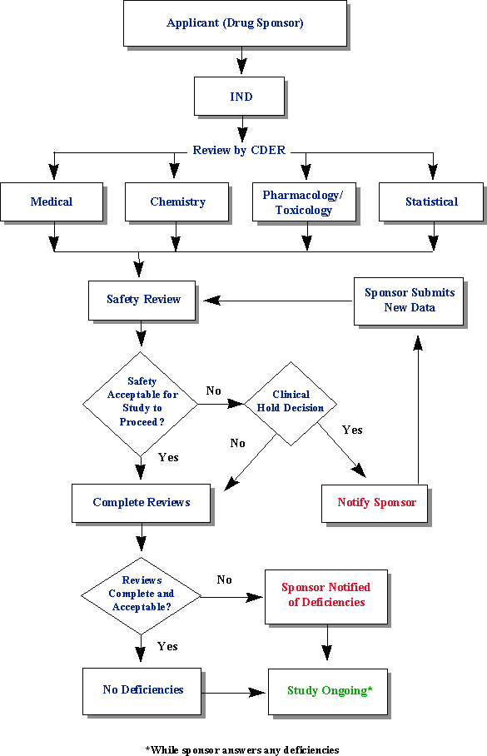
INDA Review Process

Slide 16
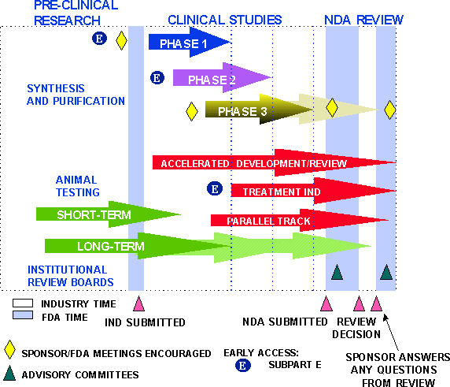
DRUG DEVELOPMENT PROCESS

Slide 17
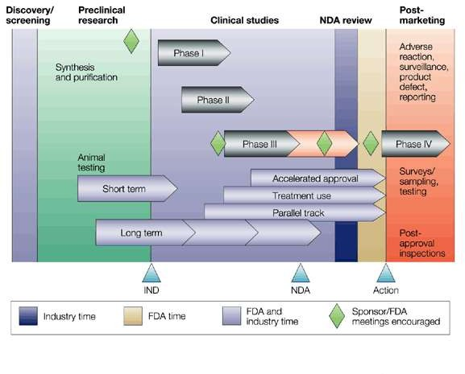
New Drug Development and Review Process
Steps from Test Tube to New Drug Application Review

Slide 18
Phases of clinical testing
Phase | Number of patients | Length | Purpose | Percent successfully completing
Phase 1 | 20-100 | Several months | Mainly safety | 67
Phase 2 | Up to several hundred | Several months to two years | Some short- term safety but mainly effectiveness | 45
Phase 3 | Several hundred to several thousand | 1-4 years | Safety, effectiveness, dosage | 5-10

Slide 19
Clinical Trials
10-15 years from lab to US patients
Only 1 in 5000 compounds make it to human testing
Only 1 in 5 tested in humans is approved
Testing Phases in Humans
DISCOVERY
Phase I RESEARCH
Phase II DEVELOPMENT
Phase III CLINICAL STUDIES
Phase IV MEDICINE APPROVED

Slide 20
Introductory statement
Description of the investigational drug
All active ingredients
Drug’s pharmacological classification
Structural formula
Route of administration
Summary of previous human experience
Formulation of dosage forms
Objective and planned duration of proposed clinical investigation.

Slide 21
Investigational plan
Description of clinical studies planned for the experimental drug
Purpose of the study
Indication to be studied
Types of trials to be initiated
Number of study subjects
Risks involved

Slide 22
INVESTIGATORS BROCHURE
Structural formula of drug.
Summary of pharmacological , toxicological , pharmacokinetic effects in animals.
Safety and efficacy
Purpose of study
Dose / dose frequency
Monitoring procedures

Slide 23
Clinical protocol
A clinical protocol describes how a particular clinical trial is to be conducted.
It describes
the objectives of study
the trial design
how subjects are selected
how the trial is to be carried out

Slide 24
It should contain the following elements:
A statement of the objective and purpose of study.
Name , address and qualification of each investigator participating in
the study.
Name and address of each clinical site.
Study subject inclusion and exclusion criteria.
Estimate of the number of subjects to be enrolled in the study.

Slide 25
Chemistry, manufacturing and Control Data
Determines the adequacy of methods used to manufacture and assay investigational compound
Safety concerns
Describe drug substances
Method of preparation
Reagent and solvents
Acceptable limits and analytical methods to ensure quality and purity of drug.

Slide 26
Pharmacological and Toxicology data :
Pharmacology and drug disposition
Integrated toxicology summary
Previous human exposure :
Marketed (foreign) or previously tested in humans.

Slide 27
FDA Review of The INDA
Once the ind is stamped as received ,it is sent to the review division
within CDER.
On arrival at the review division , it is critically evaluated by several reviewers of
Chemisty
Biopharmaceutics
Medical
Stastistics
Microbiology
Pharmacology /toxicology sections

Slide 28
All these areas review the data submitted with the primary purpose to ensure safety of the individual enrolled in th e study.
Once an IND is submitted,the study can’t be initiated until a period of 30 days.
If there are any major issues relating to the safety of the volunteers in the proposed study , the FDA can institute a clinical hold.

Slide 29
INDA Annual reports
Sponsors should submit an annual report that provides the FDA with a brief update on the progress of all investigations included in the IND.
It should contain the following:
Individual study information.
Summary of the study.
Listing of any significant foreign marketing developments with the drug e.g. approval in another country.

