Slide 1
Climate change, climatic variability, global warming, causes of climate change and its impact on regional and National Agriculture

Slide 2
What Is Climate Change?
Climate change is generally defined as a significant stable variation of average weather conditions— conditions becoming warmer, wetter, or drier—over several decades or more.
It’s the long-term trend that differentiates climate change from natural weather variability.

Slide 3
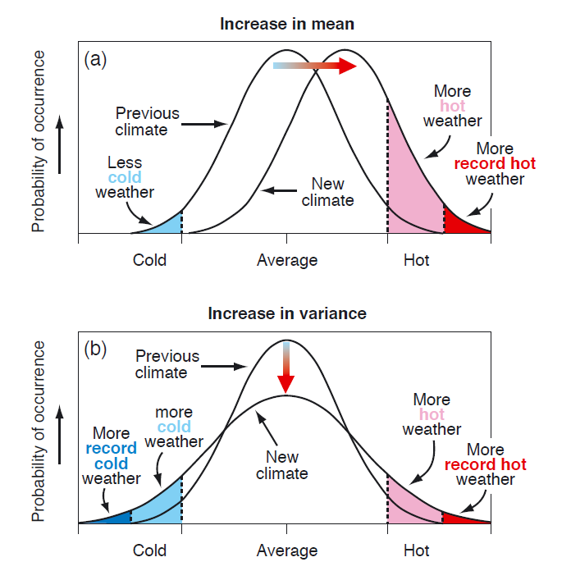
As per IPCC Climate change concept
Effect of climate change on mean and variance in atmospheric temp.

Slide 4
How Is Climate Change Measured Over Time?
Climate refers to the general weather conditions of a place as measured over many years.
Earth-orbiting satellites, remote meteorological stations, and ocean buoys are used to monitor present-day weather and climate.
But it’s paleoclimatology data from natural sources like ice cores, tree rings, corals, sediments of ocean and lake, that have enabled scientists to extend the earth’s climatic records back millions of years.
These records provide a comprehensive look at the long-term changes in the earth’s atmosphere, oceans, land surfaces, and cryosphere (frozen water systems).
Scientists then feed this data into sophisticated climate models that are able to predict future climate trends with impressive accuracy.

Slide 5
It’s worth noting that while climate change and global warming are often used interchangeably.
Global warming—the recent rise in the global average temperature near the earth’s surface—is just one aspect of climate change.
What Causes Climate Change?
The mechanics of the earth’s climate system.
When energy from the sun is reflected from the earth and back into space (mostly by clouds and ice), or
When the earth’s atmosphere releases energy, the planet cools.
When atmospheric gases prevent heat released by the earth from radiating into space (the greenhouse effect), the planet warms.
A variety of factors, both natural and human, can influence the earth’s climate system.

Slide 6
Climatic variability
While the climate tends to change quite slowly, that doesn't mean we don't experience shorter-term fluctuations on seasonal or multi-seasonal time scales. There are many things that can cause temperature, for example, to fluctuate around the average without causing the long-term average itself to change.
This phenomenon is climate variability, and when scientists talk about it they are usually referring to time periods ranging from months to as many as 30 years.
For the most part, when discussing climate variability, we're describing natural (that is, non-man-made) processes that affect the atmosphere.
For example, the North Atlantic Oscillation (NAO) refers to anomalous changes in atmospheric pressure at sea level that occur near Iceland and the Azores High. NAO-positive phases are often associated with above-average storm counts over parts of Europe and the U.S.

Slide 7
We are also familiar with the El Niño Southern Oscillation (ENSO) phenomenon near the equatorial Pacific Ocean, where fluctuations of sea surface temperatures typically alternate every few years between a warming phase (El Niño) and cooling periods (La Niña), with a neutral phase in between.
Many researchers have found that negative ENSO years are correlated with a higher probability of Atlantic hurricane formation, as well as warmer, dryer weather in northern states.

Slide 8
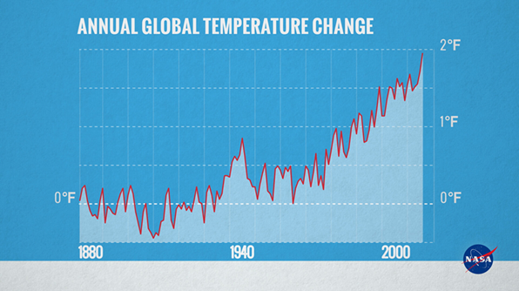
Global Warming
In the earths atmosphere molecules of different gases float.
These gases molecule absorb part of short wave incoming solar radiation and the out going long wave radiation emitted by the Earth.
Absorption of radiation energy by the gaseous molecules enhance the thermal status of the earths atmosphere.
This also enhance the earth surface temperature through the convection method of heat transfer.
This phenomena is termed as global warming.

Slide 9
The greenhouse effect is a natural process that plays a major part in shaping the earth‘s climate.
It produces the relatively warm and hospitable environment near the earth‘s surface where humans and other life-forms have been able to develop and prosper.
However, anthropogenic activities, increased level of greenhouse gases [Water vapour, CO₂, CH₄, N₂O, hydrofluorocarbons (HFCs), perfluorocarbons (PFCs), and sulfur hexafluoride (SF₆) etc.] to an unexpected level.
This causes to an overall increase of the earth‘s temperature, leading to a global warming.
As per IPCC (2007) average global surface temperature increased by 0.74 ºC since the late 19th Century and is expected to increase by 1.4 ºC - 5.8 ºC by 2100 AD with significant regional variations.

Slide 10
During the span of 1750 to 2012.
The atmospheric CO₂ concentration has increased from 280 ppm to 395 ppm.
In case of CH₄ concentration increased from 715 ppb to 1882 ppb.
Concentration N₂O elevated from 227 ppb to 323 ppb
The Global Warming Potential (GWP) of these gases i.e, CO₂, CH₄ and N₂O are 1, 25 and 310 respectively.

Slide 11
What Causes Climate Change?
1. Emission of Greenhouse Gases
Greenhouse gases play a vital role in the earth’s climate cycles.
As the planet gets hit with the sun’s rays, some of the energy is absorbed, and the rest of that energy and heat gets reflected into space.
Greenhouse gases in the atmosphere trap the reflected energy, redirecting it back down to the earth and eventually contributing to global warming.
Green house gases are:
Water vapor ; CO₂; CH₄; N₂O; Chlorofluorocarbons (CFCs)

Slide 12
2. Solar Activity
Solar activity, as mentioned above, does play a role in the earth’s climate.
While the sun does go through natural cycles, increasing and decreasing the amount of energy that it emits to the earth.
It is unlikely that solar activity is a major contributor to global warming or climate change.
Since scientists began to measure the sun’s energy hitting our atmosphere, there has not been a measurable upward trend.

Slide 13
3. Deforestation
Deforestation and climate change often go hand in hand.
Not only does climate change increase deforestation by way of wildfires and other extreme weather, but deforestation is also a major contributor to global warming.
Deforestation is the second leading contributor to global greenhouse gasses. Many people and organizations fighting against climate change point to reducing deforestation as one of, if not the most, important issues that must be addressed to slow or prevent climate change.

Slide 14
4. Agriculture
Many of the agricultural operations influences the intensity of Climate Change.
Deforestation in places like catchment area of Amazon river or African countries.
Increase in live stock population responsible for CH₄ emission.
Fertilizer application enhance NO emission.
Tillage responsible for CO₂ emission.
Rice cultivation in organic rich soils increase CH₄ emission.
Agriculture also has the potential to act as a carbon sink, and could eventually absorb nearly the same amount of CO₂ it emit

Slide 15
5. Human Activity
According to the Environmental Protection Agency, the most significant contributor to climate change is the burning of fossil fuels for electricity, heat, and transportation.
Of these factors, transportation in the form of cars, trucks, ships, trains, and planes emits the largest percentage of CO₂–speeding up global warming and remaining a significant cause of climate change.
6. Livestock
Livestock in the form of cattle, sheep, pigs, and poultry play a significant role in climate change.
According to one study,“Livestock and Climate Change,” livestock around the world is responsible for 51% of annual global green housegas emissions.

Slide 17
Impact of climate change on regional and national Agriculture

Slide 19
Sector-wise Effects of Climate Change in Agriculture
Field crops:
An average of 30% decrease in crop yields is expected by mid-21st century in South Asian countries.
North Indian states and Bangladesh are highly susceptible due to erratic changes in rainfall and temperature.
The normal crop yield is anticipated to decrease by 50 % in Pakistan.
In India, by 2050 rainfed and irrigated rice yield will decreased by <2.5 & 7%.
By 2080 irrigated rice yield decreased by 10%.
Wheat yiled will reduced by 6 to 25% in 2080.
Maize yield in India will reduced by 18 to 23% at 2100.
The chickpea yield will increase by 23 to 54%

Slide 20
The production of maize in European countries is expected to increase by 25% in ideal hydrologic conditions.
The drastic changes in climate alters the progressive stages of pathogens that eventually affect the growth and yields of crops severely, and also could lead to an increase in pest and insect population, ultimately devastating the overall productivity.
Horticultural Crops:
Vegetable crops when exposed to extreme high temperatures are subject to very high transpiration losses, and it also limits fruit setting in citrus fruits.
High temperature causes burning or scorching effect of blossoms, predominantly on young trees.
Fruit setting stage of navel oranges is recorded to be severely affected by high temperatures during flowering.

Slide 21
High temperature induces moisture stress condition leading to sunburn and cracking symptoms in fruit trees like apricot, cherries and apples.
The temperature enhancement at ripening stage causes fruit burning and cracking in litchi plantation.
Most of the vegetable crops are severely affected by flooding, particularly tomato.
If the ozone concentration reaches to >50 ppb/day, yield of vegetable crops will be reduced by 5 to 15%.

Slide 22
Livestock, Poultry and Fishery sectors:
The growth and development of any species with some specific characteristics is governed by their resilience and tolerance to the changes in their environment.
Global climate changes affect production, reproduction, health and adaptability of every animal.
Higher temperatures abruptly change the animal's body physiology, such as rise in respiration rates (> 70- 80/minute), blood flow and body temperature (>102.5º F). The correlation between performance of cattle production and temperature-humidity index is negative.
Erratic changes in weather conditions directly impact the production level of animal by 58% and reproduction by 63.3%.
Dairy breeds are more vulnerable to heat stress than the meat breeds.

Slide 23
An increase in metabolic heat production in higher milk producing breeds leads to higher susceptibility to heat stress; while the low milk producing animals are resistant.
Increase in temperature and temperature humidity index value beyond the critical threshold level reduces the dry matter intake and milk yield.
It also interrupts physiology of animal's body.
Poultries are extremely sensitive to temperature-associated issues, specifically heat stress.
Endocrinological changes caused by prolonged heat stress in broiler chickens enhance lipid accumulation, reduced lipolysis, and induced amino acid catabolism. Due to heat stress, feed intake of poultries will be reduced, which leads to less body weight, egg production and quality of meat.
Heat stress has negative effect on strength, weight, ash content, thickness of the eggshell and increases the egg breakage.

