Slide 1
Atmospheric humidity, concept of saturation, vapor pressure, process of condensation,

Slide 2
What is Condensation?
Condensation is the process through which the physical state of matter changes from the gaseous phase into the liquid phase.
For example, condensation occurs when warm water vapour (gaseous form) raised from lower layer comes in contact with a cooler surface and transformed into liquid water.
Condensation can also be defined as the removal of heat from a system in such a manner that vapour is converted into liquid.

Slide 3
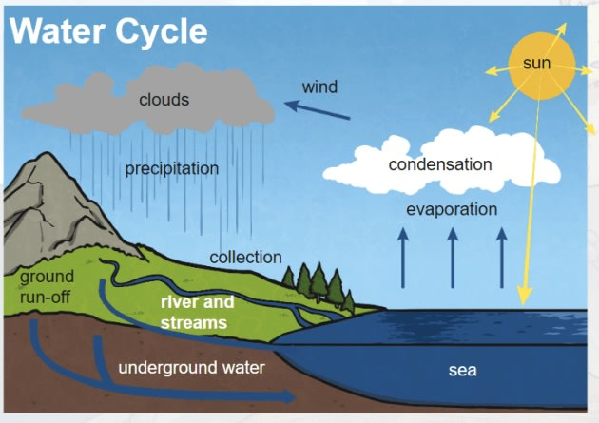

Slide 4
Conditions needed for condensation
Cooling of warm moist air until it saturates
Presence of condensation nuclei

Slide 5
Cooling of warm moist air until it saturates
Radiative Cooling: As per Plank’s law every physical body emits electromagnetic radiation. During emission of energy through radiation the thermal status of a body lowered down, this phenomena is termed as radiative cooling.
Advective Cooling: When a warmer air mass passes across a colder surface, then due to conduction thermal status of air mass lowered down. This phenomena termed as advection cooling.
Adiabatic cooling: is the process of reducing heat through a change in air pressure caused by volume expansion.

Slide 6
Presence of condensation nuclei
Condensation does not take place even if the temperature is below dew point.
For condensation to happen, condensation nuclei are needed.
There are two types of condensation nuclei, Hygroscopic and Hydrophobic.
Hygroscopic particles attracts water molecules when the saturation is near (ex: Salt).
Hydrophobic nuclei are water repelling (ex: oil, gasoline, and paraffin).
Water vapor will condense on hydrophobic surfaces only at relative humidity greater than 100 percent with great difficulty.

