Slide 1
Formation and classification of cloud, dew, fog, mist, and frost.

Slide 2
Formation of Cloud
Through the process of condensation water vapours turns into tiny water or ice particles and floats in the upper atmosphere this is the first step of cloud formation.
There after these particles transformed into larger particles and fall on earth surface from atmosphere.
There are two popular theories to explain the formation of larger water droplets or ice crystal.
These are
The Bergeron or "Ice Crystal" theory
Collision and Coalescence theory

Slide 3
1) Ice-Crystal Theory of Bergeron (Tor Bergeron, 1933)
Clouds present at temperature below freezing point (-40 ⁰C), contains both ice crystal and super-cooled water droplets.
Saturation vapour pressure over ice is smaller than that of over water.
This caused direct transformation of water vapour into ice and thus the size of the ice crystal (act as the nuclei) increases and it fall down.
While falling from the top region the ice breaks into pieces and the fraction act as a new nuclei to form large ice particles. This is a chain process.

Slide 4
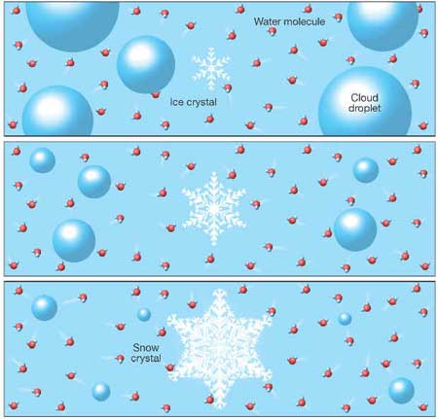
Vapour deposition onto the ice crystal results in a shrinking of the liquid water droplets and a growing of the ice crystal.

Slide 5
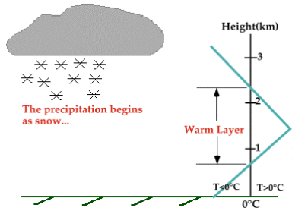
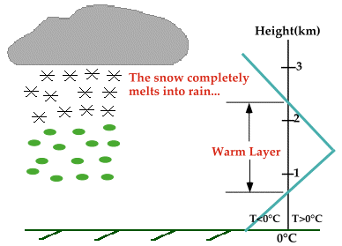
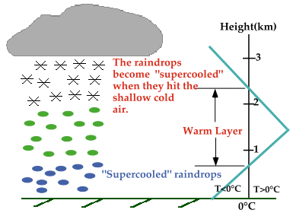
In the figures, blue line represents the temp. of the atmosphere and the black line represents the ⁰C isotherm (a line of equal temperature). When the blue line is to the right of the black line, the atmosphere is warmer than ⁰C and when the blue line is to the left, the atmosphere is colder than ⁰C.
As the snow falls, it encounters a layer of warm air where snow and ice particles completely melt and collapse into raindrops.
As the raindrops fall further, they encounter a layer of cold air (⁰C), since the cold layer is so shallow, majority of the droplets transformed into super cooled raindrops.
(a)
(b)
(c)

Slide 6
2) Collision-Coalescence Theory (E.G. Boven, 1940)
Clouds formed in thermal environment of >⁰C, are made up exclusively of liquid droplets. A giant condensation nuclei is needed for for the formation of large droplets (>20 μm).These nuclei are provided by sea salts with hygroscopic nature. Condensation on these hygroscopic nuclei starts even before the air reaches saturation point. Since the rate of fall is size dependent, the larger drops fall faster than the smaller. As such they collide with the smaller droplets and coalesce.

Slide 7
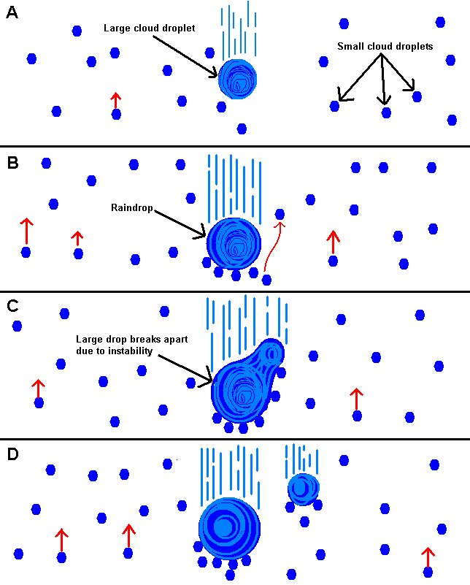
Collision/coalescence process of precipitation
Conditions needed for precipitation under this theory
There must be a high liquid water content within the cloud.
There must be sufficiently strong and consistent upward drafts within the cloud.
A wide range of cloud droplet sizes is very helpful.
The cloud must be thick enough so that the cloud droplets have enough time to gather surrounding smaller droplets.

Slide 8
Cloud

Slide 9
Clouds can be defined as a visible aggregation of minute water droplets and / or ice particles suspended in the atmosphere caused by condensation.
Clouds can take on all sorts of shapes and sizes, ranging from thin wispy clouds (cirrus) to large, dark menacing clouds (cumulonimbus).

Slide 10
How Clouds Forms
Clouds form when moist, warm rising air cools and expands in the atmosphere.
Three lifting mechanisms
The water vapor in the air condenses to form tiny water droplets which are the basis of clouds.
Two theories of precipitations

Slide 11
Lifting Mechanisms of warm moist air from land / sea surfaces to upper atmosphere
Convective lift
Orografic lift
Frontal Lift

Slide 12
Cloud Classification and Characteristics
Clouds are classified according to their :
Height & texture (appearance) from the ground surface

Slide 13
Approximate height of cloud bases (km) above the ground surface for various latitudes
Cloud group | Mid. Latitude Region | Tropical Region | Polar Region
High (Cirrus) | 6 - 18 | 5 - 13 | 3 -8
Middle (Alto) | 2 - 8 | 2 - 7 | 2 - 4
Low (Stratus) | 0 - 2 | 0 - 2 | 0 - 2
High: > 20000 feet, Mid. : 6500 – 20000 feet, Low: < 6500 feet

Slide 14
Several clouds are grouped by their elevation as:
High (mean heights 5 to 13 km):
i) Cirrus , ii) Cirrocumulus and iii) Cirrostratus
Middle (mean heights 2 to 7 km):
i) Altocumulus, ii) Altostratus and iii) Nimbostratus
Low (mean heights 0 to 2 km):
i) Stratocumulus, ii) Stratus, iii) Cumulus and iv) Cumulonimbus

Slide 15
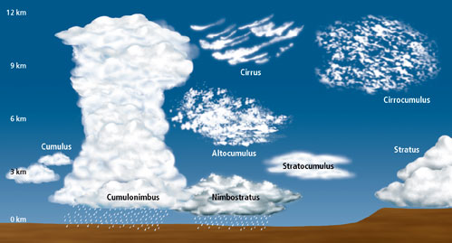
Cloud classification at a glance
1) Cirrus : curly hair, 2) Alto, 3) Stratus: Developed horizontally ,
4) Nimbus-: rain, 5) Cumulus-: heap, developed vertically

Slide 16
High-level clouds:
High-level clouds are given the prefix "cirro-".
Due to cold tropo-spheric temperatures at these levels, the clouds primarily are composed of ice crystals, and often appear thin, streaky, and white.
During sunset, can create an array of color on the clouds.
The three main types of high clouds are:
i) cirrus, ii) cirrostratus, and iii) cirrocumulus

Slide 17
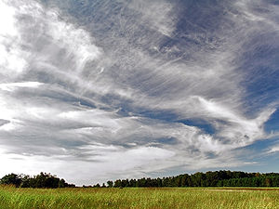
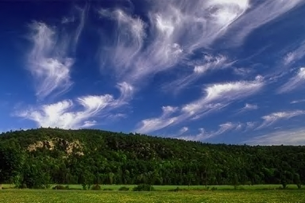
Cirrus clouds are wispy, feathery, and composed entirely of ice crystals.
Cirrus clouds

Slide 18
Unlike cirrus, cirrostratus clouds form more of a widespread, veil-like layer (similar to what stratus clouds do in low levels). When sunlight or moonlight passes through the hexagonal-shaped ice crystals of cirrostratus clouds, the light is dispersed or refracted (similar to light passing through a prism) in such a way that a familiar ring or halo may form.
As the warm front approaches, cirrus clouds tend to thicken into cirrostratus, which may, in turn, thicken and lower into altostratus, stratus, and even nimbostratus.

Slide 19
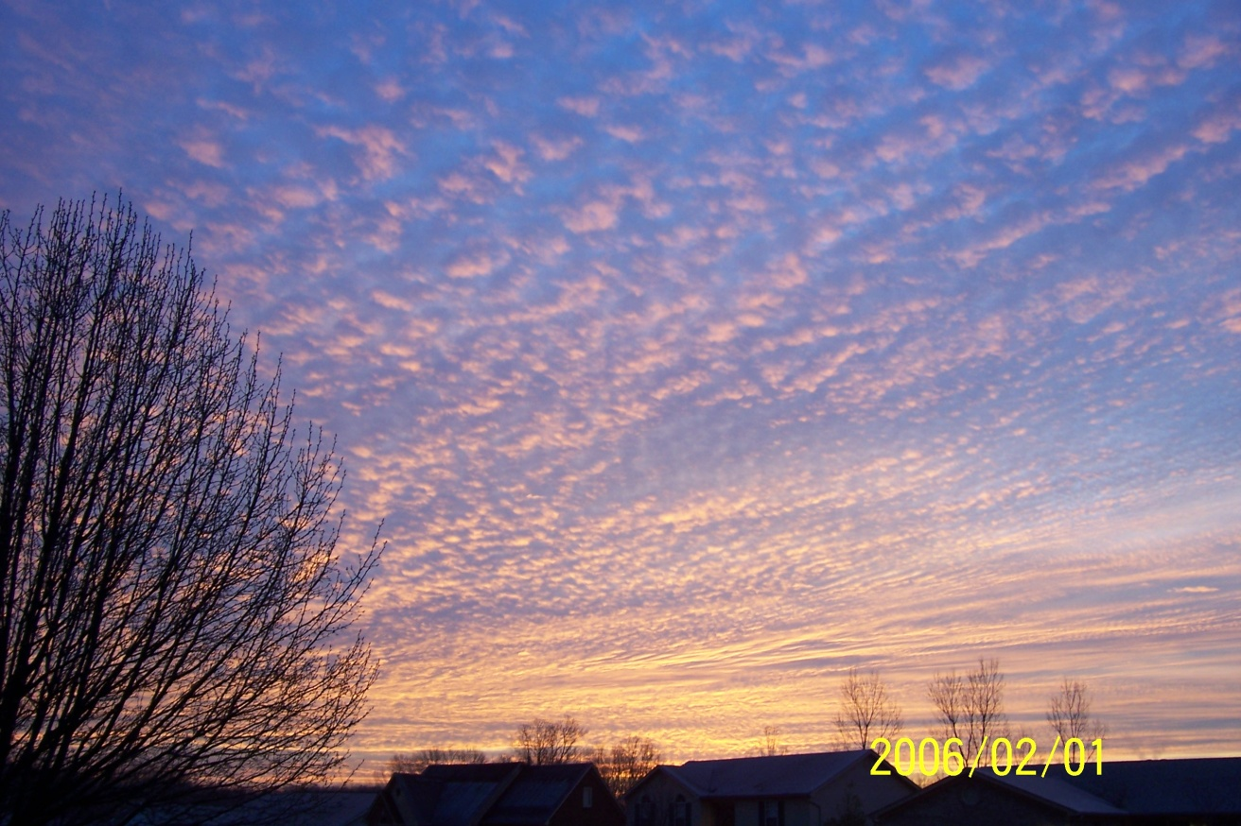
cirrocumulus clouds are layered clouds permeated with small cumuliform lumpiness. They also may line up in streets or rows of clouds across the sky.

Slide 20
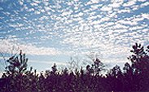

Slide 21
Mid-level clouds:
The clouds in the middle level of the troposphere, given the prefix “Alto“. Depending on the altitude, time of year, and vertical temperature structure of the troposphere, these clouds may be composed of liquid water droplets, ice crystals, or a combination of the two, including super cooled droplets.
The two main type of mid-level clouds are:
i) Altostratus and ii) Altocumulus.

Slide 22
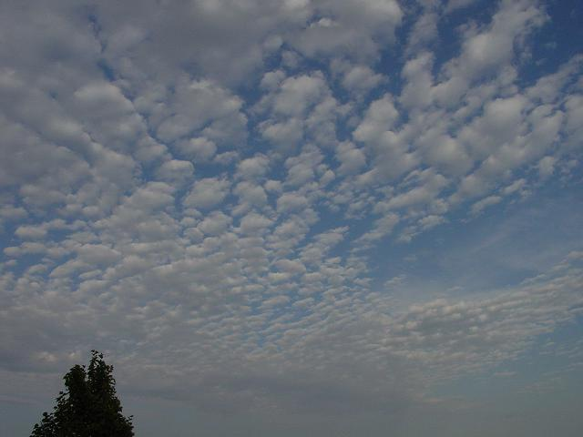
Altostratus clouds are "strato" type clouds that possess a flat and uniform type texture in the mid levels. They frequently indicate the approach of a warm front and may thicken and lower into stratus, then nimbostratus resulting in rain or snow. However, altostratus clouds themselves do not produce significant precipitation at the surface, although sprinkles or occasionally light showers may occur from a thick alto-stratus deck

Slide 23
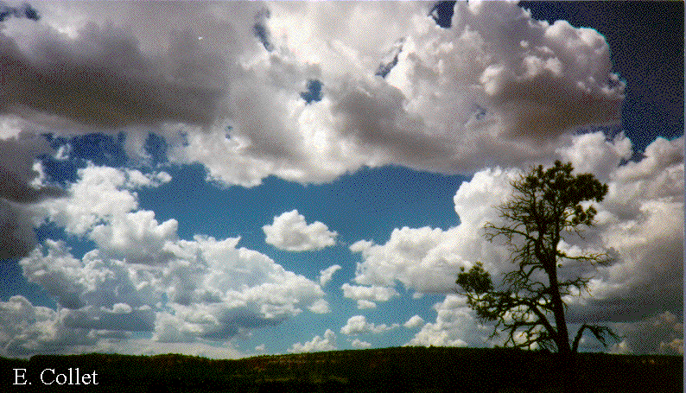
Altocumulus clouds exhibit "cumulo" type characteristics in mid levels, i.e., heap-like clouds with convective elements. Like cirrocumulus, altocumulus may align in rows or streets of clouds, with cloud axes indicating localized areas of ascending, moist air, and clear zones between rows suggesting locally descending, drier air. Altocumulus clouds with some vertical extent may denote the presence of elevated instability, especially in the morning, which could become boundary-layer based and be released into deep convection during the afternoon or evening.

Slide 24
Low-level clouds:
Low-level clouds are not given a prefix, although their names are derived from "strato-" or "cumulo-", depending on their characteristics.
Stratus, which develop horizontally,
Stratus clouds are uniform and flat, producing a gray layer of cloud cover which may be precipitation-free or may cause periods of light precipitation or drizzle.
Cumulus, which develop vertically.
Low clouds normally consist of liquid water droplets or even super cooled droplets, except during cold winter storms when ice crystals (and snow) comprise much of the clouds.

Slide 25
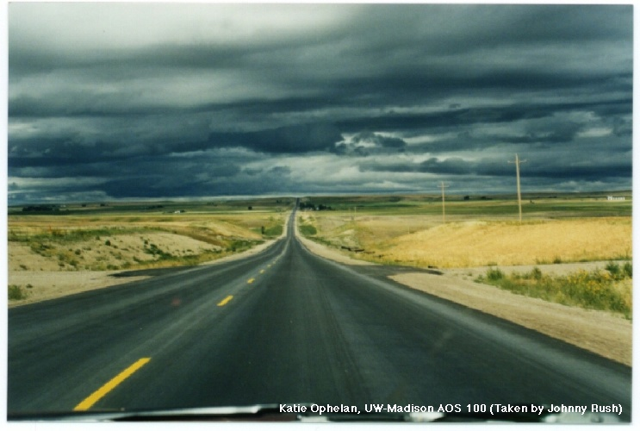
Stratocumulus clouds are hybrids of layered stratus and cellular cumulus, i.e., individual cloud elements, characteristic of cumulo type clouds, clumped together in a continuous distribution, characteristic of strato type clouds.
Stratocumulus also can be thought of as a layer of cloud clumps with thick and thin areas. These clouds appear frequently in the atmosphere, either ahead of or behind a frontal system

Slide 26
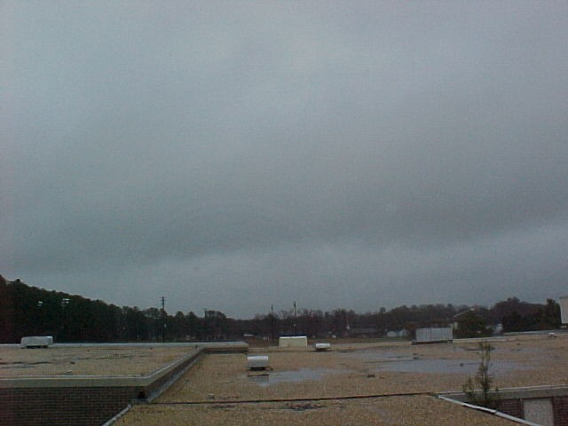
Nimbostratus clouds is a formless cloud layer that is almost uniformly dark grey. "Nimbo" is from the Latin word "nimbus", which denotes precipitation.
It is generally a stratification cloud of moderate vertical development that produces precipitation This cloud typically forms from altostratus in the middle altitude range then subsides into the low altitude range during precipitation.
Nimbostratus usually has a thickness of about 2000 m. Though found worldwide, nimbostratus is found more commonly in the middle latitudes

Slide 27
In contrast to layered, horizontal stratus, cumulus clouds are more cellular (individual) in nature, have flat bottoms and rounded tops, and grow vertically.
In fact, their name depends on the degree of vertical development.
For instance, scattered cumulus clouds showing little vertical growth on an otherwise sunny day used to be termed "cumulus humilis" or "fair weather cumulus," although normally they simply are referred to just as cumulus or flat cumulus.

Slide 28
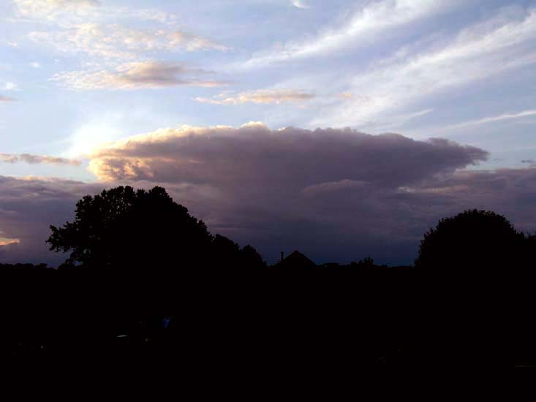
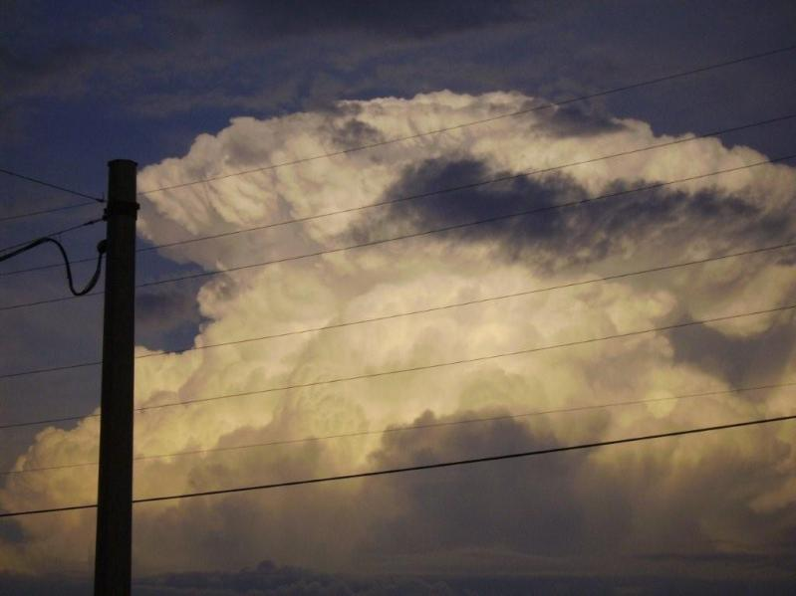
Approaching Cumulus
Mature cumulus

Slide 29
A cumulus cloud that exhibits significant vertical development (but is not yet a thunderstorm) is called cumulus congestus or towering cumulus. If enough atmospheric instability, moisture, and lift are present, then strong updrafts can develop in the cumulus cloud leading to a mature, deep cumulonimbus cloud, i.e., a thunderstorm producing heavy rain. In addition, cloud electrification occurs within cumulonimbus clouds due to many collisions between charged water droplet, graupel (ice-water mix), and ice crystal particles, resulting in lightning and thunder.
Cumulus clouds are all capable of producing some serious storms!!!

Slide 31
DEW

Slide 32
What is Dew?
Dew is the deposit of waterdrops formed at night by the condensation of water vapor from the air onto the surfaces of objects freely exposed to the sky.
Dew is water in the form of droplets that appears on thin, exposed objects in the morning or evening due to condensation.
Formation mechanism: On clear nights, adequate cooling of the surface typically takes place when it loses more energy by infrared radiation than the radiation it receives from the sun.
Then atmospheric moisture condenses at a rate greater than that at which it can evaporate, resulting in the formation of water droplets. Water vapor will condense into droplets depending on the temperature.
Most objects, including grass blades, leaves, and petals, are much better reradiators than air and, as a result, are usually colder at night than is the air.

Slide 33
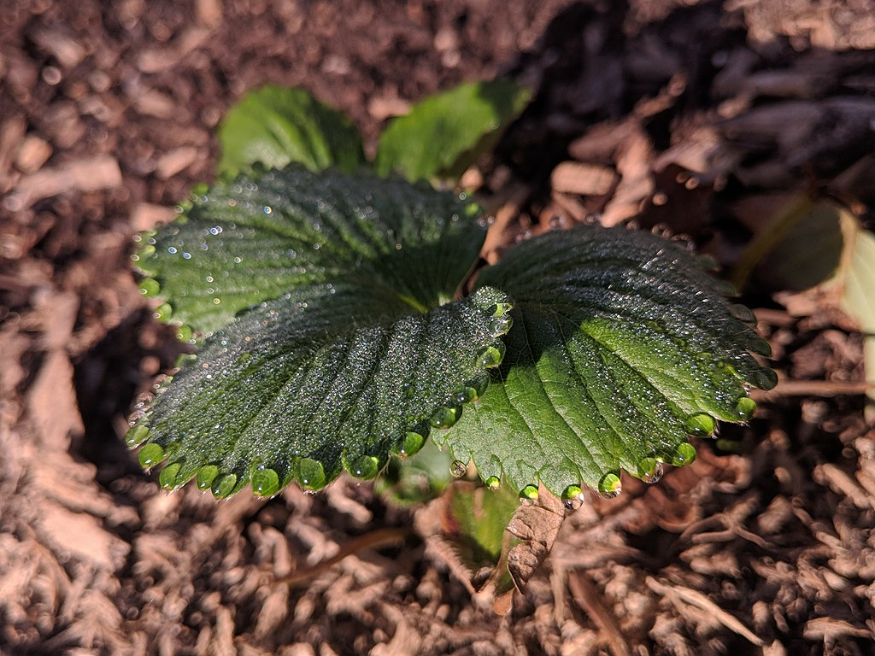
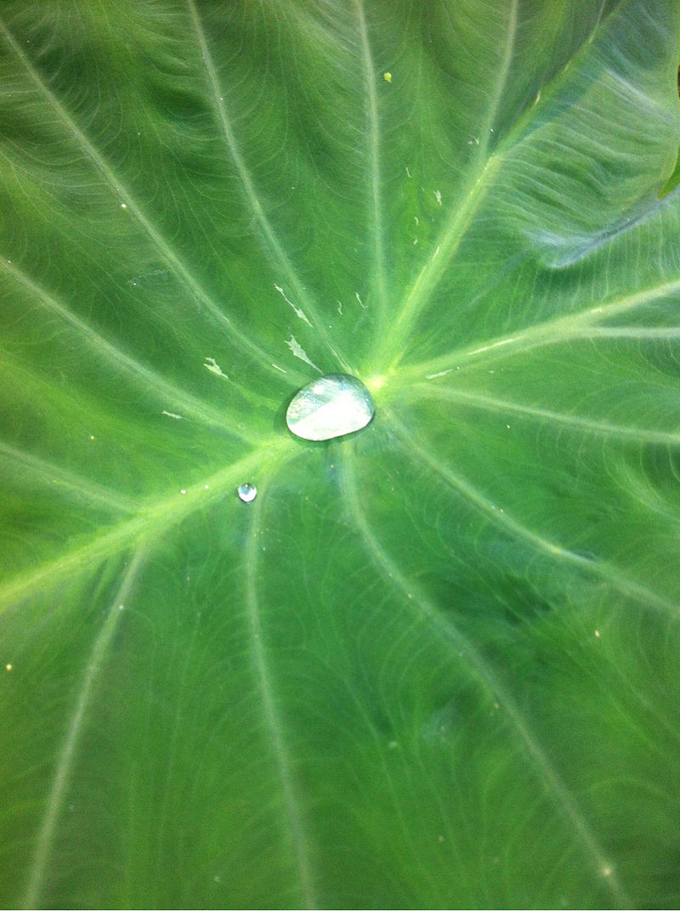

Slide 34
Favourable environment:
Dew forms on clear nights, because on such nights reradiation of heat from freely exposed surfaces takes place at a faster rate.
Calm or low wind flow enhance the process.
Dew Point Temperature: The temperature at which droplets are formed is called the dew point temperature.
Above this temperature the moisture will stay in the air.
If the dew point temperature is close to the air temperature, the relative humidity is high
If the dew point is well below the air temperature, the relative humidity is low.
Why land surfaces get less dew than grass and leaves?
Glossy vegetative surface with higher thermal conductivity are better infrared radiator over soil having rough surface and poor thermal conductivity.

Slide 35
Measurement:
Drosometer is a classical device for dew measurement. This instrument consists a small, (artificial) condenser surface, which is suspended from an arm attached to a pointer that records the weight changes of the condenser on a drum.
Besides being very wind sensitive, this device, only provides a measure of the meteorological potential for dew formation.
The actual amount of dew in a specific place is strongly dependent on surface properties.
For its measurement, plants, leaves, or whole soil columns are placed on a balance with their surface at the same height and in the same surroundings as would occur naturally. Thus providing a small lysimeter.
Further methods include estimation by means of comparing the droplets to standardized photographs, or volumetric measurement of the amount of water wiped from the surface.

Slide 36
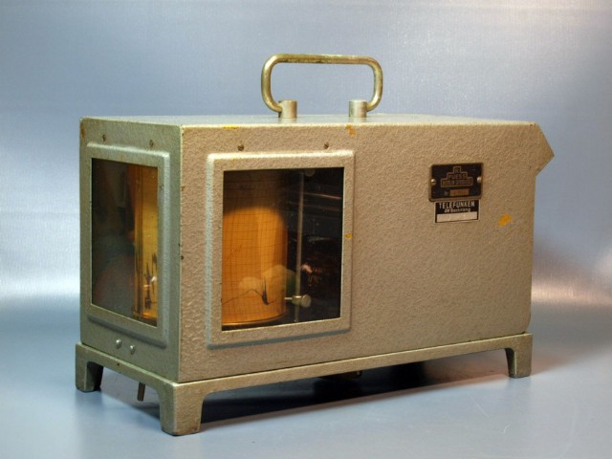

Slide 37
Beneficial effects of Dew in relation to Agriculture
In the arid and semiarid regions or in the dry season, because of its higher frequency dew acts as a notable water resource. This, accelerates the increase of biomass in plants.
During desiccation and rehydration dew enhance the photosynthetic activity. It regulates the transpiration pressure and thus helping the wilting plant to restore the appropriate turger pressure of cell.
Dew provide a moist environment in repairing the DNA of embryo, thus maintain viability of seed under harsh desert conditions;
Improving water content of surface soil and there by mitigating soil water stress partially.
Regulating growing environment of forest plants.

Slide 38
Harmful effects of Dew:
Creation of moist environment due to dew increases pest and disease attack.
Dew inhibits the plant stomata movement
When the quantity and sustaining time of dew is high it discourage the route of pollen diffusing.
Acid dew could lead to a degradation of vegetation for the decreasing of CO2 assimilation efficiency.
Black spot disease of fruit could be induced by dew.
Some times it deteriorated the quality of vegetables, Fruits.

Slide 39
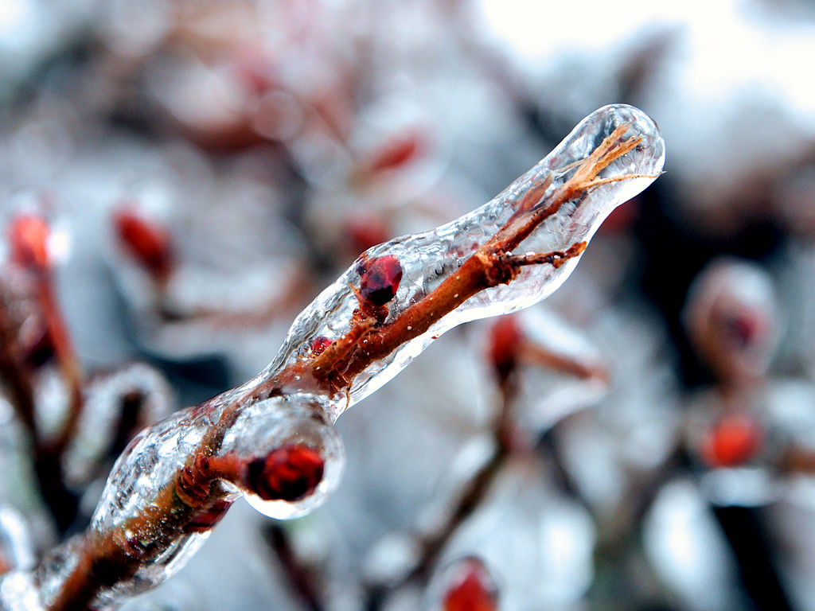
Under cold temp., dew may freeze and form a layer of ice over plants and objects

Slide 40
What is Frost
Due to reradiation temperature on surface of objects may reach below the freezing point. Under that situation, water vapour directly condensed to tiny ice crystal. These ice crystals are called frost.
Frost is a thin layer of ice on the solid surface, which forms from water vapour in an above- freezing atmosphere coming in contact with a solid surface whose temperature is below freezing, and resulting in a phase change from water vapor (a gas) to ice (a solid).
In temperate climates, it most commonly appears on surfaces near the ground as fragile white crystals with variety of forms.
The propagation of crystal formation occurs by the process of nucleation.

Slide 41
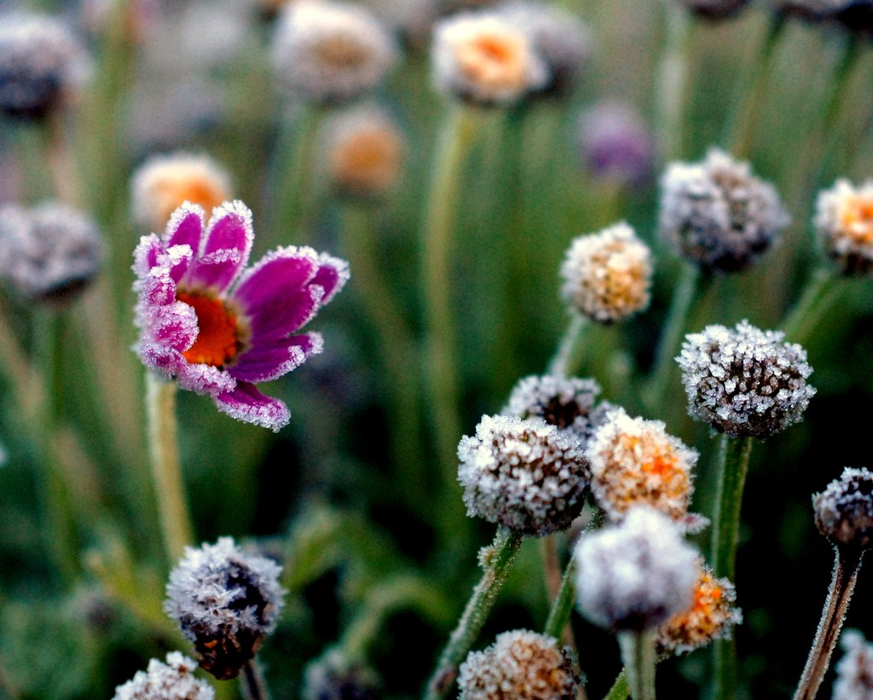
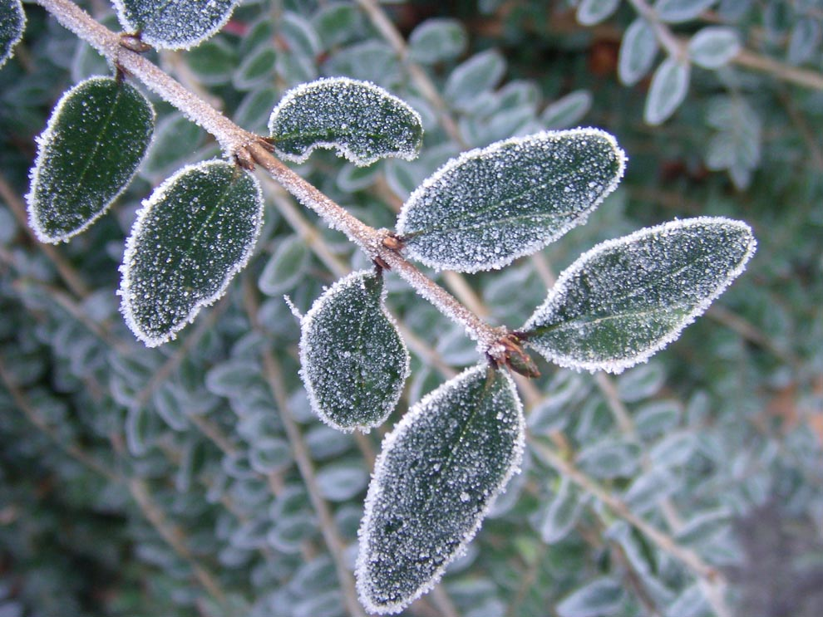
A flower with advection frost on the edges of its petals

Slide 42
Type of Frost
Hoar frost (Radiation frost): Refers to white ice crystals deposited on the ground or exposed objects, such as wires or leaves.
The word "hoar" means "showing signs of old age".
Hoar frost formed on cold, clear nights when conditions are such that heat radiates into outer space faster than it can be replaced from nearby warm objects or brought in by the wind. Under this circumstances, objects cool to below the frost point of the surrounding air.
Hoar frost may freeze in such low-lying cold air even when the air temperature a few feet above ground is well above freezing.
In this context, it refers to the frost that makes trees and bushes look like white hair.

Slide 43
Hoar frost may have different names depending on where it forms:
Air hoar is a deposit of hoar frost on objects above the surface, such as tree branches, plant stems, and wires.
Surface hoar refers to fern-like ice crystals directly deposited on snow, ice, or already frozen surfaces.
Crevasse hoar consists of crystals that form in glacial crevasses where water vapour can accumulate under calm weather conditions.
Depth hoar refers to faceted crystals that have slowly grown large within cavities beneath the surface of banks of dry snow. Depth hoar crystals grow continuously at the expense of neighboring smaller crystals, so typically are visibly stepped and have faceted hollows.

Slide 44
Advection frost refers to tiny ice spikes that form when very cold wind is blowing over tree branches, poles, and other surfaces. It looks like rimming on the edges of flowers and leaves, and usually forms against the direction of the wind. It can occur at any hour, day or night.
Window frost forms when a glass pane is exposed to very cold air on the outside and warmer, moderately moist air on the inside. If the pane is a bad insulator (for example, if it is a single-pane window), water vapour condenses on the glass, forming frost patterns. With very low temperatures outside, frost can appear on the bottom of the window even with double-pane energy-efficient windows because the air convection between two panes of glass ensures that the bottom part of the glazing unit is colder than the top part

Slide 45
White frost is a solid deposition of ice that forms directly from water vapor. It forms when relative humidity is above 90%, air temperature below −8 °C, and it grows against the wind direction. White frost resembles a heavy coating of hoar frost with big, interlocking crystals, usually needle-shaped.
Rime is a type of ice deposition that occurs quickly, often under heavily humid and windy conditions. Technically speaking, it is not a type of frost, since usually supercooled water drops are involved, in contrast to the formation of hoar frost, in which water vapour desublimates slowly and directly. Unlike hoar frost, which has a feathery appearance, rime generally has an icy, solid appearance.
Black frost is not strictly speaking frost at all, because it is the condition seen in crops when the humidity is too low for frost to form, but the temperature falls so low that plant tissues freeze and die, becoming blackened, hence the term "black frost".

Slide 46
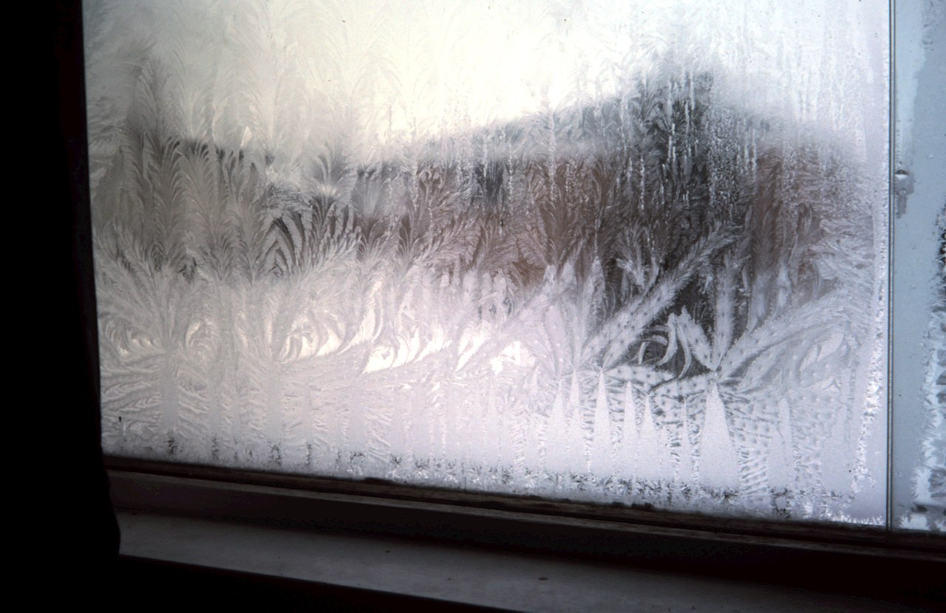

Slide 47
Effects on Plants
Many plants can be damaged or killed by freezing temperatures or frost.
This varies with the type of plant, the tissue exposed, and how low temperatures get; a "light frost" of −2 to 0 °C damages fewer types of plants than a "hard frost" below −2 °C.
Plants likely to be damaged even by a light frost are: Beans, Grapes, Squashes, Melons, Tomatoes, Eggplants, and Peppers.
Plants that may tolerate (or even benefit from) frosts include:
Root vegetables (Beets, Carrots, Onions)
Leafy greens (Lettuces, Spinach, Cucumber)
Cruciferous Vegetables (Cabbages, Cauliflower, Broccoli, Radishes)
These frost tolerate crops may be damaged once temperatures drop below −4°C

Slide 48
FOG

Slide 49
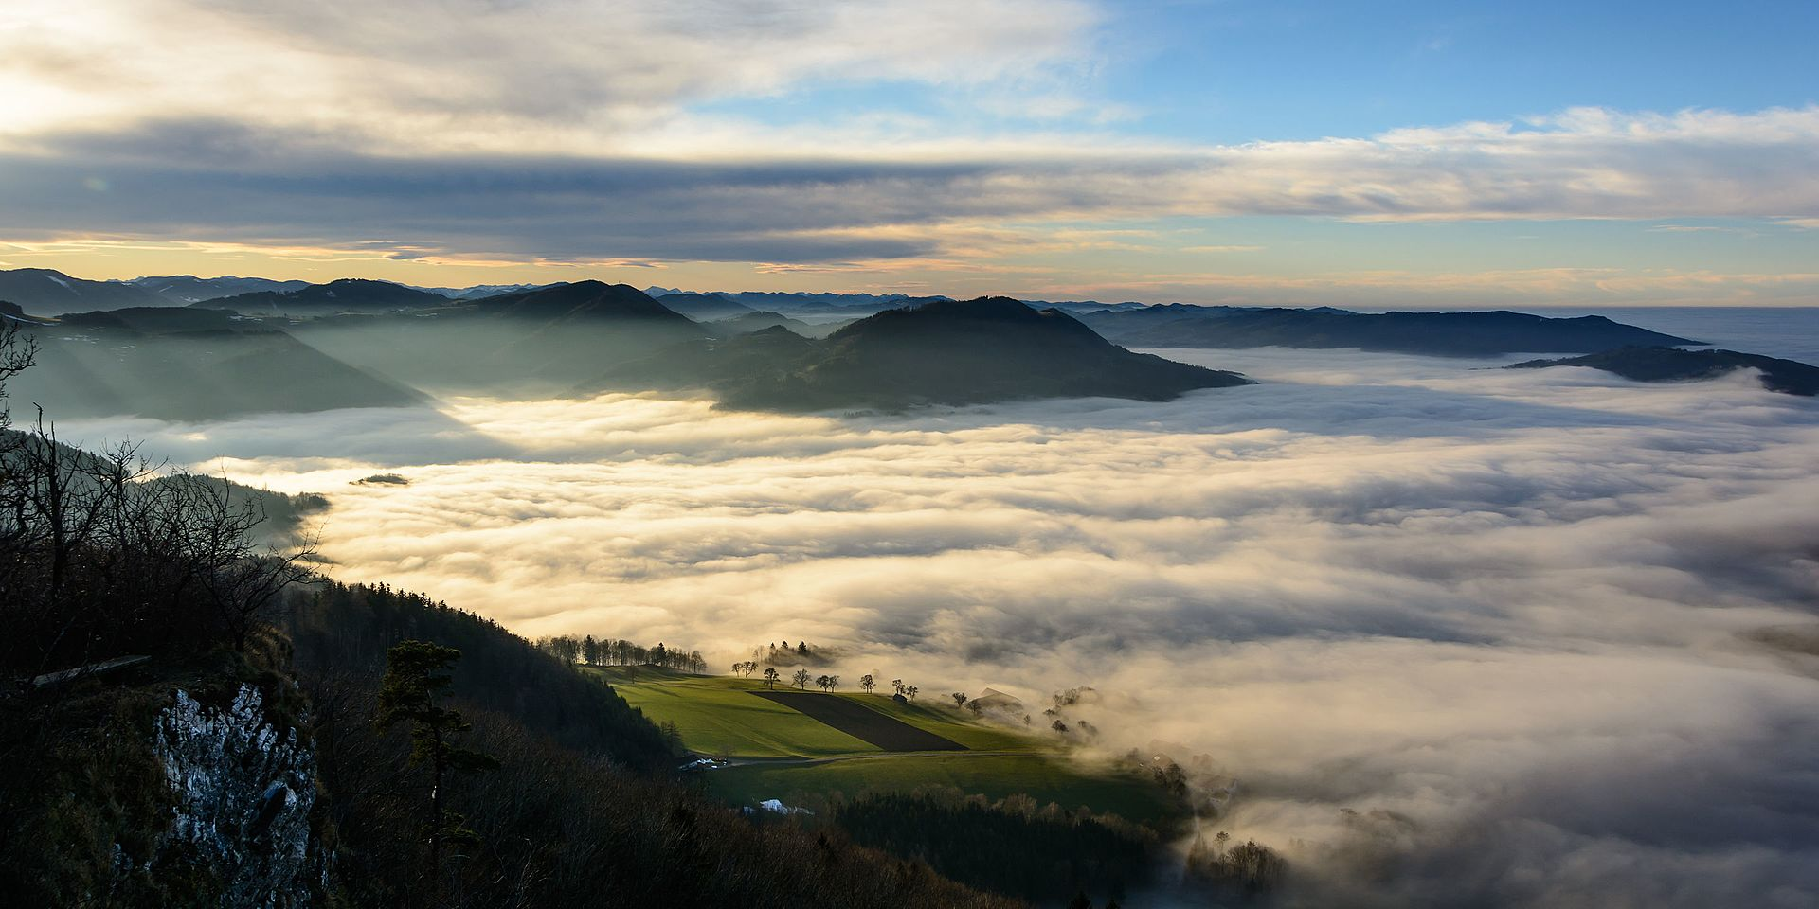
Fog is a visible aerosol consisting of tiny water droplets or ice crystals suspended in the air at or near the Earth’s surface.
Fog can be considered a type of low-lying cloud usually resembling stratus and is heavily influenced by nearby bodies of water, topography and wind conditions.
In turn, fog affects many human activities, such as shipping, travel and warfare.
The term fog is typically distinguished from the more generic term cloud in that fog is low-lying, and the moisture in the fog is often generated locally
fog reduces visibility to less than 1 km., whereas mist causes lesser impairment of visibility.

Slide 50
Formation of Fog
Fog forms when the difference between air temp. and dew point is less than 2.5.
Addition of water vapor by wind convergence into areas of upward wind motion.
Intense precipitation.
Evaporation from the surface of oceans/ water bodies/ wet land due to daytime heating.
Cool or dry air moving over warmer water.lifting air over mountains
When, at 100% RH, the minute water droplets begin to coalesce into larger droplets, fog produces precipitation in the form of drizzle or very light snow, This can occur when the fog layer is lifted and cooled sufficiently, or when it is forcibly compressed from above by descending air.
The thickness of a fog layer is largely determined by the height of the inversion boundary, which in oceanic locales is also the top of the marine layer, above which the air mass is warmer and drier.

Slide 51
Fog is classified according to the way it is produced.
A. Fogs resulting from evaporation.
Steam fog is the fog that is produced by intense evaporation of water into relatively cold air. Saturation occurs, then condensation, then fog. Steam fog is observed over water bodies in mid- and high latitudes. Sometimes it occurs over warm, wet land immediately after a rain.
Frontal fog is the fog found along the boundary of two air masses. Evaporation from warm rain falling through the drier air below may be followed by saturation and condensation in cooler layers to form frontal fog.

Slide 52
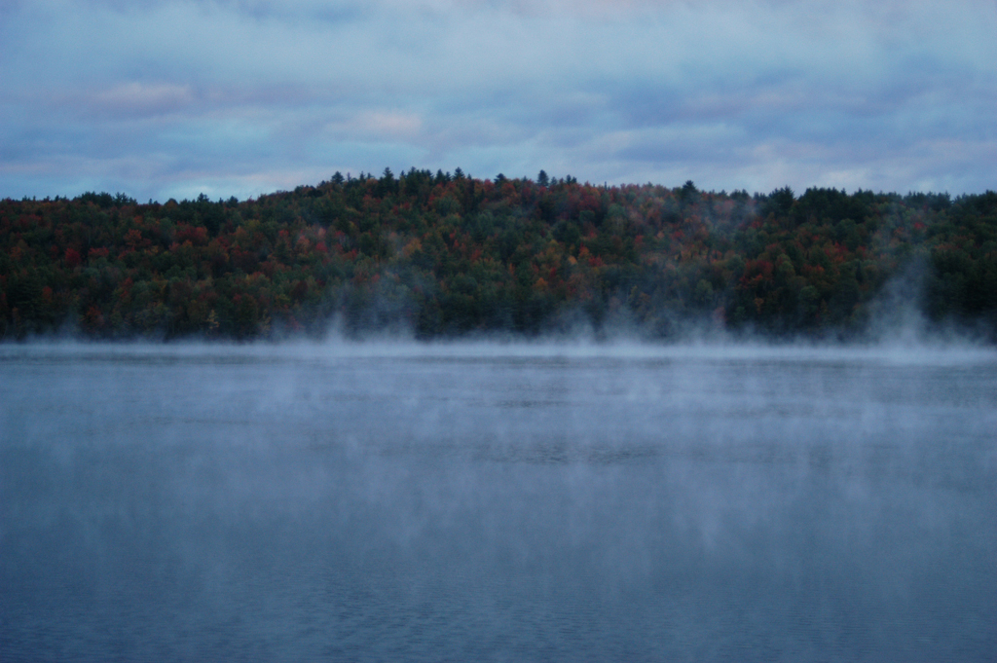
Steam Fog
Frontal Fog

Slide 53
B. Fogs resulting from cooling.
Radiation Fog is produced when fairly calm moist air, which is in contact with the ground, is cooled to saturation and then condensation by night time reradiation. If air is completely calm only dew or frost will form. Slight turbulence increases the depth of the fog, but if it is violent enough it will prevent or dissipate the fog.
Valleys are particularly susceptible to radiation fog or frost. In polar regions fogs are composed of ice crystals and are called ice fog.
The process of formation of fog by radiation is called a diabatic process. The cooling occurs by taking heat energy away from the air

Slide 54
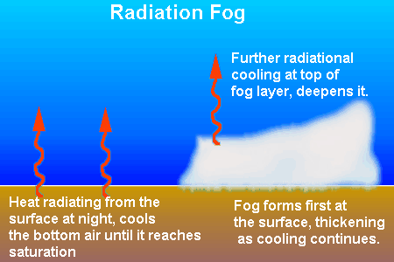
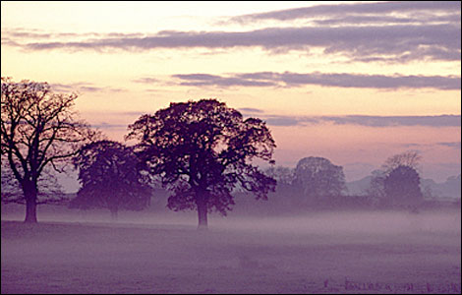

Slide 55
b) Advection fog is formed when moist air is transported over a cold surface. The cold surface causes the air in contact with it to cool. Cooling causes the air close to the surface to also become saturated, and the motion of the air causes a mixing of the air and causes the condensation to occur at higher levels above the surface until the fog covers the entire area.
Advection fog is especially common at sea. Winds blowing onshore tend to carry the fog inland.
The fog also occurs over land when warm moist air is transported over snowy surfaces.

Slide 56
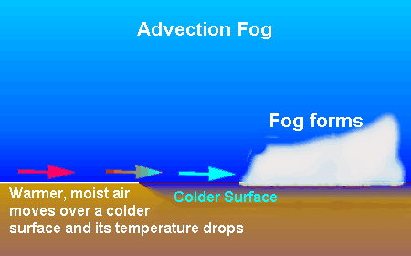

Slide 57
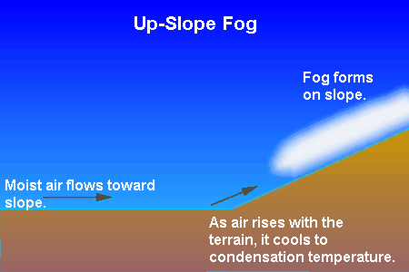
c) Upslope fog is forms when there is a gradual orographic ascension of moist air up a sloping plain or hilly region. The moist air will cool adiabatically to form upslope fog providing the air is already close to saturation.

Slide 58
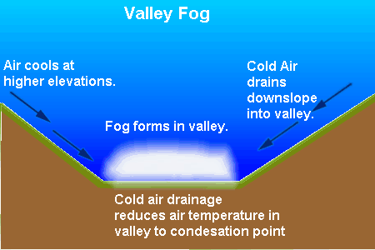
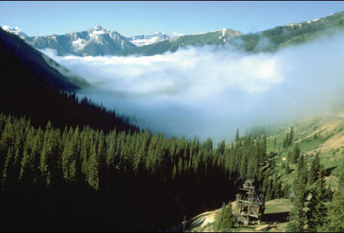

Slide 59
d) Mixing fog occurs when warm moist air comes in contact with cool moist air. The mixture may have a temperature low enough to produce saturation and condensation, producing the mixing fog.
Mixing fog occurs at fronts between air masses of maritime origin. This process doesn’t last long because the mixed air mixes with even more drier air until the air is no longer saturated and the water droplets from your breath quickly evaporate.

Slide 60
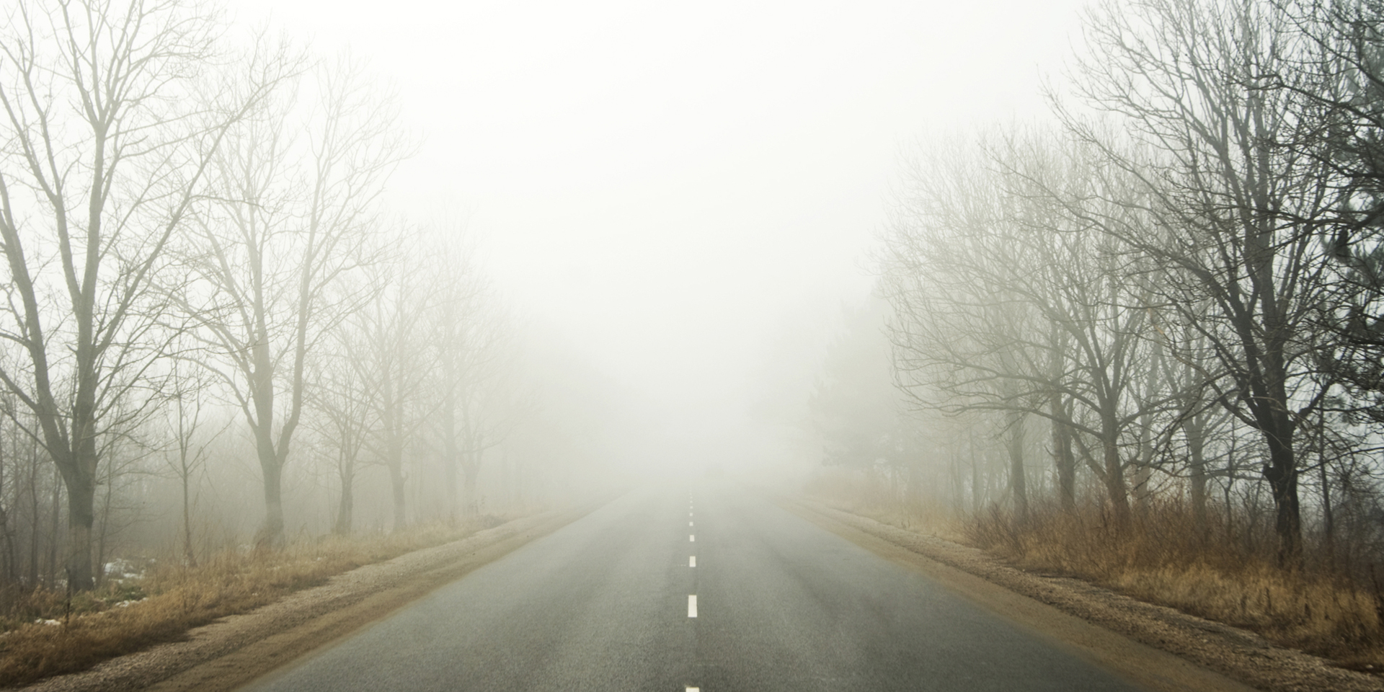
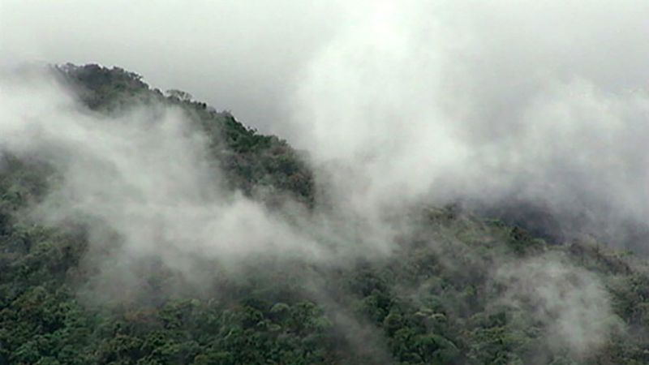
Mixing Fog

Slide 61
MIST

Slide 62
Mist is a phenomenon caused by the formation of tiny droplets of water due to condensation and suspended in the cold air.
Physically, it is an example of a dispersion.
It is most commonly seen where water vapor in warm, moist air meets sudden cooling, such as in exhaled air in the winter.
It occurs, when humid air cools rapidly, notably when the air comes into contact with surfaces that are much cooler than the air (e.g. mountains).
Mist is commonly confused with fog. Fog is denser, more opaque, and generally lasts a longer time, while mist is thinner and more transparent.
The phenomenon is called fog if the visibility is 1 km or less.

Slide 63
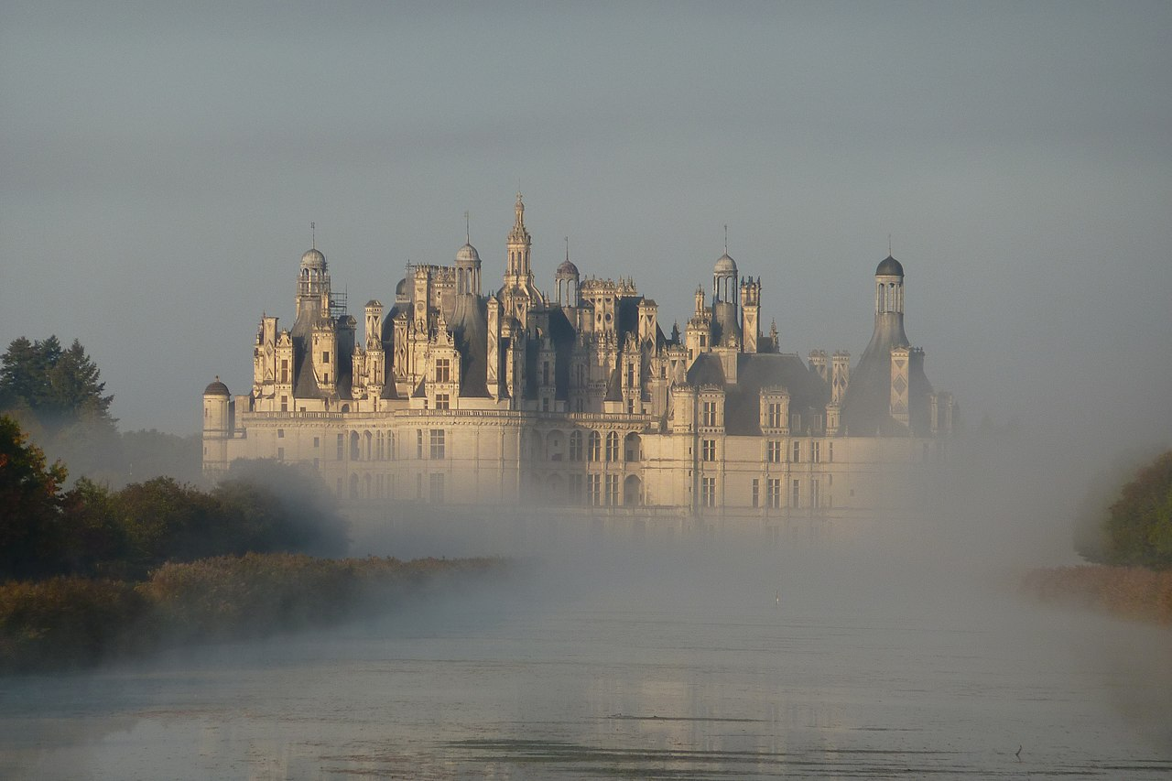
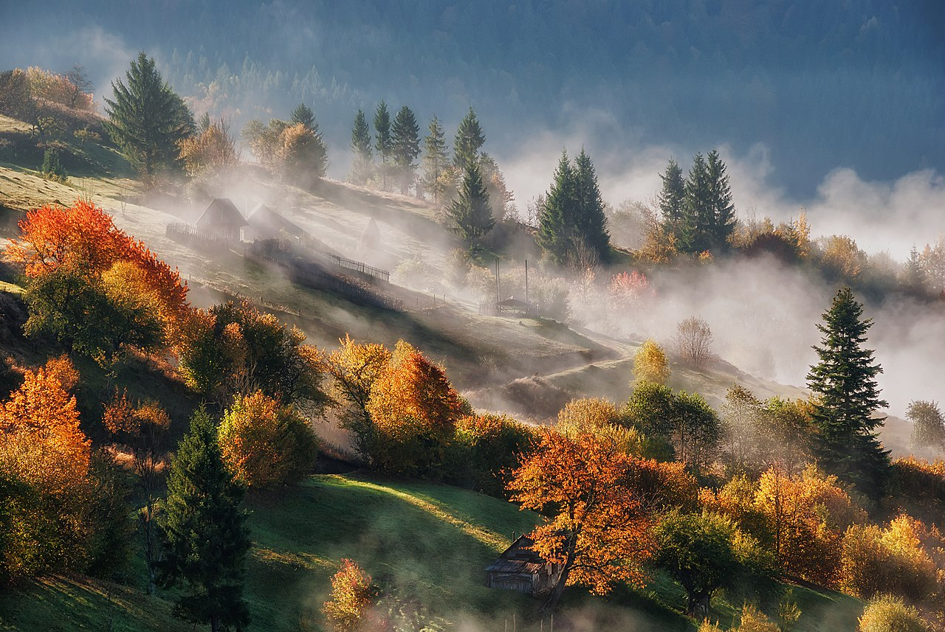
MIST

