Slide 1
COPD: CHRONIC OBSTRUCTIVE PULMONARY DISEASE
COPD- Airflow resistance which is not reversible
COPD includes; chronic bronchitis, chronic bronchiolitis(small airways disease), emphysema: damaged air sac in lungs
COPD associated with impaired weight loss and skeletal muscle dysfunction , obstruction of airway for long time.
Risk factors: tobacco smoking, fulltime smoke, Air pollution, industrial exhaust ,fumes, exposure to cadmium, other kind of respiratory infection
Time available for expiration reduced caused infection & loss of ventilation.

Slide 2
Pathophysiology:
Enlargement of mucus secreting gland
Increased no of goblet cell in larger airways
Loss of elastic tissue in surrounding the smaller airways
Inflammation & fibrosis in airways wall & mucus in airways lumen

Slide 3
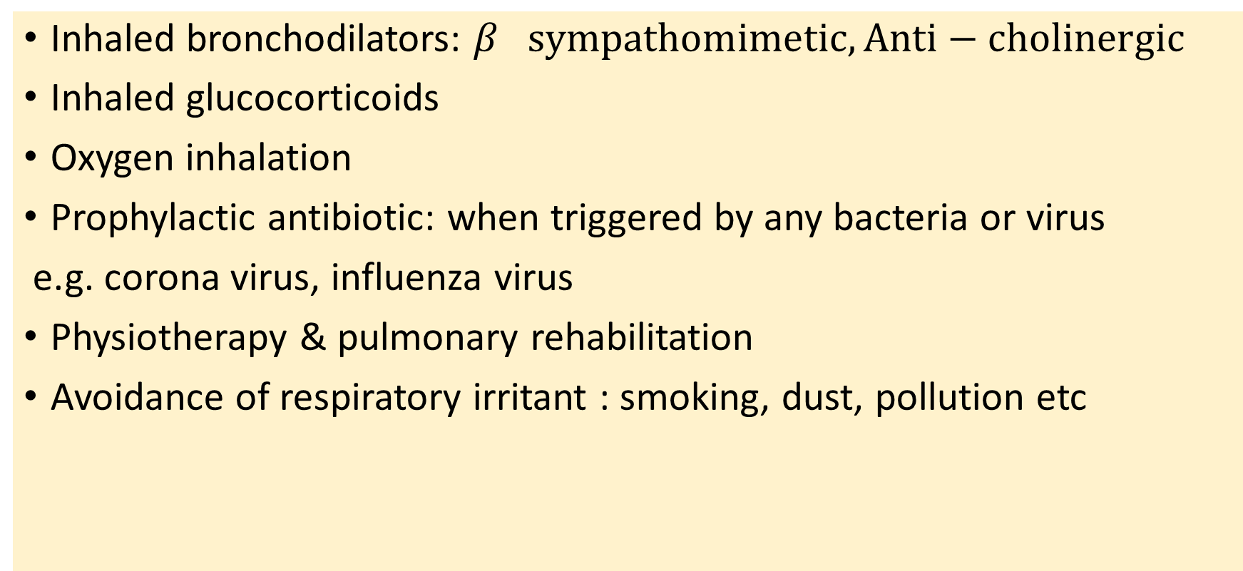
Approaches to treat COPD:
Inhaled bronchodilators: $β sympathomimetic, Anti−cholinergic$
Inhaled glucocorticoids
Oxygen inhalation
Prophylactic antibiotic: when triggered by any bacteria or virus
e.g. corona virus, influenza virus
Physiotherapy & pulmonary rehabilitation
Avoidance of respiratory irritant : smoking, dust, pollution etc

