Slide 2
Contents:
Introduction
Investigational New Drug (IND)
New Drug Application (NDA)
Abbreviated New Drug Application (ANDA)
Investigation of Medicinal Products Dossier (IMPD)
Investigator’s Brochure (IB)

Slide 3
INTRODUCTION:
The non-clinical (or pre-clinical) development phase primarily aims to identify which candidate therapy has the greatest probability of success, assess its safety, and build solid scientific foundations before transition to the clinical development phase.
Also, during the non-clinical development phase, the candidate compound should meet non-medical objectives, including defining the intellectual property rights and making enough medicinal product available for clinical trials. The non-clinical development of a medicine is complex and regulatory-driven.

Slide 4
The studies in non-clinical development are performed:
In silico: ‘performed on computer or via computer simulation’, e.g. predicting the toxicology profile of a product using its chemical structure from data-based approaches.
In vitro (Latin for ‘within the glass’): performing a procedure in a controlled environment outside of a
living organism, e.g. use of hepatocyte (cells from the liver) cultures for metabolism studies.
In vivo (Latin for ’within the living’): experimentation using a whole, living organism as opposed to tissues or
cells, i.e. animals, humans or plants.

Slide 5
Objectives:
Once a candidate compound is identified, the non- clinical development should start answering the following questions, and answers will come from specific assessments/studies:
Does it work? → efficacy assessment
How will it be delivered and how will the body react?
→ profiling
Is it safe? → toxicology/safety
Is the manufacture viable and controllable?
Non-clinical development activities can continue throughout the life-cycle of the product, although the earlier
these questions are answered, the easier it is to identify the profile of the patient who will benefit most.

Slide 6
Non-clinical regulatory guidelines;
There are many players development of medicines, and each
involved
in the organisation or
institution follows their own set of rules. For instance, companies have their Standard Operating Procedures (SOP).
In addition to Good Clinical Practice provisions, guidelines can be consulted at the European Medicines Agency (EMA) website.
They are either general or more specific addressing scientific and technical aspects (e.g. specific to required toxicology studies).
They must be strictly followed for any new
any
marketing authorisation application;
deviation
must be justified.

Slide 7
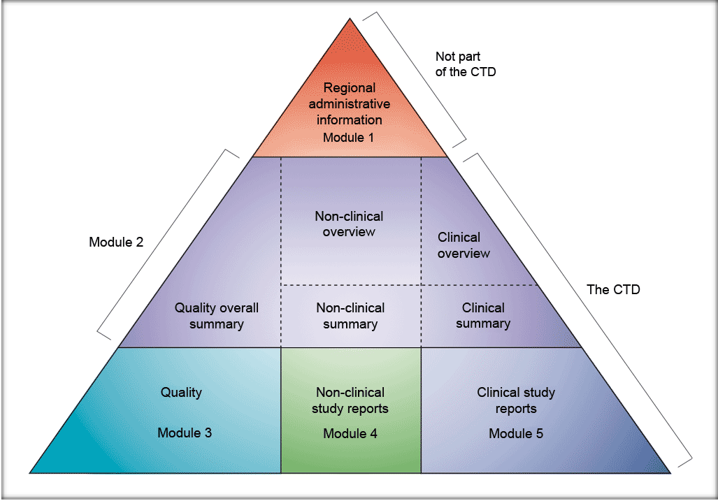
Non-clinical development in CTD modules

Slide 8
INVESTIGATIONAL NEW DRUG (IND)
Investigational New Drug is defined under 21 CFR 312.3(b)
as ‘ a new drug or biological drug that is used in clinical
investigation’.
The term also includes a biological product used in-vitro for
diagnostic purposes.
After pre-clinical investigations when the new molecule has been screened for pharmacological activity and acute toxicity potential in animals the sponsor requires permission from FDA for its clinical trials in humans.

Slide 9
The sponsor submits the application for conduct of human clinical trials called Investigational New Drug (IND) application to FDA or DCGI .
Once IND application is submitted , the sponsor must wait
for 30 days before initiating any clinical trial.
Clinical trials in humans can begin only after IND is reviewed by the FDA and a local institutional review board (IRB).
IRBs approve clinical trial protocol, informed consent of all
participants and appropriate steps to prevent subjects from
harm.

Slide 10
TYPES OF INDs
COMMERCIAL INDs
These are applications that are submitted primarily by the
companies to obtain marketing approval for a new product.
NONCOMMERCIAL (Research)INDs
These INDs are filed for noncommercial research.
These are :
1) Investigator’s IND- It is submitted by a physician who
both initiates and conducts an investigation and who also administers and dispenses the IP. A physician might submit a research IND to propose studying an unapproved drug or an approved drug for new indications or in new patient population.

Slide 11
Emergency Use IND
This IND allows FDA to allow the use of an experimental drug in an emergency situation that does not allow submission of an IND in accordance with 21 CFR Sec312.23 or Sec 312.34.
It can also be used for patients who do not meet the criteria of an existing study protocol or if an approved study protocol does not exist.
Treatment IND- Also called Expanded Access IND
This IND may be submitted for experimental drugs
showing promise in clinical testing of serious and immediately life threatening conditions while the final clinical work is conducted and the FDA review takes place (21 CFR 312.34).

Slide 12
Criteria for IND application
A new indication
Change in the approved route of administration or dosage level.
Change in the approved patient population (vulnerable
subjects e.g. pediatrics, elderly, HIV +ve, immunocompromised)
Significant change in the promotion of an approved Drug.

Slide 13
IND PROCESS IN INDIA

Slide 14
NEW DRUG APPLICATION (NDA)
The New Drug Application is the vehicle through which
the drug sponsors formally propose FDA or DCGI to approve a new investigational drug for sale and marketing after Phase IIIA Pivot trials.
The official definition of New Drug is in Sec 201(p) of Federal Drug, Food and Cosmetics Act as;
Any new drug , the composition of which is such that it is not recognized among experts qualified by scientific training as safe and effective for use under prescribed, recommended or suggested conditions.

Slide 15
Any drug the composition of which is such that it as a result of investigations to determine safety and efficacy for use has become recognized, but which has not, otherwise in such investigations been used to a material extent.
The following letter codes describe the review priority of the drug;
S-Standard review: For drugs similar to currently
available drugs
P-Priority review: For drugs that represent significant advances over existing treatments.

Slide 16
Classification of drugs in NDA
Center of drug evaluation and Research(CDER) classifies new drug applications according to the type of drug being submitted and its intended use:
New molecular entity
New salt of previously approved drug
New formulation of previously approved drug
New combination of two or more drugs
Already marketed drug product- Duplication (i.e., new manufacturer)
New indication (claim) for already marketed drug (includes switching marketing status from prescription to OTC)
Already marketed drug product ( no previous
approved NDA) S

Slide 17
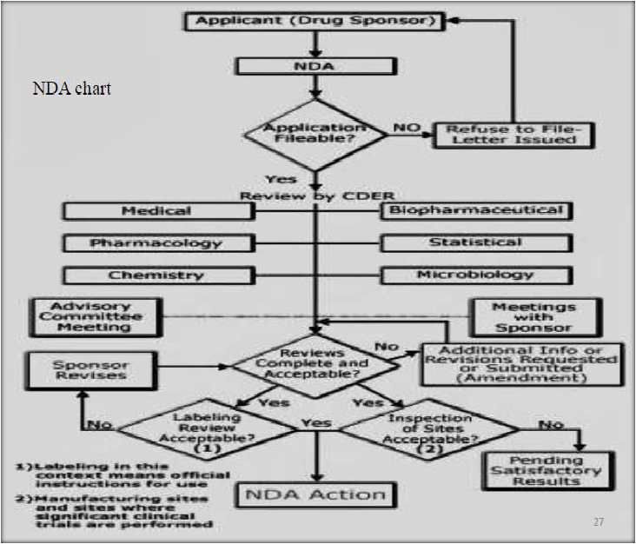
PROCESS OF NDA

Slide 18
ABBREVIATED NEW DRUG APPLICATION (ANDA)
. Generic drug applications are referred to Abbreviated New Drug Application.
Pharmaceutical companies must admit ANDAs and receive FDA’s approval before marketing new generic drugs according to 21CFR 314.105(d).
Once ANDA is approved, an applicant can manufacture and market generic drug to provide safe, effective and low cost alternative of innovator drug product to the public.
Generic drugs are termed ‘abbreviated’ as they are not required
to include preclinical and clinical data to establish safety and efficacy. They must scientifically demonstrate Bioequivalence to Innovator (brand name) drug.

Slide 19
A generic drug is comparable to Innovator drug I dosage
form, strength, route of administration, quality, performance and intended use.
One of the ways to demonstrate bioequivalence is to measure the time taken by generic drug to reach bloodstream in 24-36 healthy voluanteers. The time and amount of active ingredientsa in the bloodstream should be comparable to those of Innovator drug.
Use of bioequivalence as base for approving generic drug products
was established in 1984, also known as WAXMAN-HATCH ACT. It is because of this act that generic drugs are cheaper without conducting costly and duplicative clinical trials.

Slide 20
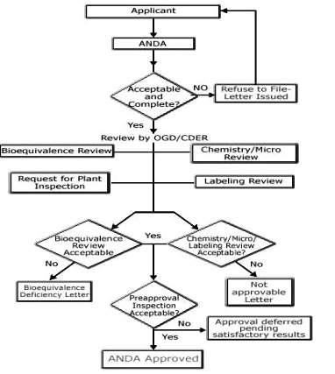
PROCESS OF ANDA

Slide 21
INVESTIGATION OF MEDICINAL PRODUCTS DOSSIER (IMPD)
The IMPD is the basis for approval of clinical trials by the competent in the EU.
The Clinical Trial Directive came in force harmonizing the laws,
regulations and administrative provisions of the Member states relating to the implementation of GCP in the conduct of clinical
trials on medicinal products for human use.
The directive introduced a harmonized procedure for the authorization to perform a clinical study in any one of the EU Member States.

Slide 22
In addition, it defines the documentation to the documentation to be submitted to the Ethics Committee as well as the IMPD to be submitted to the competent authority for approval.
Dossier;
A collection of documents about a particular person, event or subject.
E.g. Patient’s medical record
Medicinal product dossier;
File containing detailed records about a particular drug
product.

Slide 23
Objectives:
Since clinical trials will often be designed as multi center studies, potentially involving different Member States, it is the aim of this guideline to define harmonized requirements of the documentation to be submitted throughout the European Country.

Slide 24
INVESTIGATOR'S BROCHURE
The Investigator's Brochure (IB) is a compilation of the clinical and nonclinical data on the investigational product(s) that are relevant to the study of the product(s) in human subjects.
Purpose:
Its purpose is to provide Information to the Investigators and others involved in the trial such as the dose, dose frequency/interval, methods of administration, and safety monitoring procedure.
The IB also provides insight to support the clinical management of the study subject during the course of the clinical trial.

Slide 25
The information should be presented in a concise and simple
manner.
IB enables a clinician or potential investigator, to understand
it and make his/her own unbiased risk benefit assessment of the appropriateness of the proposed trial. For this reason, a medically qualified person should generally participate in the editing of an IB.

Slide 26
General Considerations:
Title Page
Sponsor name
The identity of each investigational product (i.e., research number, chemical or approved generic name, and
trade name(s) where legally permissible and desired by the
sponsor).
The release date.
Confidential statement

Slide 27
Confidentiality Statement
The sponsor may wish to include a statement instructing the investigator/recipients to treat the IB as a confidential document for the sole information and use of the investigator's team and the IRB/IEC.
The investigator brochure should include:
1.Table of Contents 2.Summary 3.Introduction 4.Description of IB 5.Nonclinical Studies
Effects in Humans
Summary of Data and Guidance for the Investigator.

