Slide 1
History of Drug Safety - I
2
1848 – 15 year old Hannah Greener died in course of routine anaesthesia with chloroform (problem: ingrown nail of toe; fibrillation of ventricles?).
1893 - Lancet initiated foundation of a commission and starting collection of notifications about side effects
1906 - US Federal Food and Drug Act - required, that the pharmaceuticals should be “pure” and “free of any contamination” (nothing about the efficacy)
1936 - USA-s 107 lethal cases after sulphanilamides (diethylene glycol was used to solubilize);
1938 - Food, Drug, and Cosmetic Act, 1938. Firms had to prove to FDA that any new drug was safe before it could be marketed: the birth of the new drug application.
Katalyst Healthcares & Life Sciences
12/10.16

Slide 2
History of Drug Safety - II
3
1961 - Dr William McBride (Australia) reported 20% increase in foetal abnormalities and phocomelia in relation with thalidomide use, later numerous reports from other countries (more than 4000 cases)
1962 - USA Kefauver-Harris amendment to the law (requirement to prove safety and efficacy before issuing MA)
1963 - resolution WHA 16.36 reaffirmed the need for early action in regard to adverse drug reactions
1964 - UK started “yellow cards” system
1965 - European Union issued EC Directive 65/65 - first European pharmaceutical directive. The directive was a reaction to the Thalidomide tragedy in the early 1960s, and aimed to establish and maintain a high level of protection for public health in Europe.
1968 - start of WHO Programme for International Drug Monitoring
1990 - ICH - elaboration of intra-regional requirements for safety starts. ICH Safety Guidelines
Katalyst Healthcares & Life Sciences
12/10.16

Slide 3
Are Drugs Safer Today?
4
During 1960-1999 there were 121 safety related withdrawals Worldwide
Market life less than 2 years 31%
Market life less than 5 years 50%
Fung et al. Drug Information Journal, 2001; 35:293-317
During 1972-1994 in 583 new active substances were approved
Of these 59 were withdrawn later
Katalyst Healthcares & Life Sciences
12/10.16

Slide 4
Recent Drug Withdrawals
Drugs withdrawn from market due to Safety Issues
5
Terfenadine (Seldane)
1998
Withdrawn due to risk of cardiac arrhythmias;
Mibefradil (Posicor)
1998
Withdrawn due to dangerous interactions with other drugs
Trovafloxacin (Trovan)
1998-1999
Withdrawn due to risk of liver failure
Troglitazone (Rezulin)
2000
Withdrawn due to risk of hepatotoxicity; superseded by
pioglitazone and rosiglitazone
Cisapride (Propulsid)
2000s
Withdrawn in many countries due to risk of cardiac arrhythmias
Cerivastatin (Baycol, Lipobay)
2001
Withdrawn due to risk of rhabdomyolysis
Rofecoxib (Vioxx)
2004
Withdrawn due to risk of myocardial infarction
Katalyst Healthcares & Life Sciences
12/10.16

Slide 5
Drug Safety
6
No medicine is absolutely safe and all pose some magnitude of safety and health risks
Making sure that medicines are safe for their intended use is an on-going process that starts in the developmental stage & continues long after medicine is in the market.
The process is closely monitored by manufactures and the Regulatory Agencies.
Katalyst Healthcares & Life Sciences
12/10.16

Slide 6
Pharmacovigilance
7
Investigational Products
Marketed Products
Development phase
Post-marketing
Vigilance: Watching carefully in order to avoid danger
Katalyst Healthcares & Life Sciences
12/10.16

Slide 7
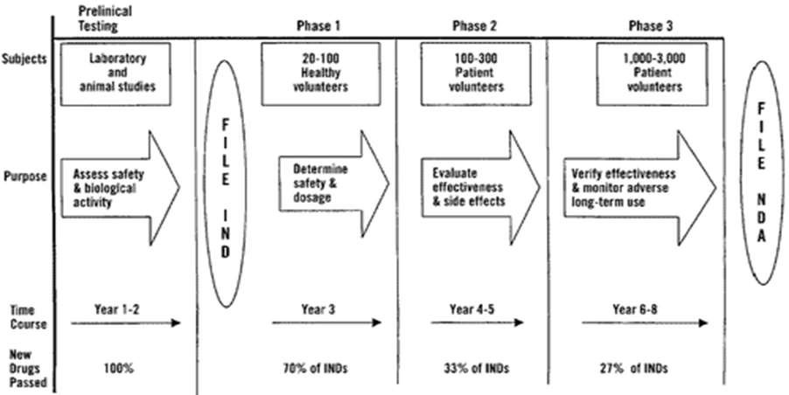
Drug Development
8
Katalyst Healthcares & Life Sciences
12/10.16

Slide 8
What is Pharmacovigilance?
9
Pharmacovigilance is a science and activities relating to the detection, assessment, understanding and prevention of adverse effects or any other possible drug-related problems (e.g. interactions, misuse, medication errors, abuse, overdose, addiction potential).
Katalyst Healthcares & Life Sciences
12/10.16

Slide 9
Drug Safety – some definitions
10
Adverse event/adverse experience (AE)- Any untoward medical occurrence that may occur during treatment with a pharmaceutical product but which does not necessarily have a causal relationship with this treatment
undesirable signs & symptoms
disease or accidents
abnormal lab finding ( leading to dose reduction / discontinuation / intervention )
Side effect - Any unintended effect of a pharmaceutical product occurring at doses normally used in man, which is related to the pharmacological proprieties of the drug
Adverse drug reaction (ADR) - A response to a drug which is noxious and unintended, and which occurs at doses normally used in man for the prophylaxis, diagnosis, or therapy of disease, or for modification of physiological function – causal role is suspected
Katalyst Healthcares & Life Sciences
12/10.16

Slide 10
AE_{AE}s_{s v}V_{ers}e_{us}r_{A}s_{D}u_{Rs}s ADRs
AE
ADR
12/10.16
Katalyst Healthcares & Life Sciences

Slide 11
Drug Safety – some definitions
12
SAE (Serious Adverse Event) - an AE or ADR that is associated with
Death
Life threatening
Results in hospitalization /Prolongs existing hospitalization
Persistent or significant disability or incapacity
Congenital anomaly or birth defect
Medically significant
SUSAR (Serious, unexpected, suspected adverse reaction)
Serious
Not included in Product Core Safety Data Sheet
Suspected link to the drug
Katalyst Healthcares & Life Sciences
12/10.16

Slide 12
Serious vs Severe
13
The term "severe" is often used to describe the intensity (severity) of a specific event (as in mild, moderate, or severe pain); the event itself, however, may be of relatively minor medical significance (such as severe headache).
This is not the same as "serious" which is based on patient/event outcome or action criteria usually associated with events that pose a threat to a patient's life or functioning.
Katalyst Healthcares & Life Sciences
12/10.16

Slide 13
Safety Signal
14
Safety Signal - information on a possible causal relationship between an adverse event and a drug, the relationship being unknown or incompletely documented previously.
Detected / generated during pharmacovigilance
Usually more than a single report is required to generate a signal, depending upon the seriousness of the event and the quality of the information
Katalyst Healthcares & Life Sciences
12/10.16

Slide 14
Drug Safety –
Main sources of information
15
Pre-marketing (During Development)
Pre-clinical (animal / in-vitro) studies
Clinical studies – Phase I – III
Post-marketing
Spontaneous adverse reaction reporting
 national and international
Regulatory authorities
Contractual partners
Published medical literature
Clinical trials - PMS & Phase IV studies, epidemiological studies
Data collected for other purposes
 routine statistics
 special purpose registries
 databases of prescription and outcomes
Katalyst Healthcares & Life Sciences
12/10.16

Slide 15
Limitations of pre-approval clinical 16
trials
Size (maximum 3,000-5,000 subjects)
 Sometimes larger for vaccines
Narrow Population
 Often does not include special groups
(e.g., children, elderly)
Narrow indications not covering actual evolving uses in practice
Short Duration (1-3 years)
 Latent effects not directly measured
Katalyst Healthcares & Life Sciences
12/10.16

Slide 16
No. of patients required to be 95% certain of detecting 1, 2 or 3 ADRs
Incidence of ADR | No. of patients required
 | One Case | Two Cases | Three Cases
1 in 100 | 300 | 480 | 650
1 in 1,000 | 3,000 | 4,800 | 6,500
1 in 2,000 | 6,000 | 9,600 | 13,000
1 in 10,000 | 30,000 | 48,000 | 65,000
12/10.16
Katalyst Healthcares & Life Sciences

Slide 17
Rationale for continued Pharmacovigilance
18
Information obtained prior to first marketing is inadequate to cover all aspects of drug safety:
Tests in animals are insufficiently predictive of human safety,
In clinical trials patients are selected and limited in number,
Conditions of use in trials differ from those in clinical practice,
Duration of trials is limited
Information about rare but serious adverse reactions, chronic toxicity, use in special groups (such as children, the elderly or pregnant women) or drug interactions is often not available.
Katalyst Healthcares & Life Sciences
12/10.16

Slide 18
Why Pharmacovigilance
19
Impact of ADRs
4-6th leading cause of death (Lazarou et al, JAMA; 1998)
Upto 19 % of in-patients will have an ADR (Davies et al, J Clin
Pharm & Ther; 2006);
up to 70 % ADRs are preventable (Pirmohamed et al, BMJ; 2006.
The cost factor
588 million $ / year in Germany (1997),
> $ 177.4 billion in the US in 2000,
$847m / year in the UK (2006, BMJ)

Slide 19
Classification of ADRs
20
Type A
Type B
Type C
Type D

Slide 20
Type A
21
Augmented reactions - pharmacologically predictable from the known activity of the drug, and are usually discovered during early research.
They are common, dose related, but are usually benign with a low mortality and morbidity.

Slide 21
Type B
22
Bizarre reactions which are unpredictable and are rare, often at rates of less than 1:1000 patients per annum.
are usually dose-independent
have a high morbidity or mortality.
Eg Agranulocytosis with Clozapine, Anaphylaxis with Penicillins

Slide 22
Type C
23
Type C or chemical reactions are those reactions whose biological characteristics can be either rationalized or even predicted based on the chemical structure of the parent drug, or of reactive intermediates and metabolites.
Example: hepatotoxicity caused by high doses of acetaminophen

Slide 23
Type D
24
Delayed effects
E.g. the development of vaginal cancer of the offspring where the mothers had received the drug Diethylstilbestrol during pregnancy between 1938 &
1971

Slide 24
Pharmacovigilance Aims
25
Early detection of unknown safety problems
Detection of increases in frequency
Identification of risk factors
Quantifying risks
Preventing patients from being affected unnecessarily
Rational and Safe use of Medicines Combined responsibility of Industry & Regulators

Slide 25
Pharmacovigilance
26
MAH*Responsibilities
Timely collection of data, recording and notification (reporting) – PV systems & processes, safety database
Appropriate assessments (data completeness, seriousness, relatedness, expectedness, medical significance, reporting requirements & timelines)
Expedited and periodic reporting to RA
Signal detection & proactive risk management
* Marketing Authorization Holder

Slide 26
Assessing Adverse Reactions
27
Nature, organ/system involved, severity, duration
Serious / not serious
Causality – relationship to the drug (definite, probable, possible, unlikely)
Expected / unexpected (as per known safety profile of the
drug)
Medical significance (significant / not significant)

Slide 27
Regulatory Reporting of Adverse
28
Reactions
Why Report?
Ethical requirement
Regulatory requirement
Legal requirement
Who Reports?
Company (post marketing),
Company & investigator joint responsibility (clinical trials)
When to Report?
Expedited – 7 to 15 days
Periodic – depending on when launched / region

Slide 28
Reporting Adverse Reactions
29
What to report?
Patient details: Pt. identifier, initials, sex, age etc
Suspected drug: generic name, indication, dates of admin., dose, starting & stopping date and time
Other treatments
Details of suspected ADR – nature, severity, duration, relationship to drug, action
taken
Outcome
Details about the reporter/ investigator
Formats for reporting
Expedited reports – ICSR, MedWatch 3500A, CIOMS I & II
Periodic reports – annual safety reports, PSUR, NDA PADER

Slide 29
Minimum Data for a Reportable ADR
30
Identifiable patient
AE/ADR
Suspected Medicinal Product
Reporter (HCP)

Slide 30
PV Regulations
31
Main Players – EMEA (EU), US FDA, MHRA (UK),
TGA (Australia), Japan
Slightly different regulations, based on ICH guidelines

Slide 31
EU Requirements
32
Applicable Regulations / Guidelines:
Pre-authorization - Clinical Trials Directive 2001/20/EC
Post-marketing - Volume 9A Eudralax
ICH guidelines - E2A (pre-approval safety data management); E2D (post-approval safety
data); ICH E2B (electronic reporting); ICH E2C (PSURs)
Expedited Reporting to RA
Timelines - 7 days for Fatal or Life threatening events; 15 days for other SUSARs
Mandatory e-reporting of Individual Case Safety Reports (ICSR) in pre & post-authorization phase
Regulatory-compliant ADR database
QPPV
Main contact for the RA on pharmacovigilance issues
Residing in the EU region with access to medically qualified safety expert
PSURs
Pre- authorization : EU Annual Safety Reports (ASR)
6 monthly for 1st two years after authorization ; Yearly for next 2 years ; 3 yearly thereafter
Signal generation & ongoing communication with RA
Risk Management Plan

Slide 32
US Requirements
33
Applicable Regulations / Guidelines
21 CFR parts 310, 312, 314, 320, 600, 601, 606
FDA Guidance for Industry on Good Pharmacovigilance Practices and Pharmacoepidemiologic Assessment – March 2005
ICH guidelines - E2A (pre-approval safety data management); E2D (post-approval safety
data); ICH E2B (electronic reporting); ICH E2C (PSURs)
Timelines – 7 days for Fatal or Life threatening events; 15 days for other SUSARs
Electronic reporting possible but not mandatory
21 CFR Part 11 compliant safety database
Expedited Reporting to RA
Safety Reports - NDA PADERs (post approval), ASRs (pre-approval)
Quarterly for first 3 years after approval, yearly thereafter in NDA PR format
PSURs in ICH format accepted on agreement with FDA
Annual Safety Reports (pre-approval) - yearly
Signal generation, ongoing communication with RA
◆ RiskMAPs – Risk Minimization Action Plans (REMS)
Katalyst Healthcares & Life Sciences

Slide 33
Clinical Trial Safety Monitoring
34
Adverse Event experienced by Patient
Medical eva
AE noted
Data Capture & Entry (Receive SAE & assign Unique ID No / Data entry in ADR Database) (Company / CRO)
Medical Evaluation & Reporting Assessment
Preparing rep
Reporting to Reg Authority within prescribed timelines, if reportable (Com / CRO) Reporting to IRB & DSMB Reporting to other investigators
Data Mining, Safety Signal & Report Writing - Annual Safety Reports (Com / CRO)
Katalyst Healthcares & Life Sciences
12/10.16

Slide 34
35
Katalyst Healthcares & Life Sciences
12/10.16

Slide 35
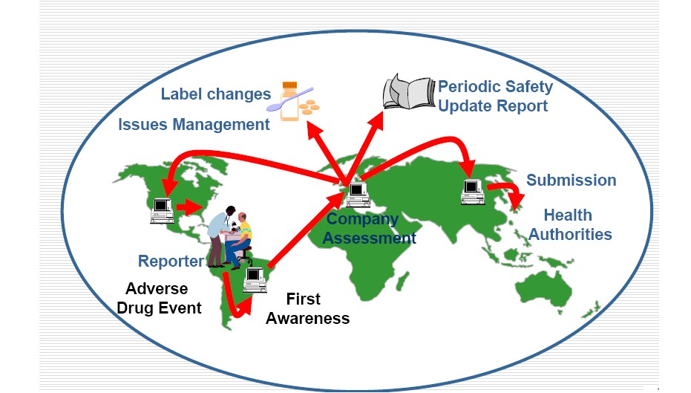
Drug Safety Post Marketing
36
Katalyst Healthcares & Life Sciences
12/10.16

Slide 36
Safety Reports & Documents
37
Individual Case Safety Reports (ICSR)
Paper or electronic
MedWatch 3500 / CIOMS forms
Patient safety narratives (individual reporting / incl in CSR)
Periodic / Aggregate Safety Reports
Annual safety reports, DSURs (EU) – pre-marketing
IND Annual Safety Reports (US) – per-marketing
Periodic Safety Update Reports - PSUR (EU) – post-marketing
NDA PADER (US) – post-marketing
Canadian Annual Report (CAR)
Integrated safety summary (US) – for NDA
Safety overview (EU) – for NDA
Risk Management Plan (EU)
RiskMAP or REMS (US)
12/10.16
Katalyst Healthcares & Life Sciences

Slide 37
Drug Safety Requirements
38
Understanding of global requirements & regulations
Workflow management SOPs for collection of ADRs, collation,
assessment, reporting , risk management
Validated database e.g. Arisg, Argus, Oracle AERS
Data / documents management systems, storage, security
Data back-up & disaster management
People
Drug Safety Associates - Medical (allopathic or integrated
alternative system BAMS, BHMS) or Life Sciences graduates
Drug Safety Physicians – Medical graduates / post-graduates with
experience in safety assessment
Medical / Safety Writers
Drug safety expert –experienced drug safety physician

