Slide 1
Drug safety evaluation in
clinical trial

Slide 2
Overview
²  Introduction
 Safety concerns
 Source of safety information & safety evaluation
 Safety monitoring
 IND safety reporting requirements
 Causality assessment
 Postmarketing safety & reporting
 Improving risk assessment & safety
 Conclusion

Slide 3
INTRODUCTION
3
 All medicinal products carry risks in addition to their possible
benefits
 For developing a new medicine, a decision can only be made if both benefits & risks are addressed
 Risk associated with the drug is minimized when medicines of good quality, safety & efficacy are used rationally by an informed health professional & by patients
 Pharmacovigilance helps in reducing the risk of harm by ensuring use of good quality medicines appropriately

Slide 4
Introduction…
4
 Need of international efforts to address drug safety were realized & initiated in 1961, following the Thalidomide disaster
 Guidelines were developed to monitor drugs, foods & environmental contaminants for adverse reactions & toxicity
 In beginning, guidelines were restricted to local needs. Globalization - recognized need of a system, accepted internationally, to ensure safety of medicinal products

Slide 5
Introduction…
⁵  New drugs: marketed on basis of comparatively limited information, as clinical trials are designed to answer specific questions
 In US, ~ 500 to 2000 patients receive a new drug during clinical trials, & only a few hundred of them are treated
> 3-6 months
 In clinical trials, critical efficacy endpoints are identified in advance & sample sizes are estimated for assessment of effectiveness
 Common AEs are generally identified & well characterized in prospective trials

Slide 6
Introduction…
⁶  Infrequent or delayed AEs: characterized depending on their severity & importance to risk-benefit assessment & require special techniques (e.g., case control studies, cohort studies)
 Isolated reports: definitive in associating a drug with an AEs, if drug administration & event are temporally related, de-challenge or re- challenge
 In contrast, with few exceptions, phase 2-3 trials are not designed to test specified hypotheses about safety nor to measure or identify AEs with any pre-specified level of sensitivity
 Exceptions occur when a particular concern related to drug or drug class has arisen & when there is a specific safety advantage being studied

Slide 7
Introduction…
7
 Safety evaluation during clinical drug development is not expected to characterize all the AEs, for example, those occurring in < 1 in 1000 patients
 Risks that may be missed include
rare events
events occurring after long-term use
events occurring in special populations
events occurring in association with specific diseases &
events occurring in association with concomitant therapy

Slide 8
Safety Concerns
8
 Available data depend on the stage of development
 Safety information on approved products is reflected in product labelling (Package Insert)
 Up-to-date safety information on the products under
investigation is found in Investigator’s Brochure (IB)
In vitro testing, Nonclinical pharmacology/toxicology studies
Clinical safety & pharmacokinetic data, if available
For products under investigation, IB is equivalent to Package Insert

Slide 9
Safety Concerns…
9
 Pharmacology of drug or pharmacologically related drugs can be useful in identification & exploration of major safety concerns
E.g., clearance pathway of a drug can be indicative of certain potential drug-drug interactions or certain effects of ↓ renal or hepatic function
 Similarly, pharmacologic class, & prior experience, could lead to focus on particular laboratory or clinical abnormalities
E.g., muscle or liver abnormalities: HMGCoA reductase inhibitors,
sexual dysfunction: SSRIs &
GI, renal & cardiovascular effects: NSAIDs

Slide 10
Safety Concerns…
10
 Systematic reviews & meta-analyses of clinical trials have recently raised concerns about ↑ in risk of
serious adverse outcomes (ischemia & arrhythmia): varenicline
Mortality: tiotropium inhaler,
 Similarly, ↑ risks of MI: rosiglitazone &
CHF & fractures: thiazolidinediones (rosiglitazone & pioglitazone) in clinical trials have resulted in regulatory warnings

Slide 11
Sources of safety information & Safety
evaluation
 Various sources of information are -
Spontaneous ADR reporting schemes,
Clinical & epidemiological studies,
Worldwide published medical literature,
Pharmaceutical companies,
Worldwide regulatory authorities,
Morbidity & mortality databases,
Nonclinical data (in vitro, animals),
Post marketing experience &
Safety profile of other drugs in the same class
11

Slide 12
Sources of safety information & Safety evaluation…
12
 Nonclinical information
Chemical structure/Drug class
– Class toxicities
In-vitro toxicity evaluation
Genotoxicity
Cardiac repolarization
Pharmacology-Toxicology studies in animals
Organ specific toxicities
Carcinogenicity
Teratogenicity

Slide 13
Sources of safety information & Safety evaluation…
13
 Information from all of these sources is carefully screened & may
identify unexpected SEs;
indicate that certain SEs occur more commonly than previously believed, or
that some patients are more susceptible to some effects than others
 Such findings can lead to changes in marketing authorisation of
medicine –
restrictions in use,
changes in specified dose of the medicine &
introduction of specific warnings of SEs in product information

Slide 14
Sources of safety information & Safety evaluation…
14
 As new information related to a marketed drug becomes available, regulatory agencies - review the data & evaluates any potential drug safety concern
 If potential drug safety concern arises, relevant scientific experts within the agency - prompt review & analysis
 Period of uncertainty - agency evaluates new safety information to determine whether there is an important drug safety issue related to a specific drug or drug class & whether regulatory action is appropriate

Slide 15
Sources of safety information & Safety evaluation…
15
 During this period, agency - actively engaged in gathering
additional safety information
 Sponsors - evaluate new safety information & provide the
results of their analyses to agency during this time
 As additional data relevant to an emerging drug safety issue become available (e.g., data from an ongoing study or data from available clinical databases) - considered in analysis & decision-making process

Slide 16
Sources of safety information & Safety evaluation…
16
 Upon evaluation of additional data, further regulatory action
revision to product labelling or
Risk Minimization Action Plan (RiskMAP), as appropriate
 As agency evaluates a drug safety issue to determine whether regulatory action is warranted - communicate further information to public at appropriate points

Slide 17
Knowing if the subject is fit for the trial
17
 As safety of the subject is of utmost importance, it is necessary to determine whether the subject is fit for the trial or not
 For this, investigation brochure (IB) findings are applied to protocol & a prospective subject
 Fitness of subject is decided based on Inclusion / Exclusion criteria &
by examining the potential for drug accumulation / toxicities
Inclusion / Exclusion criteria – medical history, lab values & concomitant medications used
Examining the potential for drug accumulation / toxicities involves PK parameters, single versus multiple doses & linearity of exposure with dose escalation

Slide 18
Phase 1 / Pharmacokinetic Trials
18
 Absorption, metabolism, C_{max}, AUC, T_{1/2}
in healthy subjects
in patients
 Drug safety profile in dose escalation trials
Healthy volunteers
Safety signals supporting nonclinical findings
New safety signals in humans only

Slide 19
Ascertainment of Adverse Events
19
 By spontaneously reported symptoms or symptoms reported as a result of a probe or both
 Spontaneously reported symptoms have advantage of
detecting more severe episodes,
truly unexpected AEs &
identifying what’s important to the patient
But, may lack standardization (e.g. within & across trials)
 Symptoms reported as a result of a probe (using Checklist &
Questionnaire) allows standardization within & across trials
But, may miss unexpected AEs

Slide 20
Other Safety Assessments/Monitoring
20
 Vital signs
 Laboratory evaluations
CBC
LFTs
CPK
KFTs
Pancreatic enzymes
 Special safety assessments
Visual, Hearing
Neurological exam
ECG

Slide 21
Safety monitoring
21

Slide 22
Adverse Event / Experience
22
 Any untoward medical occurrence associated with the use of
a drug in humans whether or not considered drug related
sign, symptom, or disease
abnormal lab, imaging, ECG, etc
worsening of the above
constellation of the above

Slide 23
AE Severity Grading Scales
23
 Provide general guidance on parameters for monitoring safety in clinical trials
 They are specific to:
Study population
Phase of product development (1-4)
Product evaluated (small molecule, therapeutic biologic, device, vaccine)
 Examples:
NCI (National Cancer Institute)
DAIDS (Division of AIDS)

Slide 24
Serious Adverse Event
24
 An AE or suspected AR is considered “serious” if, it results in the opinion of the Investigator or Sponsor in any of the following outcomes:
death,
a life-threatening AE,
inpatient hospitalization or prolongation of existing hospitalization,
a persistent or significant incapacity or substantial disruption of the ability to conduct normal life functions, or
a congenital anomaly/birth defect, or
requires intervention to prevent permanent impairment or damage

Slide 25
Unexpected Adverse Event
25
 Not listed in the Investigator’s Brochure (IB) or if IB not available or required
 Not listed at the specificity or severity observed
 Mentioned in IB as anticipated due to pharmacokinetic properties of the drug or occurred with other drugs in this class, but not with the study drug
 Not consistent with the risk information described in the general investigational plan or elsewhere in current application, as amended

Slide 26
Other definitions
26
 Adverse drug reaction:
AE that has a causal relationship with the medicinal product
 Suspected adverse reaction:
Any AE for which there is a reasonable possibility that the drug caused the adverse event
 Life-threatening adverse reaction:
An AE or suspected AR is considered “life-threatening” if, in the view of either the investigator or sponsor, its occurrence places the patient or subject at immediate risk of death

Slide 27
Other definitions…
27
 Suspected serious Adverse Reaction (SSAR):
Adverse reaction that is classed in nature as serious & is consistent with information about medicinal product in question
 Suspected unexpected serious Adverse Reaction (SUSAR): Adverse reaction that is classed in nature as serious & is not consistent with information about medicinal product in question
In case of a licensed product, in summary of product characteristics for that product
In case of any other investigational medicinal product, in the
investigator’s Brochure (IB) relating to trial in question

Slide 28
Investigational New Drug (IND)
28
Safety Reporting Requirements
 Unexpected fatal or life-threatening suspected AEs - important safety information & thus, must be reported more rapidly to FDA
 Any unexpected fatal or life-threatening suspected AR – reported in no later than 7 calendar days after the sponsor’s initial receipt of the information
 If the safety report submitted within 7 calendar days is complete, additional submission within 15 days from day zero is not required

Slide 29
Investigational New Drug (IND) Safety Reporting
Requirements…
 Sponsor must also report any findings from
clinical, epidemiological, or
pooled analysis of multiple studies or
29
any findings from animal or in vitro testing: significant risk in humans exposed to drug (e.g., mutagenicity, teratogenicity, carcinogenicity)
 Follow-up IND Safety Report –
If sponsor obtains any relevant additional information – submitted no later than 15 calendar days after the sponsor receives the information

Slide 30
Investigational New Drug (IND) Safety Reporting
Requirements…
30
 IND annual safety report - required of all IND holders & should include –
most frequent & most serious AEs by body system,
list of subjects who died, including cause &
list of subjects who dropped out in association with an AE

Slide 31
Expedited Safety Reporting to FDA by Sponsor
31
 Adverse Events that meet all three criteria are reported to FDA (SUSAR):
Serious (S)
Unexpected (U)
Suspected Adverse Reactions (SAR)
 Fatal or life-threatening SUSAR should be reported to FDA no
later than 7 days
 Others SUSAR should be reported to FDA no later than 15 days

Slide 32
Causality assessment
32
 An inherent problem in pharmacovigilance: most case reports concern suspected ADRs
 Adverse reactions are
rarely specific for the drug,
diagnostic tests are usually absent &
re-challenge is rarely ethically justified
 In practice, few adverse reactions are certain or unlikely; most
are somewhere in between possible & probable

Slide 33
Causality assessment…
33
 Statistical analysis can lead to structured & harmonized assessment
of causality by
decreasing disagreement between assessors,
classifying relationship likelihood,
marking individual case reports &
improvement of scientific evaluation
 It can be particularly useful for evaluation of common AEs
 Causality assessment can be performed simply by
categorizing evidence by the quality of its sources &
evaluating evidence of a causal relationship using standard guidelines

Slide 34
Causality assessment…
34
 Various sources for causality assessment can be
clinical trials,
cohort or case-control studies,
time-series studies &
case-series
 Individual assessment unlikely to help determine attribution for common AEs, i.e. headache, nausea, MI in elderly
 Such AEs require aggregate analyses using a population approach (risk or rate with study drug vs. control)
Placebo or active control
Other doses in multiple dose studies

Slide 35
Causality assessment…
35
 Use of standard guidelines for evaluating the evidence of a
causal relationship may include
temporal relationship,
strength of association,
dose-response relationship,
consideration of alternate explanations,
cessation of exposure,
specificity of the association &
consistency with other knowledge

Slide 36
FDA system of managing risks
36
 FDA approves a product: benefits of using a product outweigh the risks for the intended population & use
 Major goal of premarketing review: ensure that products
are truthfully & adequately labelled for the population & use
 Labelling is given considerable emphasis: chief tool the Agency uses to communicate risk & benefit to the healthcare community & patients
 Once medical products are in the market - ensuring safety is principally the responsibility of healthcare providers & patients, who make risk decisions on an individual basis
Drug safety evaluation in clinical trial - Dr. Vikas S. Sharma

Slide 37
FDA system of managing risks…
³⁷  They are expected to use the labelling information to select & use products wisely, thereby minimizing AEs
 To assist with post marketing risk management, Agency
maintains a system of complex
post marketing surveillance &
risk assessment programs
To identify AEs that are not identified during development & premarketing review
 Agency uses this information to
initiate labelling updates &,
on rare occasions, to re-evaluate the marketing decision
Drug safety evaluation in clinical trial - Dr. Vikas S. Sharma

Slide 38
Postmarketing Safety
38
 Postmarketing surveillance (PMS): practice of monitoring the safety of a pharmaceutical drug or medical device after it has been released in the market
 Since drugs are approved on the basis of clinical trials, which
involve
relatively small numbers of people
who normally do not have other medical conditions which may exist in the general population
 Thus, PMS can further refine, or confirm or deny, the safety of a drug after it is used in the general population, who have a wide variety of medical conditions

Slide 39
Postmarketing Safety…
39
 Approaches to monitor the safety of licensed drugs:
Spontaneous reporting databases,
Prescription event monitoring,
Electronic health records,
Patient registries,
Nonclinical studies,
Observational studies and
Record linkage between health databases
 These data are reviewed to highlight potential safety concerns in a process known as data mining
Drug safety evaluation in clinical trial - Dr. Vikas S. Sharma

Slide 40
Postmarketing Safety…
40
 For post-market safety evaluations, data sources are
Product's preapproval safety profile,
Current FDA-approved label,
Reports made to FDA Adverse Event Reporting System (FAERS),
Reports made to Vaccine Adverse Event Reporting System
(VAERS),
Manufacturer submitted periodic safety update reports (PSURs),
Medical literature,
Drug utilization databases &
Data from post-approval clinical trials & other studies, when applicable

Slide 41
Postmarketing Reports
41
 For ensuring drug safety on long term & on a wider population,
regulatory authorities ask the marketing authorization holders
(MAH) for
Reporting of AEs &
Periodic submission of safety reports
 For serious & unexpected AEs, FDA recommends reports to be submitted within 15 calendar days either foreign or domestic
 Follow up to 15-day alert reports should be submitted within
15 calendar days

Slide 42
Post Marketing Surveillance under Schedule Y
42
 Applicant shall furnish PSURs in order to-
report all relevant new information from appropriate sources;
relate the data to patient exposure;
summarise market authorisation status in different countries & any significant variations related to safety; &
Indicate whether changes shall be made to product information in order to optimize the use of product
 Ordinarily all dosage forms & formulations as well as indications for new drugs should be covered in one PSUR

Slide 43
Post Marketing Surveillance under Schedule Y…
43
 “The applicant shall submit PSUR every six months for the first two years. For subsequent two years, the PSUR shall be submitted annually.”
 PSURs due for a period must be submitted within 30 calendar days of the last day of the reporting period
 If marketing of new drug is delayed by applicant after obtaining approval to market - such data will have to be provided on deferred basis beginning from the time new drug is marketed

Slide 44
Post Marketing Surveillance under Schedule Y…
44
 Data emerging through PSUR or other PMS studies –
basis of further decision about indication / usage / restriction on indication of pharmaceutical product &
further decision on extension of duration of submission of PSUR data beyond 4 years may be taken
 All cases involving serious unexpected ARs must be reported to the licensing authority within 15 days of initial receipt of the information by the applicant

Slide 45
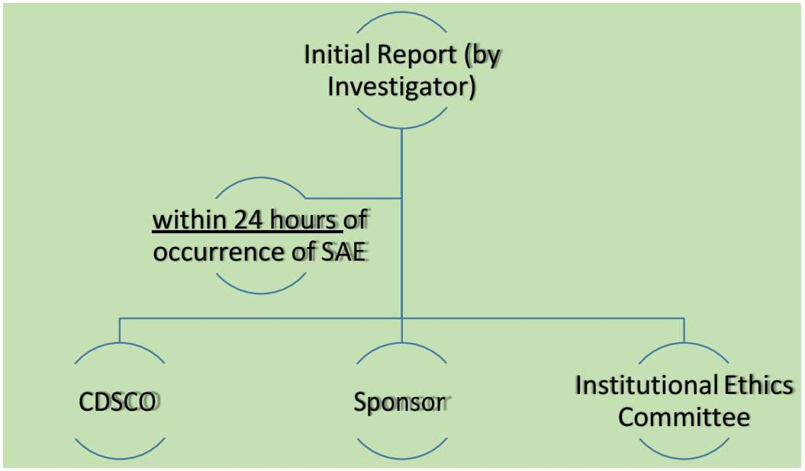
Reporting of SAEs
45

Slide 46
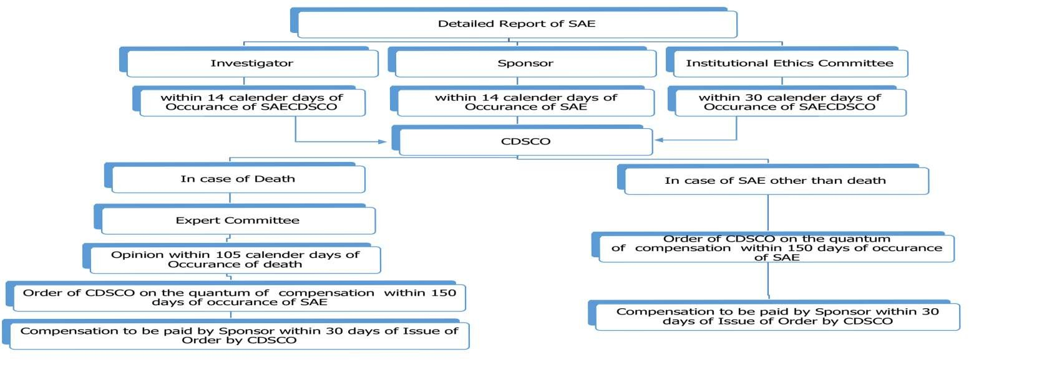
Reporting of SAEs…

Slide 47
New safety data related to combination
therapy
47
 If PSUR is for fixed combination product – summarise important safety information arising from individual component
 Information specific to combination can be incorporated into separate section(s) of PSUR for one or all of the individual components of the combination

Slide 48
Literature monitoring
48
 MAHs shall perform monthly literature search of their product
by using electronic literature database
 Any AEs / ADRs identified by this process needs to be processed as per spontaneous Individual Case Safety Report (ICSR)
 Follow-up ICSR – Any missed information – in the form of supplementary detailed information required for clinical evaluation of ICSR – reported to NCC-PvPI, IPC
 When all the essential elements are reported in an individual report – ICSR (Identifiable reporter, identifiable patient, suspected pharmaceutical product & AE/ADR)
Drug safety evaluation in clinical trial - Dr. Vikas S. Sharma

Slide 49
Literature monitoring…
49
 All serious unexpected AEs, reported to licensing authority within 15 calendar days of initial receipt of information by the applicant
 All serious AEs/ADRs, reported to regulatory authority / NCC-PvPI, IPC within 15 calendar days of initial receipt of information by the MAHs
 All non-serious AEs/ADRs, reported to NCC-PvPI, IPC within 30 calendar days of initial receipt of information by the MAHs

Slide 50
Adverse events following immunisation (AEFI)
50
 Licensing authority - advise MAH to conduct Phase IV trial in case of demonstration of product safety, efficacy & dose definitions
 AEFI can be serious or non serious.
Serious AEFIs - reported immediately & investigated timely
Non-serious AEIFs - reported routinely in health management information system (HMIS)
 Based on causality assessment report, detailed inspection related to GMP, product etc. & further regulatory action are initiated by
CDSCO in case quality of implicated vaccines are responsible for AEs

Slide 51
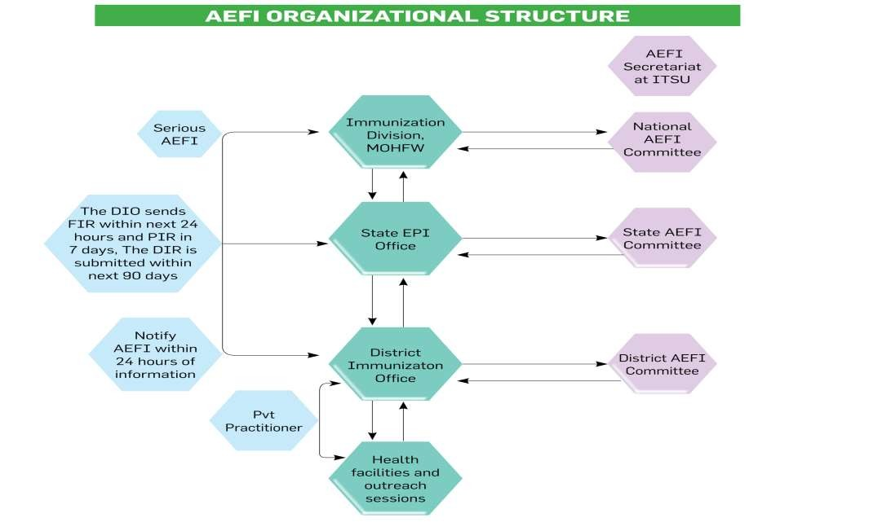
51
Drug safety evaluation in clinical trial - Dr. Vikas S. Sharma
10-01-2018

Slide 52
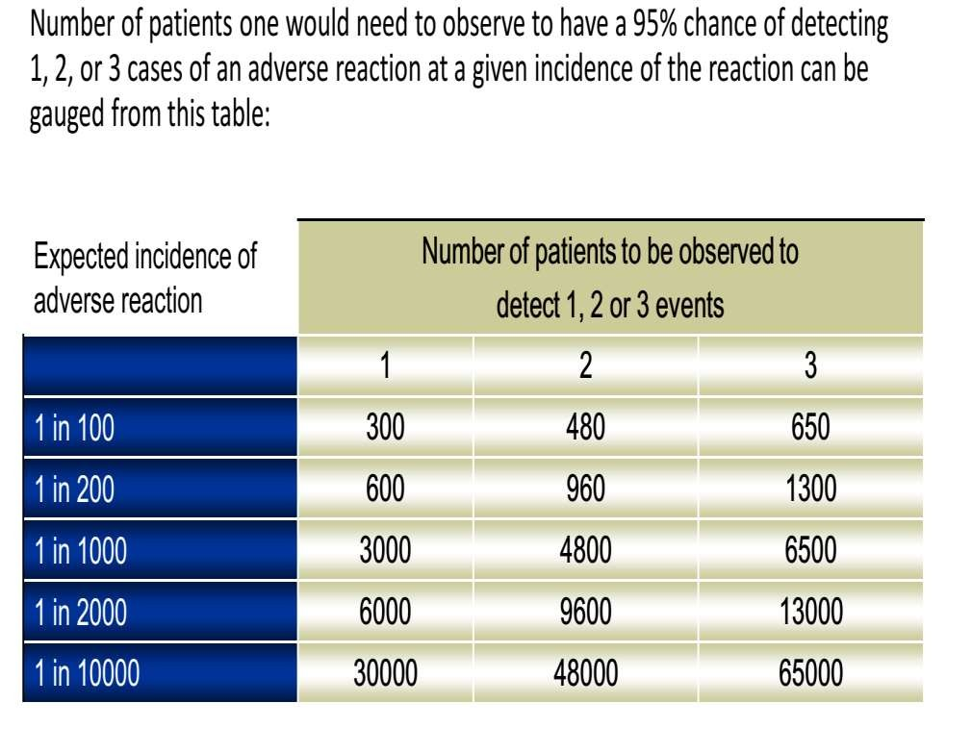
Sample size considerations
52

Slide 53
Improving risk minimization
⁵³  All participants (manufacturers, FDA, healthcare practitioners & patients) in the medical product development & delivery system have a role to play in maintaining benefit-risk balance
 By making sure that products are developed, tested, manufactured, labelled, prescribed, dispensed, & used in a way that maximizes benefit & minimizes risk
 But often the actions of participants are insufficiently
integrated
 To achieve such a framework,
better understanding of the risks involved & their sources, &
clarifications of individual roles can be effective
Drug safety evaluation in clinical trial - Dr. Vikas S. Sharma

Slide 54
Improving Post marketing Risk
54
Assessment and safety
 Regulatory authorities like ICH, FDA & EMA are working together to make sure drug safety throughout lifespan of a drug product
 With their strict regulations & adherence of various MAHs to these regulations: effective in exploring new dimensions of drug safety

Slide 55
Improving Post marketing Risk Assessment and safety…
55
 Effective tools in improving post marketing risk assessment & safety
Applying new tools or gathering better data from observational trials & targeted post-approval studies,
Active surveillance system to query diverse automated healthcare data,
Drug utilization databases &
Medication error prevention

Slide 56
Coding of Adverse Events
56
 Process of converting investigators’ “verbatim” terms to standardized
“Preferred Terms” (PT)
Standardization allows sorting of AEs and grouping of like events
PT used to calculate incidence of AE
 Currently most used: MedDRA (Medical Dictionary for Regulatory Activities)
Drug safety evaluation in clinical trial - Dr. Vikas S. Sharma

Slide 57
Coding of Adverse Events…
57

Slide 58
Coding Problems
58
Coding problems may lead to missing safety signals
 Splitting same AE among similar PTs
Hypertension, high blood pressure, etc.
 Lumping different terms to same PT
Leg edema, face edema, etc.
 Lack of adequate term/definition
Drug hypersensitivity, Metabolic syndrome, Serotonin syndrome
Drug safety evaluation in clinical trial - Dr. Vikas S. Sharma

Slide 59
Conclusion
59
 Safety assessment of a medicinal product is an ongoing, dynamic process that never ceases during a product's active life cycle
 Probability of detecting all possible relevant AEs of a drug during premarketing development is moderate
 However, with systematic & effective pharmacovigilance previously unrecognized, clinically significant ADRs can be frequently detected & corrective measures can be initiated soon after commercialization
 Communication of risks & benefits through product labelling is corner stone of risk management efforts for prescription drugs

Slide 60
Thank you
62

