Slide 1
Course Title: Introductory Agrometeorology & Climate Change
Course No.: ASAG1202
Credit: 2 (1+1)

Slide 2
STUDIES ON AGROMETEOROLOGICAL OBSERVATORY

Slide 3
Definition:
An observatory is a specially designed station or place where the regular and simultaneous records of the weather data are made by physical measurements using various techniques, sensors, skills, recorders, instruments etc. by standard methods

Slide 4
Why we need an Agrometeorological Observatory:
Climate is one of the important natural resources plays crucial role in crop production.
Adequate meteorological data are of fundamental importance to sound planning of agricultural projects.
Careful consideration should therefore be given to the planning of project activities concerned with the collection and processing of such data.
Agrometeorological observatories are installations maintained within a large cultivated field for regular monitoring of weather elements essential for agricultural activities.

Slide 5
Criteria for site selection
The site should contain a flat rectangular plot with 55 meters (180 feet) in north-south direction and 36 meters (120 feet) in east-west direction,
The site must be representative of climate, soils and agricultural (cropping) conditions of the area and should be located at a suitable place of the farm,
The site must be free from water logging and easily accessible throughout the year,
The soil of the station and the surrounding area should have a vegetative cover

Slide 6
Site selected should be away from hills, buildings, streams and trees to avoid shade, shield or channel affects,
It should be away from steep slopes, water bodies and frequent irrigation.
The recommendable distance from the obstacles from the rain gauge and other instruments are at least twice and 10 times the height of the obstructions, respective.
The station should be fenced by barbed wire up to 1-1.5m height.

Slide 7
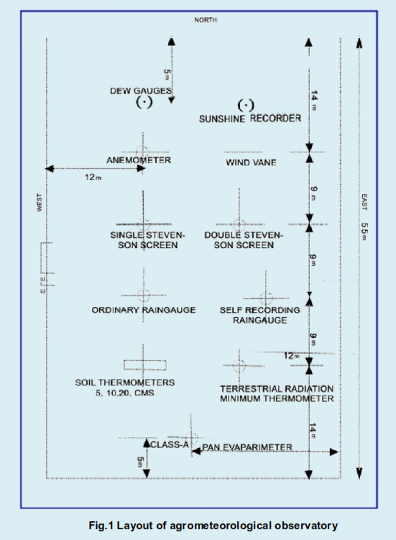

Slide 8
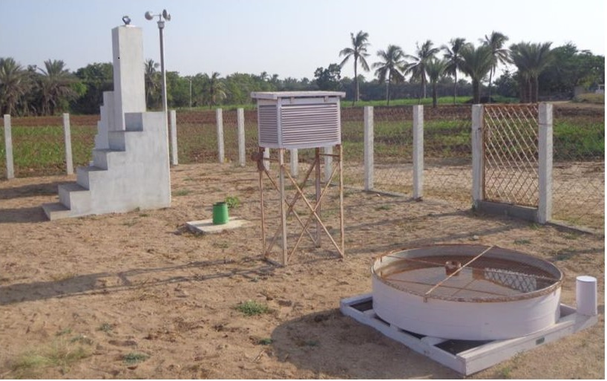

Slide 9
Meteorological components that one must measure in an observatory
Thermal : Maximum , Minimum , Dry & Wet Bulb Thermometer.
Energy : Bright Sunshine Hours
Rainfall : Manual or automatic rain gauge
Evaporation : Open Pan Evaporimeter
Wind : Cup Anemometer and Wind Vane

Slide 10
Weather Element Measured in observatory
Maximum and Minimum Temperature,
Dry and Wet Bulb Temperature,
Soil Temperature at 5,15 and 30 cm depth,
Rainfall and Evaporation,
Wind Direction and speed,
Sunshine hours and cloud cover,
Others (Dew, grass minimum temperature, Evapotranspiration, Rainfall Intensity etc.)

Slide 11
Agrometeorological observatories are of three types based on availability of instruments
Auxiliary
Ordinary
Principal
In an Auxiliary Observatory following instruments must be there
Rain gauge
Maximum & Minimum Thermometers
Dry bulb & Wet bulb Thermometers

Slide 12
In an Ordinary Observatory following instruments must be there
Rain gauge
Maximum & Minimum Thermometers
Dry bulb & Wet bulb Thermometers
Wind vane and anemometer
Pan evaporimeter
Soil Thermometer

Slide 13
In a Principal Observatory following instruments must be there
Rain gauge
Maximum & Minimum Thermometers
Dry bulb & Wet bulb Thermometers
Wind vane and anemometer
Pan evaporimeter
Soil Thermometer
Sunshine recorder
Thermograph and Hygrograph
Self recording raingauge
Lysimeter

Slide 14
Time of Recording Observations
7.00 and 14.00 Local Mean Time(LMT)
8.30 Indian Standard Time(IST)
Dry bulb temperature, Wet Bulb temperature, Maximum temperature, Wind Direction and Speed are recorded at 7.00 LMT
Dry bulb temperature, Wet Bulb temperature, Minimum temperature and Wind Directions Speed are recorded at 14.00 LMT
Rainfall and Evaporation measurements are taken at 7.00 LMT or 8.30 IST

Slide 15
Determination of observatory recording time at LMT with reference to IST
Allahabad (82.5º long.) has been marked for IST,
1⁰ deviation in long. From Allahabad means 4 min change in LMT
With reference to Allahabad if the deflection is towards east then 4 min reduction from IST. If it is towards west then + 4 min.

Slide 16
Calculation of Time for observation
LMT = IST – [(Longitude of the place-82⁰ 30’) x 4 min]
Problem:
Calculate, at what IST maximum temperature is conventionally measured in the following meteorological observatories
Kalyani (Longitude = 88⁰ 57’ E)
B. Ahmadabad (Longitude = 72⁰ 40’ E)
C. Parlakhemundi (Longitude = 84⁰ 09’ E)
D. Ludhiana (Longitude = 75⁰ 54’ E)

Slide 17
Probable sources of observations error
Instrument error
Exposure error
Observer error

