Slide 2
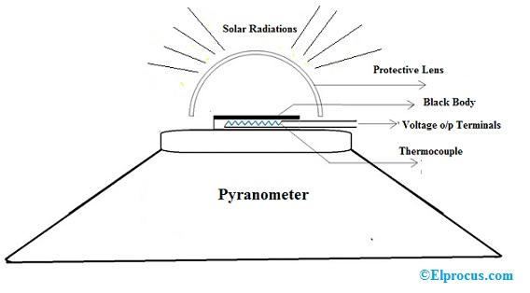
A pyranometer is a sensor that converts the received global solar radiation into an electrical signal that can be measured. Pyranometers measure a portion of the solar spectrum, eg. the CMP21 Pyranometer measures wavelengths from 0.285 to 2.8 µm

Slide 3
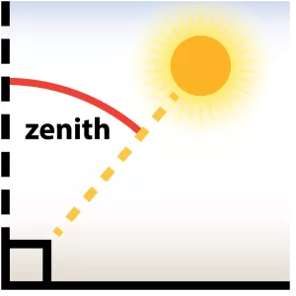

Slide 4
As particles electromagnetic waves are called photons and energy E expressed as (Plank’s Law):
E = h * ν
where E = energy of a photon in Joules, h = Planck constant = 6.6 *10⁻³⁴ J s, and
ν = frequency of radiation, s⁻¹.

Slide 5
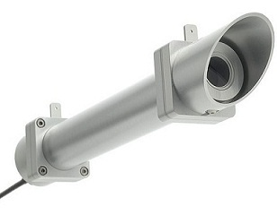
What is Pyrheliometer?
The pyrheliometer is, used to measure the direct solar radiation at the regular occurrence. This instrument is used with a tracking mechanism to follow the sun continuously. It is responsive to wavelengths bands that range from 280 nm to 3000 nm. The units of irradiance are W/m². These instruments are specially used for weather monitoring & climatological research purposes.

Slide 6
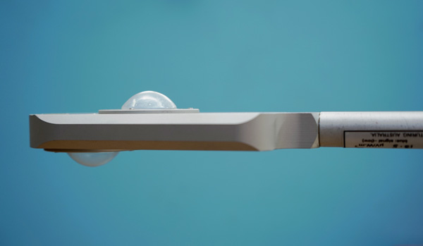
Net Pyrradiometer measures the net total radiation flux (solar, terrestrial, and atmospheric) downward and upward through a horizontal surface. It is suitable for solar energy studies in agriculture and meteorology.

Slide 7
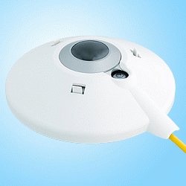
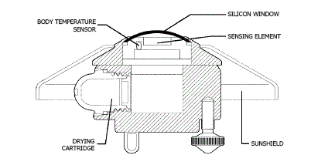
A pyrgeometer is a device that measures near-surface infra-red radiation spectrum in the wavelength spectrum approximately from 4.5 μm to 100 μm.

Slide 8
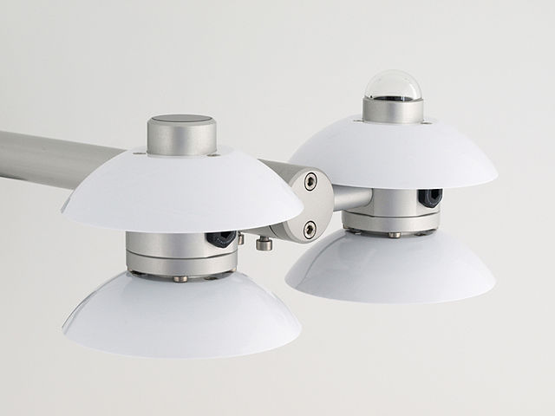
A net radiometer is used to measure net radiation (NR) at the Earth's surface for meteorological applications.
It measures the difference between downward/incoming and upward/outgoing radiation from Earth

