Slide 1
Measurement of maximum and minimum air temperature its tabulation, trend and variation analysis.

Slide 2
Rate of plant growth and development is dependent upon the temperature surrounding the plant.
Responses to temp. differ among crop phenological stages.
For most plant species, vegetative development usually has a higher optimum temperature than for reproductive development.
Each plant species has a specific temperature range represented by a minimum, maximum, and optimum.
Base or Cardinal Temperature

Slide 3
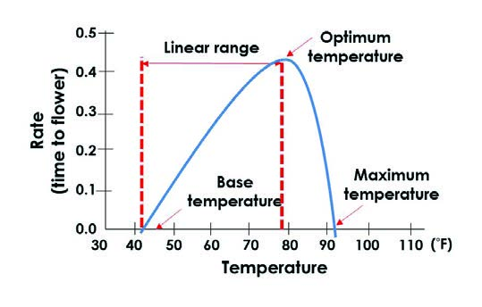

Slide 4
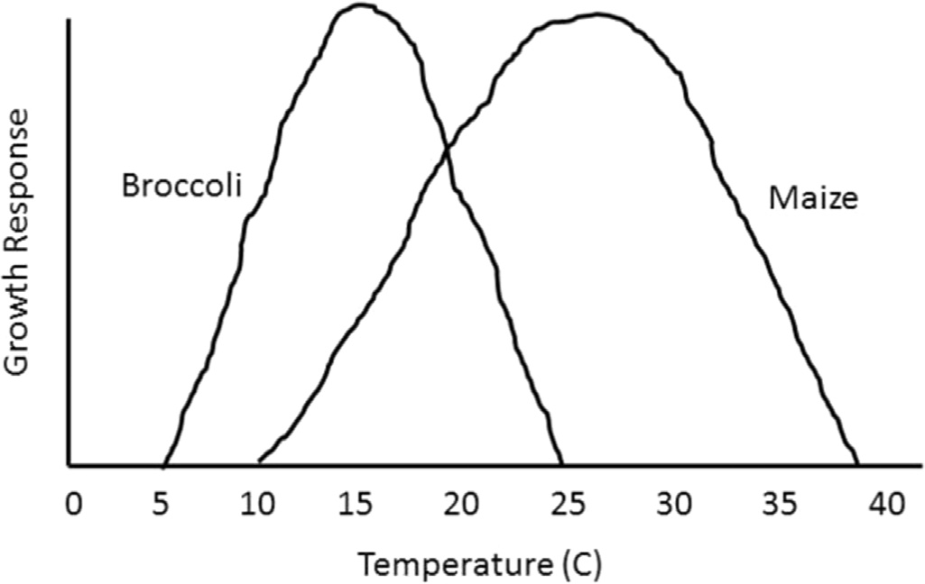
Minimum, maximum and optimum temperature limits for growth of Brocoli and Maize

Slide 5
Mini., Max., & optimum temp. For some crops
Crop | Minimum | Maxmum | Optimum
Rice | 10 -12 | 36 - 38 | 30 -32
Wheat | 3 -4.5 | 30 -32 | 24-26
Maize | 8 -10 | 40 -44 | 32 -35
Oat | 4 - 5 | 29 - 31 | 24-26
Sorghum | 8 -10 | 42 -44 | 33 -35
Pearl Millet | 8 -10 | 38 - 40 | 30 - 32
Berseem | 3 - 4 | 31 - 33 | 25 -27

Slide 6
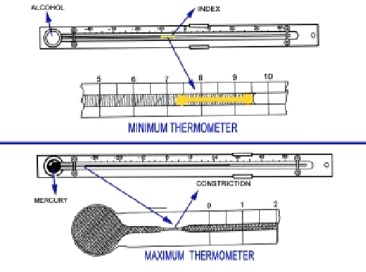
Maximum and minimum temperature are recorded with maximum and minimum thermometers

Slide 7
Measurement of maximum temperature
There is a constriction in the capillary of the glass tube below the lowest graduation of the scale.
It is kept at an angle of less than 10º from the horizontal with the bulb downwards.
The thermometer is mounted horizontally in the upper portion of the Stevenson screen.
The reading of the maximum thermometer after setting should agree with that of dry bulb thermometer within 0.3ºC.
Reading taken at 07hr LMT

Slide 8
Measurement of minimum temperature
Measuring fluid is alcohol, provided with a dump bell shaped index in the stem.
As the temperature of the air falls, the meniscus retreats towards the bulb dragging with it the index, till the minimum temperature is reached.
As the temperature rises, the index remains stationary.
Thus the end of the index nearest from the bulb indicates the minimum temperature recorded since the thermometer was kept set.
Record is taken during 14hrs LMT.

Slide 9
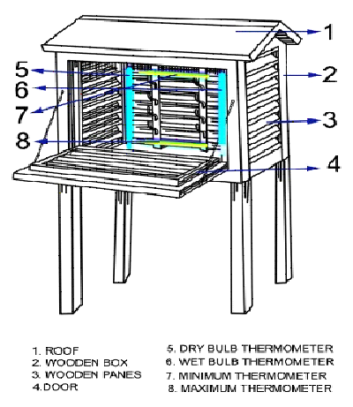
Stevension’s screen

Slide 10
Stevenson screen
Made of wood, Dimension (1/ X 1.5/ X 2/) and paint in white colour
The floor of the screen is 4/ above the ground.
Double roof having 2-3 inches air space.
Side walls and door is made of wooden ventilator, allows only air but restricts solar radiation and precipitation.
Door facing north side in the Northern Hemisphere so that only minimum sunlight would enter while the observer is reading the instruments

Slide 11
Four thermometers placed inside the Stevenson screen
Maximum thermometer
Minimum thermometer
Dry bulb thermometer
Wet bulb thermometer

Slide 12
The average of the maximum and the minimum temperature recorded during a day is called Mean temperature of the day.
The difference between the maximum and the minimum temperature recorded during a day gives the diurnal range of temperature for the day.

Slide 13
Precautions for recording maximum and minimum temperature
Take the temperature reading as quickly as possible
After taking temperature readings, index corrections of the thermometers, obtained by calibration done with the standard thermometers earlier, should be applied.
Avoid parallax error while reading the thermometers.
After reading the thermometer, verify once again whether the whole number of degrees has been read correctly.
Do not keep the door of the Stevenson screen open for a longer time than is necessary.

Slide 14
Use of temperature data to assess consumption of thermal energy a crop
Growing degree days (GDD) is a weather-based indicator for assessing crop development.
Growing degrees (GDs) is defined as the mean daily temperature (average of daily maximum and minimum temperatures) above a certain threshold base temperature accumulated on a daily basis over a period of time.
Negative values are treated as zeros and ignored.

Slide 15
GDD can be calculated by using the following formula:
GDD = (T_{max} + T_{min}) / 2 – T_{base}

