Slide 1
Measurement of Soil Temperature and Computation of Soil Heat Flux
Aim: To record soil temperature at different depths and computation of soil heat flux
Instruments required: Soil thermometer for 5,10, and 20cm depths

Slide 2
Computation of soil heat flux (q_{T} )
The amount of thermal energy that moves through an unit cross sectional area of soil per unit time is termed as soil heat flux or heat flux density.
Its units are J m^{–2} s^{–1} or W m^{–2}
How to compute soil heat flux
q_{T} = K_{T} * i_{T}
K_{T} is the thermal conductivity, unit Wm⁻¹K⁻¹.
i_{T} = (T5 – T10) / 5 ⁰c per cm

Slide 3
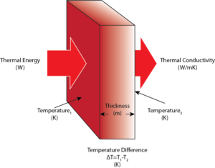

Slide 4
Irrespective of moisture content clayey soils had lower thermal conductivity than sandy soils.
Thermal conductivity of different textural groups
Textural group of the soil | Thermal conductivity, cal m⁻² s⁻¹
Sandy Loam | 0.37 to 1.90
Loam | 0.38 to 1.71
Sandy Clay Loam | 0.37 to 1.42
Clay Loam | 0.39 to 0.41

