Slide 2
Measurement of Humidity
The important measures of humidity are:
Vapour Pressure,
Relative Humidity and
Dew point temperature.
The partial pressure in air due to water vapour alone is called “vapour pressure”.
It is expressed in energy units viz., millibar or millimetre of mercury.
The pressure exerted by water vapour actually present in air called the actual vapour pressure of air (e_{a}).
The pressure exerted by water vapour under saturated condition is called saturation vapour pressure (e_{s}).

Slide 3
The ratio of actual vapour pressure (e_{a}) to sat. vapour pressure (e_{s}) under a fixed temperature, expressed in percentages is known as Relative Humidity (e_{a}/ e_{s}).
Dewpoint temperature, T_{d}, is the temperature at which the water vapor in air at constant barometric pressure condenses into liquid water at the same rate at which it evaporates.
Dew point temperature, is the temperature at which air would become saturated if cooled at constant pressure without addition or removal of water vapour.
The Dew Point is the temperature to which air must be cooled to become saturated with water vapour, assuming constant air pressure and water content.
When the air is cooled below the dew point, water vapour retention capacity is minimum and airborne water vapor will condense to form liquid water known as Dew.
When this occurs via contact with a colder surface, dew will form on that surface

Slide 4
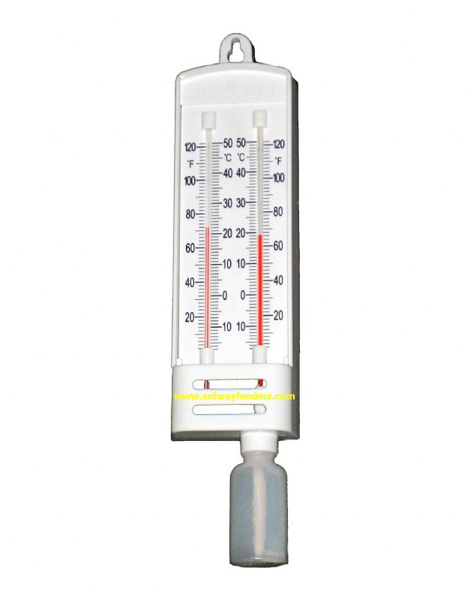
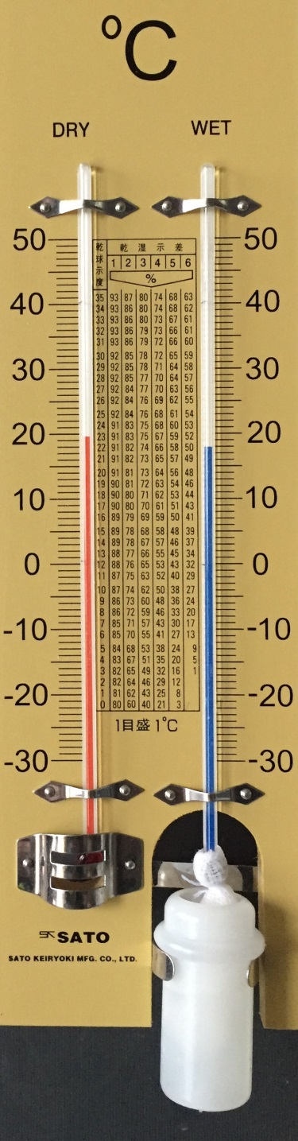
Drybulb and Wetbulb thermometers

Slide 5
Principles of wet bulb thermometer
When water soaked muslin cloth covers the bulb of a thermometer (wet-bulb), latent heat is removed from the surface of the bulb as the water evaporates, and the wet-bulb temperature becomes lower than the air (dry-bulb) temperature.
The rate of evaporation from the cloth depends on the actual vapour percent in the atmosphere.
When the air is dry (percent water vapour is low) the rate of evaporation will be high and the difference between dry and wet bulb thermometers will be more.
With the increase in vapour percent in air the difference will narrowed down.
There will be no evaporation when water vapour will reach to its saturation level and then reading of both dry and wet bulb thermometer will be same.

Slide 6

Computation of Vapour Pressure
Since 1876 IMD is using Regnault’s equation for computation of vapour pressure of a place at any time based on Dry bulb and Wet bulb thermometer.
The formula is:
Where
X is vapour pressure (ea) at a specific temp. recorded by wet bulb thermometer,
F’ is the saturation vapour pressure (es) at the same temp,
T is the temperature of the dry bulb
T’ is the temperature of wet bulb
P is the atmospheric pressure of the location

Slide 7
It is well known that the reading of wet bulb thermometer depends on wind flow.
In comparison to a calm wind condition the reading of wet bulb thermometer will be low when there will be wind flow.

Slide 8

Calculation of relative humidity from wet and dry bulb temperature.
Relative humidity is the ratio in between actual vapour pressure to that of saturated vapour pressure. Can be expressed as:
U is the RH, X is actual vapour pressure, F is the saturated vapour pressure
Relative humidity can be found from a standard table as used by IMD.

Slide 9
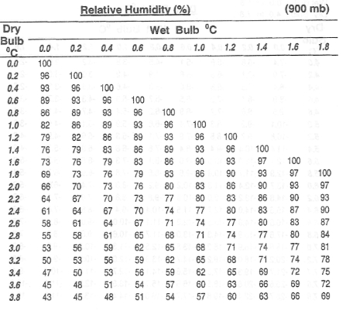

Slide 10
Calculation of Dew Point Temperature.
From the dry bulb and wet bulb temperature readings the dew point temperature can be obtained by reference to hygrometric tables.
Dew point temperature corresponding to specified values of dry and wet bulb temperature are given in the abovementioned tables at intervals of 0.2ºC.
While using the tables, interpolation to the nearest 0.1ºC has to be done, wherever necessary.
During interpolation it is to be noted if any digit is followed by 0.5, it should be rounded off to the next higher digit only when the digit is even, and when the digit is odd, it remains the same.

Slide 11
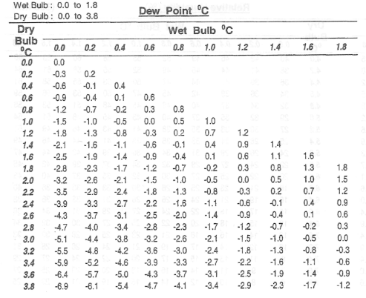

Slide 12
Precautions for recording humidity observations
Use distilled water for W B thermometer and keep the container bottle clean.
Cover the bulb with only one fold of muslin cloth tied with strands of cotton and trim the excess muslin cloth.
The bottle should have a small neck so that air inside the screen may not be moistened by evaporation of water from the vessel.
Place the bottle on one side of the wet bulb away from the dry bulb and not directly below the dry bulb.
Keep muslin and cotton thread clean and free from dust or grease.
Change muslin cloth and threads immediately after a dust storm.
Inspect wet bulb periodically and if the wet bulb develops a white coating due to incrustation of salts, clean it with a lemon or dilute acid.
Avoid parallax error while reading the thermometer and apply index correction, if any.

Slide 15
The following example is given for completeness

