Slide 1
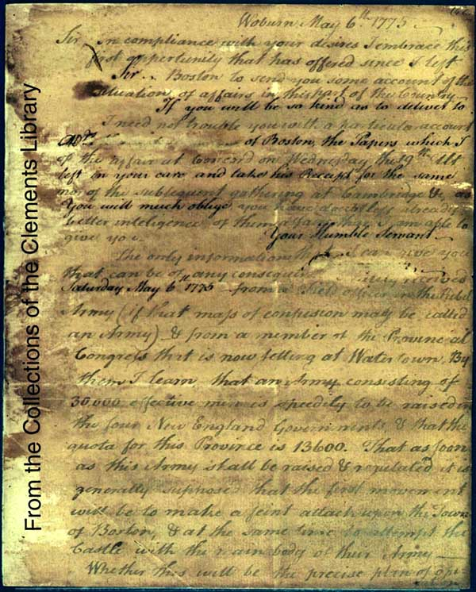
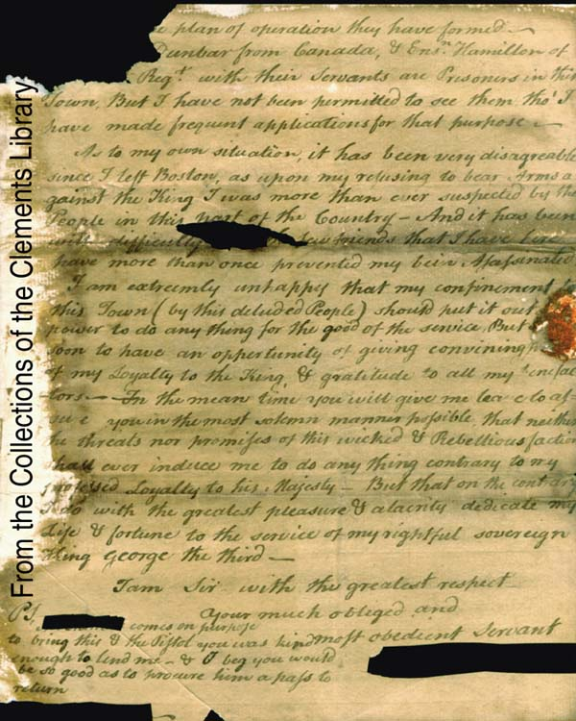
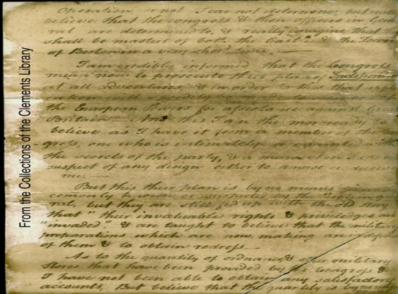
Secret writings : case study

Slide 2
What is secret writings??
Secret writings are writings that are written in codes or cipher or in such a manner that it is not visible through naked eyes.
Secret writings are used by military agencies, police people, intelligence department, political offenders, international spies, drug dealers, terrorist and criminals.

Slide 3
METHODS OF SECRET TRANSMISSION OF DATA
Invisible ink
Miniature writing
Latent photograph
Steganography
Cryptography

Slide 4
Invisible ink
It is also known as ‘Sympathetic Ink’ or ‘Security Inks’, which are colorless in nature and that cannot be seen untill it is treated with heat, vapour or chemicals.
Such ink may include body fluids like sweat, saliva, urine, milk, lemon juice, onion juice, orange juice , soap solutions, chemicals, medicinal solutions etc. can be used.

Slide 5
EXAMINATION AND DECIPHERMENT OF INVISIBLE INK
UV light can be used to decipher the text written by body fluid.
Some chemicals also give fluorescence under UV light.
Heating can be done on the paper if chemical or juice (orange , lemon) is used. Certain salts or organic compound can also be examined by using the same technique.
If the writing is made with secret ink bearing heavy metals, it can be read under IR light rays.

Slide 8
Geiger counter technique can be used to detect the text written using radioactive material.
Writings with silver nitrate solution becomes evident when exposed to strong light.

Slide 9
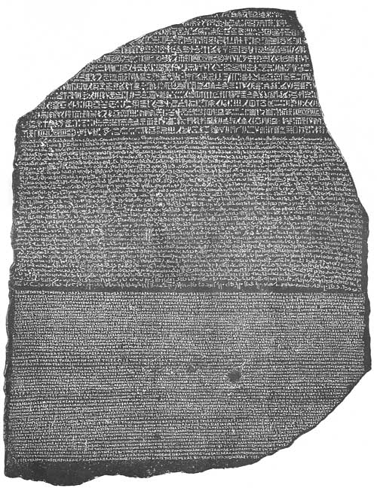
MINIATURE WRITING
The secret message may be sent in form of micro text.
Even a photograph bearing small dots of inconspicuous size and shape may carry all the necessary information of secret message.

Slide 10
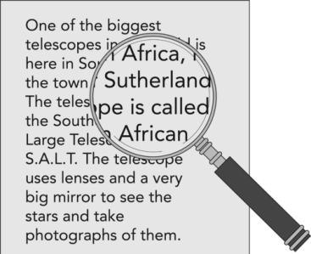
EXAMINATION AND DECIPHERMENT OF MINIATURE WRITING
Such type of writings are first examined using magnifying lens under normal lighting conditions.
The writings will be clearly evident under stereomicroscope.

Slide 11
LATENT PHOTOGRAPH
A secret message may be conveyed in the form of latent image on photographic bromide paper.
The recipient will develop and fix it to read the message
Such documents should be carefully handled as there are great chances of their destruction as soon as it is exposed to light.

Slide 13
CRYPTOGRAPHY
Cryptography is science of creating and deciphering the codes.
In cryptography, a cipher (an algorithm) is used for encrypting and decrypting any information.
Encryption : Process of transforming any information or data into codes or any unreadable form.
Decryption : Process of converting a secret code or encrypted data back into its original readable form.

Slide 14
EXAMINATION AND DECIPHERMENT OF CRYPTOGRAPHIC MESSAGES
There are different techniques, information, books available for coding and cipher.

Slide 15
STEGANOGRAPHY
The word Steganography is derived from two Greek words, ‘Stegnos’ meaning covered and ‘Graphien’ means to write.
Its an act of hiding the information or writing behind any text or picture.
The messages are hidden in such a way that no one apart from sender and intended recipient can read that.

Slide 16
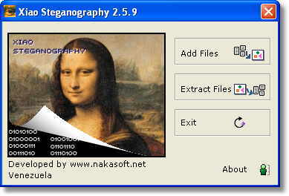

Slide 17
USE OF SCERET WRITINGS BY BRITISH AND AMERICAN SPIES : A CASE STUDY

Slide 18
Mask Letter
The British used one type of secret writing that appears to have been unknown to the Americans.
Sir Henry Clinton composed letters that were meant to be read through a mask or grille, a technique known as the Cardan system. (The technique is named after Geronimo Cardano, one of the most famous code-makers in the sixteenth century).

Slide 19
Composition demanded care because the letter must make sense both with or without the mask
Clinton probably wrote the real message first- in this case in the shape of an hourglass figure. Additions were added to the beginning and end of the lines in order to manipulate the content. Advantages of the method include the ability to send the letter by one route and the mask by another, and an opportunity to convey false information if intercepted.

Slide 20
Clinton's letter to John Burgoyne is full of misinformation. The letter, read without the mask, exaggerates British military successes and available troops. Clinton writes that General William Howe's actions "just at this time have been capital.“
With the mask, however, Clinton expresses a different opinion, "I own to you that I think Sr.W's move just at this time the worst he could take."

Slide 21
Clinton also used masks in conjunction with printed material. He strategically cut small windows out of blank pieces of paper that could be placed over selected text in order to convey secret messages. An example of this type of perforated paper was found in the Clinton manuscripts at the Clements Library.

Slide 22
August 10, 1777 -- Henry Clinton to John Burgoyne

Slide 23
Clinton's August 10, 1777 letter was designed to be read through a mask or grille. Composition demanded care because the letter must make sense both with or without the mask.

Slide 24
LETTER WITH MASK
Sir. W. Howe / is gone to the / Chesapeak bay with / the greatest part of the / army. I hear he is / landed but am not / certain. I am / left to command / here with / too small a force / to make any effectual / diversion in your favour. / I shall try something / at any rate. It may be of use / to you. I own to you I think / Sr W's move just at this time / the worst he could take. / Much joy on your success.

Slide 25
THANK YOU …

