Slide 1




Slide 2
PROFILE COVERING
NAME OF THE PLANT
SYNONYMS
SOURCE AND FAMILY
GEOGRAPHICAL SOURCE
CULTIVATION & COLLECTION
PLANT PRODUCTION
PREPARATION OF CRUDE DRUG FOR MARKET
MORPHOLOGY (OR)MACROSCOPIC CHARACTERS
MICROSCOPICAL CHARACTERS
CHEMICAL TEST
THERAPEUTIC & PHARMACEUTICAL USE
COMMERCIAL VARIETIES, STORAGE.

Slide 3
ADVANTAGES OF CULTIVATION
It ensures quality and purity of medicinal plants.
Collection of crude drugs from cultivated plants gives a better yield and therapeutic quality.
Cultivation ensures regular supply of a crude drug.
The cultivation of medicinal and aromatic plants also leads to industriialisation to a greater extent.
Cultivation permits application of modern technological aspects such as mutation, polyploidy and hybridisation.

Slide 4
DIS ADVANTAGES OF CULTIVATION
The high cost of cultivation drugs as compared to wild source and losses due to ecological imbalance such as storms, earthquakes, floods, droughts etc…… are major disadvantages of cultivation.

Slide 5
METHODS OF PROPAGATION
SEXUAL METHOD
ASEXUAL METHOD

Slide 6
Advantages of Sexual Propagation :-
 This is very simple and easy method of propagation.
Some species of trees, ornamental annuals and vegetables which cannot be propagated by asexual means
should be propagated by this method. E.g. Marigold, Tomato etc.
Hybrid seeds can be developed by this method.
Papaya,
New variety of crops are developed only by sexual method of propagation.
Root stocks for budding and grafting can be raised by this method.
The plants propagated by this method are long lived and are resistant to water stress.

Slide 7
Cont…
Transmission of viruses can be prevented by sexual method.
Seed can be transported and stored for longer time for propagation.
Disadvantages of sexual propagation :
Characteristics of seedling propagated by this method are not genetically true to type to that of their mother plant.

Slide 8
Conti…

Plants propagated by sexual method
requires long period for fruiting.
 Plants grow very high, so they are difficult for intercultural practices like spraying, harvesting etc.
The plants which have no seeds cannot be propagated by this method. E.g. Banana, fig, Jasmine, Rose etc

Slide 9
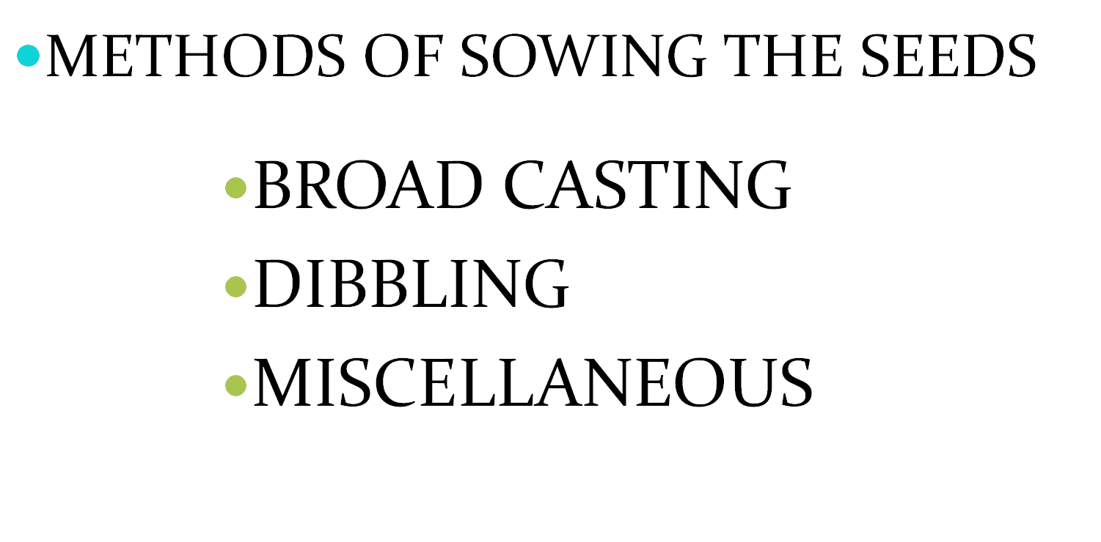
SEXUAL METHOD

Slide 10
BROAD CASTING
In this method the seeds are scattered freely in well prepared soil for cultivation.
The seeds only need raking.
If they are deeping sown or covered by soil.
Necessary thinning of the seddling is done by keeping a specific distance
Examples: isapgol linseed, sesame.

Slide 11
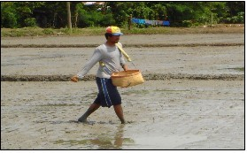
BROAD CASTING

Slide 12
DIBBING
When the seeds of average size and weight are available.
They are sown by placing in holes.
Number of seeds to be put in holes vary from 3 to 5 Depending upon thr vitlity.

Slide 13
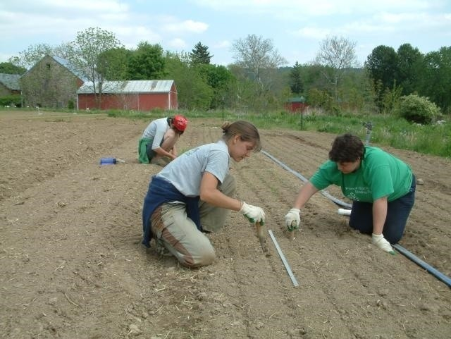
DIBBLING

Slide 14
MISCELLANEOUS
Many a times the seeds are sown in nursery beds.
The seedling thus produced are transplanted to farms for futher growth.
Such as cinchona, cardamom, clove, etc.

Slide 15
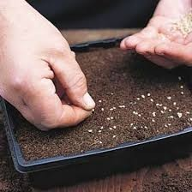
MISCELLANEOUS

Slide 16
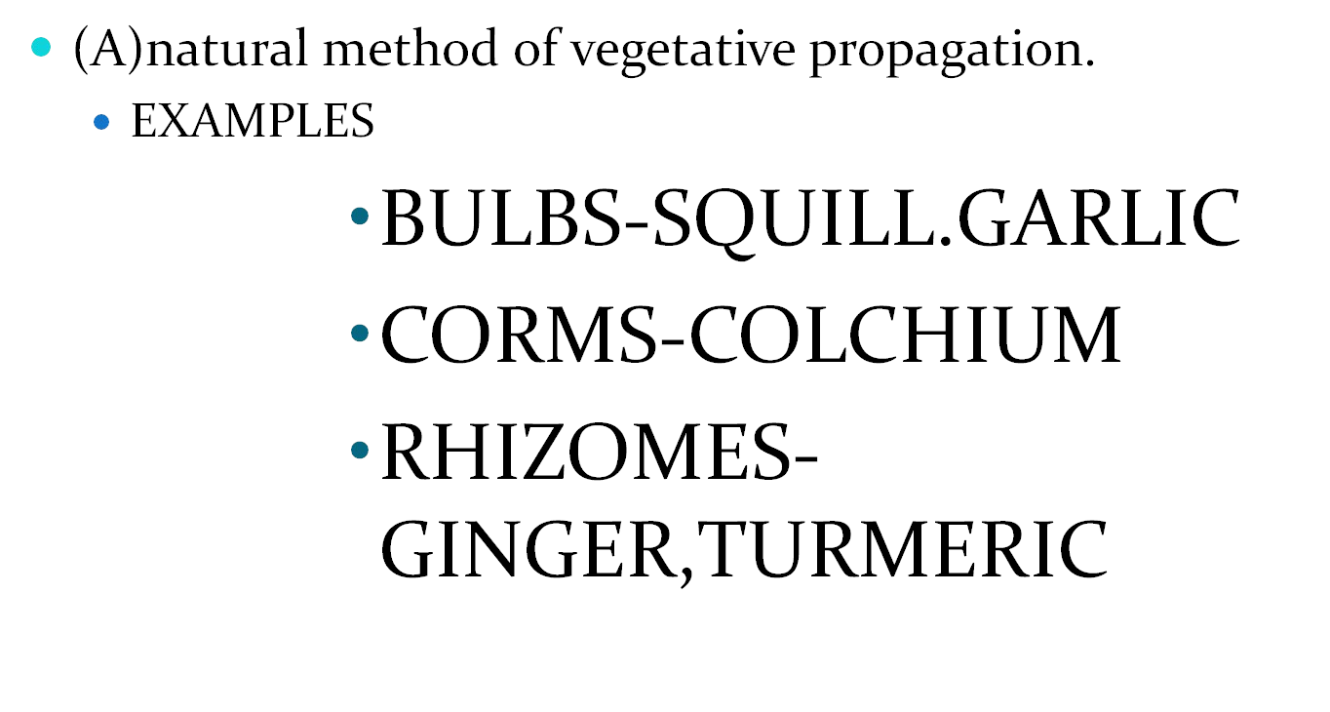
ASEXUAL METHOD

Slide 17
Advantages of Asexual propagation
The horticultural crops which donot produce viable seeds are propagated by vegetative method.
Most of the important fruit crops are cross pollinated and are highly heterozygous. When propagated through seeds, the progenies shows large variation, so vegetative propagation is remedy for these crops.
The asexual propagation method gives true to type plants.
The vegetative way propagated plants bear fruits early.
In case of fruit crops where root stocks are used, the root stocks impart insect or disease resistance to the plant.

Slide 18
Cont…
Vegetative propagation helps to alter the size of the plant. i.e. dwarfing effect. This helps for spraying, intercropping & harvesting of crops easy and economical.
By grafting method different variety of fruit crop can be grown & harvested.
Inferior quality fruit plants can be converted into good quality plants.
By means of bridge grafting a repairing of injured plants can be done.

Slide 19


Disadvantages of the vegetativ e
propagation:

By vegetative propagation new variety can not be
developed.
It is an expensive method of propagation and required specialized skill.
The life span of vegetatively propagated plants is short as compared to sexually propagated plants.
As all the plants are homozygous the whole plantation may get attacked by a particular pest or disease.
Viral diseases could be transferred through vegetative parts.

Slide 20
PREPARATION AND TYPE OF
NURSARY BEDS
FLAT BED METHOD
RAISED BED METHOD
RIDGES AND FURROW METHOD
RINGS AND BASIN METHOD

Slide 21
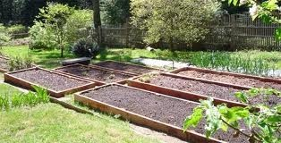
1.FLAT BED METHOD

Slide 22
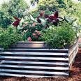
RAISED BED METHOD

Slide 23
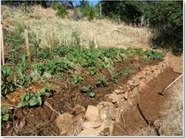
RIDGES AND FARROW METHOD

Slide 24
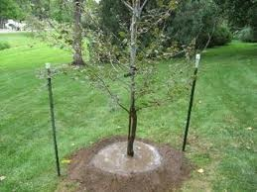
RINGS AND BASIN METHOD

Slide 25
(B)ARTIFICIAL METHOD OF VEGETATIVE PROPAGATION
CUTTING
LAYERING
GRAFTING

Slide 26
CUTTING
STEM CUTTING
ROOT CUTTING
LEAF CUTTING
LEAF BUD CUTTING

Slide 27
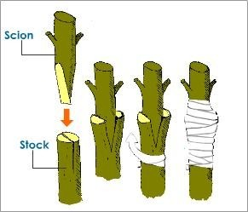
STEM CUTTING

Slide 28
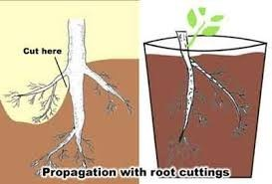
ROOT CUTTING

Slide 29
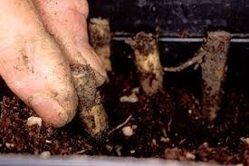
ROOT CUTTING

Slide 30
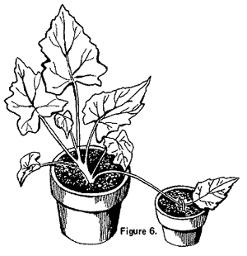
LEAF CUTTING

Slide 31
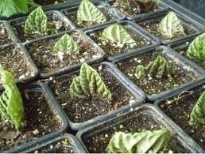
Leaf cutting

Slide 32
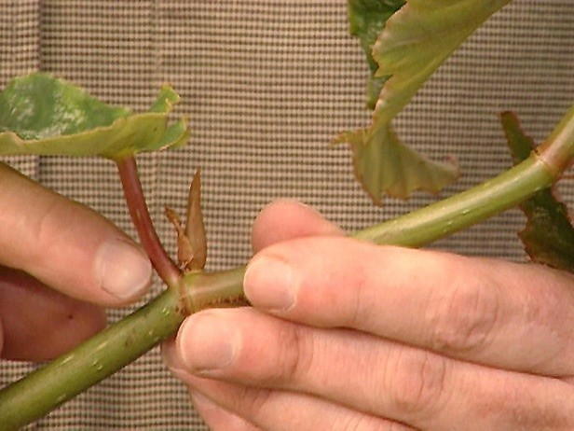
LEAF BUD CUTTING

Slide 33
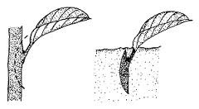

Slide 34
LAYERING
SIMPLE LAYERING
SEPENTINE LAYERING
AIR LAYERING
MOUNT LAYERING
TIP LAYERING

Slide 35
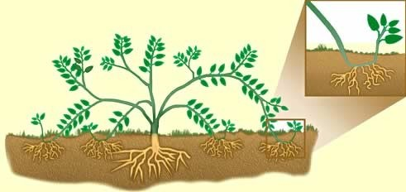
SIMPLE LAYERING

Slide 36
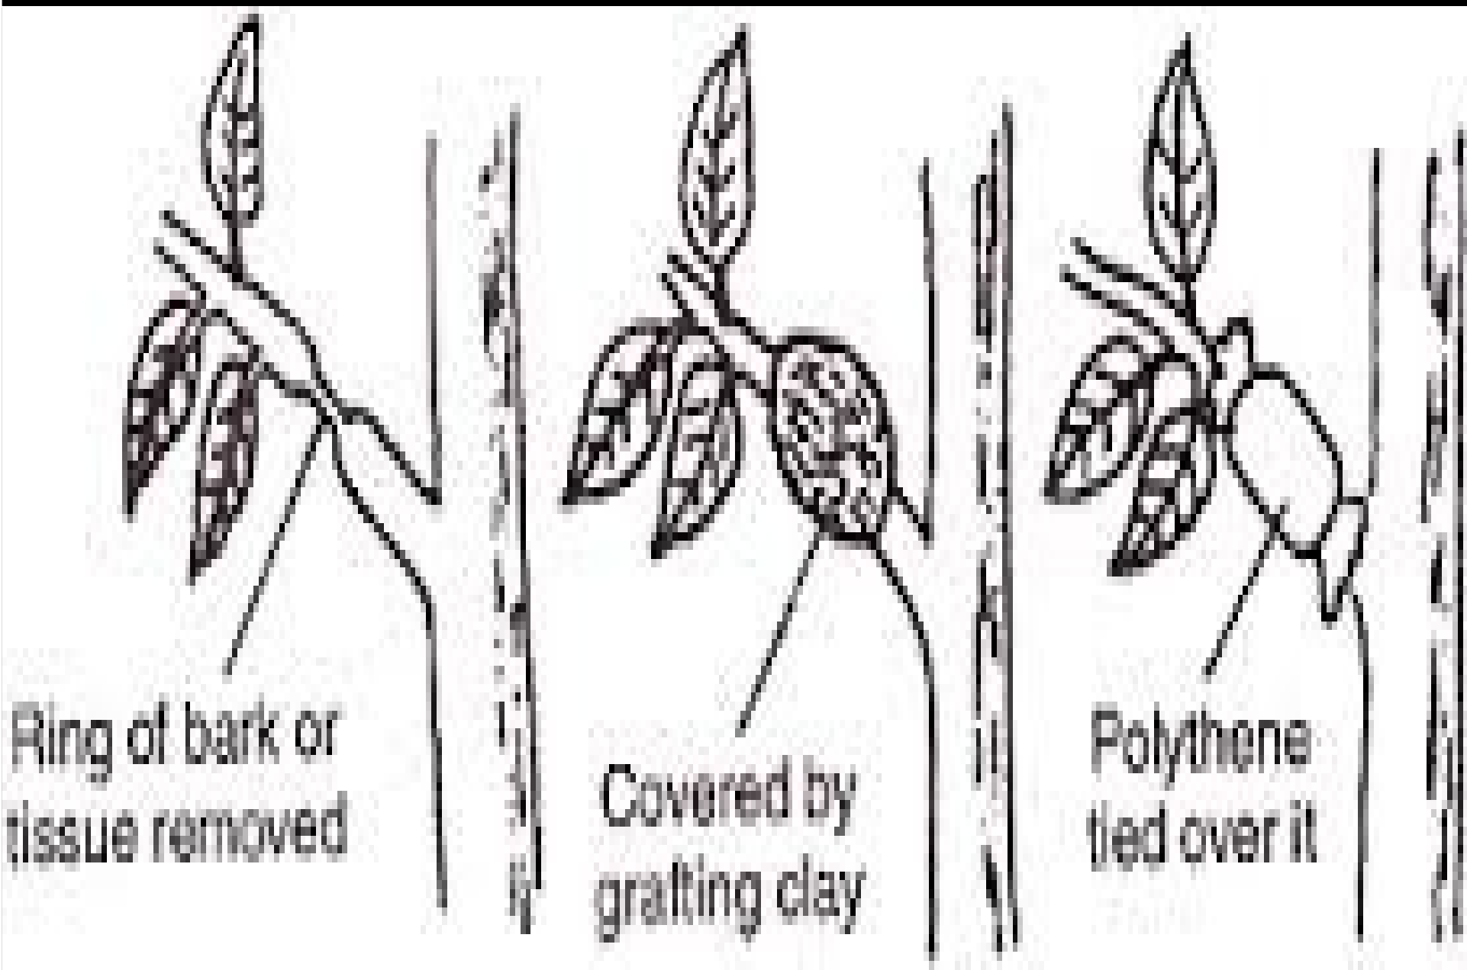
AIR LAYERING

Slide 37
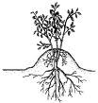
MOUNT LAYERING

Slide 38
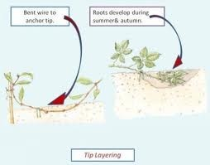
TIP LAYERING

Slide 39
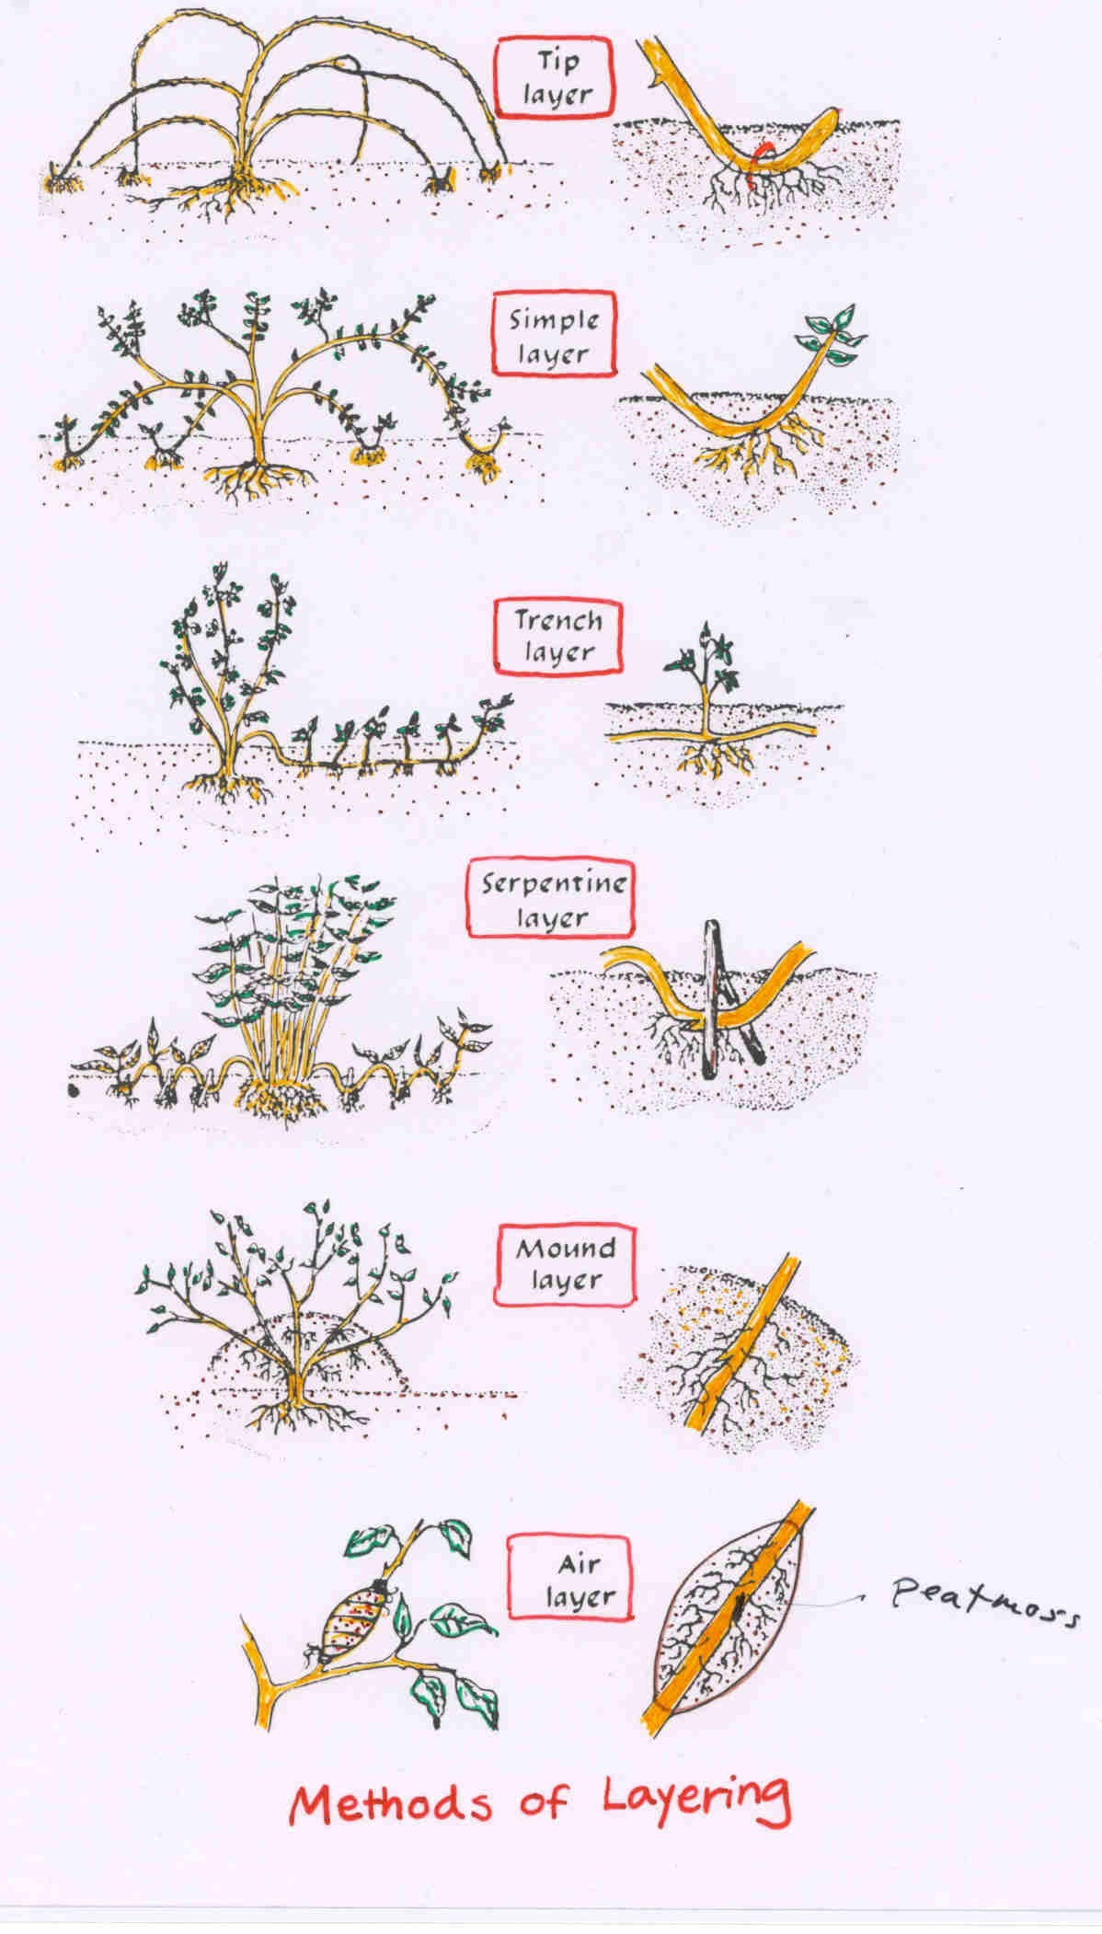

Slide 40
GRAFTING
WHIP GRAFTING
TONGUE GRAFTING
SIDE GRAFTING
STONE GRAFTING

Slide 41
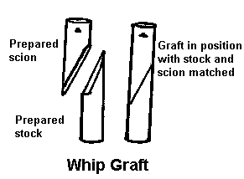
WHIP GRAFTING

Slide 42
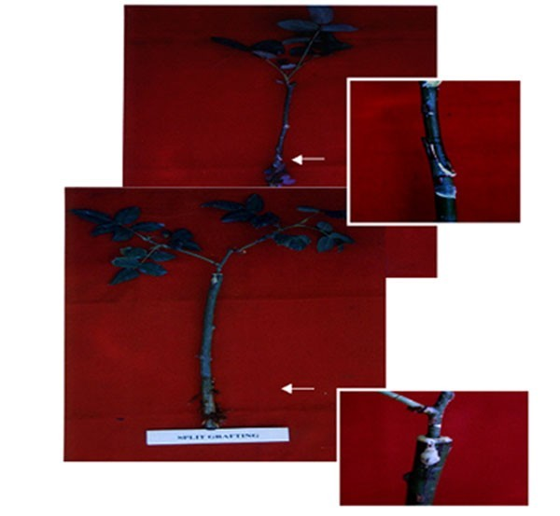
TONGUE GRAFTING

Slide 43

SIDE GRAFTING

Slide 44

STONE GRAFTING

Slide 45
(C)ASEPTIC METHOD
TISSUE CULTURE

Slide 46
FACTORS AFFECTINGCULTIVATION
CLIMATIC CONDITIONS [A]ALTITUDE [B]TEMPERATURE [C]RAIN FALL
[D]TYPE OF SOIL [E]FERTILIZERS [F]PEST CONTROL

Slide 47
CULTIVATION DETAILS
TYPE OF PROPAGATION
TIME OF CULTIVATION
DURATION OF CROP
PREPARATION OF LAND
NURSERY BED
TRANSPLANTATION
IRRIGATION
FERTILIZERS
INTERCROPS
HARVESTING
YIELD
USE
STORAGE

Slide 48
ALTITUDE
EXAMPLES
TEA
CINCHONA
COFFEE
CLOVE
CARDAMOM
1000-1500m
1000-2000m
1500-2000m UPTO-900m 600-1600m

Slide 49
TEMPERATURE
EXAMPLES
CINCHONA
COFFEE
TEA
CARDAMOM
60-75F
55-70F
70-90F
50-100F

Slide 50
RAIN FALL OR IRRIGATION
EXCEPT THE XEROPHYTIC PLANTS LIKE ALOE, ACACIA AND FEW OTHERS, MOST OF THE PLANTS NEED EITHER PROPER ARRANGEMENTS FOR IRRIGATION OR SUFFICIENT RAINFALL FOR THEIR FAVOURABLE DEVELOPMENT.
IN FEW CASES, WELL DISTRIBUTED RAINFALL THROUHOUT THE YEAR IS DESIRED.

Slide 51
METHODS OF IRRIGATION
HAND WATERING
FLOOD WATERING
BOOM WATERING
DRIP IRRIGATION
SPRINKLER IRRIGATION

Slide 52
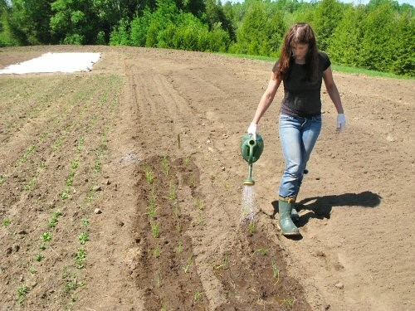
HAND WATERING

Slide 53
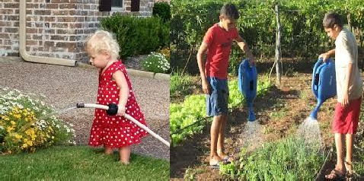
HAND WATERING

Slide 54
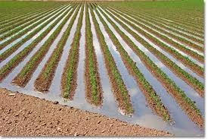
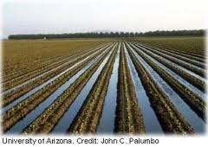
FLOOD WATERING

Slide 55
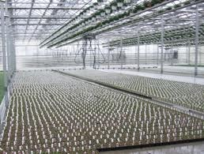
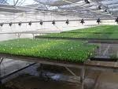
BOOM WATERING

Slide 56
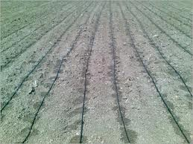
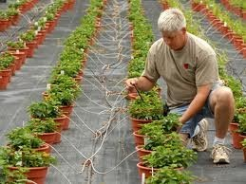
DRIP IRRIGATION

Slide 57
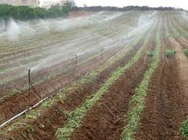
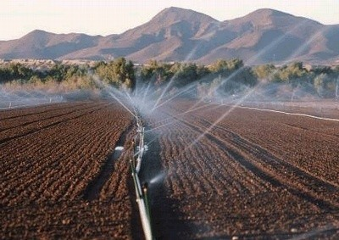
SPRINKLER
IRRIGATION

Slide 58
SOIL
DEPENDING UPON THE SIZE OF THE MINERAL MATTER.
PARTICLE SIZE
Less than 0.002mm
0.002-0.02mm
0.02-0.2mm
0.2-2.00mm
TYPE OF SOIL
fine clay
coarse clay(or)slit fine sand
coarse sand

Slide 59
DEPENDING UPON THE
PERCENTAGE COVERED BY CLAY
TYPE OF SOIL
Clay
Loamy
Silt loam
Sandy loam
Sandy soil
Cal carious soil
PERCENTAGE COVERED
more than 50% of clay 30 to 50%clay
20 to 30% of clay 10 to 20%of clay
more than 70% sand more than 20% of lime

Slide 60
SOIL FERTILITY
IT IS THE CAPACITY OF THE SOIL TO PROVIDE NUTRIENT IN ADEQUATE AMOUNTS AND IN BALANCED PROPORTION TO PLANTS.
SOIL FERTILITY CAN BE MAINTAINED BY ADDITION OF ANIMAL MANURES , NITROGEN- FIXING BACTERIA OR BY APPLICATION OF CHEMICAL FERTILIZERS.

Slide 61
FERTILIZERS
CHEMICAL FERTILIZERS
PRIMARY NUTRIENTS
N, P, K.
SECONDARY NUTIENTS
Copper, manganese, iron, boron etc.

Slide 62
MANNURES
FYM/COMPOST
CASTOR SEED CAKE
NEEM CAKES
VERMI COMPOST etc.

Slide 63
BIO FERTILIZERS
RHIZOBIUM
AZOTOBACTOR
AZOSPERILLIUM
BLUE GREEN ALGAE

Slide 64
PEST AND PEST CONTROL
TYPES
FUNGI
VIRUSES
INSECTS
WEEDS
NON-INSECT PESTS

Slide 65
METHODS OF PEST CONTROL
MECHANICAL
AGRICULTURAL
BIOLOGICAL
CHEMICAL
FUNGICIDES
HERBICIDES

Slide 66
MECHANICAL METHOD
THE SIMPLE TECHNIQUES USED ARE HAND- PICKING, PRUNING, TRAPPING OF PEST.
A
PROPER APPROACH IS MADE FOR
COLLECTION AND DESTRUCTION OF EGGS, LARVAE, PUPAE, ADULTS OF INSECTS.

Slide 67
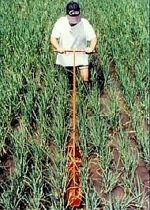
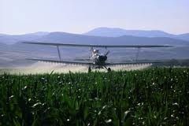
MECHANICAL
METHOD

Slide 68
AGRICULTURAL METHOD
IT COVERS ADVANCED PLANT BREEDING TECHNIQUES CAPABLE OF INDUCING GENETIC MANUPULATION RESULTING IN PRODUCTION OF PEST-RESISTANT SPECIES.
IT HAS PRODUCING RESISTANT ATTACK .
ACHIVED MUCH HYBRID VARIETIES
SUCCESS IN WHICH ARE
TO FUNGAL AND
BACTERIAL

Slide 69
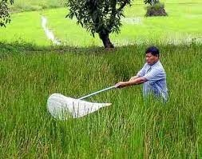
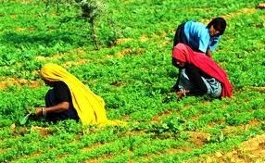
AGRICULTURAL
METHOD

Slide 70
BIOLLOGICAL METHOD
THIS METHOD IS PRACTISED BY THE PESTS, MOSTLY THE INSECTS LIVING ORGANISMS .
COMBATING WITH OTHER
IT MAY EMERGE AS AN EFFECTIVE SAFE AND ECONOMIC METHOD OF PEST CONTROL..

Slide 71
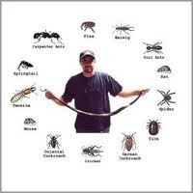
BIOLLOGICAL METHOD

Slide 72
COLLECTION OF MEDICINAL
PLANTS
HARVESTING
DRYING
NATURAL DRYING
ARTIFICIAL DRYING
TRAY DRYERS
VACCUM DRYERS
SPRAY DRYERS
PACKING
STORAGE & PRESERVATION OF CRUDE DRUGS.

Slide 73
HARVESTING
HARVESTING CAN BE DONE EFFICIENTLY IN EVWRY RESPECT BY THE SKILLED WORKERS..

Slide 74
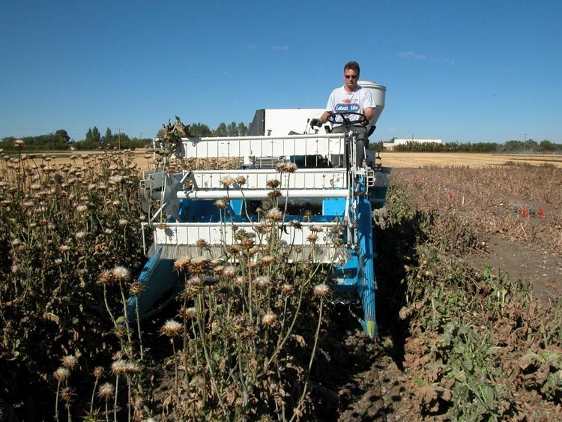
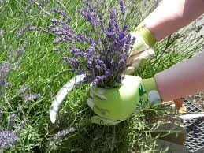
HARVESTING METHODS

Slide 75
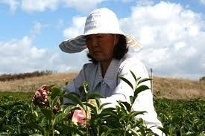
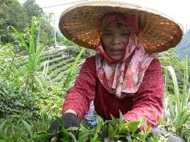
Leaf harvesting

Slide 76
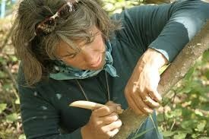
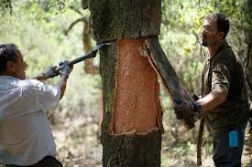
Bark harvesting

Slide 77
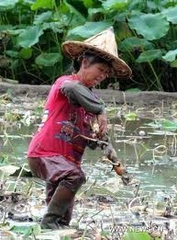
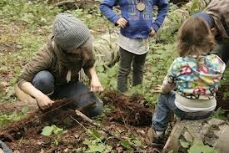
Root harvesting

Slide 78
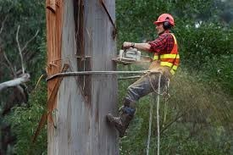
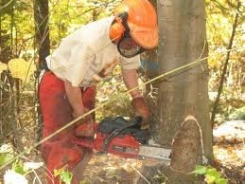
Wood harvesting

Slide 79
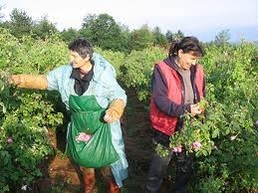
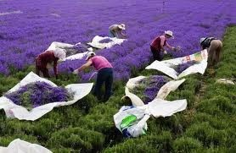
Flower harvesting

Slide 80
DRYING
DRYING CONSISTS OF
REMOVAL MOISTURE
OF SUFFICIENT
CONTENT OF CRUDE DRUG.
SO, AS TO IMPROVE ITS QUALITY AND MAKE IT RESISTANT TO THE GROWTH OF MICROORGANISMS.

Slide 81
NATURAL DRYING
IN CASE OF NATURAL DRYING IT MAY BE EITHER DIERCT SUN- DRYING OR IN THE SHED .
IF THE NATURAL COLOUR OF THE DRUG(DIGITALIS, CLOVE, SENNA) AND THE VOLATILE PRINCIPLE OF THE DRUG (PEPPERMINT)…

Slide 82
TRAY DRYERS
IN THIS THE
PROCESS
, HOT AIR OF
IS
DESIRED
TEMPERATURE
CIRCULATED
THROUGH
THE
DRYERS AND THIS THE REMOVEL OF
FACILITATES
WATER
CONTENT OF THE DRUG.

Slide 83

A. TRAY DRYERS

Slide 84
VACCUM DRYERS
THE DRUG WHICH ARE SENSITIVE TO HIGHER TEMPERATURE ARE DRIED BY THIS PROCESS
EX: TANNIC ACID, DIGITALIS LEAVES.

Slide 85

B.VACCUM DRYERS

Slide 86
SPRAY DRYERS
THE TECHNIQUE IS FOLLOWED FOR QUICK
DRYING
OF
ECONOMICALLY IMPORTANT PLANT OR ANIMAL CONSTITUENTS, RATHER THAN THE CRUDE DRUGS.

Slide 87

SPRAY DRYERS

Slide 88
GARBLING(DRESSING)
The next step in preparation of crude drug for market after drying is garbling.
This process is desired when sand, dirt & foreign organic parts of the same plant, not constituting drug are required to be removed.

Slide 89
PACKING
The morphological & chemical nature of drug, its ultimate use & effects of climatic conditions during transportation & storage should be taken into consideration while packing the drugs.
Aloe is packed in goat skin.
Colophony & balsam of tolu are packed in kerosene tins.
While asafoetida is stored in well closed containers to prevent loss of volatile oil.
The leaf drugs are stored in plastic bags.
The crude drugs like roots, barks, seed are packed in gunny bags.

Slide 90



Slide 91



Slide 92



Slide 93


Slide 94


Slide 95
Storage & preservation o f
crude drugs:
Preservation of crude drugs needs should knowledge of their physical & chemical properties.
All the drugs should be preserved in well closed and possibly in the filled containers.
They should be stored in the premises which are water- proof, fire proof and rodent proof.
A number of drugs absorb moisture during their storage and become susceptible to the microbial growth.
Apart from protection against adverse physical and
or
chemical changes, the preservation against insect
mould attacks is also important.

Slide 96


