Slide 1
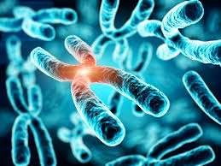
Mutation and Polyploidy
LADI ALIK KUMAR
Assistant professor Centurion University

Slide 2
Mutation- Introduction
Mutation is a sudden, hereditary change in the genetic make up of an organism.
The offspring resemble their parents in one or several aspects, yet there are differences between the two. These differences whether large or small are called variations.
Mutation is discontinuous variation. In molecular term, mutation is defined as the permanent and relatively rare change in the number and sequence of nucleotides.

Slide 3
History of mutation
Little was known about mutation before 19th century. Darwin first noticed sudden changes in the organisms in nature and referred those
changes as ‘sport’ or ‘mutation’.
In 1901 Hugo De Vries observed sudden changes in Oenothera lamarkiana such as Gigas(Large sized), nanella(dwarf) and other unusual changes..
De Vries called those sudden changes as mutation and were published in a book entitled The Mutation Theory.

Slide 4
The case of mutation was first noticed in England by Wright in 1791 in male lamb which had short legs, The ancon sheep had a short leg that appeared suddenly in flock of sheep and disappeared later. Again after 80 years they reappeared in Norway.
Morgan in 1904 reported white eyed Drosophila melanogaster in the population of red eyed flies.The term mutation was coined by De Vries.He derrived the term Mutation from the latin word ‘mutare’ meaning to change.
Mutation described by De Vries in Oenothera Lamarkiana are now known to be due to variation in chromosome number or ploidy and structural changes in the chromosomes.

Slide 5
After discovery of white eyed mutant, Morgan and his co-workers and other scientists have reported 500 mutants of Drosophila. Several cases of mutation have been observed in Neurospora, bacteria(E. coli) and bacteriophages, plants(pea, snapdragon, maize )etc and animal (rodents, fowl, men etc)

Slide 6
Types of mutation
On the basis of origin( causing factors)
– Spontaneous and induced mutation

Slide 7
Spontaneous mutation
Spontaneous mutations are those that arise occasionally in the absence of a known cause, i.e., without exposure to external agents.
These mutations may result from errors in DNA replication, or from the action of transposons, or even from the effect of some mutagenic agents present in the environment.

Slide 8
Spontaneous mutations
Caused mainly by: Spntaneous replication errors..
1.Tautomeric shifts
2. Wobble base pairing
3. Strand slippage
4. unequal crossing over
5. Spontaneous Chemical Changes : Depurination, Deamination

Slide 9
Induced Mutations
Caused by exposure to a mutagen
Causes
Exposure to base analogs
Chemical mutagens
Intercalating agents
Uv- radiation
Transposable elements
Mutator genes

Slide 10
Induced mutations
The mutation which are caused artificially in the living organisms are called induced mutations. Under experimental or artificial conditions induced mutations are caused. Any physical or chemical agent which introduces mutation in an organism is a mutagen or mutagenic agent.
.-

Slide 11
Types of mutation (on the basis of origin)
Mutation is of two types –
i)gene mutations or point mutations and ii)chromosomal mutations.
Gene mutations -include changes in the structure or composition of genes whereas
chromosomal mutations or chromosomal aberrations involve changes in the structure or number of chromosomes

Slide 12
i) Gene mutation or Micromutation
It is caused due to change in the structure of the individual gene of DNA molecule. It results due to change in nucleotide sequence of DNA molecule at particular region of chromosome.It involves just one or two bases in DNA molecule. Hence it is also called point mutation.

Slide 13
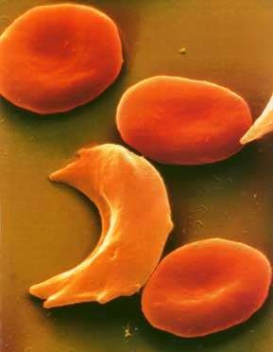
Gene mutation or Point Mutation
Sickle Cell disease is the result of one nucleotide substitution
Occurs in the
hemoglobin gene

Slide 14
Types of gene mutation
Gene mutation may be caused due to following changes in DNA and RNA.
–Substitutions
–Insertions
–Deletions
–Frameshift

Slide 15
Substitution mutation
One base pair is replaced by a different one is called substitution mutation. It occurs by two types
(i) Transitions- In transition, a purine is replaced by another purine and a pyrimidine is replaced by another pyrimidine i.e., A = T is replaced by G = C or vice-versa.
(ii) Trans versions-
In trans version, a purine is replaced by a pyrimidine or a pyrimidine by a purine, i.e., C = G is replaced by G = C or A = T is replaced by T = A.

Slide 16
A frameshift mutation is a genetic mutation caused by a deletion or insertion in a DNA sequence. There is shift in reading frame forward or backwarsd by one or two nucleotides.
Frameshift mutations arise when the normal sequence of codons is disrupted by the insertion or deletion of one or more nucleotides
It results in abnormal protein products with an incorrect amino acid sequence that can be either longer or shorter than the normal protein.
•

Slide 17
Types of Frameshift mutatiom
Addition or insertion mutation-
It is caused by addition of one base pair to a gene. All the triplets after insertion are affected
Deletion
It is the point mutation caused by loss of one base pair in a triplet code

Slide 18
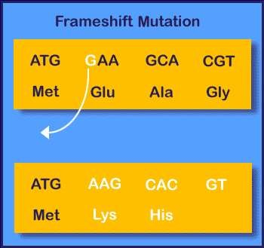
Amino Acid Sequence Changed

Slide 19
Chromosomal Aberrations
It is cause either by change in structure of chromosomes called
A) chromosomal aberrations(change in chromosome number) or
-B) Genomatic mutation of ploidy (Change in chromosomal number)

Slide 20
B. Changes Involving Change in the Structure of Chromosomes:
Some accidents sometimes occur which end in the breaking-down of chromosomes. The broken bits may get healed up or get re- attached in a wrong way or may even get lost.
structural modifications of chromosome occur in nature or by harsh treatment, chiefly by X- rays and other ionising radiations.

Slide 21
Deficiency:
A deficiency has a bit of a chromosome lost altogether. Some genes are, therefore lost. A deficiency may be terminal when it involves the end of a chromosome, or intercalary when it is an intermediate part that is deficient. Intercalary deficiency is also called deletion. Both terminal and intercalary deficiencies are known in maize

Slide 22
Duplication:
A broken bit of a chromosome may remain free in the nucleus as a fragment in addition to two complete homologues. However, no such fragment can survive if it does not contain a centromere.
Thus, some alleles will be represented thrice. The broken bit, instead of remaining free may also remain attached to some other broken chromosome (which may or may not be its homologue) at an intercalary position. It should be remembered that there can be no attachment to the unbroken telomere end.

Slide 23
Translocation:
A broken bit of a chromosome may get attached to some other chromosome. Translocations are usually reciprocal—somewhat resembling crossing-over but very different from the latter as whole chromosomes are involved here. Such reciprocal translocation may involve homologous or non-homologous chromosomes.
Simple translocation of only one bit of a chromosome to another is extremely rare. If that rare event happens, the broken bit may even get re-attached in a different position on the mother chromosome.

Slide 24
Inversion:
A segment of a chromosome gets inverted during reattachment. Thus, a chromosome having the genes abcdef in linear order may get the segment cd inverted.
Then the new arrangement will be abdcef.

Slide 25

Gene Mutation Animation

Slide 26
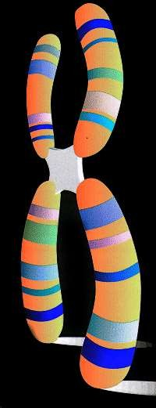
Chromosomal mutation or macromutation
Chromosomal mutation is caused by-
change in structure of chromosome (chromosoma l aberration) and
Due to change in chromosomal number(ploidy)

Slide 27
Chromosomal Mutations(chromosomal aberration)
Large pieces of chromosome may break off and be lost or reattach themselves in the wrong place.
Five types exist:
Deficiency
Deletion
Duplication
Inversion
Translocation

Slide 28
Deficiency
Loss of terminal segment
ABCDEF- ABCD(EF is missing)
Deletion
Loss of interacalary segment
ABCDEF- ABCD

Slide 29
Duplication
Segment or part of chromosome gets repeated
ABCDEFGH- ABCDEFEFGH

Slide 30
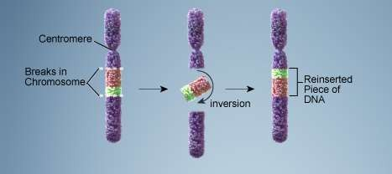
Inversion
Chromosome segment
breaks off
Segment flips around
backwards
Segment reattaches

Slide 31
Translocation
Involves two chromosomes that aren’t homologous
Part of one chromosome is transferred to another chromosomes
ABCDEF/IJKLMN- ABCDMN/IJKLEF

Slide 32
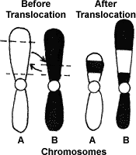
Translocation

Slide 33
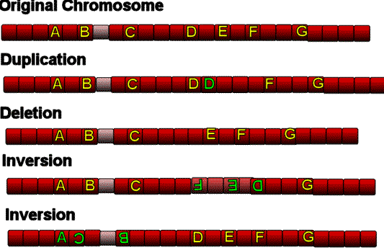

Slide 34
Genomatic mutation or ploidy
Mutations caused by the change in number of chromosomes is called ploidy or genomatic mutation.
It occurs mainly of two types-
– Aneuploidy and Euploidy

Slide 35
Aneuploidy
In aneuploidy the chromosome number is either one or more less or mor than the original number of chromosomes. Thus the total number of chromosomes is not exactly the multiple of haploid number. It is of following types-
Monosomics- due to loss of one chromosome from a complet set of chromosomes( 2n-1)
Nullisomics- Loss of single pair of chromosome(2n-2)
Polisomics- addition of one or more chromosomes
Trisomics(2n+1)
Tetrasomics(2n+2)

Slide 36
When the chromosome complement is increased by one chromosome, it is called trisomic (2n + 1). These are found in Drosophila and more common in plants. Organisms containing 2n—1 chromosomes are called monosomic but they are neither fertile and nor vigorous.
When both the chromosome of a given pair are missing, the individual is called a nullisomic (2n— 2). These are inviable in some species but viable in others.

Slide 37
If there are two homologues added to a chromosome pair, then it is called tetrasomic (2n + 2)

Slide 38
Euploidy
It includes the addition or loss of complete one set of chromosomes.
An organism with the basic chromosome number 7, may have euploids with chromosome number 7, 14, 21, 28, 35, 42. Euploids are further of different types – monoploids, diploids and polyploids.

Slide 39
In monoploidy or haploidy, it involves loss of complete one set of chromosomes. From the diploid set.Monoploids are usually smaller and less vigour. Eg. Male wasps, bees

Slide 40
Polyploidy
It involves the addition of one or more sets of chromosomes
An organism having more than two sets of homologous chromosomes is known as polyploid and the phenomenon polyploidy. It was discovered by Lutz. It is rarely found in animals but is of general occurrence in plants. eg in a diploid organism.

Slide 41
Types of polyploidy
Depending on whether polyploids are produced from chromosome sets of single species or from two different species, polyploidy is classified into two types-
i) Auto-Polyploidy,
ii) Allopolyploidy,

Slide 42
(i) Auto-Polyploidy:
Auto-Polyploids are derrived from the multiplication of chromosomes of same species. Same basic set of chromosomes is multiplied.
For instance, if a diploid species has two similar sets of chromosome or genomes (AA), an auto-triploid will have three similar genomes (AAA) and an auto- tetraploid will have four such genomes (AAAA), pentaploid(5n) and hexaploid(6n)
The chromosomes replicate during anaphase but the cytoplasm fails cleavage during cytokinesis.
Autoploids have vigour and are large sized.

Slide 43
One of the very common example of natural auto-ploidy is found in ‘doob’ grass (Cynodon dactylon).
Auto-triploids (3n) are usually sterile and cannot produce seeds. Hence they are used in producing seedless varieties such as water lemons, tomato, banana, grapes etc.
Likewise, auto-tetraploids are known in marigolds (Tagetes), maize (Zea mays), apples, and Oenothera, etc.

Slide 44
Autotetraploids:
These usually show greater vigour, increased cell size, mainly in stomata and guard cells. The auto-tetraploidy leads the plant to perenniality and may show reduced fertility.
Autotetraploids are slower in growth, have greater adaptability, variability and some times show disease resistance. Because of their greater economic importance and breeding possibility, auto- tetraploids are now induced artificially.
Auto-tetraploids have been reported in Sorghum, wheat, rice, maize, chilli, red gram, black gram, green gram, bengal gram, cotton, guava, coffee etc. It may arise by somatic doubling and somatic doubling generally happens by the failure of first meiotic division in the zygote.

Slide 45
(ii) Allopolyploids:
Polyploidy may also result from doubling of chromosome number in hybrid which is derived from two or more distinctly different species. This brings two (or more) different sets of chromosome in hybrid. The doubling of chromosomes in the hybrid, which gives rise to a Polyploidy, is called an allopolyploid.

Slide 46
An allotetraploid has been produced by by crossing Raphanus sativus (2n = 18) and Brassica oleracea (2n = 18). The hybrid formed by crossing these two species is itself a diploid (2n = 18). It contains only one set of radish chromosome (n = 9) and one set of cabbage (n =
9) chromosomes. The hybrid differs from both the
parents and showed many characters of both.
It is almost sterile, because radish and cabbage chromosome are so different that they do not pair or fail to pair at meiosis I. But the hybrid forms an occasional gamete which contains one complete set of radish chromosomes and one complete set of cabbage chromosomes.

Slide 47
When such two gametes combine they produce a plant which contains two sets of radish chromosome and two sets of cabbage chromosomes (18+18 = 36). These F₂ progenies were fertile and tetraploids. This plant showed foliage like radish and root like cabbage. The fruit was peculier.
It resembled the cabbage in its lower portion and the radish in its apical portion. The allotetraploid bred true, hence of no practical value. As it combines characters of both radish and cabbage, therefore, has been named Raphanobrassica.

Slide 48
Some of the synthetic allotetraploids resemble closely with the existing species. Various species like wheat, cotton, tobacco etc. might have developed by this method.
During the recent years a new genus Triticale has been synthesised by combining the chromosome of Triticum duram and Secale cereale (rye). This new genus Triticale is a very useful allopolyploid (2n = 56).

Slide 49
Techniques of Inducing Polyploidy:
1. Decapitation:
It has been found in various seedlings that if their tip is removed or cut off by a sharp knife the callus is produced which give rise to some polyploids.
2. Graft combinations:
It has been observed that callus formation occurs during the graft combinations i.e., 7% (fusion of stock and scion) which may lead to some extent polyploidy – Winkler, 1916.
3. Radiations:
Irradiation of vegetative and floral buds with X-rays, gamma rays or ultra-violet rays, polyploidy may be brought in some frequencies.

Slide 50
4. Temperature:
Application of heat and cold shocks to flowers at or near the time of first division of zygote brings about polyploidy.
5. Hybridization:
It also to some extent brings about polyploidy.
6. Chemicals:
the most effective results have been obtained by colchicine and this is now being widely used on all plant species. There are various chemicals like chloral hydrate, acenaphthelene, coumarine, vertanine sulphate cavadin, vernatrine, ethyl mercury chloride, vitamin sulphate, granosan, hydroxyquinoline and nitrous oxideetc.

