Slide 1
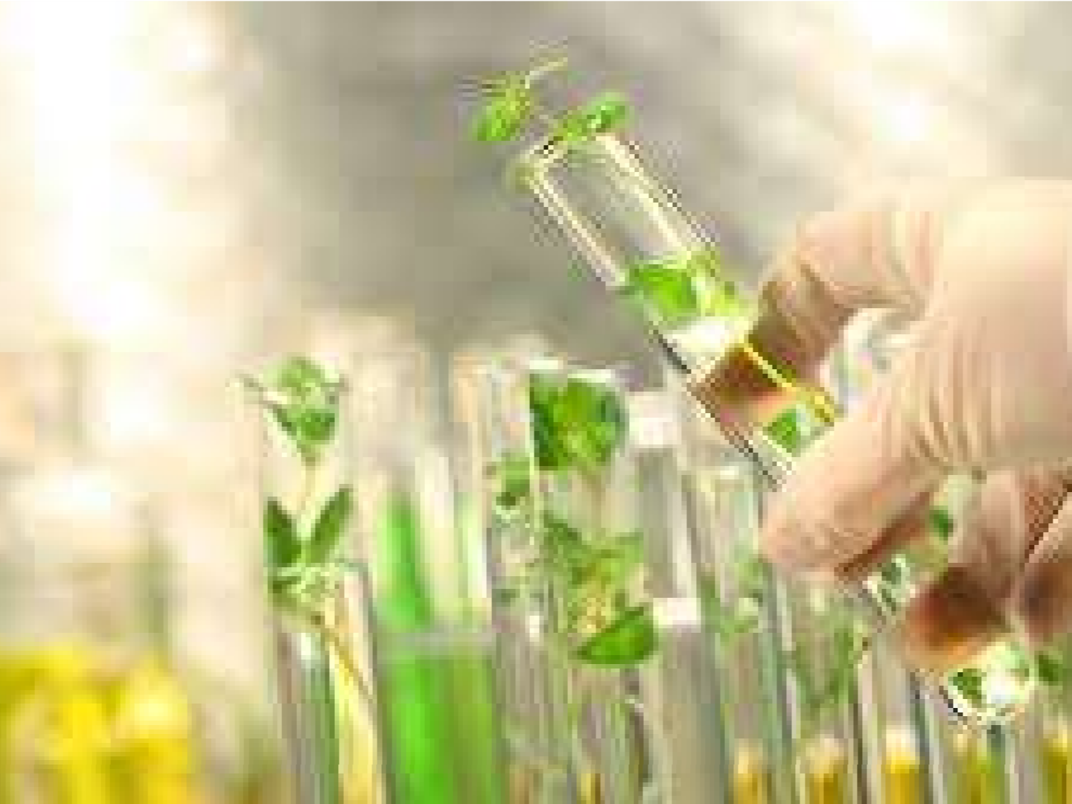
TISSUE CULTURE AS A PLANT PRODUCTION TECHNIQUE FOR HORTICULTURE CROPS

Slide 2



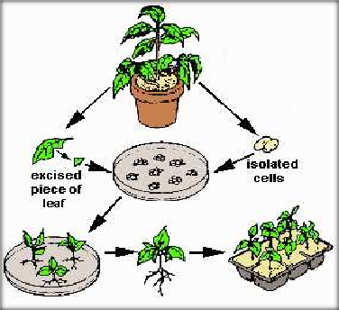
WHAT IS TISSUE CULTURE?
Tissue culture is the term used for “the process of growing cells artificially in the laboratory.
Origin : Early 20th century with the work of Gottleib Haberlandt (plants).
PLANT TISSUE CULTURE-Technique of growing plant cells, tissues, and organs in an artificially prepared nutrient medium under aseptic condition.
REQUIREMENT OF TISSUE CULTURE:
Appropriate tissue (explant)
A suitable growth medium (Some of the common media are MS, LS, Gamborg B5, White’s, Hellar for haploids etc)
Growth regulators
Aseptic (sterile) conditions
Frequent subculturing :
Plant cells are totipotent.

Slide 3


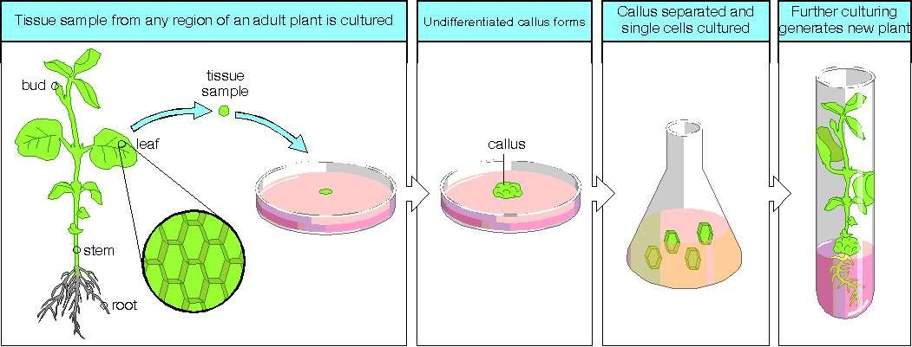
TYPES OF PLANT TISSUE CULTURE
SEED CULTURE
EMBRYO CULTURE
MERISTEM CULTURE
BUD CULTUR
CALLUS CULTURE
CELL SUSPENSION CULTURE
ANTHER CULTURE/OVARY CULTURE
PROTOPLAST CULTURE

Slide 4
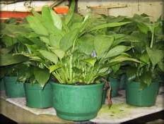
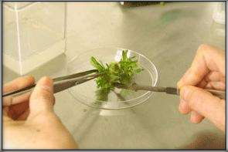
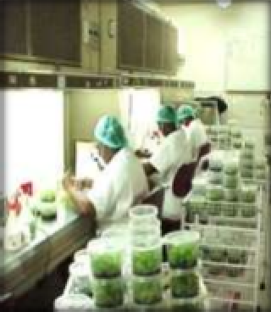
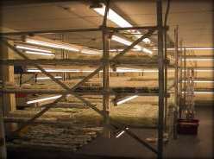
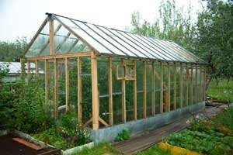
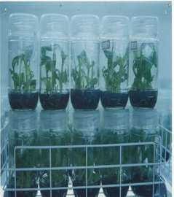
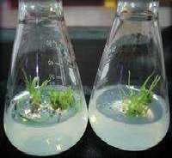
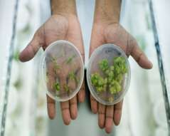
PROCESS OF PLANT TISSUE CULTURE
Parent plant
Selection of explant from mother plant
Inoculation
Light &warmth for shoot initiation
Plants are kept for hardening in green house ,sold to a nursery and then potted up.
Shoots are transferred to rooting media(higher auxin conc)
Shoot formation
Callus induction

Slide 5

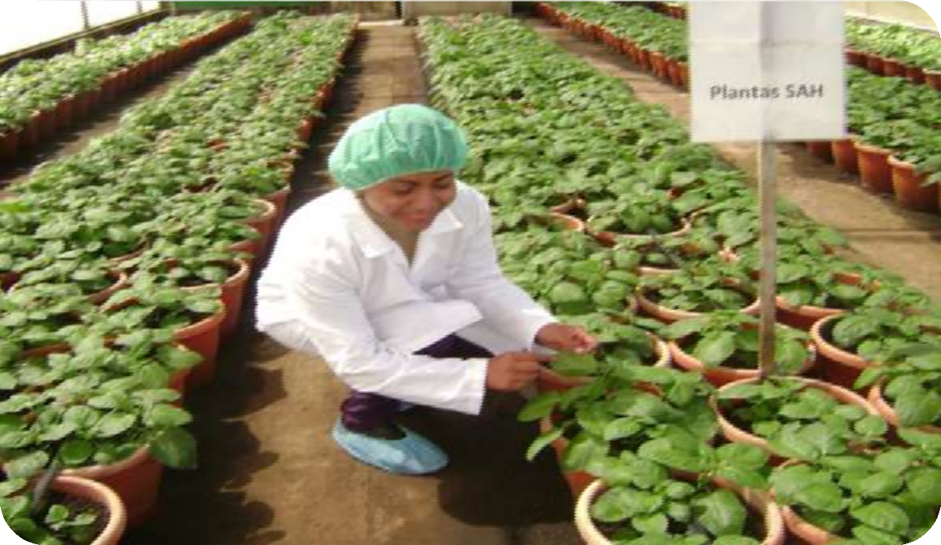

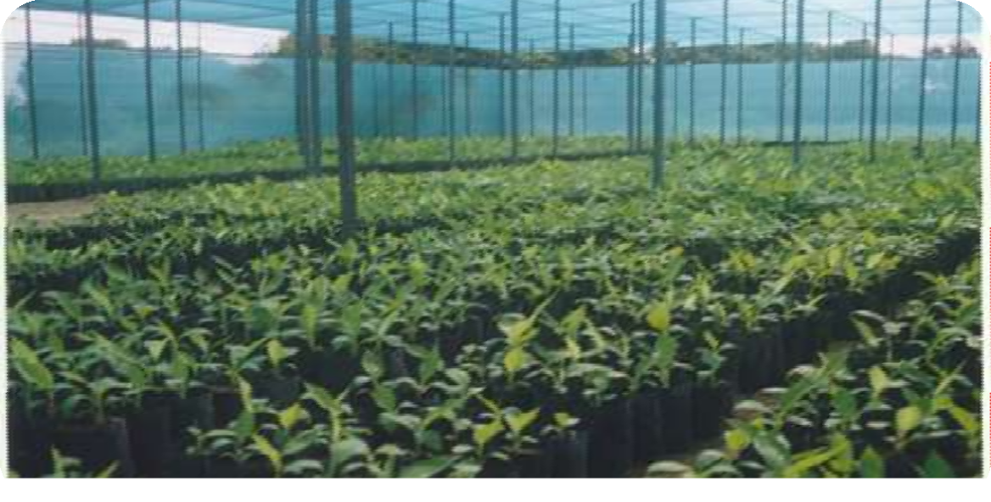

The rooted shoots are potted up (deflasked) and ‘hardened off’
This is necessary as many young tissue culture plants have no waxy cuticle to prevent water loss.
Tissue culture plants sold to a nursery & then potted up

Slide 6

FACTORS AFFECTING TISSUE CULTURE
Growth Media
  Minerals, Growth factors, Carbon source, Hormones
Environmental Factors
  Light, Temperature, Photoperiod, Sterility, Media
Explant Source
  Usually, the younger, less differentiated explant, the better for tissue culture
  Different species show differences in amenability to tissue culture
  In many cases, different genotypes within a species will have variable responses to tissue culture; response to somatic embryogenesis has been transferred between melon cultivars through sexual hybridization

Slide 7


Tissue Culture Applications
Micropropagation
Germplasm preservation
  Somaclonal variation
Haploid & dihaploid production
In vitro hybridization – protoplast fusion
  Embryo rescue
Synthetic seed production

Slide 8

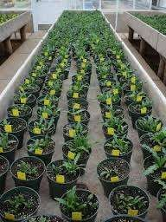
MICRO-PROPAGATION
Large scale production of genetically identical clones in vitro is called
Micro-propagation.
ADVANTAGES:
Millions of shoot tips from a small piece of plant tissue in a short period of time and space.
Maintain Genetically uniform progeny.
Can produce exact copies of plants required that have desirable traits.
Supplies plant throughout the year irrespective of seasonal variation
COMMERCIAL APPLICATION:
Micro propagation of Orchids demonstrated profit all over the
world.
Many other crops like banana, papaya, potato, gerbera, carnation, Anthurium, apple, pear,cherry etc have been grown through micro propagation are commercially exploited.
Development of disease resistant crops .Some valuable clones recovered from virus are
Tobacco- TMV, Sugarcane-Mosaic virus etc.
Among the innovative techniques of micro propagation, the concept of somatic embryogenesis with synthetic seed production or artificial seed technology is very promising,

Slide 9

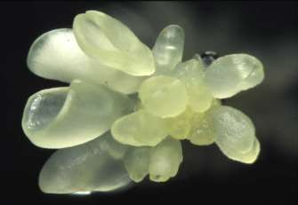
GERMPLASM CONSERVATION
Maintenance of germplasm of plants vulnerable to pathogen, insects and various climatic hazards and plants with early embryo degeneration, are difficult to maintain
Plant species which are endangered, rare threatened with extinction are needed to be conserved by ex-citu method of germplasm conservation.
Provides cost effective alternative to growing plants under field condition , nurseries or green houses.
Cryopreservation of germplasm is really effective in conservation biotechnology.
EMBRYO CULTURE
Using embryo culture seed dormancy can be overcome.
Embryo rescue which can circumvent post zygotic barriers.
To raise the rare hybrids by rescuing embryo from incompatible crosses is the most popular
application. The production of embryos from somatic or “non-germ” cells.
Usually involves a callus intermediate stage which can result in variation among seedlings

Slide 10
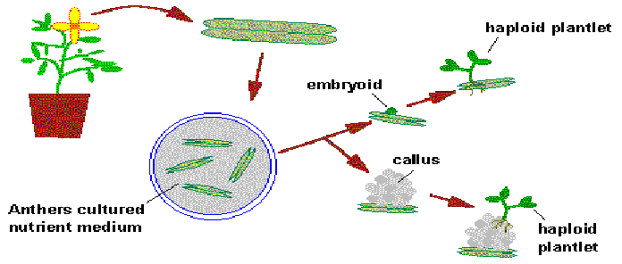
HAPLOID&DIHAPLOID PRODUCTION
Anther or Ovary/ovule culture
Production of pure homozygous line in leser time period.
Androgenic haploids are used to produce different lines of aneuploids like monosomic,nullisomic,trisomic etc.
Induction of mutagenesis
Recessive traits(e.g low glucosinolate in Brassica ) can be made expressed.
Use in hybrid development and early release of varieties.

Slide 11
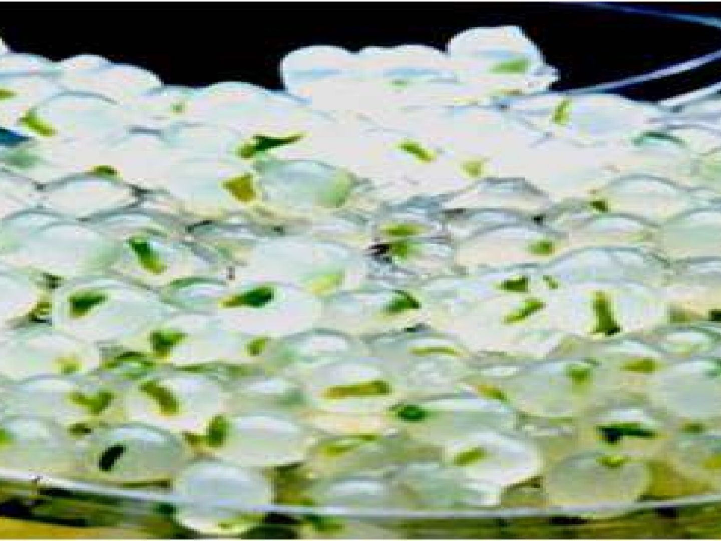
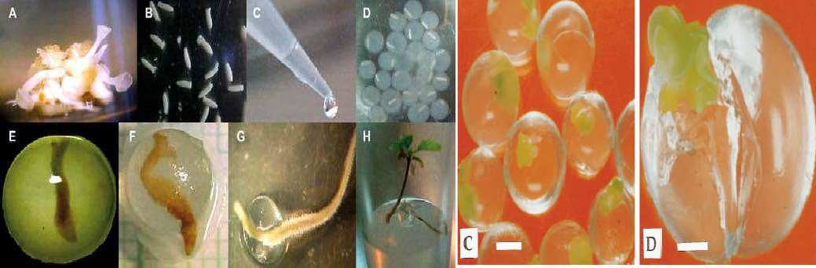
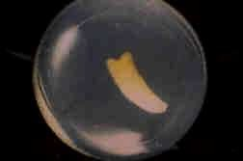
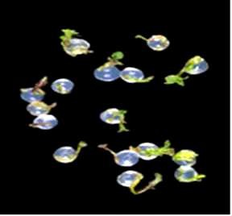
ARTIFICIAL SEED PRODUCTION
.
Synthetic or Artificial Seeds (living seed-like structure) are any totipotent cells(somatic embryos or meristem tips etc )which is artificially encapsulated by chemicals (Hydrogels) which behave like true seeds if grown in soil and can be used as substitutes of true seeds and possess the ability to convert into a plant ex vitro or invitro.
SOMATIC EMBRYO
ARTIFICIAL ENDOSPERM
ARTIFICIAL SEED COAT
GERMINATED SYNTHETIC SEEDS

Slide 12

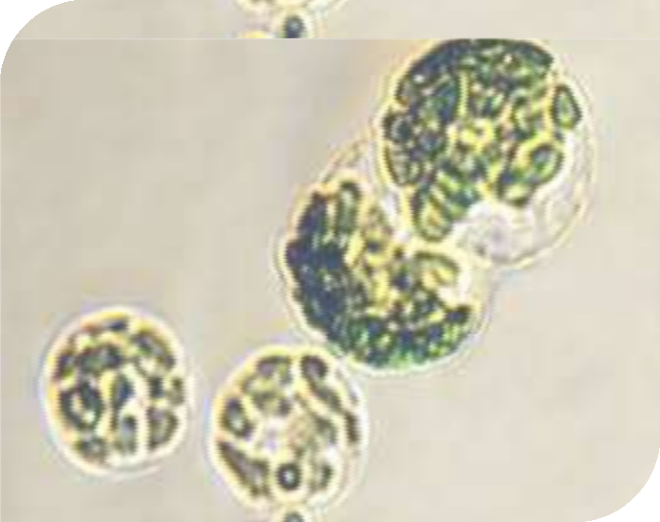
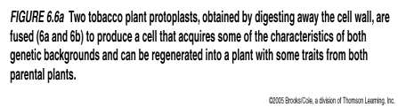
PROTOPLAST FUSION
Production of somatic hybrids.
Production of CMS line.
Somatic Hybrids with specific alien gene.
Production of Unique Nuclear Cytoplasmic
Combination.
Production of Autotetraploid or Allotetraploid.
Production of Heterozygous line.
SOMACLONAL VARIATION
Play an important role in polyploidisation.
Genetic variability can be raised which include resistance to a particular disease, herbicide resistance,stress tolerance etc

Slide 13
ADVANTAGES OF PLANT TISSUE CULTURE
A single explant can be multiplied into several thousand plants in less than a year - this allows fast commercial propagation of new cultivars. Very useful solution for the prevention of starvation in third world countries since the process is highly efficient i.e. by using only one plant it is possible to produce more than one thousand copies of the same plant with higher productivity if its genome is changed.
Taking an explant does not usually destroy the mother plant, so rare and endangered plants can be cloned safely.
Once established, a plant tissue culture line can give a continuous supply of young plants throughout the year.
The production of clones of plants that produce particularly good flowers, fruits, or have other desirable traits.
The production of multiples of plants in the absence of seeds or necessary pollinators to produce seeds.
Allows production of plants from seeds that otherwise have very low chances of germinating and growing, i.e.: orchids and Nepenthes.
The regeneration of whole plants from plant cells that have been genetically modified.
Tissue culture clones are ‘true to type’ as compared with seedlings, which show greater variability.
The production of plants in sterile containers reduces disease transmission. To clean particular plants of viral and other infections and to quickly multiply these plants as 'cleaned stock' for horticulture and agriculture.
Plant ‘tissue banks’ can be frozen, then regenerated through tissue culture.
Tissue culture allows fast selection for crop improvement - explants are chosen from superior plants, then cloned.

Slide 14

DISADVANTAGES OF PLANT TISSUE CULTURE
Chromosomal abnormalities appear as cultures age: undesirable changes.
Long term culture lose regenerative potential.
Expensive,labour intensive especially if less than 1000 plants are needed.
The procedure is quite variable and also it depends on the type of the species so sometimes it needs trial-and-error type of experiments if there is no available review about that species.
The procedure needs special attention and diligently done observation. There may be error in the identity of the organisms after culture.
Infection may continue through generations easily if possible precautions are not
taken
Decrease genetic variability.

Slide 15
ADVANTAGES OF TISSUE CULTURE CROP IMPROVEMENT
Tissue culture has been exploited to create genetic variability from which crop plants can be improved.
to improve the state of health of the planted material and to increase the number of desirable germplasms available to the plant breeder
The culture of single cells and meristems can be effectively used to eradicate pathogens from planting material and thereby dramatically improve the yield of established cultivars.
Large-scale micropropagation laboratories are providing millions of plants for the commercial ornamental market and the agricultural, clonally- propagated crop market. With selected laboratory material typically taking one or two decades to reach the commercial market through plant breeding, this technology can be expected to have an ever increasing impact on crop improvement as we approach the new millenium.

Slide 16

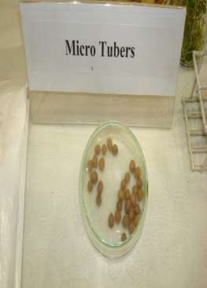
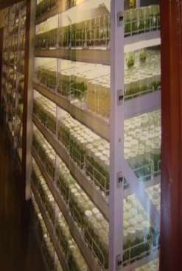
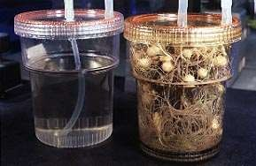
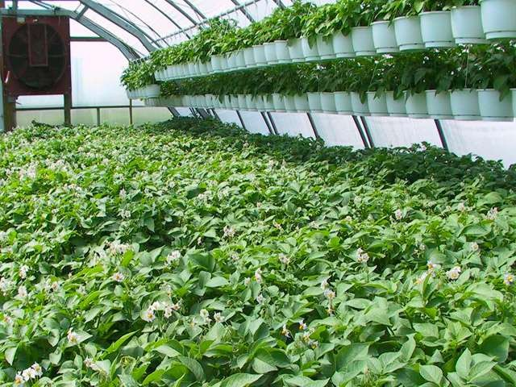
Research on some horticulture crops
1.POTATO (Solanum tuberosum)
Tissue culture plants are when grown In insect proof net houses produces mini tubers.
Tissue culture of mini tubers give 20- 30% higher yield.
Protected against bacterial disease aphids(bacterial disease-crop failure).
Uniform evenly shaped potatoes.

Slide 17
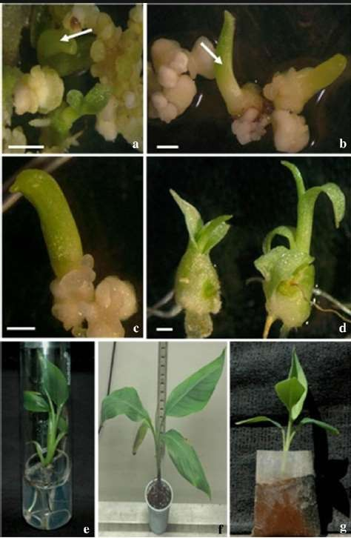
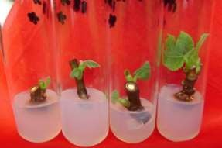
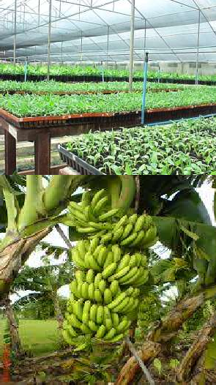
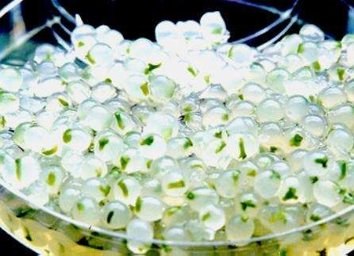
BANANA
PLUMUlE
SHOOT TIP
EXPLANT-SUCKER
Disease & pest free planting material.
Little space needed for multiplying large number of plants
Plantlets more vigourous , uniform shorter harvest period, higher bunch weights.
Allows for faster distribution of superior germplasm.
EMBRYO
GERMINATION
WELL DEVELOPED ROOT
& SHOOT
5CM PLUG PLANTS ARE GROWN IN GREEN HOUSE
ACCLIMITIZA
-TION STATE
SECONDARY HARDENING
COMPLETE PLANTLET
SYNTHETIC SEED OF BANANA
EMBRYO CULTURE OF WILD Musa SP

Slide 18
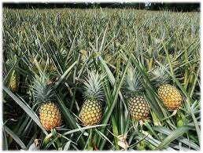
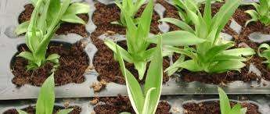

FRUITS
PINEAPPLE
Resistance to mealy bugs,nematodes,wilt disease,heart and root rot.
Uniform yield,uniform fruit weighing.
Faster growth and spineless darker leaves
Sweeter pulp
Ripens evenly and naturally
PAPAYA
Rapid and mass propagation of homogenous and uniform plants for both commercial and research purposes.
As the sex of the plant is known,the required nummber of male to female plant species can be produced.
To decrease mortality% and to increase gaermination%.
To increase yield.
To avoid papaya viral disease.
To obtain export quality food.

Slide 19

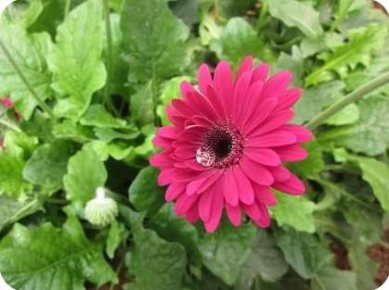
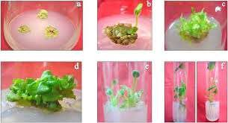
FLOWERS
SUNFLOWER
IMMATURE EMBRYO CULTURE-For the shortening of the entire lifecylce
To overcome seed dormancy.
In vitro tissue culture methods in sunflower accelerates the breeding process.
Gene from sunflower known as HAHB4, which helps the plant endure water shortages. That gene is introduced into wheat, soybean and maize.
GERBERA
Gerbera – hybrid seed germination followed by axillary bud proliferation and separation

Slide 20

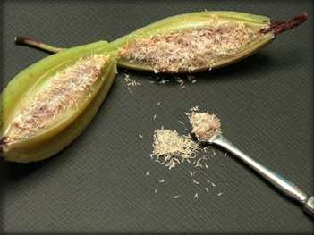
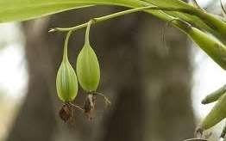
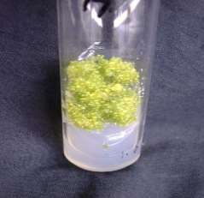

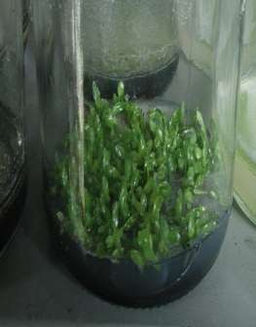
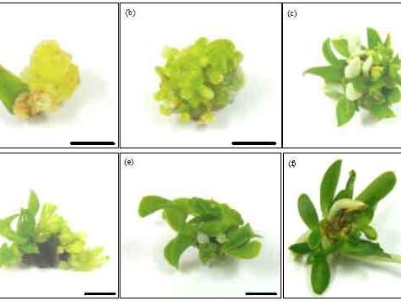
ORCHIDS
Seeds are exceedingly small with small reserves,loose their viability very fast so they need to be germinated in a nutrient medium.
Higher seed germination % even in rare to germinate species
Exact clones are produced .
Mass and rapid propagation.
Diseased free plant
Embryo rescue and culture in hybrid plant production.
CAPSULE OF ORCHID
MATURE CAPSULE BEARING SEEDS
CALLUS (OR PLB)OF ORCHID
INVITRO GERMINATION BY SEEDS
(a) Clump formation at the base of leaf segments on week three, (b) PLB initiation, (c) PLB development into shoots and roots, (d) direct shoot formation (e) shoot induced roots on week six and (f) 3-month- old plantlets

Slide 21
Conclusion
Plant tissue culture represents most promising areas of application and giving an outlook into the future.
While tissue-culture offers tremendous benefits, it could be a bane if undertaken improperly. It could be the fastest means of spreading disease in any crop. If the source of the material to be tissue-cultured is disease-infected, the resulting tissue-cultured plantlets will carry the disease. Since tissue culture could produce thousands if not millions of plantlets tremendously fast, the disease could spread super fast. Thus conducting tissue culture we must be sure that the parent plant is free from infection or disease.

Slide 22
THANK YOU

