Slide 1
Chemistry of Life
Proteins and Enzymes

Slide 2
Assignment
In the red/black book read the section titled:
Four levels of protein structure
-primary structure
-secondary structure
-tertiary structure
-quaternary structure
Summarize each subtopic
Tomorrow you should be able to discuss protein structure.
Maybe there will be a pop quiz!!!

Slide 3
#1. Protein Organization
Proteins have four levels of organization
  Primary structure = amino acid sequences
-these are polypeptide chains (between 50 and 1000 a.a. in length)
-20 amino acid names are on p. 69
-changing one of the amino acids in a sequence can change the entire protein
-the R groups of a.a. aid in shaping the protein

Slide 4
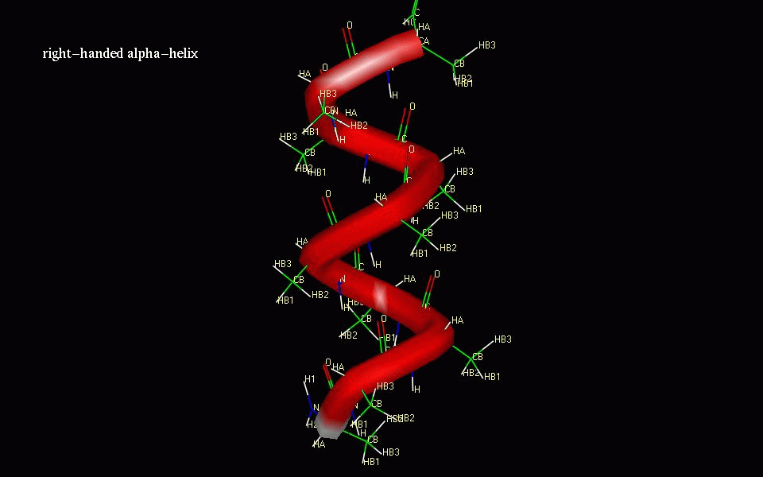
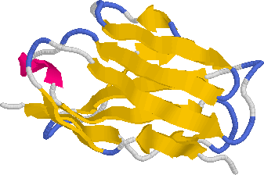
A. Proteins have four levels of organization (continued)
1. Secondary structure-describes the shape of the protein
-there are two types (alpha helices and beta pleated sheets)
-Beta sheets and alpha helices are stabilized by hydrogen bonding between groups in the main chains

Slide 5
A. Proteins have four levels of organization (continued)
3. Tertiary Structure – the overall shape of conformation of a polypeptide (the 3-D shape)
-caused by bonding of the R groups to each other
-hydrophilic R groups bond to each other
-hydrophobic R groups bond to each other
-types of bonds may include:
-covalent -ionic -hydrogen
-hydrophobic interactions

Slide 6
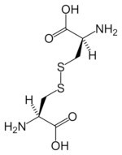
A. Proteins have four levels of organization (continued)
3. Tertiary structure continued:
-R groups that have sulfur will form covalent bonds with each other (this forms a disulfide bridge)

Slide 7
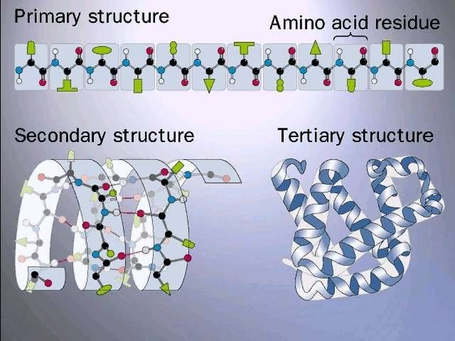
A Generic Protein

Slide 8
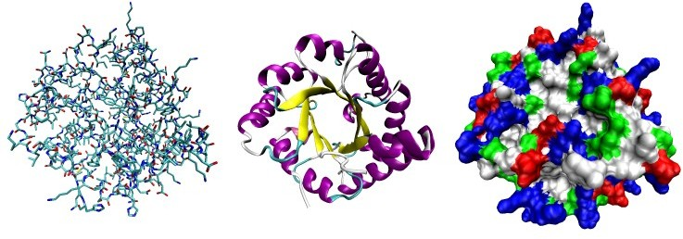
A. Proteins have four levels of organization (continued)
4. Quaternary structure- association of two or more polypeptide chains to form an entire protein
-see p. 75 for a good illustration
One protein shown three ways

Slide 9
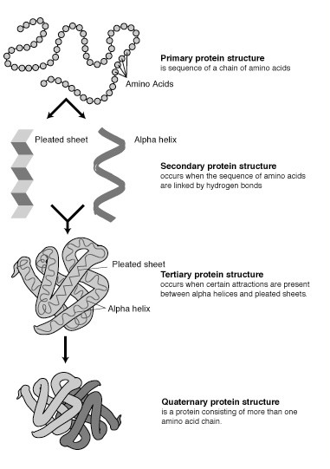

Slide 10
1. Draw the basic structure of an amino acid and label the groups that are used in peptide bond formation. [4]
2. Outline protein structure. [4]

Slide 11

#2. Protein types (fibrous and globular)
A. Fibrous proteins
-have long narrow shape
-insoluble in water
-Examples
collagens-found in connective tissue
-makes up extracellular matrix
-found in cartilage, ligaments, tendons, etc.
keratins-found in hair, nails and bird feathers

Slide 12
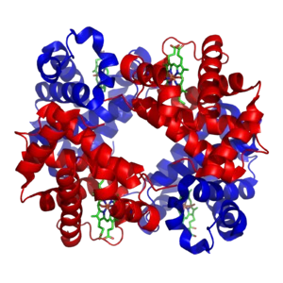
#2. Protein types (fibrous and globular)
B. Globular proteins
-have round shape (complex chains folded into complex configurations)
-water soluble
-Examples:
enzymes-catalase
hormones-insulin
antibodies-immunoglobulins

Slide 13
#3. Polar and Non-polar amino acids
Polarity of a.a. depends on the R groups
Polar a.a. have hydrophilic R groups
Non-polar a.a. have hydrophobic R groups

Slide 14
#3. Polar and Non-polar amino acids
D. Polar Amino Acids:
-water soluble (remember water is polar/when considering polarity ‘like attracts like’)
-In the cell membrane:
create channels in the proteins for hydrophobic substances to pass through
cause parts of membrane proteins to protrude from the cell membrane
Transmembrane proteins have two polar regions (one on surface and one in channel)

Slide 15
#3. Polar and Non-polar amino acids
E. Non-polar amino acids
-water insoluble
-stabilize the entire protein when found in the center of water soluble amino acids
-cause proteins to remain embedded in the cell membrane

Slide 16
#5. Specific Protein Examples
Enzymes (globular)
-Amylase: catalyzes the reaction of starch into maltose (first step of chemical digestion)
Hormones (globular)
-Insulin: hormone that reduces blood sugar
Antibodies (globular)
-Immunoglobulins: aid in defense against anitgens
Hemoglobin (globular)
-aids in binding oxygen to red blood cells

Slide 17
#5. Specific Protein Examples
Collagen (fibrous)
-provides structure for skin (without is we get wrinkled)
Actin and myosin (fibrous)
-aids in muscle contractions
Fibrin (fibrous)
-aids in clotting of blood

Slide 18
#6. Enzymes
A. Enzymes=globular protein molecules that accelerate specific reactions
-enzymes are a type of catalyst
-they speed up reactions without changing the products or equilibrium of the reaction
-assist in reaching equilibrium faster
-catalytic action of enzymes converts substrate to product faster

Slide 19
#6. Enzyme-substrate specificity
Enzymes are specific to certain reactants
Reactants=substrate (what you start with)
Enzymes have an active site

Slide 20
#6. Enzymes
D. Active site=where the substrate binds to the enzyme (the pocket/groove on the enzyme)
-not rigid, but it is specific enough to recognize only one substrate
-created by the tertiary and quaternary levels of protein organization
-when substrate enters the active site, it induces the enzyme to slightly change its shape to fit more snugly = induced fit

Slide 21
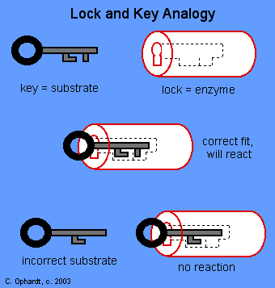
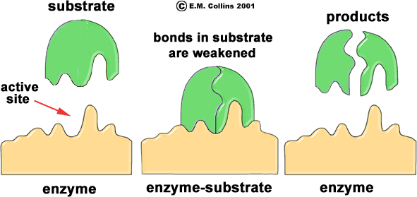
#7. Lock and key model
A.
B. Enzymes are substrate specific
C. Enzyme specificity is determined by the active site

Slide 22
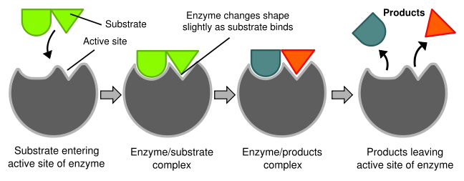
#8. Induced Fit
The enzyme has an almost perfect fit to the substrate
Once the substrate binds to the enzyme the fit becomes ‘tighter’

Slide 23
#9. Enzymes and Activation Energy
If two molecules are going to react with each other they must collide at a certain rate
The higher the activation energy, the higher the required speed
Enzymes reduce the required activation energy
The active site facilitates the chemical change

Slide 24
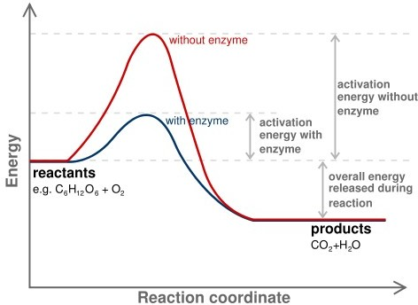
Graph of activation energy and energy release with and without the presence of an enzyme
**This is an exothermic reaction (energy is released)

Slide 25
#10. Temperature and Enzyme Activity
Increase in temp. can increase activity by increasing the number of collisions between active sites and substrates
If temp. increases too much, the enzyme will denature
Most enzyme/substrate interactions have temperature thresholds
Example: A typical human enzyme has an optimal temperature of 35-40 degrees Celsius
-After that the reaction rate sharply decreases

Slide 26
#11. pH and Enzyme Activity
Very similar to temp. info
Most enzymes have optimal pH (if the pH deviates to far from optimum the enzyme will denature)
Example: Pepsin in the stomach is an enzyme that aids in protein digestion
-Pepsin works best at pH of 2

Slide 27
#12. Enzyme Denaturation
When proteins unravel and lose their original conformation
Can be caused by extreme temperatures or pH levels
Prevents substrate from binding by changing the active site
The proteins become inactive

Slide 28
#13. Substrate concentration and enzymes
Increase in substrate concentration (with fixed enzyme concentration) increases reaction rate
However, if the substrate concentration increases too much the reaction rate will plateau much quicker
-the active sites will be occupied until products are formed
-this prevents other substrate molecules from binding

Slide 29
#14. Competitive Inhibition
Inhibitors-molecules that can reduce the effectiveness of enzymes
Competitive inhibitors-resemble normal substrate and compete for the active site
-prevents ‘intended’ substrate from binding to the active site
-adding more of the substrate may reduce the effects of the inhibitor

Slide 30
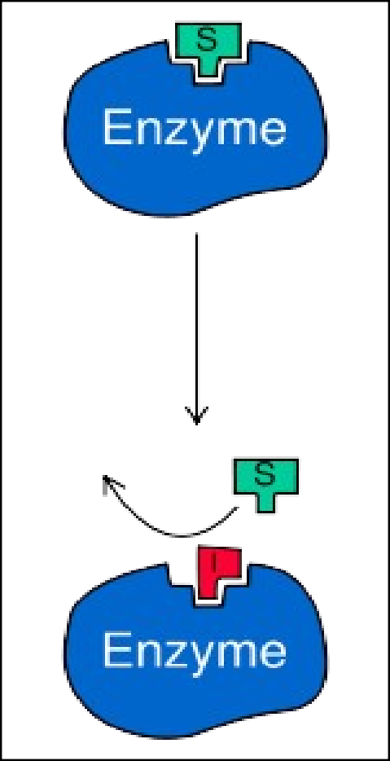
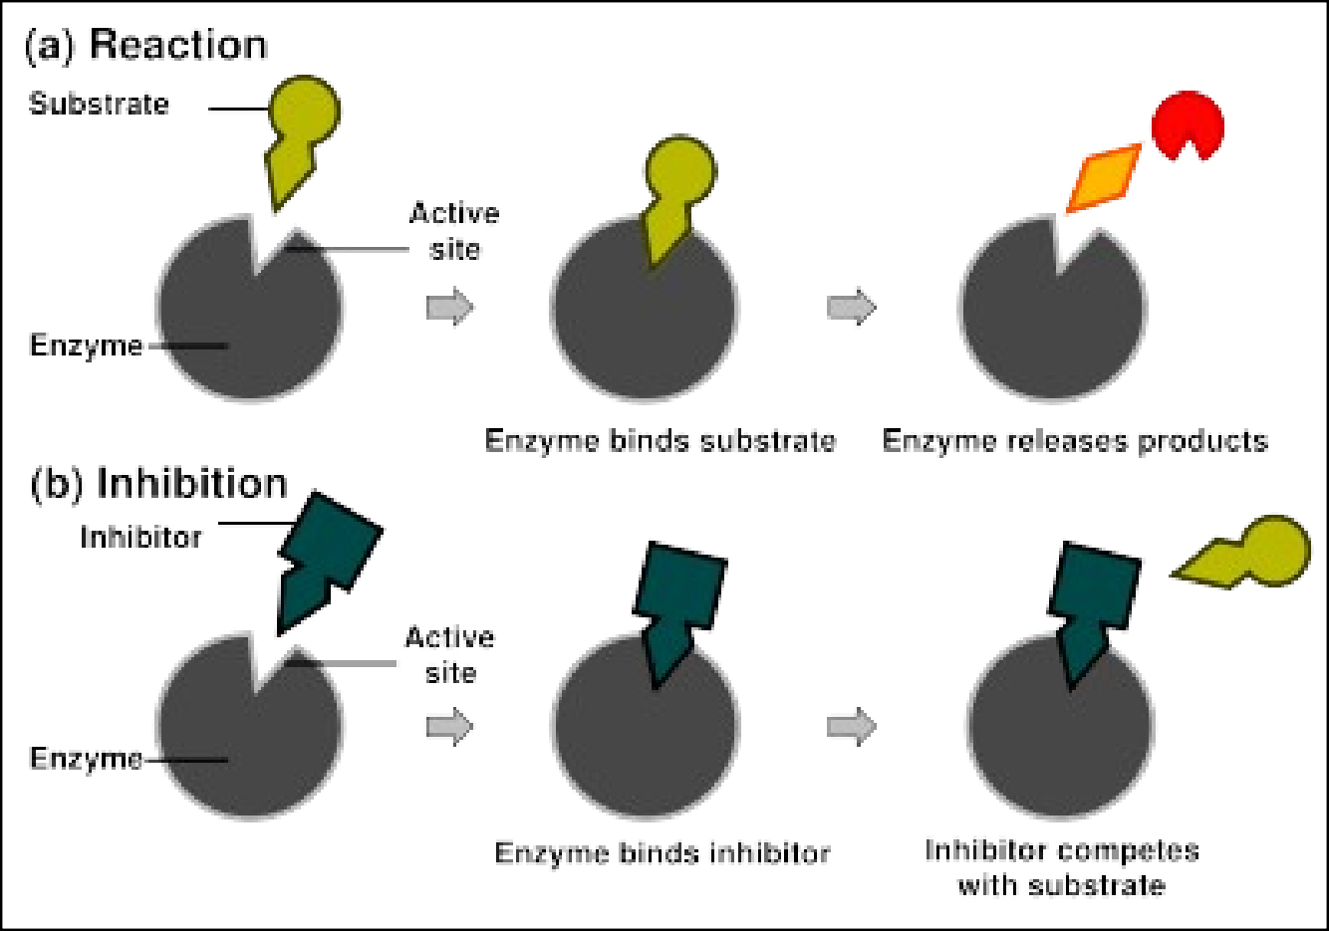
Competitive inhibition

Slide 31
#15. Non-competitive Inhibition
Occurs when an inhibitor binds to the enzyme (but not at the active site)
By binding to another place on the enzyme, the active site is changed
Prevents substrate from binding because the shape of the active site has changed
Adding more substrate will have no effect
Link

Slide 32
#16. Examples of Inhibitors
A. Competitive Inhibition-
Example: Prontosil (an antibiotic)
-works by inhibiting synthesis of folic acid in bacteria
-prontosil binds to the enzyme that aids in producing folic acid and the bacteria dies
** Our cells (animal cells) are not damaged because:
-they absorb folic acid from food
-they lack the enzyme to produce folic acid
-the drug has no effect on animal cells

Slide 33
#16. Examples of Inhibitors
B. Non-competitive inhibition Example: Cyanide (CN⁻)
-Cyanide attaches to sulfur groups and destroys disulfide bridges
-changes the tertiary structure of the enzymes
-the active site becomes changed and cellular respiration is disturbed
-energy is not released (no ATP)
-if cyanide effects too many cells, the organism dies

Slide 34
#17. Enzymes and Metabolic Pathw
Reactions occur in specific sequences
Enzymes catalyze each reaction
Some build organic compounds and require energy (anabolic pathways)
Some break down organic compounds and release energy (catabolic pathways)

Slide 35
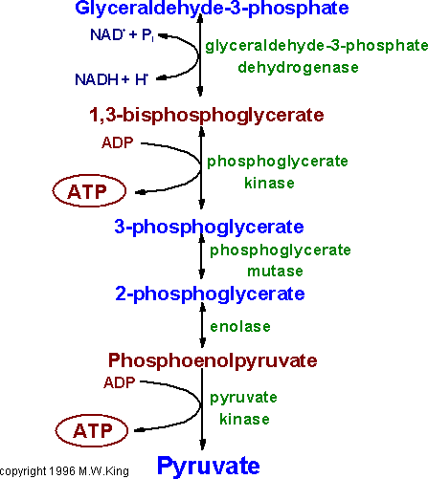
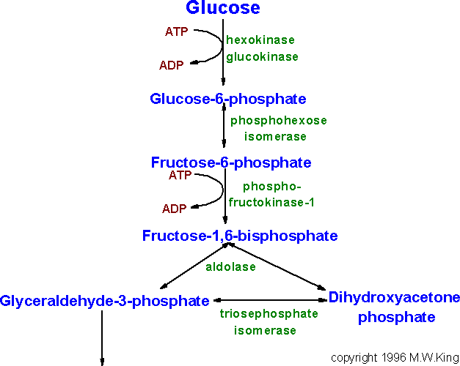
E. Some metabolic pathways are chain rxns.
-Example: glycolysis (chain of ten enzyme controlled reactions that convert glucose into pyruvate)
-General reaction:
initial substrate→intermediate(s)→product

Slide 36
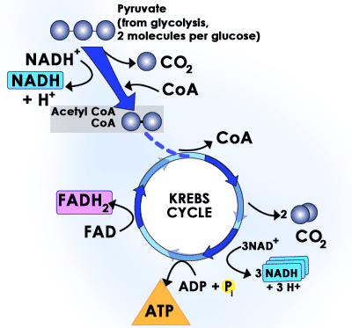
F. Some pathways have reaction cycles
-substrate is continuously generated
-Example: Kreb’s cycle

Slide 37
#18. Enzymes and Allostery (96-97)
Allostery-a type of non-competitive inhibition
In some metabolic pathways the product of the last reaction inhibits the enzyme that catalyzed the first reaction
This is end-product inhibition
Allosteric enzymes=enzymes that are made of two or more polypeptides and can be inhibited by the end product

Slide 38
#18. Enzymes and Allostery
E. Allosteric enzymes
-have two non-overlapping binding sites (one is the active site, the other is the
allosteric site)
F. Allosteric site=binding site for the end product
-when the end product binds it changes the shape of the active site and prevents substrate binding
-the process can be reversed

Slide 39
#19. Advantages of Allostery
If there is an excess of end-product the entire pathway is “switched off”
If there is a decrease in end-product the inhibitor will be removed and normal activity resumes
Allostery is a type of negative feedback by preventing the over production of end product

Slide 40
#20. Negative feedback
A. Negative feedback acts to establish continuous equilibrium
-Example: The AC unit in your home has a set temperature
-when the temperature gets too far above or below the set temp. the AC unit turns on
-when the set temperature is reestablished the AC unit turns off

Slide 41
#21. Allosteric effectors
Two types
  allosteric activators-speed reactions up
  allosteric inhibitors-slow the reactions down
End products of metabolic pathways can act as allosteric inhibitors
Example: Phosphofructokinase catalyzes a reaction in glycolysis (end products ATP and pyruvate)
-If ATP is already present it will bind to the enzyme to prevent further ATP production

Slide 42
#22. Lactose intolerance
Lactose intolerance describes the bodies inability to break down lactose in dairy products
Dairy alternative usually contain the lactose digesting enzyme lactase
Lactase breaks down 70-100% of the lactose into glucose and galactose
The nutritional value of the milk remains the same (as if lactase was not present)

Slide 43
#22. The lac operon: controlling gene expression
Studied in prokaryotes
Jacob and Monad (1961)
-studied synthesis of lactose digesting enzymes in E. coli
-found that E. coli do not produce lactose digesting enzymes when grown in a medium without lactose
-when E. coli were placed in a lactose rich environment, they produced lactase w/in minutes

Slide 44
#22. The lac operon: controlling gene expression
C. If lactase is produced, the gene is ‘on’
D. If there is no lactose, lactase is not produced and the gene is ‘off’

Slide 45
#23. The Operon Model
Proposed by Jacob and Monad
Explains switching of the genes on and off
Operon=promoter, operator and structural genes
The lac operon is found in E. coli

Slide 46
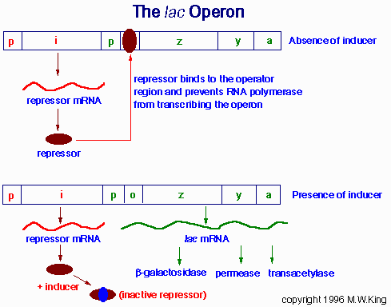
(lactose)
(lactose)

