Slide 1
Fibres

Slide 2

Content
Introduction
Classification
Cotton
Hemp
Jute

Slide 3

FIBRES
Tissue composed of Spindle shaped or elongated thick walled cells with pointed ends, cell walls of which consist of cellulose and may or may not contain lignin.
Fibres are developed from single cell, the fibre initial, which during its development grows rapidly in the axial direction.
They are unicellular in structure.
During its growth period, the tips of the elongating cells may push one another. This process is known as “Gliding growth.”

Slide 4
Differentiation of fibres:
On the basis of tissue in which they occur they are diffrentiated as:
  Pericyclic fibres
  Phloem fibres
  Xylem fibres
Pericyclic fibres: They are found in the pericyclic region i.e. near xylem and phloem. May or may not be lignified.
Pholem fibres: They are found in the phloem region May or may not be lignified.
Xylem fibres: They are found in the xylem region. They are dead and always lignified elements.

Slide 5
Classification of fibres:
Fibres
Natural
Artificial
Plant
Animal
Mineral
Regenerated
Synthetic
Nylone,
terylene
Glass,
Cotton, Jute, Hemp,
Asbestos
Carbohydrate
Flax, Banana
Alginate yarrn, viscose rayon, Proxyline, Acetated Rayon
Wool, Silk
Protein
Aridil, Fibroline

Slide 6
Identification of fibres
Microscopical examination
Physical test like ignition test
Various chemical test are done like
MOLISCH’S TEST: Sample + α-napthol in alcohol and conc. Sulphuric acid Violet colour- Plant and regenerated fibres present
MILLION’S TEST:
Sample + Millon’s reagent + Warm Animal fibres present
Red colour-

Slide 7
COTTON
SYNONYM:- Raw cotton or absorbent cotton, surgical cotton, purified cotton
BIOLOGICAL SOURCE:- Cotton consist epidermal trichomes or hairs of the
of the seeds of
cultivated species of the Gossypium herbaceurre , G. herbaceum, G. barbadense, G. hirsutum
FAMILY:- Malvaceae

Slide 8
COTTON
Purified or absorbent cotton consist of the trichomes as mentioned above, but freed from fatty matter, and adhering impurities. It is also bleached and sterilized.
GEOGRAPHICAL SOURCE:- Africa, South africa etc.
USA,
Egypt,
India,

Slide 9
Cotton Preparation
Seeds are covered with the hairs are known as Bolls.
They are collected, dried and taken to ginning press where trichomes are separated from the seeds.
Various devices are used to separate the hairs.
The short and long hairs are separated from each other. The hairs with short length are know as Linters and used for the manufacture of absorbent cotton
while long hairs are used for the preparation of cloth.
The raw cotton obtained by this way is full of impurities, like wax, fat, coloring matter, vegetable debris etc.

Slide 10
Cotton Preparation
It is processed to get rid of most of the impurities.
It is taken to the machine known as cotton opener and followed by treatment with dilute soda solution or soda ash solution under pressure for about 10-15 hours.
The wax, fatty material and coloring matter are removed by this treatment.
It is then washed with water and treated with suitable bleaching
agent.
It is again washed with water, dried and carded into flat sheets.
It is finally packed in wrappers and sterilised by means of
Gamma radiations.

Slide 11
Morphological Description
Size- 2.5 to 4.5 cm in length and 25 to 35µ in diameter.
Shape- Cylindrical when young, but becomes flattened and twisted as it matures
Colour- white (Due to bleaching), Slightly off white if sterilized
Odour- Odourless
Taste- Tasteless
Extra features: Appearance is soft, fine, filament like hairs which are unicellular

Slide 12
Microscopical Characters
The trichomes are unicellular, flattened and ribbon like with slightly thickened and rounded apex.
They are tubular and hollow.

Slide 13

Chemical Constituents
90% of cellulose,
7-8% of moisture,
0.4% wax, fat, oil,
0.6% protoplasm and other cell content and
0.2% ash.
Purified cotton or absorbent cotton is
entirely
cellulose with 6-7% of moisture and 0.2-0.3% ash.

Slide 14
CHEMICAL TESTS
1. Specific test for cotton:- Cotton fibres + N/50 iodine Solution+ dry it + add few ml. of 80% sulfuric acid Trichomes assume purplish-blue
or bluish-green colour (Distinction from
yarn
jute, and
hemp, wool, silk, nylon, alginate
acetate rayon)
2. Cuoxam test:- Raw cotton fibres + Ammonical
copper dissolves balloons,
oxide solution (cuoxam-reagent)
raw cotton fibres with formation of
while absorbent cotton dissolves
completely with uniform swelling.

Slide 15
CHEMICAL TESTS
3.Cotton + dilute sodium hydroxide solution and HCl
Insoluble (Distinction from silk).
4.Cotton + Cold 80% of sulfuric acid Soluble. And insoluble in cold 60% sulfuric acid, Conc. HCl, 5% KOH, 90% phenol, cresol, acetone

Slide 16
USES
Filtering medium and surgical dressings.
Insulating material
Absorbent cotton absorbs blood, mucus, pus and prevents the wounds from infections.

Slide 17
STORAGE
store in cool place.
The absorbent cotton should be wrapped in wrappers so as to prevent the dust and microbial contamination.

Slide 18
Hemp
Synonyms: Cannabis Indica, Indian hemp, Ganja, Marihuana, Charas.
Biological source:
Hemp fibre is obtained from the bast of the plant Cannabis sativa
Family: Cannabinaceae.

Slide 19

Cultivation
There are broadly three groups of Cannabis
varieties being cultivated today:
Varieties primarily cultivated for
their and
fibre, little
characterized by long stems
branching, called industrial hemp.
Varieties grown for seed from which hemp oil is extracted.
Varieties grown for medicinal or recreational purposes.

Slide 20

Preparation & Morphology
Fibres are obtained by subjecting the stalks to a series of operations—including retting, drying, and crushing—and a shaking process
that completes separation from the woody portion, releasing the long, fairly straight fibre, or line.
The fibre strands, usually over 1.8 metres (5.8 feet) long, are made of individual cylindrical cells with an irregular surface.
The fibre diameter ranges from 16 to 50 microns.
The fibre, longer and less flexible, is usually yellowish, greenish, or a dark brown or gray and, because it is not easily bleached to sufficiently light shades, is rarely dyed.

Slide 21
Chemical Constituents
Long, strong and durable, hemp fibres are about 70% cellulose and contain low levels of lignin (around 8-10%).
Pectin-2.9%
Fat-Wax-0.9%
Mineral-1.8%

Slide 22
Uses
Hemp has been used for centuries to make rope, canvas and paper
Cloth
Filter

Slide 23

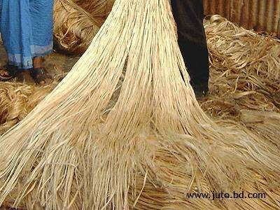
Jute
Synonym :- Gunny.
BIOLOGICAL SOURCE:
It consists of phloem fibres from the stem of various species of the Corchorus; C. capsularis Linn, C. olitorius Linn, and other species like
C. cunninghamii, C. junodi
etc., belonging to
family :- Tiliaceae.

Slide 24

Jute
Geographical Source :-
  West Bengal and Assam.
Description :-
  They are tall, usually annual herbs.
  Reaching to a height of 2–4 m, unbranched and if branched it has only a few side branches.
  The leaves are alternate, simple, lanceolate, 5–15 cm long and a finely serrated or lobed margin.
  The flowers are small (1.5–3 cm in diameter) and yellow, with five petals;
  The fruit encloses many seeds in the capsule

Slide 25
Jute: Preparation
Retting is the process for the preparation of bast fibres.
This process is done by three methods,
  Microbial (or Water),
  Steam
  Mechanical Process.
The microbial or water retting process is the oldest and the popular method employed for the breaking of lignin bond present between parenchyma and sclerenchyma.
The breaking of this bond facilitates the easy procurement of skin from its core.
Then the material is washed dried to release pectin bond
which makes the hard skin to fine thread like fibres.
The jute fibres are graded according to its colour, strength and fibre length.
The fibres are of white to brown and 1–4 m. long

Slide 26

Jute
Microscopy :-
A thin transverse section of the strand when treated with phuloroglucinol and HCl, stains the strands deep red, indicating the presence of lignin.

Slide 27

Chemical Constituents
Cellulose → 50-53%
Hemi-cellulose → 20%
Lignin → 12-13%
Water Soluble matter → 1.5%
Fat and Wax → 1 % each

Slide 28

Jute: Uses
It is listed as the second most important vegetable fibre after cotton.
Jute is used chiefly to make cloth for wrapping bales of raw cotton, in the preparation of sacks and coarse cloth.
They are also woven into curtains, chair coverings, carpets,
Hessian cloth very fine threads of jute can be made into imitation silk and also in the making of paper.
It is even used in the manufacture of tows, padding splints, filtering, and straining medium.
Jute is used for the preparation of coarse bags.

Slide 29
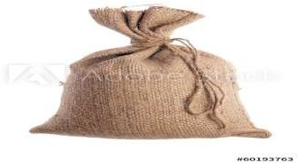
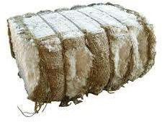
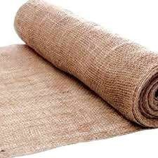
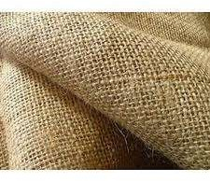
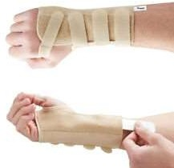
sacks
Bales of raw cotton
Hessian cloth
Padding splints

Slide 30



