Slide 1
Conformations of Cyclohexane
* Sachse’s suggestion(1890) : CH exists in Folded form. All nuclear carbons do not lie in one plane.
Chair Conformation
Boat Conformation
Twist boat Conformation or Skew Boat Conformation
Half Chair Conformation

Slide 2
Chair Conformation
Shape : Like a Chair
No. of Carbon atoms
All Carbon atoms
: 06
: sp³ hybridised
Bond angle between any two bonds : 109⁰ 28’
No. of Hydrogen atoms : 12
Two sets of Hydrogen atoms : 06 + 06
Axial hydrogen atoms
Equatorial hydrogen atoms

Slide 3
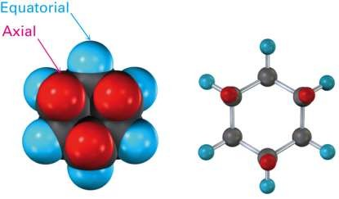
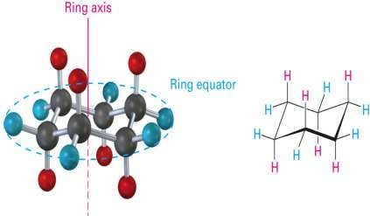
Axial and Equatorial Bonds in Cyclohexane
There are two kinds of positions for substituents on the cyclohexane ring
Axial positions – 6 axial positions perpendicular to ring and parallel to ring axis. Bonds in these positions are axial bonds and atoms/grps. are axial
Equatorial positions – 6 equatorial positions are in rough plane of the ring around the equator, i. e. Projecting outwards the ring. Bonds in these positions are equatorial bonds and atoms /grps are equatorial

Slide 4
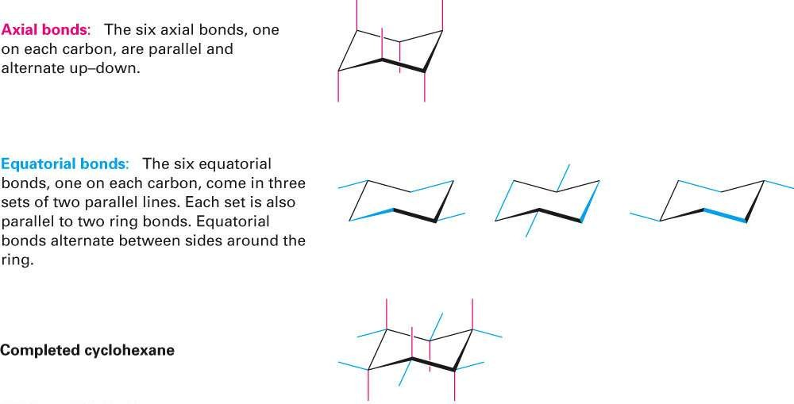
Axial and Equatorial Bonds in Cyclohexane

Slide 5
Boat Conformation of Cycohexane
Shape : Like a boat
No. of Carbon atoms
All Carbon atoms
: 06
: SP³ hybridised
Bond angle between any two bonds : 109⁰ 28’
No. of Hydrogen atoms : 12
Four types of Hydrogen atoms : 2 + 2+ 4+4
Flag pole Hydrogen atoms : 2
Bow-sprit Hydrogen atoms : 2
Quasi axial Hydrogen atoms : 4
Quasi equatorial Hydrogen atoms : 4

Slide 6
Steric Strain
Steric strain is the increase in potential energy of a molecule due to repulsion between groups on non-neighbouring carbons

Slide 7
Types of Hydrogen atoms in Boat Conformation
Ring Axis
^{H}fp
Hfp
^{H}bs
Hbs
^{H}qe
^{H}qe
^{H}qe
^{H}qe
^{H}qa
^{H}qa
^{H}qa
^{H}qa
fp : Flag Pole,
bs : Bow – sprit ,
qa : quasi axial,
qe : quasi eqautorial

Slide 8
Twist Boat and Half Chair Conformations
Twist Boat : Twisting of the boat results in release in steric strain due to fp-fp interactions. _{H}
H
H
H
H
H
H
H
Half Chair Conformation : If C₁ or C₄ of chair conformation is brought in the average plane of the ring, the resulting conformation is known as Half chair conformation.The conformation has both angle strain and
torsional strain
H H
H
H
H
H
H
H

Slide 9
Stability of Conformations of Cyclohexane
Decreasing Order of Stability
Chair > Twist Boat > Boat > Half Chair

Slide 10
Explanation Stability
Factors contribute to instability of conformations
Bond distortion strain
Charge repulsion strain
Bond opposition strain
Steric strain
In cyclohexane due to ring puckering and uncharged nature bond opposition and charge repulsion strain are irrelevant.
Bond opposition and steric strain contribute to internal strain in CH.
Different conformations of CH differ in internal strain and hence in
PE content.

Slide 11
1. chair conformation: Bond opposition and steric strain
are minimum.
C-H bonds are perfectly staggered
∴Bond opposition strain is minimum.
‘H’ atoms on adjacent carbon atoms have enough space
for their accommodation.
( Sum of van der Waal’s is 2.5Aº , where as ‘a’ and ‘e’ H atoms on adjacent C atoms are separated by 2.3º .)
∴Steric strain is minimum.
H
H
H
H H
6
H
H
H
1
H
H
1
2
H
H
5
H
3
4
H
H
6
H
2
5
H
3
H
H
H
H
H 4
H
Therefore PE content of chair conformation is minimum. Hence it is most stable.
H

Slide 12
Boat Conformation: suffers from two strains
Bond opposition strain: C-H bonds on the sides are eclipsed.
Fp – Fp interaction: Distance between two Fp Hs is 1.84Aº
Distance required is 2.5Aº
These two strains make boat conformation highly strained. It has 29.71kJ/mol more energy than chair conformation.
1.84A ⁰
H H
H
1
H H
H
H
1
4
H
H
H
H
H H
H
4
2 3
6
H
H H 6
H
5
2
3
5
H
H
H H
H H
Therefore boat conformation is less stable than chair
conformation.
Thermodynamic calculations : 0.1 to 0.2 % boat form i.e. 1 or 2 molecules per thousand.

Slide 13
Twist or Skew boat Conformation:
Less torsional strain as compared to boat conformation. Flag pole Hs are away from each other.
C2, C3, C5 and C6 become non-planer.
H
Fp
Fp
H
H
1
4
H
2
6
5
Energy content : 6.696kJ less than boa³t but 23.02kJ more than chair.
Therefore more stable boat but less stable than chair.

Slide 14
Half chair conformation: Suffers from angle
strain
H
H
H
4
2
3
H
H
H
1
H
H
6
H
5
H
H
H
It has 46.04kJ more energy
than chair
conformation. Maximum energy content than any other conformation. There it is least stable.

Slide 15
Isolation of any conformation of CH is not possible because :
At RT the average energy content of CH is more than sufficient to overcome this small barrier.
There exists a dynamic equilibrium between different conformations of CH.
Chair  Twist Boat  Boat  Half Chair

Slide 16
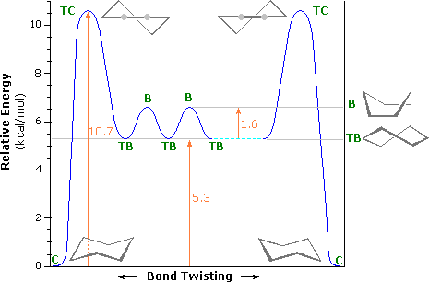
Energy Profile diagram
Boat 29.7kJ/mol
TB : 23.02kJ/mol
HC: 46.04kJ/mol

Slide 17
Torsional Strain
Torsional strain is the resistance to bond twisting in a chemical compound.
When the atoms separated by three bonds are placed in eclipsed conformation instead of stable staggered conformation, then it causes torsional strain between the bonds.
It is related to the bond angle in relation to rotation of bonds.
In case of staggered conformation (anti), torsional strain is minimized as the two methyl groups (large groups) are farthest apart.
In case of staggered conformation (gauche) torsional strain is increased as the two methyl groups (large groups) are very close together.
In case of eclipsed conformation torsional strain is maximized with very high energy as the two methyl groups (large groups) are in close proximity.

Slide 18
Locking of Conformation
In substituted cyclohexane small substituent may acquire either axial or equatorial position.
e.g.
But with increase in size of the substituent 1,3-diaxial interactions become very severe increasing internal PE. Thereby stability is decreased.
Very large substituents like t-butyl prefer to lie in equatorial position only to avoid 1,3 – diaxial interactions
The existence in only one conformation is termed as locking of conformation.

