Slide 1




Slide 2

Paper Submission
·
·
Non – eCTD electronic submission (eNDA/eANDA)
·
Electronic submission with eCTD

Slide 3

Lesser and lesser space at Agencies
·
·
Handling paper an uphill task and quite subjective
·
Electronic submission give more accountability and ease decision making process

Slide 4
eCTD is a superior technology
·
·
Establish a single application format for all applications
·
Avoids expensive internal processes and systems for receiving and archiving applications

Slide 5

FDA stated effective Jan 1, 2008 all elctronic submissions in eCTD format
·
·
Paper submissions still acceptable but not encouraged
·
EU made Jan 2010 as the deadline for submission in eCTD

Slide 6
FDA still prefers FTF’s in CD and not in electronic gateway submission – litigation issues
·
·
USFDA’s electronic gateway constantly update their database and linkages – with constant contact with applicants

Slide 7

XML backbone
·
·
Modules
·
Granules

Slide 8

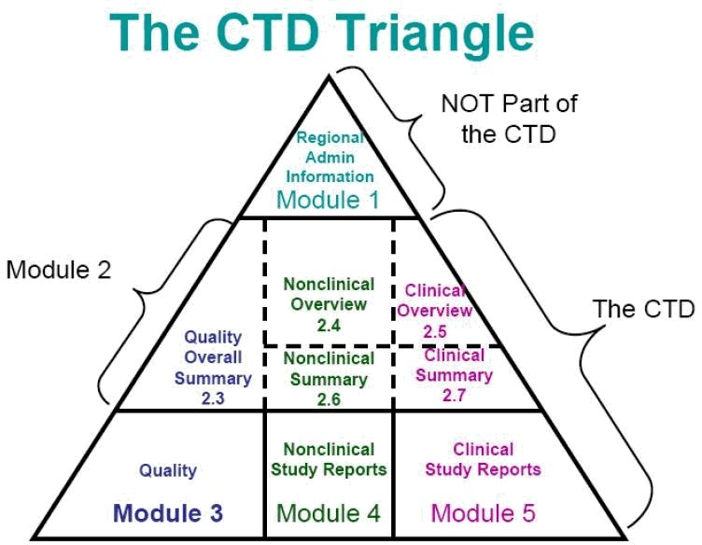

Slide 9
Module 1 : Administrative Module 2 : Summaries Module 3 : Quality (CMC)
Module 4 : Non clinical study reports Module 5 : Clinical study reports
·
·
·
·
·

Slide 10

eCTD Software
·
·
Software training and support from the supplier
Compiling and eCTD eCTD hyper linking QC of eCTD
Submit eCTD on CD/DVD or Use electronic gateway
·
·
·
·

Slide 11

Module 1 : Administrative
·
Required for Generic and New drug applications
Specific for the agency like FDA , UK MHRA, CBG NL
Regulatory information

Slide 12
Module 2 Summaries
·
CMC and Bioequivalence information
2.3 Quality Over all summary
2.7 Clinical Summary – Bioequivalence studies

Slide 13
Module 2
Question based review
·
·
In PDF and Word format
Insert all questions
Bioequivalence data summary Tables
- All 16 tables in MS word in Module 2.7

Slide 14
Module 3 : Quality (CMC)
·
Details of Drug Substance
Details of Drug Product
Product development
Regional information

Slide 15
Module 4 : Non-clinical data study reports
·
Not required for generic applications

Slide 16
Module 5 : Clinical Study Reports
·
Tabular listing of all studies
Clinical study reports
Literature reports
SAS files in main folder of Module 5

Slide 17
eCTD Table of contents
·
http://www.fda.gov/cder/regulatory/ersr/ 5640CTOC-v1.2.pdf
·
OGD ANDA Check list
http://www.fda.gov/cder/ogd/anda_check list.pdf

Slide 18

Submit a Pilot/Test Submission to the Agency
·
·
Request for an Pre-Assigned eCTD number
·
File by electronic submission gateway or Mail

Slide 19

Send an e.mail to esub@fda.hhs.gov
·
·
·
·
·
·
Ask for sample eCTD submission Submit a sample submission
Agency checks the sample submission Resolve technical issues
Resubmit sample submission

Slide 20

· Get Secure e.mail
· Pre-assigned eCTD number expires in 60 days
· Read and follow information on http://www.fda.gov/cder/ogd/#enumber

Slide 21

Create a Gateway Test Account : esgprep@fda.gov
·
·
·
·
·
Send Test/Pilot Submission FDA ESG Validates
Create Actual Production Account Submit eCTD

Slide 22

·
Ability to process without error in review system
Is the submission content readily available Security/Accountability
·
·
·
·
Consistently good application across agencies Review experience

Slide 23

eCTD Website
·
http://www.fda.gov/cder/regulatory/ersr/ect d.htm
Organisation of CTD http://www.fda.gov/cder/guidance/45390.pdf

Slide 24


www.cycloneindiagroup.com

