Slide 1
UNIT-I
Nervous system
(Neuroglia, classification and properties of nerve fibre)
Prepared by Sucharita Babu Assistant Professor School of Pharmacy and Life Sciences

Slide 2
Neuroglial Cells
Also known as Neuroglia cells or gial cell
Neuro-neuron
Gial means glue
These cells provide mechanical support to the neurons
Fill spaces, provide structural framework, produce myelin
Neuroglia cell perform support roles for the neurons to ensure their survival.

Slide 3
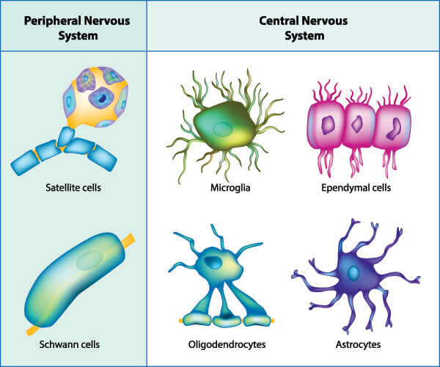
Classification of Neuroglial cell
In CNS
Astrocytes
Ependymal cells
Microglia cells
Oligodendrocytes
In PNS
Schwann cells
Satellite cells

Slide 4
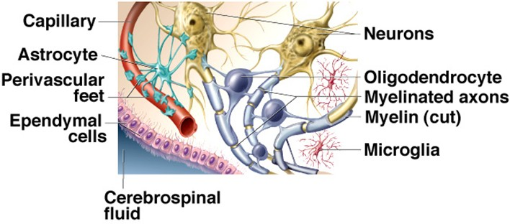

Slide 5
Astrocytes :
main supporting tissue of the central nervous system
star shaped with fine branching processes
Found in large numbers adjacent to blood vessels with their foot processes forming a sleeve round them
the blood is separated from the neurons by the capillary wall and a layer of astrocyte foot processes which together constitute the blood–brain barrier
Prevent toxins and poison from eantering brain neurons
Ependymal cells
These cells form the epithelial lining of the ventricles of tahe brain and the central canal of the spinal cord. Those cells that form the choroid plexuses of the ventricles secrete cerebrospinal fluid.

Slide 6
Microglia
It derives from monocytes that migrate from the blood into the nervous system before birth. They are found mainly in the area of blood vessels.
They enlarge and become phagocytic, removing microbes and damaged tissue, in areas of inflammation and cell destruction
Oligodendrocytes
These cells are smaller than astrocytes and are found in clusters round nerve cell bodies in grey matter; where they are thought to have a supportive function
The oligodendrocytes form and maintain myelin, having the same functions as Schwann cells in peripheral nerves.

Slide 7
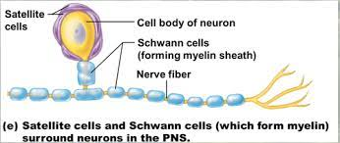
Schwann cells
The PNS contain neurological cell as well as schwanncell
Form a covering called myelin sheath around axon
Basically they perform the same roll as the oligodendrocytes found in CNS
Satellite cells
Small gial that surround neurons sensory ganglia in the ANS .
Very sensitive to injury and may exacerbate pathological pain
Gives protection to the neuron cells.

Slide 8
Thank you

