Slide 1
Frame Measurements and Frame Markings
Sony Gunaganti
Optometry &Vision Sciences

Slide 2
Dispensing Optics
Dispensing Optics
Why to Know Frame Measurements….?
It is essential /useful in proper ordering of prescription glasses.
Knowledge of measurement procedures assures receipt of the proper size when ordering a replacement for a broken part.
This Presentation deals with……
Datum System
Boxing System
Frame Measurements
Frame Markings

Slide 3
The Older Datum System
It is previously used System…
Why this System….?
It is system of reference points for frames and lenses so that placement of lens optical centers and bifocal segment heights would be consistent.
How it is Constructed…?
With the lens placed as it should sit in the frame, horizontal lines were drawn at the highest and lowest edges of the lens
A line drawn halfway between the two horizontal lines and parallel to them was known as the datum line
The width of the lens along this line was called the datum length or eye size.

Slide 4
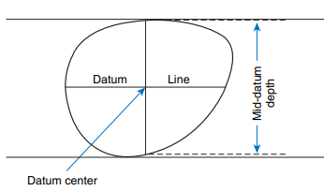
The point along the datum line halfway between the edges of the lens is the datum center.
The depth of the lens, measured as the vertical depth through the datum center, was the mid-datum depth.
Datum System in nutt shell
Datum Line
Datum Length/Eye Size
Datum Center
Mid Datum Depth
Datum Length/Eye Size
*The datum system preceded the currently used boxing system.

Slide 5
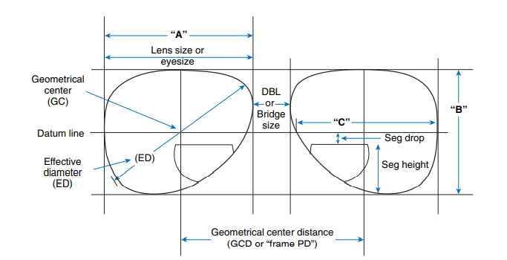
Boxing System
The boxing system improved on the foundation provided by the datum system.
The boxing system consists two horizontal lines( top and bottom to the lenses) and added two vertical lines(right and left to the lenses).
All four lines form a box around the lens… Hence boxing system.

Slide 6
1.Datum Line
2.Effective Diameter
3.Geometric Center
4. Size
5.Frame difference
6.DBL/ Bridge Size
7.Geometric center distance
8.Segment Height
9.Temple Length

Slide 7
Datum Line : Horizontal line halfway between the top and bottom of the lens(Datum line- Datum System),( horizontal midline/180 degree line- Boxing system)
Geometric Center/boxing center : The center of the lens is the point on the horizontal midline halfway between the two lens-bordering vertical lines.
Eye size &Lens Size : A size and B size and C size
A- horizontal measure of the lens B- vertical measure of the box of the lens C- width of the lens itself along the horizontal midline.
Effective Diameter : The effective diameter of a lens is found by doubling the distance from the geometric center of the lens to the apex of the lens bevel farthest from it.
Frame Difference/Lens difference : The difference between the horizontal and the vertical measurements is known as the frame difference and is measured in millimeters.

Slide 8
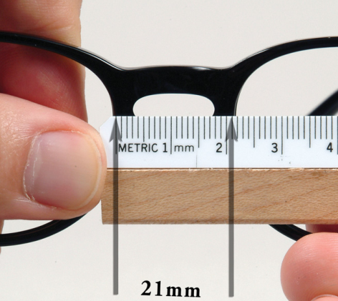
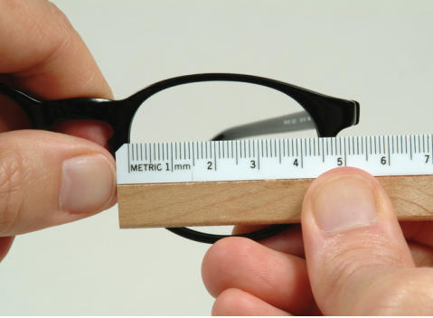
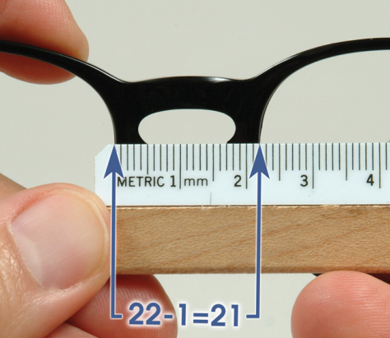
Distance Between Lenses (DBL) or Bridge Size : . The DBL is the distance between the two boxes when both lenses are boxed off in the frame.
Geometric Center Distance (GCD) : The distance between the two geometric centers of the lenses is known as the geometric center distance (GCD) and also known as Distance between centers (DBC)/ Frame center distance/Frame PD.

Slide 9
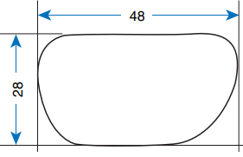
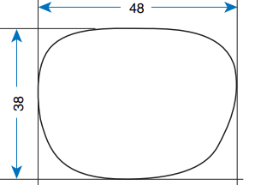
Frame Difference :

Slide 10
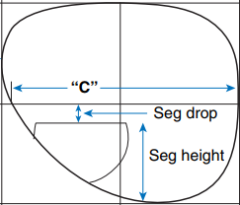
Seg drop/Seg raise :
Segment Height :

Slide 11
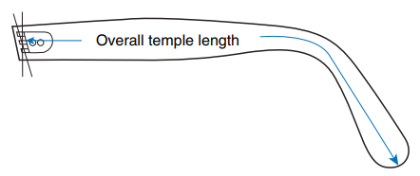
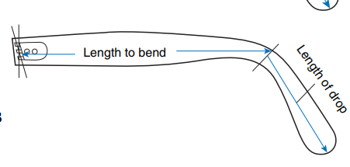
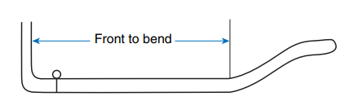
TEMPLE LENGTH :
Overall Temple Length : The overall temple length is the distance from the center of the center barrel screw hole to the posterior end of the temple, measured along the center of the temple.
Length to Bend (LTB) : This is measured from the center of the barrel to the middle of the bend
Front to Bend (FTB) :
If the endpieces wrap around in a swept-back manner, there is a distance between the plane of the frame front and the actual beginning of the temple. In this case, the temple length could be specified as frame to bend (FTB)

Slide 12
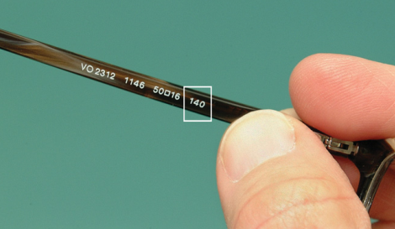
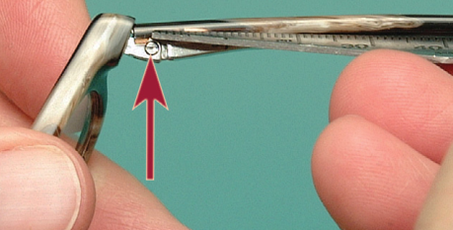
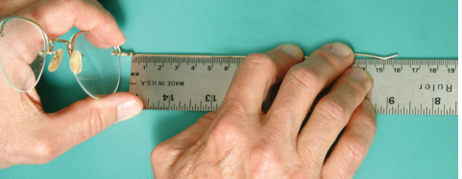
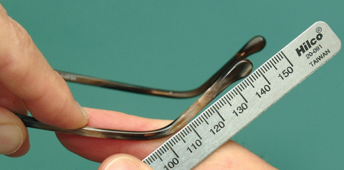
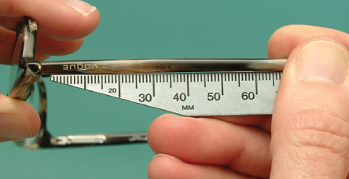
FRAME MARKINGS : Most frames are marked according to size with three measurements: eye size, DBL, and temple length.
Eye Size and DBL : it means that the eye size is 50 mm and the distance between lenses is 20 mm.
Location of Markings : inside of the nosepad/upper outer section of the eyewire / back side of the endpiece / eyesize – one end piece and DBL – other end piece /inner side of the temples.

Slide 13
Frame Manufacturer Name, Color, and Country of Origin :
Frames should also be marked as to country of origin, manufacturer, and frame name.
Many frame manufacturers use a number rather than a name.

Slide 14
Safety Frame Markings :
Frames that are suitable for use as safety glasses must have “Z87” or “Z87-2” and the name or logo of the manufacturer stamped on the frame front and on both temples- specified by American National Standards Institute (ANSI) in their standard called American National Standard Practice for Occupational and Educational Eye and Face Protection.
The standard is numbered as Z87.1. If a pair of glasses has safety lenses, but is not in a frame marked “Z87” or “Z87-2,” the glasses are not safety glasses.

Slide 15
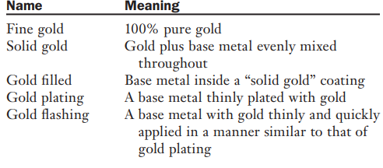
Gold Classifications for Metal Frames With Substantial Gold Content :

