Slide 1
Module-1
Public health optometry:
Concepts & implementation
Stages of disease
Dimensions
Determinants and indicators of health

Slide 2
Public Health Optometry
Public Health Optometry is an art and science of preventing visual impairment and promoting visual health through organized efforts and informed choices of society.
Public Health Optometry is a hybrid discipline that combines the principles of public health and optometry where an optometrist applies the principles of both the specialties to reach out to the communities to provide care, promote eye health and train community level eye care workers.
Visual impairment is a public health challenge affects millions of people and uncorrected refractive errors continue to remain the leading causes of visual impairment worldwide. While the technology in refractive surgery and newer contact lens designs are catching up in developed countries and urban areas in developing countries such as India, millions remain uncorrected due to lack of accessibility, availability and affordability of proper spectacles. Research has shown that this problem is more acute in remote and rural areas.

Slide 3
The current situation should completely be unacceptable for optometrists like us. We cannot afford to remain ignorant of this glaring fact. We are the primary eye care providers and probably the largest ‘organized’ eye care providers of vision correction and continue to remain so. There is a need for the development of “Public Eye Health” “Public Health Optometry” or “Community Optometry” as a distinct discipline to address the challenge of visual impairment, more specifically the challenge of uncorrected refractive errors and presbyopia. Today we often see optometrists as “contact lens specialists”, “Low vision care specialists”, “pediatric optometrists” etc. providing care. We need to have “Public health optometrists” or “Community Optometrists” as well

Slide 4
Current Concept of Public Health Optometry
The objective of public health optometry is based on the principles of reaching out to those in need and providing them help, making use of local resources, and providing services to the areas which may or may not have regular access to services
The public health optometry program not only provides access to eye care but also addresses social and economic barriers that prevent these groups of patients from accessing services. It is also an opportunity to educate the community on eye care and address conditions such as cataract, refractive errors, and diabetic eye diseases. So outreach visits need to be planned, to respond to the need of the local area, and may have a particular focus e.g. identification of cataract cases, screening of refractive error and refraction, and provision of spectacles.

Slide 5
As we know the prevalence of visual impairment is increasing across the globe, with more burdens on the developing world. Research has shown that the prevalence of chronic conditions such as diabetes and hypertension are increasing day by day in developing countries and the need for public health optometrist is huge for early detection of ocular complications for these conditions.
Despite considerable efforts in many developing countries, through National Blindness Prevention Programmes, the global number of blind and visually impaired seems to be growing, mainly as an effect of population increase and aging.
A large number of visually impaired people in a country denote poor socio-economic development and an inefficient eye care service in the country. About 80-90% of the blindness is either curable or preventable. The planning and implementation of appropriate eye care services in a country need evidence generated from the population.

Slide 6
Cataract stands out as the first priority among the major causes of visual impairments. Thus there is a need to drastically increase the number of cataract surgeries in the developing world. Refractive errors and Low vision constitute another priority in terms of visual impairment. There is an enormous need globally for spectacles and low vision devices. Emphasis on the public health optometry coverage by covering diseases other than cataracts like diabetic retinopathy, glaucoma, corneal opacity, and childhood blindness, etc. needs immediate attention to eliminate avoidable blindness.
The global initiative is still in its planning phase, but there is clearly recognized a need for a global awareness campaign to sensitize decision-makers and health care providers as to the rationale and great benefit of prevention of visual impairment. That is why a strong partnership between all those working for the prevention of visual impairments is essential for optimal utilization of resources available today and in the future.
Together Let us empower and enable the visually impaired.

Slide 7
Public health implementation
Implementation research is an integrated concept that links research and practice to accelerate the development and delivery of publichealth approaches. Implementation research involves the creation and application of knowledge to improve the implementation of health policies, programmes, and practices.

Slide 8
Public health implemented by following steps
STEP 1: CONDUCT A SITUATIONAL ASSESSMENT
STEP 2: MANAGE THE PLANNING PROCESS. . ...
STEP 3: IDENTIFY GOALS, POPULATIONS OF INTEREST, OUTCOMES.
STEP 4: IDENTIFY STRATEGIES, ACTIVITIES, OUTPUTS, PROCESS.
STEP 5: DEVELOP INDICATORS. ...
STEP 6: REVIEW THE PROGRAM PLAN.

Slide 9
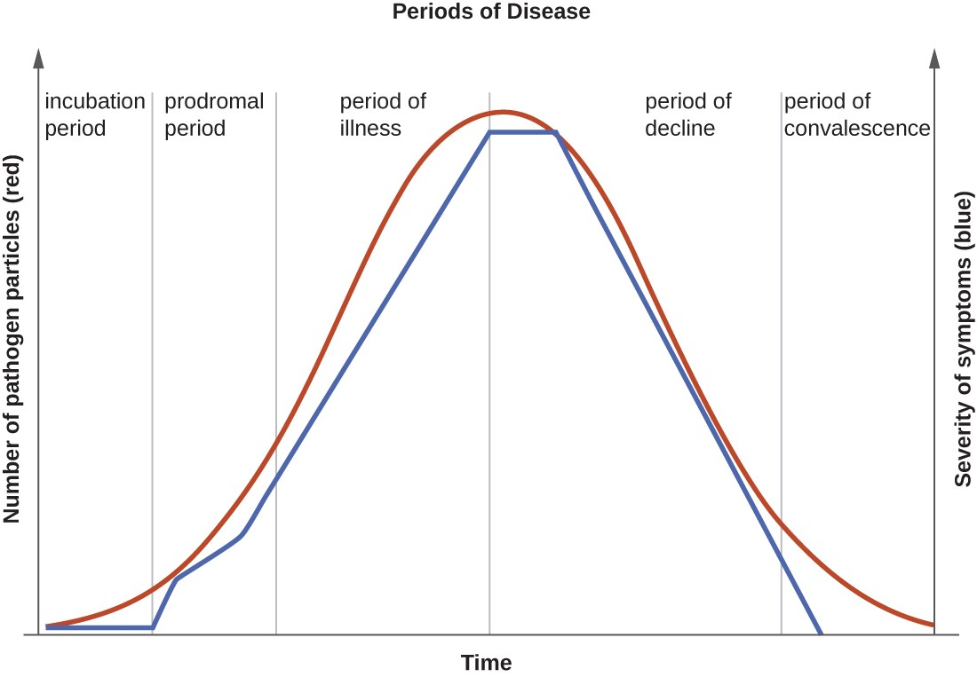
Stages of diseases
The five periods of disease (sometimes referred to as stages or phases) include the incubation, prodromal, illness, decline, and convalescence periods (Figure 2). The incubation period occurs in an acute disease after the initial entry of the pathogen into the host (patient).
.

Slide 10
INCUBATION PERIOD
This refers to the time elapsed between exposure to a pathogenic organism, and from when symptoms and signs are first apparent. It may be as short as minutes to as long as thirty years in the case of variant Creutzfeldt–Jakob disease. While the t
erm latency period is used as synonymous, a distinction is sometimes made between incubation period, the period between infection and clinical onset of the disease, and latent period, the time from infection to infectiousness. Whichever is shorter depends on the disease.
A person may be a carrier of a disease, such as Streptococcus in the throat, without exhibiting any symptoms. Depending on the disease, the person may or may not be contagious during the incubation period. During clinical latency, an infection is subclinical. With respect to viral infections, in clinical latency the virus is actively replicating. This is in contrast to viral latency, a form of dormancy in which the virus does not replicate.

Slide 11
PRODROMAL PERIOD
In this phase, the numbers of the infectious agents start increasing and the immune system starts reacting to them. It is characterized by early symptoms that might indicate the start of a disease before specific symptoms occur. Prodromes may be non-specific symptoms or, in a few instances, may clearly indicate a particular disease. For example fever, malaise, headache and lack of appetite frequently occur in the prodrome of many infective disorders. It also refers to the initial in vivo round of viral replication.

Slide 12
DECLINE STAGE:
The period of illness is followed by the period of decline, during which the number of pathogen particles begins to decrease and the signs and symptoms of illness begin to decline
CONVALESCENCE PERIOD
The patient recovers gradually and returns to normal, but may continue to be a source of infection even if feeling better. In this sense, “recovery” can be considered a synonymous term.

Slide 13
Dimensions of Health
Introduction
Health: When we talk about health, the definition that used to come into our mind is “state of complete social, mental and physical well-being” without any signs of illness and disease. We will learn more about the dimensions of health in this article.
Dimensions of Health:
Dimensions of health consist of 5 elements, Social, Physical, Emotional, Mental and Spiritual. A complete picture of health is provided by all of these five dimensions of health and with the change in any of the dimension, other dimensions are directly or indirectly affected.

Slide 14
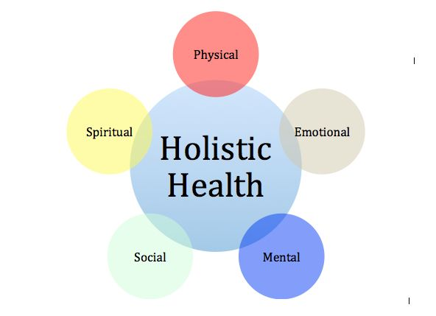

Slide 15
Physical Dimension
A physical dimension of health is nothing but a physical aspect or bodily aspect of health. This indicates to the progressively traditional meaning of heath as the absence of illness, injury or diseases.
Physical health can range in quality with a sequence where a combination of sicknesses like diabetes, cancer, diabetes, hypertension or cardiovascular disease. All these toward one side and an individual who is in ideal physical condition (think health isn’t wellness) are on another.
Physical health can influence different dimensions of health since the decrease of physical health can cause a reduction in different types of health. Like an individual who all of a sudden gets cold, usually isolated socially on the grounds that it doesn’t contaminate others, tries to concentrate on picking up anything or learning. Above all, may feel troubled because of its isolation.

Slide 16
Mental Dimension
This aspect of health used to come under the cognitive aspect of health. Although emotional and mental health are interlinked with each other, we will discuss both of them separately. Mental health or well-being is nothing the working of the cerebrum or brain, while the emotional health indicates the general population who have been related to their hormones.
Emotional wellness at that point incorporates numerous psychological well-being issues, for example, Dementia and Alzheimer’s. It means the ability of a person to think while using his brain. This might be for recalling the information or solving the problems, moreover the main focus is on the person’s cognitive aspects.
Other dimensions of health are directly affected by mental health. With the increase in physical activity, there will be a direct increase in mental health activity. Self-esteem is automatically increased when there is an increase in good mental health status. Higher self-esteem then results in an increase in confidence with respect to the social situation.

Slide 17
Emotional Dimension
Emotional dimension of health consists of emotional state and mood of an individual. When a person is in a good emotional state and in a happy mood, at that point we called that situation as good emotional health. It is directly related to your self-esteem and your ability to control and manage your emotions for maintaining a real view of circumstances.
Other dimensions of health are directly affected and are related to emotional health since a person with good dignity is much more positive in a social setting, used to deliver considerably in physical activity and used to make friends very quickly.

Slide 18
Spiritual Dimension
The understanding of the overall goal of life is known as spiritual health. Individuals used to find this objective of life through faith or believe system, while other individuals used to make their own purpose. An individual with the purpose of life is known to live a better and healthy life in comparison to those who don’t have any purpose.
Mental and Emotional health is directly affected by spiritual health because having a goal in your life can make your dreams come true.

Slide 19
Social Dimension
When we talk about the social dimensions of health, it is directly linked with the capability of an individual maintain and make an essential relationship of life. High-grade social health doesn’t only include making relations, but it also includes maintaining and behaving properly and also maintain socially acceptable measures. The family is the basic social entity of relationship which directly impacts the life of a person. Social networks, close friends, youth leaders, and teachers are also a part of a key relationship .

Slide 20
Social Determinant of Health
In Social Dimensions of Health generally, in the context in which a person’s life holds great importance both for his health status and the quality of his life, it is rapidly recognized that health is maintained not only through the advancement and application of health science and Improved, rather the efforts and the intelligent lifestyle choices of the person and society.
Some of the major determinants of health include physical environment, economic and social environment and the behavior and individual characteristics of a person. Here are some of the factors that will tell anyone that an individual of a society is happy or not:
Social support networks
Employment/working conditions
Physical environments
Healthy child development
Gender
Coping skills and personal health practices
Literacy and Education
Culture
Genetics and Biology
Healthy Child Development

Slide 21
When any doctor is working taking care of any person who is suffering from anxiety disordered, it must be taken care that doctor or professional should be having knowledge of medication for anxiety disorder. The beginning of the treatment is the major challenge that professionals need to find out before starting the treatment. By getting the knowledge of the symptoms of the anxiety disorder, the right beginning of the treatment for an anxiety disorder can find out. Like a good doctor, psychiatrist of professional, he or she should help the individuals who are suffering from an anxiety disorder with the help of therapy that helps them recover.

Slide 22
Indicators of Health
Health indicators are quantifiable characteristics of a population which researchers use as supporting evidence for describing the health of a population. Typically, researchers will use a survey methodology to gather information about certain people, use statistics in an attempt to generalize the information collected to the entire population, and then use the statistical analysis to make a statement about the health of the population.
A common example of a health indicator is life expectancy. A government might have a system for collecting information on each citizen's age at the time of death. This data about age at death can be used to support statements about the national life expectancy, in which case life expectancy would be a "health indicator". Life expectancy may be one of many "health indicators" which collectively researchers would use to describe the health of the population of the country.

Slide 23
Classification of Health Indicators
Mortality indicators
Morbidity indicators
Disability rates
Nutritional Status indicators
Health care delivery indicators
Utilization rates
Indicators of social and mental health
Environmental health
Socioeconomic Indicators
Health policy indicators
Indicators of quality of life
Other indicators

Slide 24
Quality of life indicators
Within the field of healthcare, quality of life is often regarded in terms of how a certain ailment affects a patient on an individual level. This may be a debilitating weakness that is not life-threatening; life-threatening illness that is not terminal; terminal illness; the predictable, natural decline in the health of an elder; an unforeseen mental/physical decline of a loved one; or chronic, end-stage disease processes. Researchers at the University of Toronto's Quality of Life Research Unit define quality of life as "The degree to which a person enjoys the important possibilities of his or her life" (UofT). Their Quality of Life Model is based on the categories "being", "belonging", and "becoming"; respectively who one is, how one is not connected to one's environment, and whether one achieves one's personal goals, hopes, and aspirations.
Experience sampling studies show substantial between-person variability in within-person associations between somatic symptoms and quality of life.Hecht and Shiel measure quality of life as “the patient’s ability to enjoy normal life activities” since life quality is strongly related to wellbeing without suffering from sickness and treatment. There are multiple assessments available that measure Health-Related Quality of Life

Slide 25
Mortality indicators
The point estimate for the crude mortality rate and age-specific mortality rates when measured using surveys are usually presented with confidence intervals. Moreover, the rates themselves should always contain the population constant and time period. You cannot cite a mortality rate as just a number (for example, 2.3); this is as meaningless as giving the weight of something without the unit of weight (for example, it weighs 19). In addition, the presentation should include the time to which the estimate is applicable.
Prospective death surveillance allows you to follow trends in mortality over time. The best way to display such data are in a graph of mortality incidence rates

Slide 26
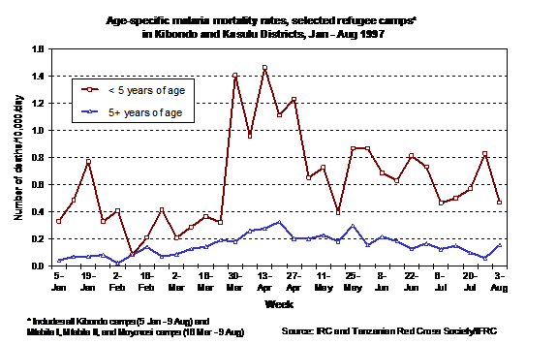
Mortality can also be presented as the number of excess deaths caused by the emergency (see section Number of excess deaths for more information). As with any important estimate from a survey, this point estimate should also be presented with confidence intervals.

Slide 27
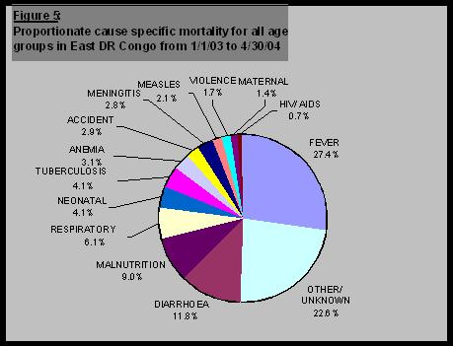
Cause of death is usually presented as the proportion of all deaths ascribed to each cause. The total of all the proportions should equal 100%. The presentation can be in the form of a table or pie chart. See section Measurement of causes of death in surveys for a discussion of important caveats regarding the measurement of causes of deathi in survey
The distribution of causes of death as shown:

Slide 28
Morbidity indicators
Morbidity Indicators. A morbidity indicator is a value describing the presence of disease in the population, or the degree of risk of an event. The incidence rate, prevalence, and attack rate (AR) are common applications of this concept in epidemiology.
Morbidity is another term for illness. A person can have several co-morbidities simultaneously. So, morbidities can range from Alzheimer's disease to cancer to traumatic brain injury. Morbidities are NOT deaths.

Slide 29
Disability Rates
Disability is difficulty performing roles and activities due to health problems. It is largely experienced by older persons as they accumulate progressive chronic conditions. ... A global disability indicator is a compact and inexpensive device for public health surveillance and scientific study of disablement.
Type:
Event type indicators
Person type indicators

Slide 30
Nutritional status indicators
3 Nutritional status indicators considered important are:
Prevalence of low birth weight(2.5kg)
Height and weight of children at school entry
Anthropometrics Measurements of preschool children.

Slide 31
Health care delivery indicators
This indicators reflect the equity of distributionof health resources in different parts of the country and the provision of health care.
The WHO joint learning initiative has established a threshold of 25 health workers (Doctors, nurses and midwives) per 10, 000 population, with a WHO endorsed lower threshold of 23 workers per 10,000

Slide 32
Utilization rates
Actual coverage is expressed as the proportion of people in need of a service who actually receive it in a given period, usually a year.
Depends on availability & accessibility of health services and the attitude of an individual towards health care system.
It gives some indication of the care needed by a population, and therefore , the health status of the population.

Slide 33
Indicators of social and mental health
As long as valid positive indicators of social and mental health are scarse,it in necessary to use indirect measures.
These include rates of suicide,homicide, other crime, road traffic accident, juvenile delinquency, alcohol and substance abuse, domestic violence battered-baby syndrome, etc.
These indicators provide a guide to social action for improving the health of people.
Social amd mental health of the children depend on their parents,Ex. Subtance abuse in orphan children.

Slide 34
Environmental indicators
Environmental indicators are simple measures that tell us what is happening in the environment. Since the environment is very complex, indicators provide a more practical and economical way to track the state of the environment than if we attempted to record every possible variable in the environment. For example, concentrations of ozone depleting substances (ODS) in the atmosphere, tracked over time, is a good indicator with respect to the environmental issue of stratospheric ozone depletion..
Environmental indicators have been defined in different ways but common themes exist.
An environmental indicator is a numerical value that helps provide insight into the state of the environment or human health. Indicators are developed based on quantitative measurements or statistics of environmental condition that are tracked over time. Environmental indicators can be developed and used at a wide variety of geographic scales, from local to regional to national levels.” ^{[1]}
A parameter or a value derived from parameters that describe the state of the environment and its impact on human beings, ecosystems and materials, the pressures on the environment, the driving forces and the responses steering that system. An indicator has gone through a selection and/or aggregation process to enable it to steer action.” ^{[2]}

Slide 35
Socioeconomics Indicators
These do not directly measures health but are important in interpreting health indicators.
These are
Rates of growth of population increase
Per capita GNP
Level of employment
Literacy rate esp:female literacy rate
Dependency ratio
Family size
Housing –the number of persons per room
Per capita”calorie” availability
Countries with favorable socioeconomic indicators have reported less health related problems.

Slide 36
Health policy indicators
Single most important indicators of political commitment is allocation of adequate resources.
Proportion of GNP spent on health services
Proportion of GNP spent on health related activities like water supply and Sanitation & housing and nutrition
Proportion of total health resources devoted primary healthcare..

Slide 37
Other indicators
Social indicators
Social indicators are defined as statistical measures that describe social trends and conditions impacting on human well-being. [1] Generally, social indicators perform one or more of three functions: providing information for decision-making. monitoring and evaluating policies.
Basic need indicators
The social indicators need to belong to the class of objective indicators expressed in physical units. The 5 basic needs selected for the purpose of presenting the integrated approach are nutrition, housing, health, education, and security.

Slide 38
Thank You

