Slide 1
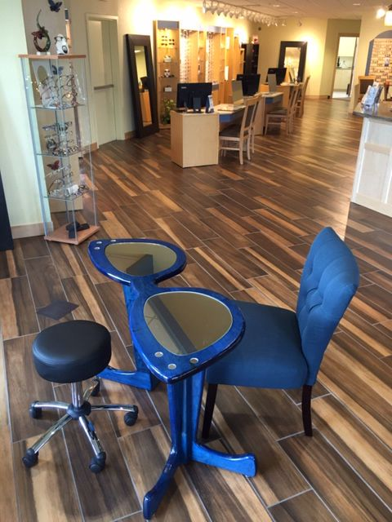
Art and science of dispensing spectacle lenses

Slide 2
Sub topics:
Introduction
History of eye wear
Overview of an optical laboratory
Review of lenses and lens materials
Final lens selection
Eye wear selection
Presentation process
Facial measurements and Frame selections
Evaluation of the prescription
Verification and Delivery of the eye wear to the patient
Patient counselling

Slide 3

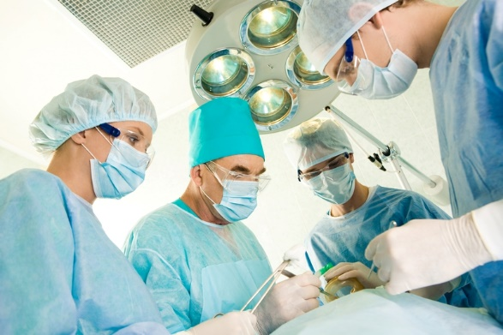
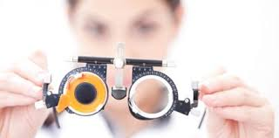
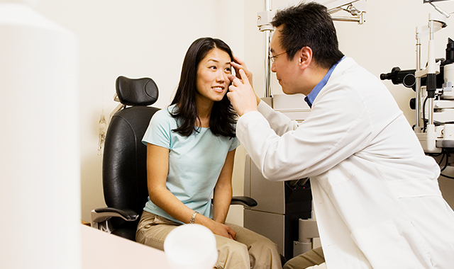
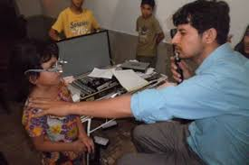


Slide 4
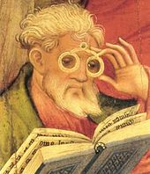
History of eye wear
The idea of eye wear began near the end of 13th century
By the end of 17th century, 1st optical store opened for business
Dr. Donders a Dutch ophthalmologist and Helmholtz a German professor , established the structure and functioning of a human eye
1900’s saw a huge advancements in lens materials , designs ,frame styles and materials.
Last part of 20th century, witnessed many new developments like polycarbonate lens prescriptions, soft contact lenses introduction , Use of different metal alloys for frames

Slide 5
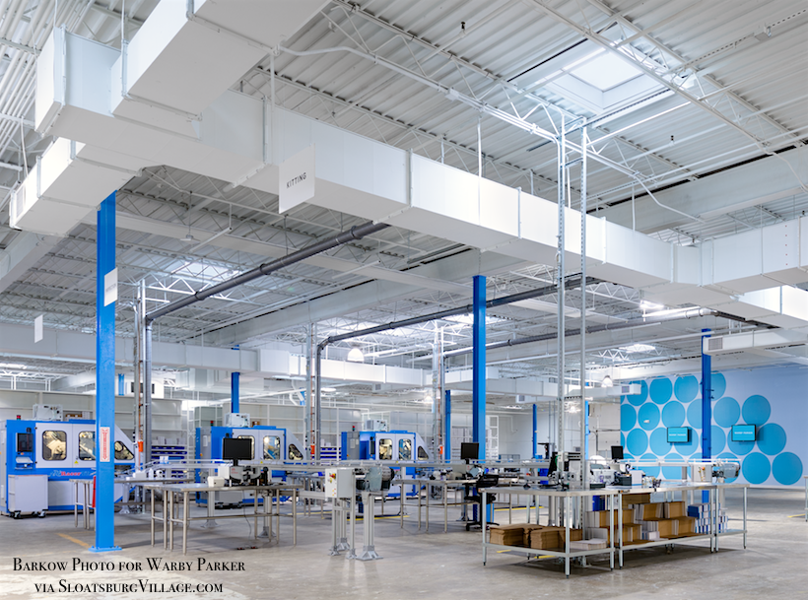
An overview of optical laboratory
Beyond just making lenses….

Slide 6
Today’s optical laboratories provide many products apart from spectacles . They include
Accessories
Education
Frame products
Contact lenses etc.
They also provide the best equipment to process the lenses.
Steps necessary to produce final products are determined by factors such as
Frame and lens selection
Facial measurements
Lens treatment and
Prescription.
After receiving the details of the order, it enters the processing part of the lab, where the semi finished lenses go to the surfacing department and finished lenses will be taken to finishing department.

Slide 7
Steps involved in surfacing department
Steps involved in finishing department
Marking Lay out
Blocking Blocking
Generating Edging
Fining Hand edging
Polishing Lens treatments
De blocking Assembly
Inspiration Inspection
Delivery

Slide 8
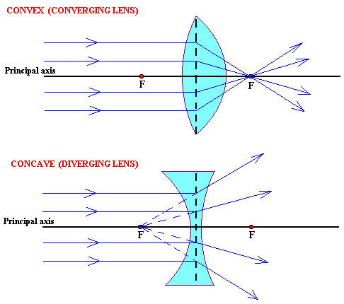
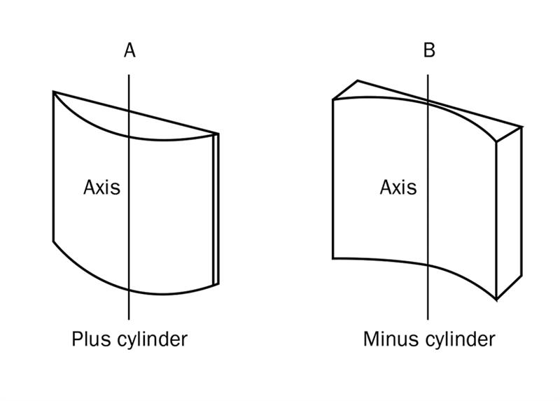
Review of lenses and lens materials

Slide 9
Lens materials
Lens materials can be differentiated by their:
Weight : density
Thickness : Mid index (1.53 to 1.58)
High index (1.586-1.6)
Super High index (1.66-1.8)
Transmission of radiant energy : Lens must be UV blocker
Optical performance: Lens must provide the best visual performance, cosmetic appearance and comfort
Low density
polycarbonate
High density
1.80 index glass

Slide 10
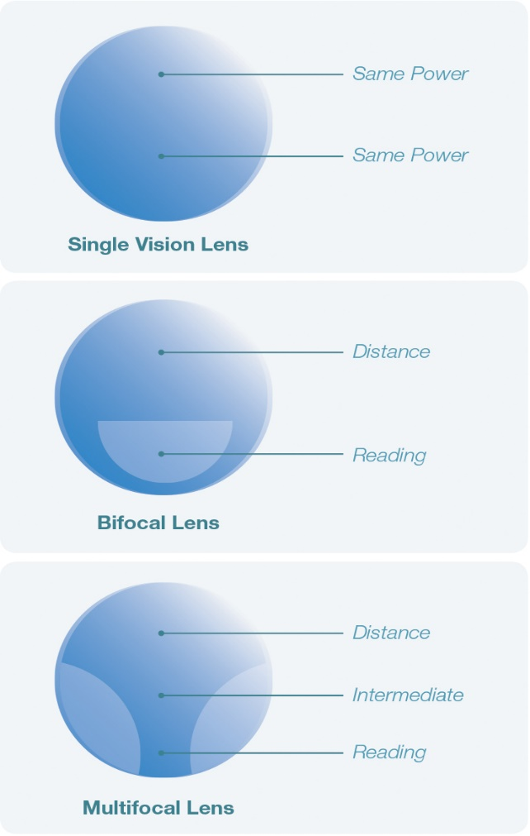
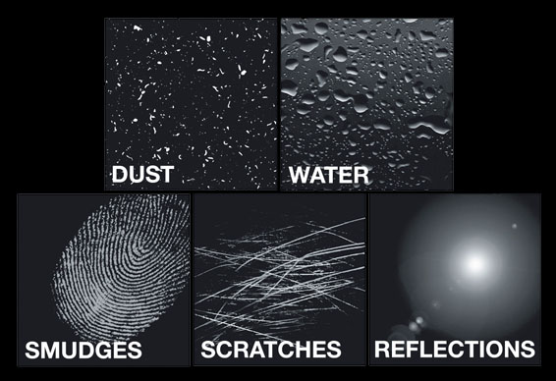
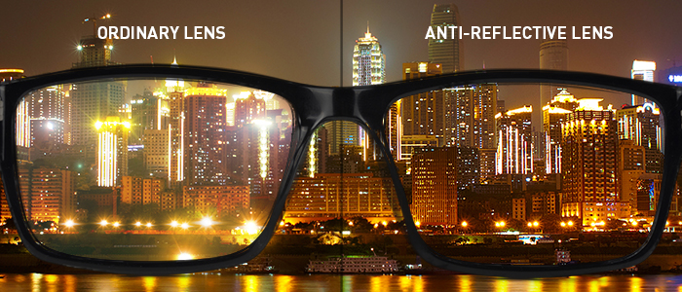
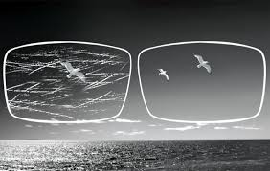
Final lens selection
Final lens selection process should take into consideration , style , design , lens materials and enhancements

Slide 11
Eye wear selection
The art of dispensing lies in :
Knowing our products
Presenting them with good skills
Understanding the lifestyle needs of our patient
Evaluate the prescription by keeping lifestyle in mind

Slide 12
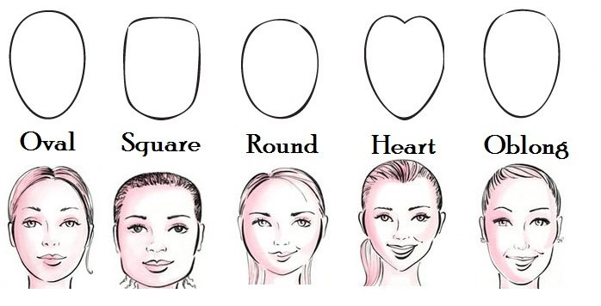
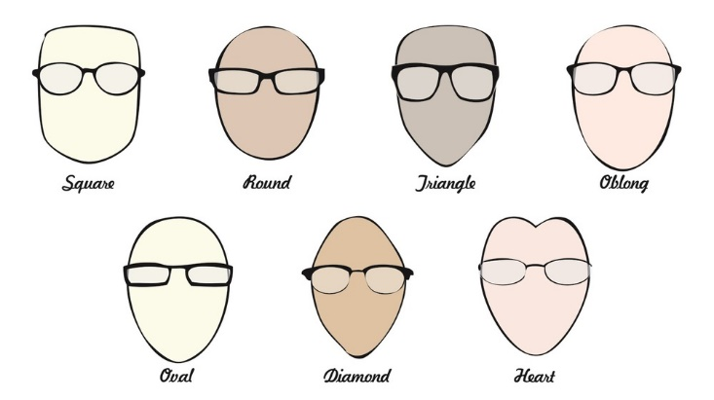
Facial measurements and frame selection:
Facial measurements : They include PD measurements, and vertical height measurements

Slide 13
Frame measurements:
FRAME:
Decentration: If the distance between the centers of the frame is not coinciding with the pupil centers of the patient, then the frame is said to be decentered.
FRAME MATERIALS include: Plastic ;cellulose acetate; propionate; nylon;
metals like Titanium; stainless steel; Monel
Front
bridge
Eye wires
Temples

Slide 14
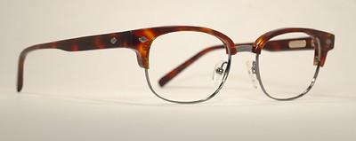
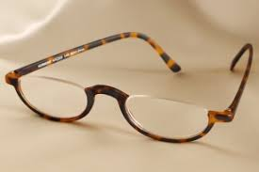
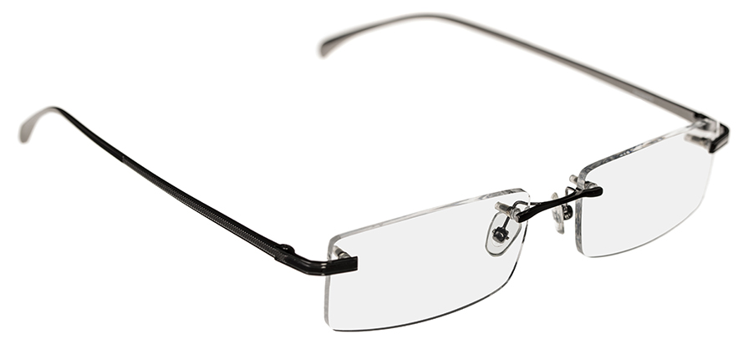
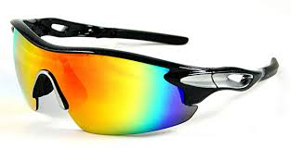
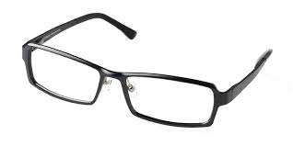
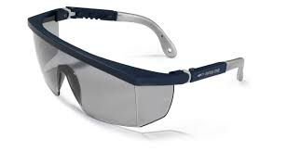

Slide 15
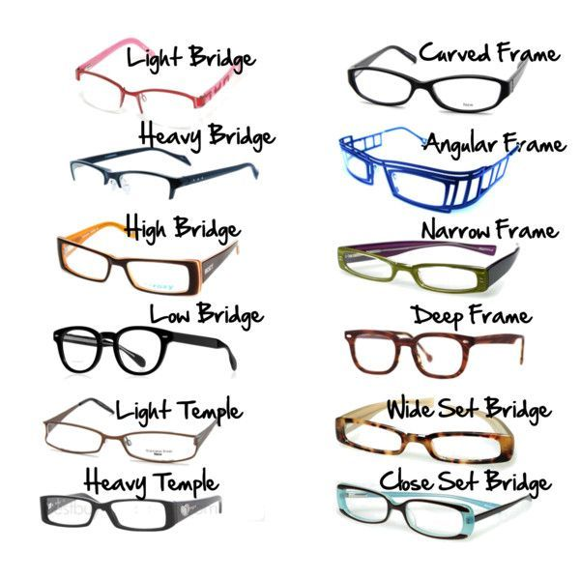
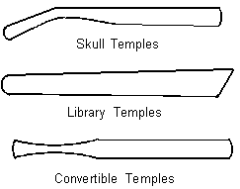
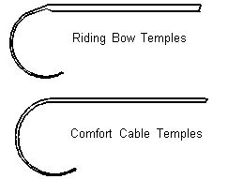
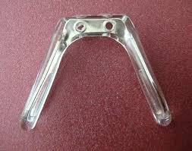

Slide 16
Frame selection :
It should be of correct eye size, bridge
Width of frame front and head should be the same
Eyes must be centered in the frame
Bridge must follow the contour of the nose
Nose pads must rest properly on the nose
Temple length must allow a bend of 1 to 1 ¼ inches
Frame cosmetics and face shapes must be considered
FRAME COSMETICS: frame shape and design
frame color must compliment the color of hair ,eyes and skin tone of the patient

Slide 17
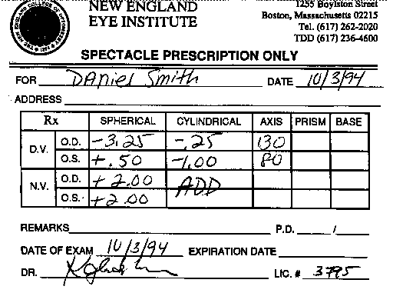
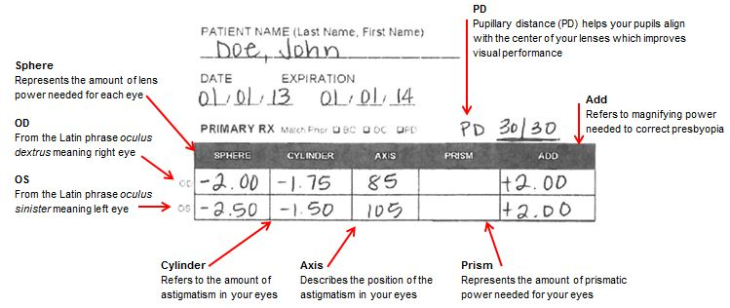
Evaluation of the prescription:

Slide 18
Delivery of the eye wear to patient:
Standard alignment must be maintained
Verifying and neutralizing: Using a proper standard alignment , we must make sure that there is a great lasting impression.
Problem adjustments : place the frame in standard alignment.
Check for screws and cracks in the frame.
Face form.
Xing from the top.
Pantascopic angle ;4 point touch test.
Adjust for correct Pantascopic angle of 8-12 degree.
Temple spread must be verified.
Temple fold angle must be checked.

Slide 19
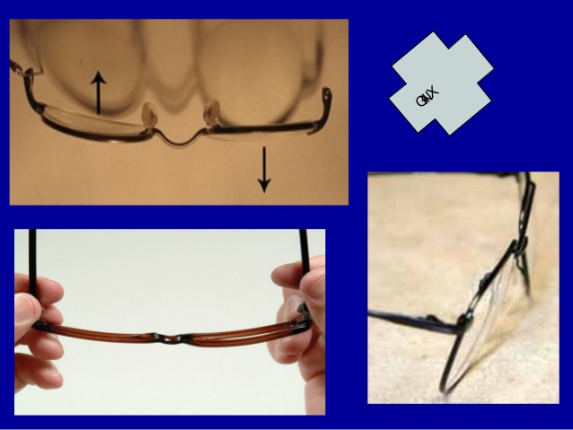
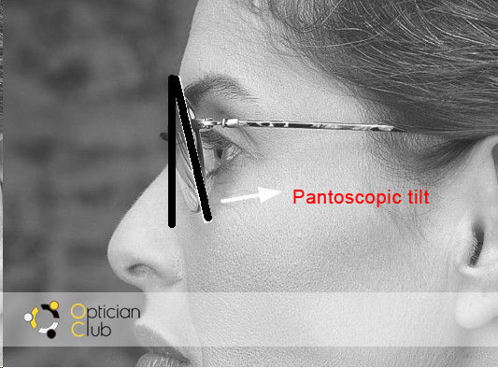
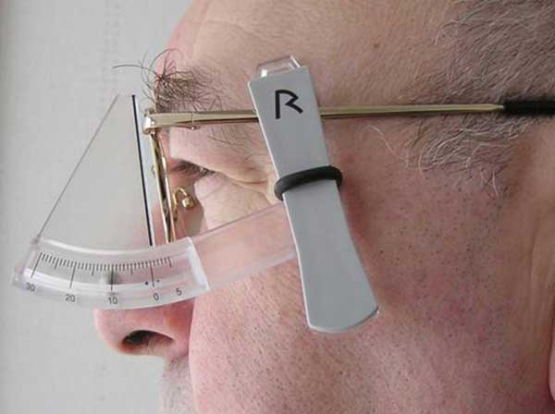
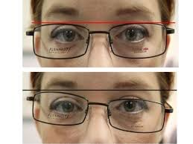
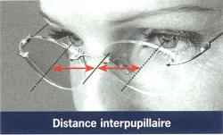

Slide 20
DO’s and Don'ts:
Don’t force the screw to turn. Find out what is binding it.
By heating bridge area of plastic frames when bending the frame
Xing can be corrected
Face form can be changed
To change Pantascopic angle, brace the front of the hinge using pilers , hold the temple near the hinge , close the temple slightly and bend up or down. This is cold bend and we need not heat it
Front temple spread must be observed
To increase: decrease front face form / moving temples out
To decrease: bow the bridge and bring the end pieces in.
Nose pads must be in a position such that the bottom of the pad must be towards the frame to follow the nose

Slide 21

Patient counselling:
Tell the patient about their error in lay man’s terms
If there are patients with high refractive errors, counsel them to have a periodic checkup
If the patient have mild to moderate error ask them to use spectacles
Counsel the patients about the proper handling of spectacles , their cleaning and safety
Ask them to return if they are facing any discomfort with the spectacles
Let them feel comfortable and ask if they require further clarifications

Slide 22


