Slide 1

Cloud Computing Applications
Session -1
Centurion University of Technology and Management

Slide 2
What is cloud computing?
Cloud computing is the on-demand delivery of IT resources over the Internet with pay-as-you-go pricing. Instead of buying, owning, and maintaining physical data centers and servers, you can access technology services, such as computing power, storage, and databases, on an as-needed basis from a cloud service provider.

Slide 3
Cloud computing is a model for enabling ubiquitous, convenient, on-demand network access to a shared pool of configurable computing resources (e.g networks, servers, storage, applications, and services) that can be rapidly provisioned and released with minimal management effort or service provider interaction.

Slide 4


Slide 5
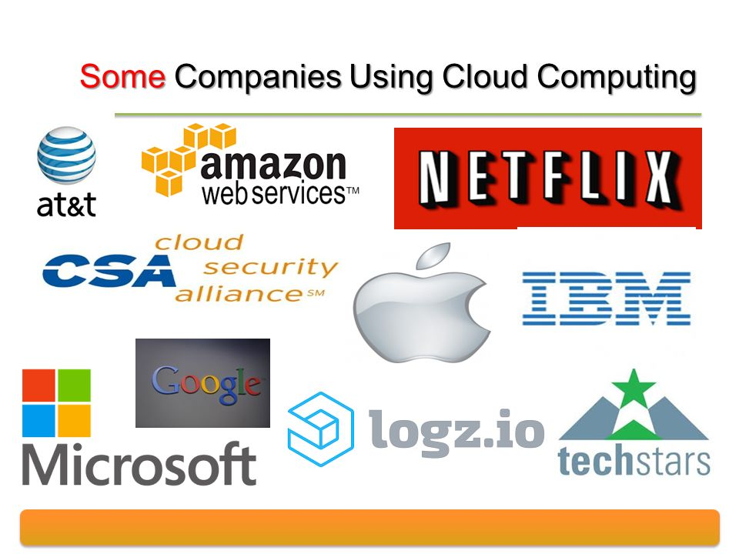


Slide 6
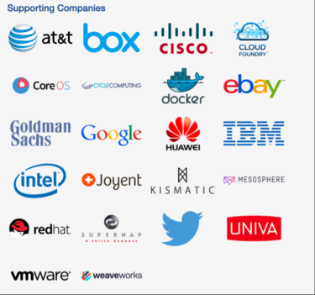

Slide 7
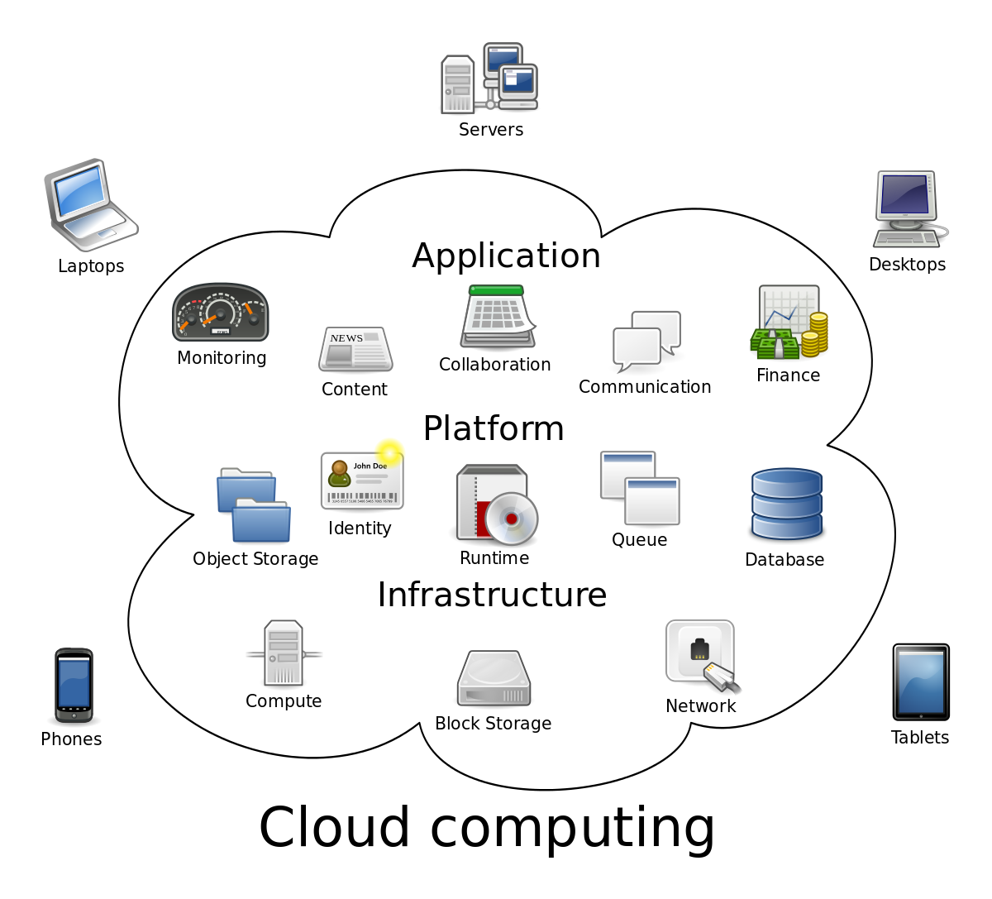

Slide 8
The public cloud is defined as computing services offered by third-party providers over the public Internet, making them available to anyone who wants to use or purchase them.
They may be free or sold on-demand, allowing customers to pay only per usage for the CPU cycles, storage, or bandwidth they consume.

Slide 9
Private cloud solutions are dedicated to one organization or business, and often have much more specific security controls than a public cloud.
Many medical offices, banking institutions, and other organizations who are required to meet federal and state guidelines for data controls use a private cloud.
Using private cloud storage allows them to control highly sensitive data by meeting regulations and industry-based criteria, whether that be medical records, trade secrets, or other classified information.

Slide 10
Hybrid cloud solutions are a blend of public and private clouds. This is a more complex cloud solution in that the organization must manage multiple platforms and determine where data is stored.
An example of a hybrid cloud solution is an organization that wants to keep confidential information secured on their private cloud, but make more general, customer-facing content on a public cloud.

