Slide 1
Composition and Functions of blood

Slide 2
special connective tissue consisting of a fluid matrix, plasma & formed elements
Plasma (55%, straw coloured, viscous fluid)
Water (90-92%)
Proteins (6-8 %)
Fibrinogen : Coagulation
Globulins : Defense Mechanism
Albumins :Osmotic balance.
Minerals : Na+, Ca++, Mg++, HCO3–, Cl–
Glucose, amino acids, lipids, etc.
Notes:
Plasma without clotting factor is known as serum.

Slide 3
Formed Elements (4.5%)
Platelets (4.8%)
RBC (95.1%) : iron containing complex protein called haemoglobin
WBC (0.1%) : Lack hemoglobin
Granulocytes
Neutrophils (60-65%) : Phagocytosis
Eosinophils (2-3%) :resist Parasitic infection and allergies
Basophils (0.5 -1%) : inflammatory reactions
Agranulocytes
Monocytes (6-8%) : Phagocytic
Lymphocytes (20-25%)
B cells
T cells

Slide 4
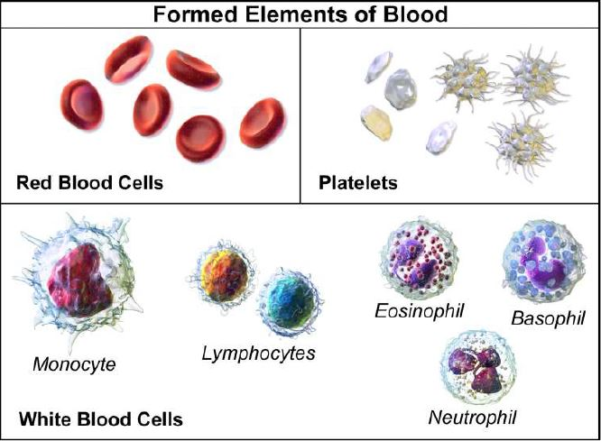

Slide 5
RBC
Red blood cells have a slightly indented, flattened disk shape (biconcave).
Lack nucleus.
They transport oxygen to and from the lungs.
Hemoglobin : Protein that contains iron and carries oxygen to its destination.
Life span of a red blood cell is 4 months (120 days), and the body replaces them regularly.
The human body produces around 2 million blood cells every second.
The expected number of red blood cells in a single drop (microliter) of blood is 4.5–6.2 million in males and 4.0–5.2 million in females.

Slide 6
Wbc/ leucocytes
Colourless blood cells (as they lack haemoglobin)
Classified as granulocytes and agranulocytes.
Mainly contribute to immunity and defence mechanism.

Slide 7
Granulocytes
Eosinophils :
Responsible for combating infections in parasites of vertebrates and for controlling mechanisms associated with allergy and asthma.
Present in high concentrations in the digestive tract.
Basophils :
Contain large cytoplasmic granules, which plays a vital role in mounting a non-specific immune response to pathogens, allergic reactions by releasing histamine and dilates the blood vessels.
Stained when exposed to basic dyes, hence referred to as basophil.
Play role in inflammation and bronchoconstriction in the airways.
Secrete serotonin, histamine and heparin.
Neutrophils :
They are predominant cells present in pus.
The nucleus is 2 to 5 lobed and cytoplasm has very fine granules.
Neutrophil helps in the destruction of bacteria with lysosomes, and it acts as a strong oxidant.
Neutrophils are stained only using neutral dyes
Neutrophils are also the first cells of the immune system to respond to an invader such as a bacteria or a virus.
The lifespan of these WBCs extend for up to eight hours and are produced every day in the bone marrow.

Slide 8
Agranulocytes
Monocytes :
These cells usually have a large bilobed nucleus, with a diameter of 12 to 20 micrometres.
The nucleus is generally of half-moon shaped or kidney-shaped and it occupies 6 to 8 per cent of WBCs.
They are the garbage trucks of the immune system.
The most important functions of monocytes are to migrate into tissues and clean up dead cells, protect against the blood borne pathogens and they move very quickly to the sites of infections in the tissues.
These white blood cells have a single bean-shaped nucleus, hence referred to as Monocytes.
Lymphocytes :
Produce antibodies.
Size ranges from 8 to 10 micrometres.
Colourless cells formed in lymphoid tissue, hence referred to as lymphocytes.
There are two main types of lymphocytes – B lymphocytes and T lymphocytes.
These cells are very important in the immune systems and are responsible for humoral and cell-mediated immunity.

Slide 9
Functions of blood
Supplying oxygen to cells and tissues.
Providing essential nutrients to cells, such as amino acids, fatty acids, and glucose.
Removing waste materials, such as carbon dioxide, urea, and lactic acid
Protecting the body from diseases, infections, and foreign bodies through the action of white blood cells
Regulating body temperature
The platelets in blood enable the clotting, or coagulation, of blood. When bleeding occurs, the platelets group together to create a clot. The clot forms a scab, which stops the bleeding and helps protect the wound from infection.

Slide 10
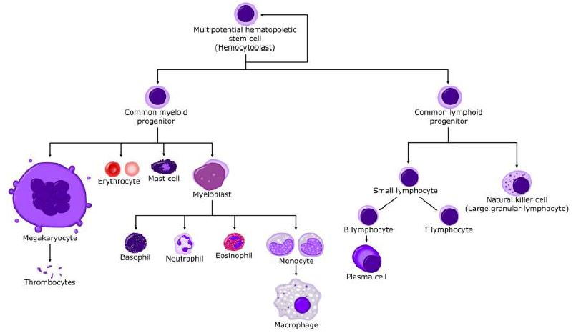
Hematopoiesis

Slide 11
Collection and preservation of blood evidence

Slide 12
Moist Stains
Wear gloves.
Air dry all items before submission.
Keep out of direct heat or sunlight.
Package separately in paper.
Label and seal packages.
Never use plastic.
Collection of Liquid Blood
Absorb into sterile cotton swab.
Let air dry.
Seal and label.
Collection of Dried Stains
Wrap stained item in paper bag or box.
Seal and label.
Large objects: Moisten swab with distilled water, rub area with swab, and package swab.
Scrapping

Slide 13
Things to be taken care of..

Slide 14
DRY STAINS
Identification: On outside of box, paper packet, or envelope: Type of specimens, date secured, CSI or investigator’s initials, case name and number, and where sample was taken from.
Evidence - Collect as much of the stain as possible. Submit entire stained object. A swabbing should be submitted when the item can not be submitted due to size, shape or hazardous nature. If swabbing, collect as much stain onto as few swabs as possible.
Preservation: Keep dry.
Wrapping & Packing: Tops, ends and all folds sealed. Never package in plastic. Always use paper.
Miscellaneous: Dry completely under natural conditions before packaging.

Slide 15
STAINED CLOTHING OR FABRIC
Identification: Type of specimens, date obtained, CSI or investigator’s initials, case name and number, and owner of garment.
Evidence - As found. Submit entire stained object whenever possible.
Preservation: If wet when found, dry under natural conditions. USE NO EXCESSIVE HEAT TO DRY.
Wrapping & Packing: Each article packaged separately and identified on outside of package. Place in cardboard box or paper bags, packed to prevent shifting of contents. Always use paper bags, never use plastic bags or containers that do not allow air flow.
Miscellaneous: Submit not less than 1 sq. in. of stain if entire article cannot be submitted. Be sure to label from where on the garment the stained areas were taken.

Slide 16
SWABS OF STAINS (FROM LARGE ITEMS WHICH CANNOT BE SUBMITTED)
Identification: On outside of envelope: Type of specimens, date secured, CSI or investigator’s initials, case name and number, and from where sample was taken.
Evidence - Collect as much stain onto as few cotton swabs as possible moistened with distilled water.
Preservation: Allow swabs to dry before packing.
Wrapping & Packing: Package in envelope or paper bag. Never package in plastic.
Miscellaneous: Contact the Biology/DNA analysis laboratory for further instructions.

Slide 17
ENVELOPES
Identification: On outside of box, paper bag, or packaging envelope: Type of specimens, date secured, CSI or investigator’s initials, case name and number.
Evidence - Submit entire envelope whenever possible.
Preservation: Keep dry.
Wrapping & Packing: Package in another outer envelope or a paper bag. Never package in plastic.

Slide 18
CANS, BOTTLES, OR CUPS
Identification: On outside of box, paper bag, or envelope: Type of specimens, date secured, CSI or investigator’s initials, case name and number.
Evidence - Submit entire container, or swab drinking area with sterile cotton swabs moistened with distilled water.
Preservation: Dry all swabs before packaging.
Wrapping & Packing: Package in box, envelope or a paper bag. Never package in plastic

Slide 19
CIGARETTE BUTTS
Identification: On outside of box, paper bag, or envelope: Type of specimens, date secured, CSI or investigator’s initials, case name and number.
Evidence - Submit entire cigarette butt.
Preservation: Keep dry.
Wrapping & Packing: Package in box, envelope or a paper bag. Never package in plastic.

Slide 20
reference samples
Reference sample is collected directly from a person into a tube or "Vacutainer" from all of the involved subjects must be sent to the crime lab
Forensic uses of "Vacutainers":
Yellow Top Vacutainers (contain Acid Citrate and Dextrose solution) : Useful for conventional serological testing and DNA testing.
Purple Top Vacutainers (contain EDTA) : Useful for DNA testing; may inhibit certain conventional serological tests.
Red Top Vacutainers (no additives) : Useful for conventional serological tests; less useful for DNA testing; can be used for pregnancy and HIV testing
Grey Top Vacutainers (contain Sodium Fluoride and sometimes EDTA) : Useful for toxicological testing; not suitable for conventional serological analysis and may not be suitable for DNA analysis.
If the investigator is collecting blood from an autopsy, then one of each type of Vacutainer should be collected from the victim. This will insure that any necessary forensic testing can be performed.
These Vacutainers should be stored in a refrigerator (not frozen) at about four degrees Centigrade until they are transported to the crime lab.

Slide 21
