Slide 1
Distinction between human & non human blood

Slide 2
The criminalist must be prepared to answer the following questions when examining dried blood: –
  Is it blood?
  From what species did the blood originate?
  If the blood is of human origin, how closely can it be associated to a particular individual?
  The determination of blood is best made by means of a preliminary color test.
  A positive result from the Kastle-Meyer color test is highly indicative of blood. – Hemoglobin causes a deep pink color.
  Luminol test is used to search out trace amounts of blood located at crime scenes. Produces light (luminescence) in a darkened area.
  Microcrystalline tests, such as the Takayama and Teichmann tests, depend on the addition of specific chemicals to the blood so that characteristic crystals will be formed.

Slide 3
Humans and other animals consist of blood, which is a body fluid, transporting oxygen, nutrients, and metabolic wastes throughout the body.
Blood is composed of blood cells and plasma.
Human blood is red in color due to the presence of oxygen.
Hemoglobin, hemerythrin, hemocyanin, and chlorocruorin are the four types of respiratory pigments in animals.
Different animal blood consists of different types of blood-borne antigens as well.
The main difference between human blood and animal blood is the components of each type of blood.

Slide 4
Identification
Sample of the blood + Anti-human serum ----- blood coagulates, blood is of human origin.
Anti-human serum is produced by injecting rabbits or other lab animals with serum of human blood type O negative.
The animals immune systems will react to the foreign non-rabbit proteins present in the human plasma, and they will develop antibodies to these proteins.
After the antibodies have formed, blood is drawn from the animal, and the antibodies are extracted from the blood.
When these antibodies come in contact with human serum proteins, a clumping or clotting reaction occurs, which can be seen with the naked eye.

Slide 5
DETERMINATION OF ORIGIN
The species specific proteins in the bloodstains or other body tissues may be identified with the help of species specific antibodies.
The species specific proteins from the bloodstain or tissue are extracted in normal saline (8.5 g of sodium chloride in one litre of distilled water) or 5% ammonia solution ( better extractant for aged stains or stains on synthetic fibers and calcified tissues.)

Slide 6
Preparation of extract
Take small portion of the bloodstain and dip in minimum amount of normal saline or 5% ammonia solution (especially for the older/fixed stains).
Keep for 1-2 hours to get light brown coloured solution.
Centrifuge and use the supernatant.

Slide 7
Preparation of extract from calcified/keratinized tissues
Pulverize the bone/dental/nail tissue thoroughly to obtain a very fine powder.
Take about 100mg of the pulverized tissue and dip in minimum amount of 5% ammonia solution.
Keep for overnight.
Centrifuge and use the supernatant.

Slide 8
Preparation of extract from soft tissues
Take small portion of the tissue and add one drop of normal saline or 5% ammonia solution.
Homogenise tissue thoroughly and keep for 1-2 hours.3.
Centrifuge and use the supernatant.

Slide 9
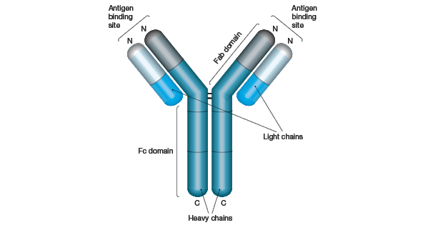
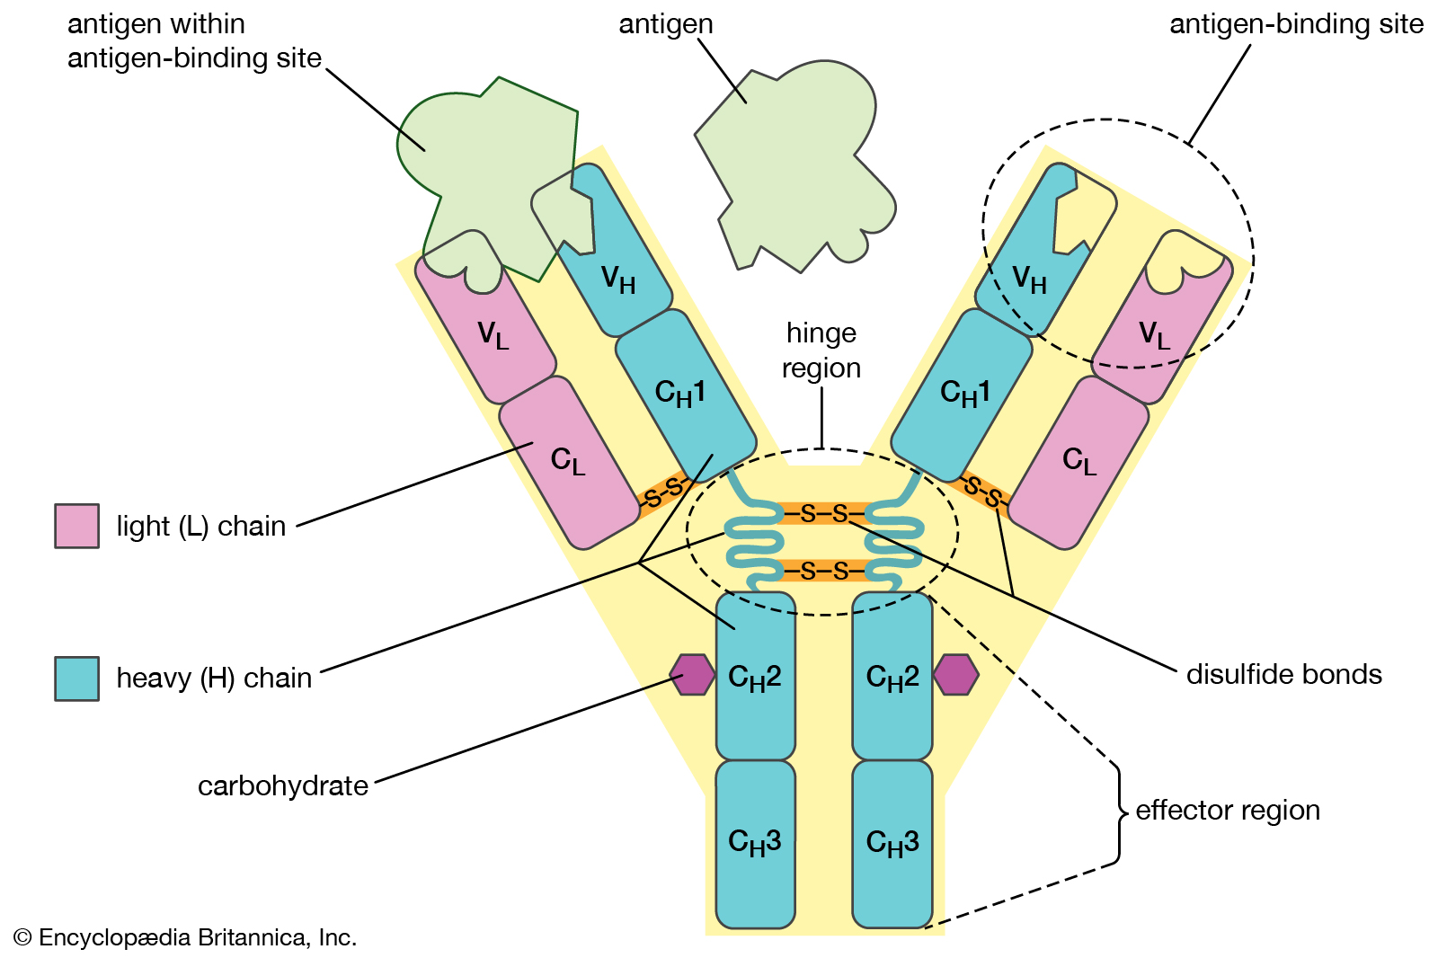

Slide 10
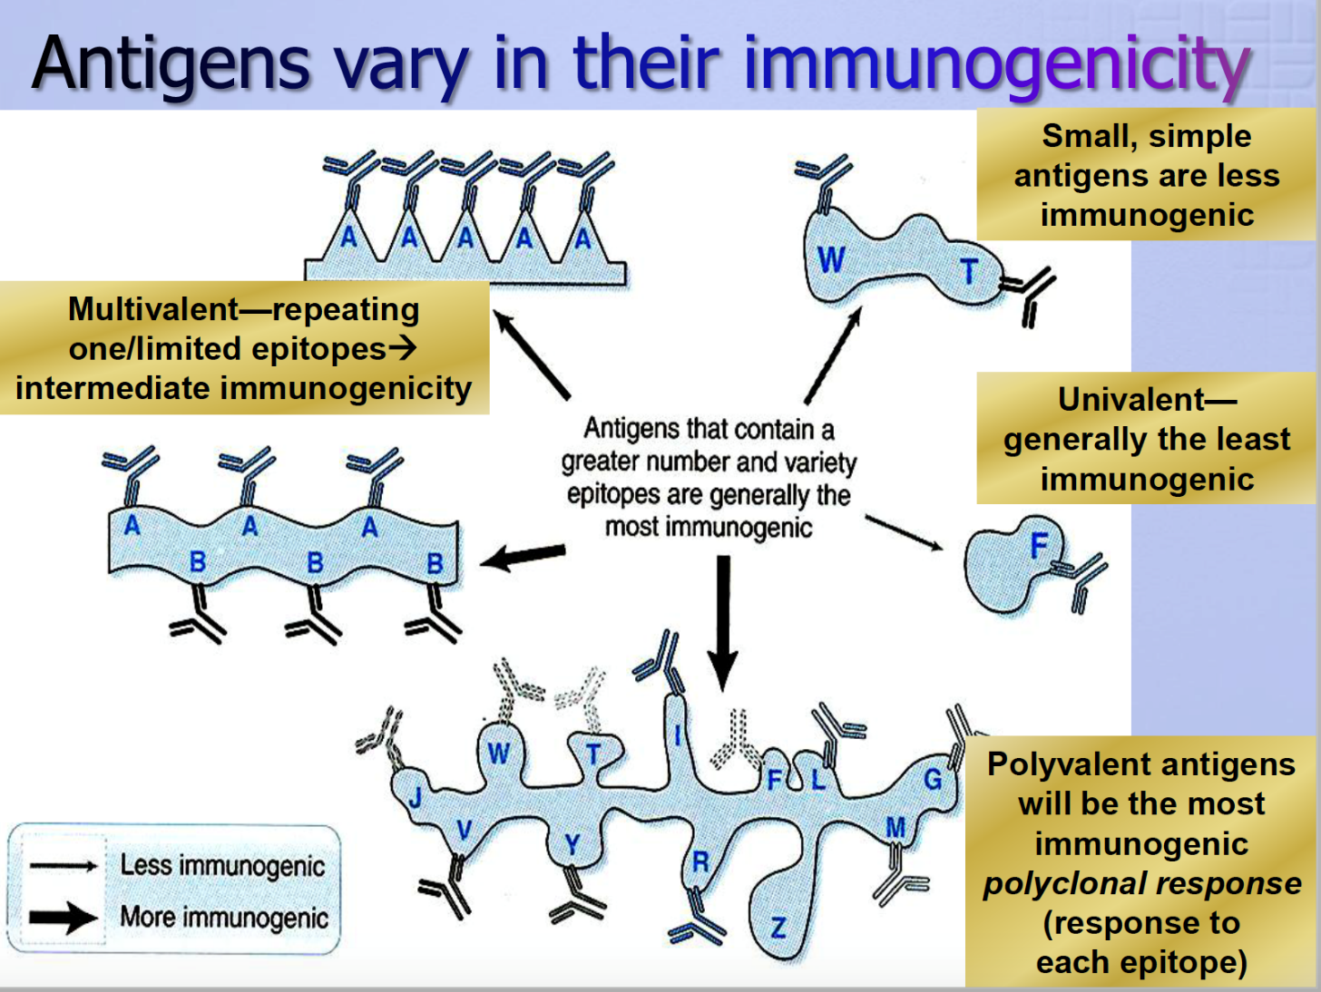
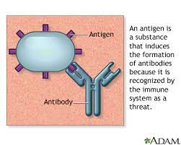

Slide 11
Precipitin Tube Method
Take six (can vary on the number of antisera used) precipitin tubes and place them vertically in a precipitin tube stand and label.
Put a drop of the bloodstain/tissue extract in the tubes.
Carefully add one drop of antiserum for species origin (anti Human serum, anti Fowl serum, anti Dog serum, anti Cow Serum, anti Goat serum etc.) along the walls of tube and leave undisturbed for 30 minutes at room temperature.
Examine for a white ring at the interface of two solutions.
Notes:
Precipitation is a process where soluble antigens bind with their specific antibody at an optimum temperature and pH, resulting in the formation of an insoluble precipitate.
Agglutination is the process of clumping of antigens with their respective antibodies.
Antigens shoud be bivalent or polyvalent
Antibodies should be bivalent

Slide 12
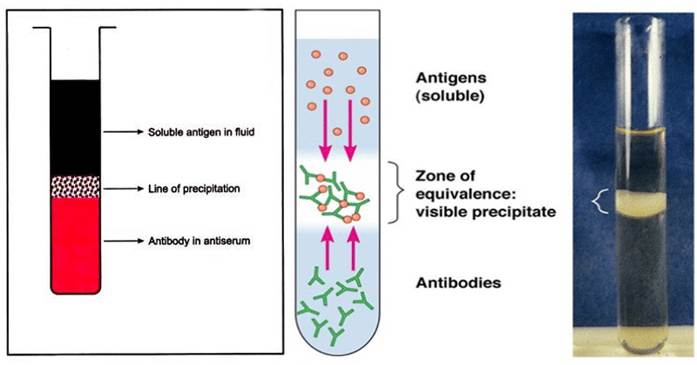

Slide 13
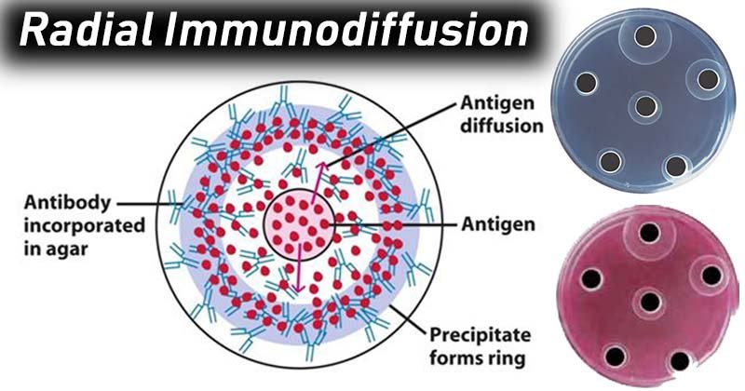
Radial Immunodiffusion

Slide 14
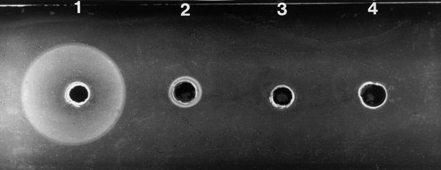

Slide 15
Double Diffusion (Ouchterlony double immunodiffusion)
Both of the reactants, antigen and antibody diffuse towards each other in gel; and when an antigen combines with its specific antibody at optimum proportions, a precipitin arc forms.
  Weigh 100 mg of Agar (or Agarose) and put in a beaker containing 10 ml of normal saline.
  Heat the solution while shaking
  When the Agar gets dissolved completely, pour it over in a properly levelled disposable petri dish or glass slide to make a 1-2mm thick agar layer. Wait until the agar solidifies.
  Punch wells in gel, each about 5 mm apart, in a hexagonal way.
  Seal the bottoms of punched wells with dilute agar (0.5%)
  Fill the central well with tissue extract and peripheral wells with different antisera for species origin or vice versa (anti Human serum, anti Fowl serum, anti Dog serum, anti Cow Serum, anti Goat serum etc.).
  Cover the petri dish and keep gel in a moist chamber for overnight.
  Examine gel for the presence of precipitin arcs.

Slide 16
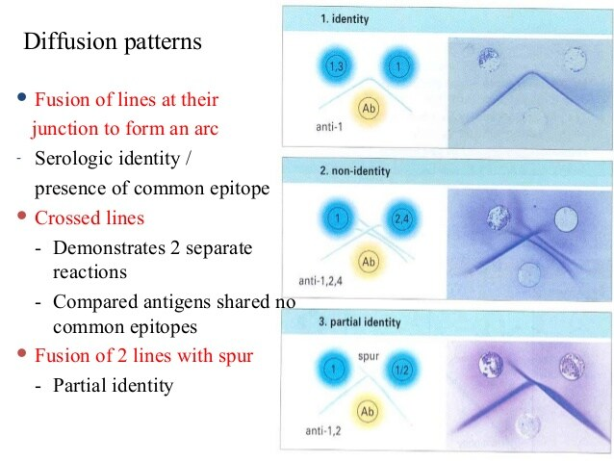
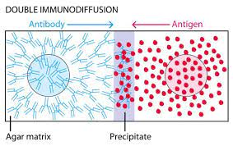
Notes:
https://www.youtube.com/watch?v=hmK7yYr2T54

Slide 17
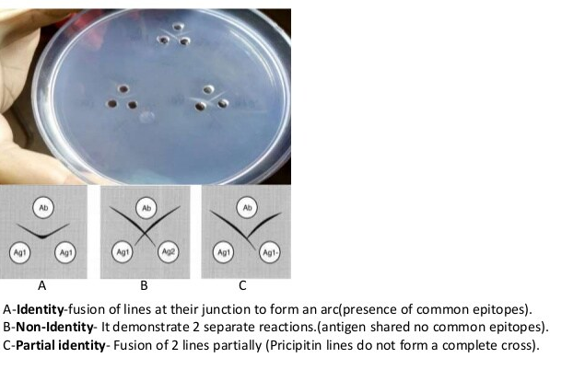

Slide 18
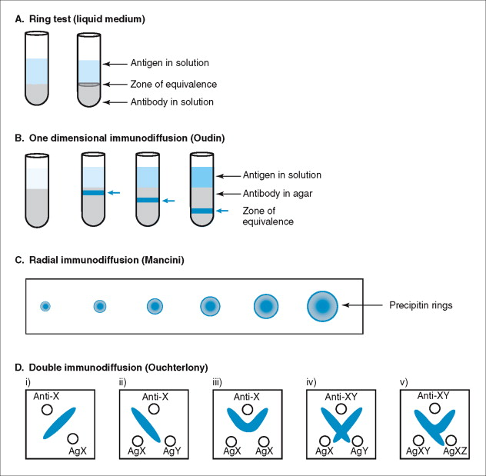

Slide 19
References
https://microbenotes.com/agglutination-vs-precipitation/
https://www.biosciencenotes.com/immunodiffusion-reaction/
https://www.slideshare.net/suniu/immunodiffusion-principles-and-application

