Slide 1
Animal Cell Lines

Slide 2
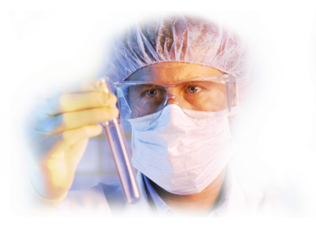
Contents
Points to be discussed
1
Introduction and History
2
Primary Cell Culture
3
Finite Cell Lines
4
Continuous Cell Lines
4
Continuous Cell Lines

Slide 3
Why needed?
Cell culture offers a means to study cellular responses in vitro under controlled conditions and is increasingly used owing to international ratification for the ‘3Rs’ principle –
reduction,
refinement
replacement of the use of animals for in vivo experimentation.

Slide 4
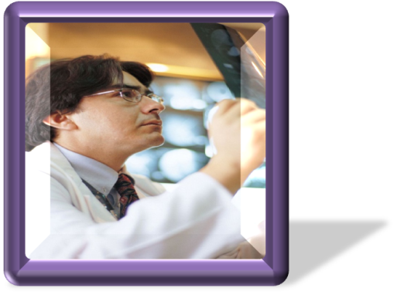
Applications
Intracellular Activity
Studies related to cell cycle and differentiation
Transcription and translation
Energy and drug metabolism
Intracellular flux
Studies involving hormonal receptors
Signal transduction
Membrane trafficking

Slide 5
Applications
Cell to Cell interaction
Cell adhesion and motility
Matrix interaction
Morphogenesis
Metabolic cooperation
Environmental Interaction
Drug actions
Infections
Cytotoxicity
Mutagenesis
Carcinogenesis

Slide 6
Applications
Genetics
Genetic analysis
Transfection
Transformation
Immortalization
Genetic disorders
Cell Products
Vaccines
Plasminogen Activators
Interferons
Blood clotting factors
Hormones
Monoclonal Antibodies

Slide 7
Animal Cell Culture - Fundamentals
Animal Cell Culture basically involves the in vitro maintenance and propagation of animal cells in a suitable nutrient media.
Culturing is a process of growing cells artificially.
Animal and human cells may be studied in vitro by a variety of approaches using whole organs or pieces of tissue as well as isolated cells and cell lines.

Slide 8
Some Definitions
Cell Culture
The culture of dispersed cells obtained from the original tissue or from a cell line
Organ Culture
The culture of native tissue that retains most of the in vivo histological features
Histotypic Culture
The culturing of cell for their reaggregation to form a tissue
Primary Culture
The culture produced by the freshly isolated heterogenous cells or tissues taken from an organism.
Cell Line
The sub culturing of the primary culture gives rise to cell line. It may be continuous or finite.

Slide 9
Animal cells have been cultivated in vitro since the 1900s, when pioneers of this technology such as Harrison and Carrel used animal serum and simple physiological salt solutions as culture media.
Methods for the cultivation of tumor cells were developed in the 1930s and the first continuous cell line, mouse L cells, was reported in the 1940s.

Slide 10
Historical Background
1900s
1930
1940
1952
Mouse L cells
Harrison and
Carrel
HeLa
Frog Tissue Culture
Methods for the cultivation of
tumour cells
Continuous cell line
continuous human
cell line
1950s and 1960s with the development of defined complex culture media such as Eagle’s Minimal Essential Medium, Ham’s F12 and RPMI1640. These growth media were supplemented with 5–10% (v/v) fetal calf serum and are still widely used today.

Slide 11
Primary Cell Culture
It broadly involves the culturing techniques carried following the isolation of the cells, but before the first subculture.
Usually prepared from large tissue masses.
Thus contains different cell types e.g. fibroblasts, macrophages, lymphocytes, epithelial cells.

Slide 12
Certain Criteria/Characteristics
Type of Cells
Minimum damage
Embryonic tissues rather than adult tissues
Careful processing and dead cells should be removed
Quantity of Cells
Selection of Medium
Should be higher as survival rate is substantially lower
Nutrient rich
Addition of Serum and Fetal Bovine Source is preferred
Necessary to remove enzymes used for disaggregation of cells by centrifugation

Slide 13
Techniques for Primary Cell Culture
Soft tissues e.g. spleen, brain, embryonic lever, soft tumors
Mechanical Disaggregation
Techniques for Primary Cell Culture
Enzymatic Disaggregation
Explant technique
When high recovery of cells is needed
More efficient
ThemeGallery is a Design Digital Content & Contents mall developed by Guild Design Inc.

Slide 14
Mechanical Disaggregation
Forcing the tissue fragments through a syringe and needle
Careful chopping or slicing
Pressing the tissue pieces through the series of sieves
Risk of cell damage.
Less expensive
Quick and simple
Preferred when plenty tissue is available and efficiency of the yield is not crucial
Viability of cells is much lower then the other techniques
When? Why?

Slide 15
Enzymatic Disaggregation
Used when high yield/recovery of cells is required from a tissue
Preferred in case of embryonic tissue
term trypsinization is used
Crud trypsin is preferred
Two methods – Warm and Cold
Trypsin
used for trypsin sensitive tissues
Crude is preferred
Collagenase
Other enzymes
Bacterial proteases – pronase, dispase
Hyaluronidase, neuraminidase

Slide 16
Primary Explant Technique
Original Method developed by Harrison in 1907.
Method
Finely chopped Tissue in basal salt solution.
BSS is removed.
Tissue pieces are spread over the growth surface.
Incubation 3-5 days after medium addition
Medium is changed weekly untill substantial outgrowth is observed.

