Slide 1
Indices
Cephalic index, Nasal index, Cranial index, Upper facial index

Slide 2
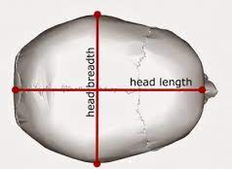
Cephalic Index
The cephalic index is a measure of the width of the skull in relation to its length.
It is calculated by dividing the width of the skull (measured from the parietal bones) by the length of the skull (measured from the glabella to the occipital protuberance) and multiplying by 100.

Slide 3
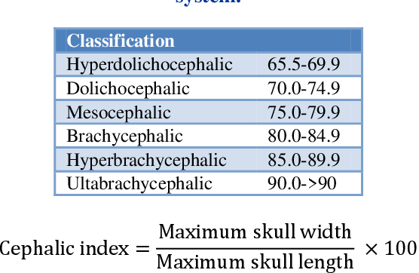

Slide 4
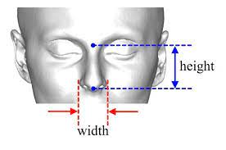
Nasal index
The nasal index is a measure of the width of the nose in relation to its height.
It is calculated by dividing the width of the nose (measured at the base) by the height of the nose (measured from the nasion to the nasal tip) and multiplying by 100.
The resulting value is expressed as a percentage.

Slide 5
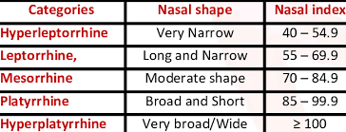

Slide 6
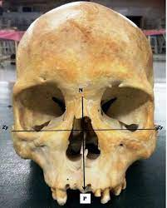
Upper Facial Index
The upper facial index is a measure of the height of the upper face in relation to the length of the skull.
It is calculated by dividing the height of the upper face (measured from the nasion to the top of the Prosthion) by Facial Width ( distance between two Zygions) or the length of the skull (measured from the nasion to the opisthion) and multiplying by 100.
An upper facial index of less than 50 is considered orthognathic (straight face), while an index of more than 55 is considered prognathic (projecting face).

Slide 8
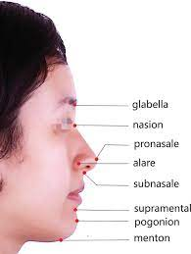
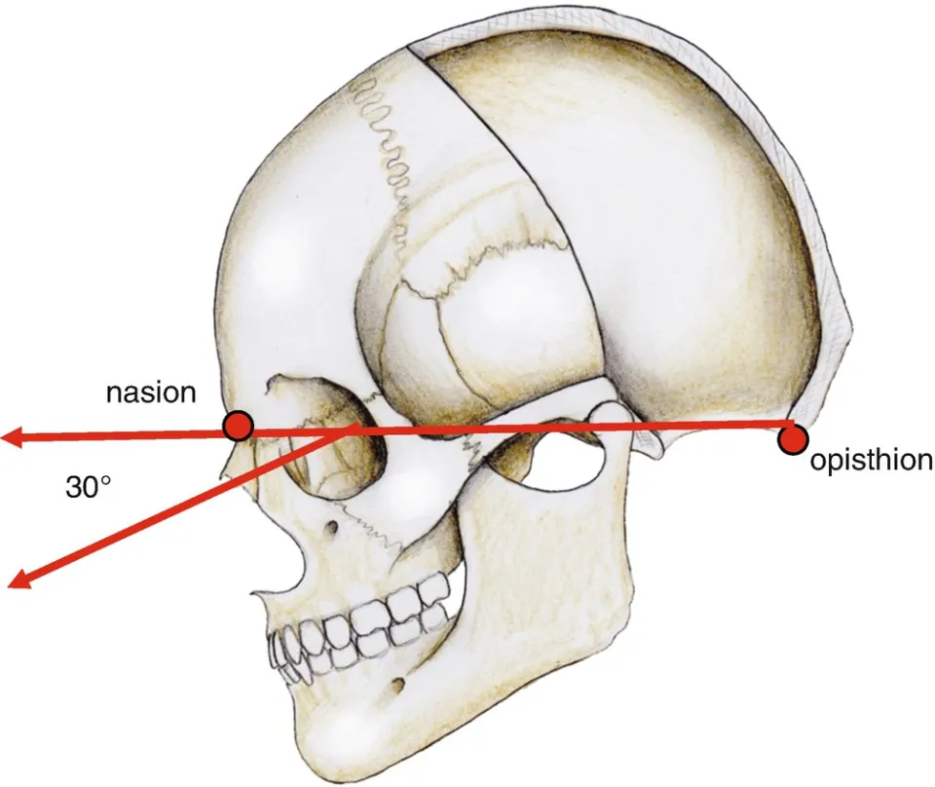

Slide 9
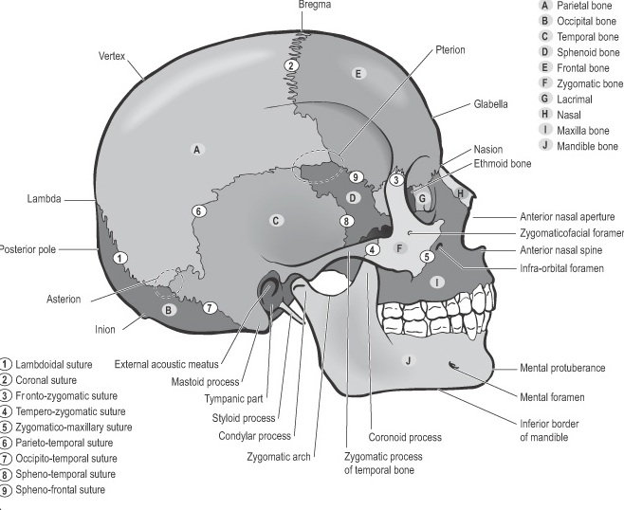
Cranial Landmarks

