Slide 1
PELVIS

Slide 2
PELVIC GIRDLE

Slide 3
ANATOMY OF PELVIS

Slide 4
Sex Determination From Pelvis

Slide 5
Sl. No. | Trait | Male | Female
1. | Pelvis as a whole | Massive, rugged, marked muscular sites | Less massive, gracile, smother
2. | Symphysis | Higher | Lower
3. | Sub-pubic angle | V-shaped, sharp angle | U-shaped, rounded, broader, divergent, obtuse angle
4. | Obturator foramen | Large, often ovoid | Small, triangular
5. | Acetablulum | Large, tends to be directed laterally | Small, tends to be directed antero-laterally
6. | Greater sciatic notch | Small, close, deep | Large, wider shallower.
7. | Ischipubic rami | Slightly everted | Strongly everted
8. | Sacro-iliac articulation | Large | Small, oblique
9. | Preauricular sulcus | Not frequent | More frequent, better developed
10. | Ilium | High, tends to be vertical | Lower, laterally divergent
11. | Sacrum | Longer, narrower with evenly distributed curvature, often 5+ segments | Shorter, broader with tendency to curve
12. | Pelvic brim | Heart shaped | Circular or elliptical
13. | True Pelvis | Relatively smaller | Oblique, shallow, spacious.

Slide 7
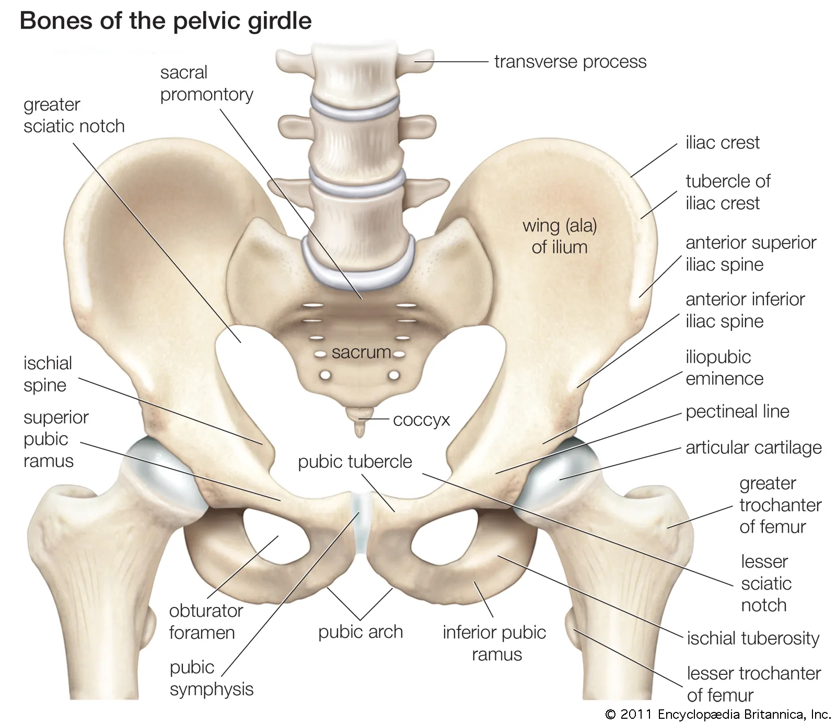

Slide 8
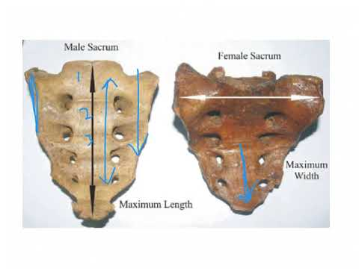
Sex determination from Sacrum
 | Male | Female
1. | Long and Narrow | Short and wide
2. | Uniform curvature along its whole length | Sharply curved forward in its lower half
3. | The articular surfaces extend over two and half to three elongated bodies | The articular surfaces extend over two to two and a half segment

