Slide 1
Rasmita Jena
Assistance Professor
SoPLS, CUTM, BBSR

Slide 10
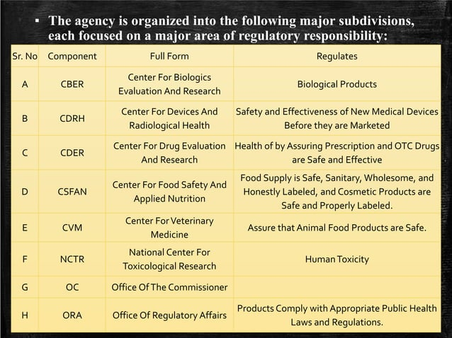

Slide 28
