Slide 1
CONGENITAL ANOMALIES

Slide 2
AKA congenital abnormalities, congenital malformations or birth defects.
Congenital means acquired in the womb.
They can be defined as structural or functional anomalies (for example, metabolic disorders) that occur during intrauterine life and can be identified prenatally, at birth, or sometimes may only be detected later in infancy, such as hearing defects.
Broadly, congenital refers to the existence at or before birth.

Slide 3
CAUSES
GENETIC
Down syndrome, Cystic Fibrosis
SOCIOECONOMIC AND DEMOGRAPHIC FACTORS
Lack of access to sufficient nutritious food by pregnant women,
Exposure to alcohol & infection, poor health care
Maternal Age (higher the age, higher risk of chromosomal abnormalities)
ENVIRONMENTAL FACTORS INCLUDING INFECTIONS
Maternal infections: Rubella, Zika, Syphillis
Exposure to radiation, pollutants
UNKNOWN CAUSES
Genetic and environmental interactions (heart defects, cleft lip or palate)
Notes:
https://www.who.int/news-room/fact-sheets/detail/birth-defects

Slide 4
Genetic Anomalies VS Congenital Anomalies
Notes:
What is the Difference Between Genetic and Congenital Disorders | Compare the Difference Between Similar Terms

Slide 5
TYPES
1. Isolated conditions
2. Generalized conditions
3. Spinal deformities.
Anatomical location
Affect the skeleton to a huge or less extent.
Deformed spine
Vertical Talus, Shoulder Girdle
Achondroplasia
Osteogenesis imperfecta
Scoliosis

Slide 6
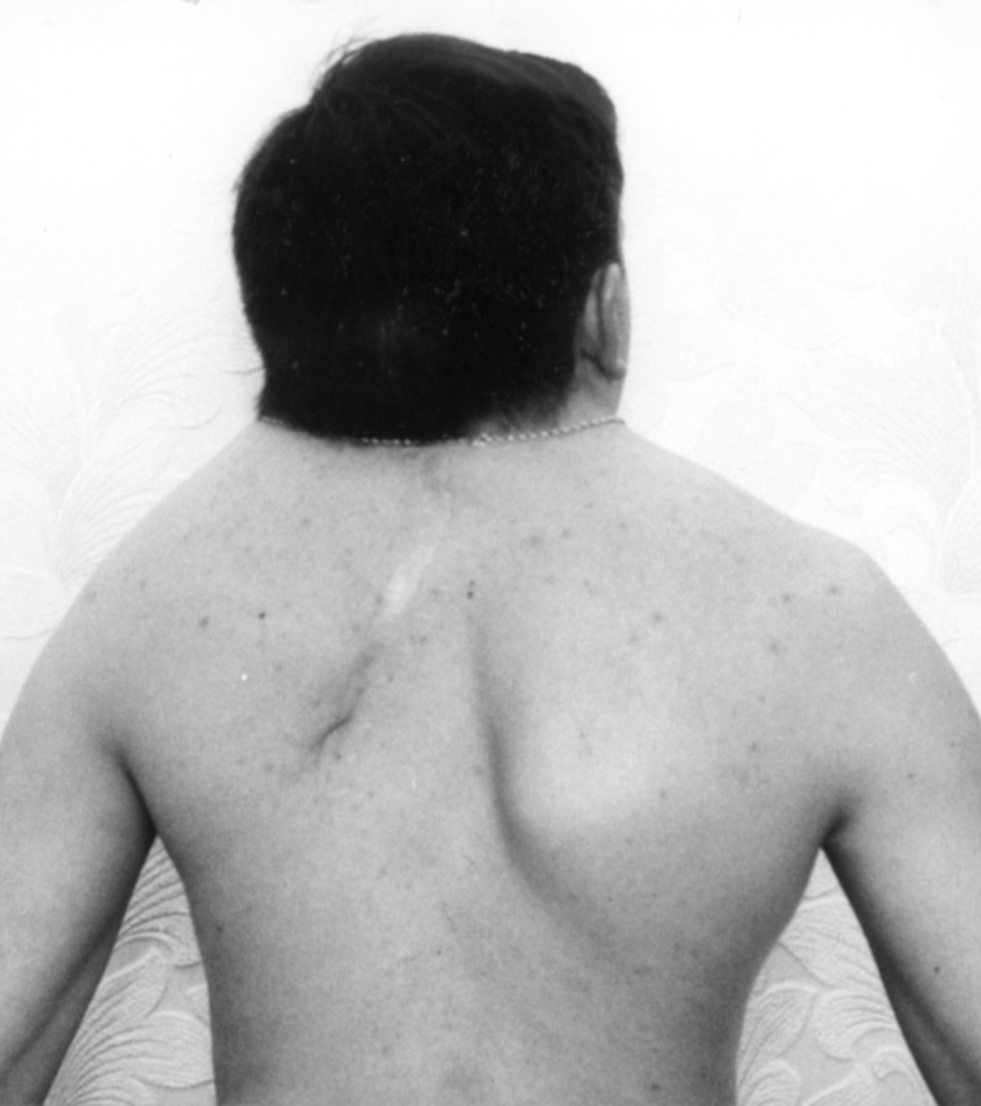
1.1. Shoulder Girdle
Klippel-Fiel syndrome :
bone disorder
Abnormal joining (fusion) of two or more spinal bones in the neck (cervical vertebrae
Three major features result from this vertebral fusion: a short neck, the resulting appearance of a low hairline at the back of the head, and a limited range of motion in the neck.
Unilateral : birth trauma of brachial nerve plexus
Bilateral : hypoplasia of glenoid due to growth disturbances

Slide 7
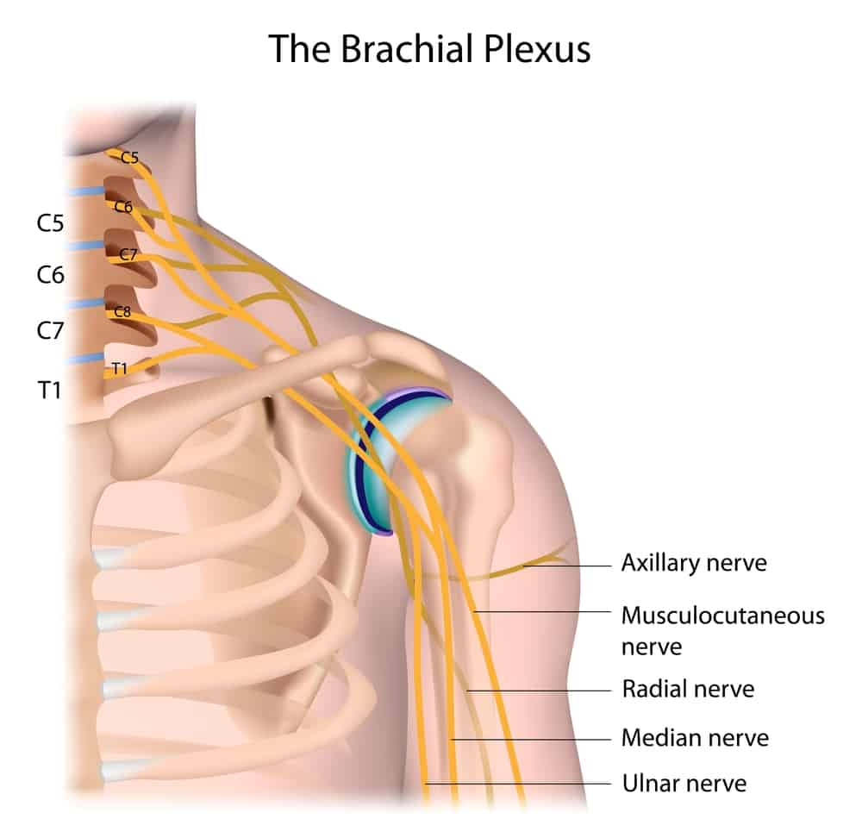
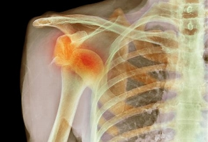
Glenoid : Socket of the ball-and-socket shoulder joint. The glenoid is part of the scapula (shoulder blade), a thin, broad bone that sits behind the rib cage.

Slide 8
1.2. Madelung Deformity
Wrist grows abnormally and part of the radius, one of the bones of the forearms, stops growing early and is short and bowed.
Due to growth disturbance of the medial aspect of the distal epiphysis.
Reason: Localized trauma or infection which causes premature fusion of part of the growth plate.

Slide 9
TYPES
STRUCTURAL ANOMALIES
Structural changes that have significant medical, social or cosmetic consequences for the affected individual, and typically require medical intervention.
Spina bifida,congenital dislocation of the hip, congenital heart defects.
FUNCTIONAL ANOMALIES
Affects the normal physiological working of body
Cystic fibrosis, haemophilia, fetal alcohol syndrome, Down syndrome.
Notes:
https://www.medicalnewstoday.com/articles/birth-defects#types

Slide 10
STRUCTURAL ANOMALIES
Heart defects
Part of the heart does not form properly in the womb.
E.g. ventricular septal defect : hole in the wall separating the two lower heart chambers. Sometimes, the hole will close on its own over time.
Limb reduction
A limb is smaller than the usual size or missing altogether.
Missing finger, clubfoot, or an arm that is shorter than usual.
Cleft lip or palate
If the tissues forming the roof of the mouth or lip do not join properly, it can cause a cleft lip or palate.
Affect speech, hearing, and eating.
Neural tube defects
occur in the first few months of pregnancy, when the brain and spinal cord of a fetus are forming.
Anencephaly, Encephalocele, Spina Bifida

Slide 11
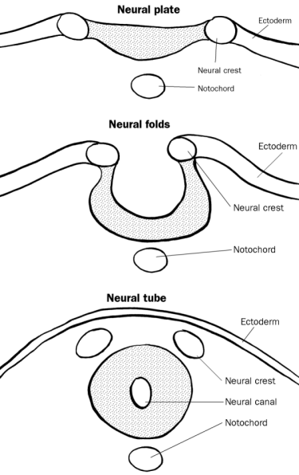

Slide 12
Neural Tube Defects
Notes:
https://healthjade.net/neural-tube-defects/

