Slide 1
HOSPITAL PHARMACY ORGANISATIONS & MANAGEMENT
NITHIN MANOHAR R
M.Pharm,(PhD),MSc Psychology,
Assoc.Professor
Dept Of Pharmacy Practice
Pushpagiri College Of Pharmacy

Slide 2
Introduction
Hospital pharmacy is one of the most important department among several departments of a hospital.
Hospital pharmacy may be defined as that department of the hospital which deals with procurement, storage, compounding, dispensing, manufacturing, testing, packaging and distribution of drugs.
It is also concerned with education and research in pharmaceutical services. A hospital pharmacy is controlled by a professionally competent and a qualified pharmacist.

Slide 3
Functions and Objectives of Hospital Pharmacy
Pharmacy is recognized as an essential hospital service in all the major hospitals. It is managed by professionally qualified pharmacists.
It has been realized that only trained pharmaceutical personnel are capable of purchasing, storing, handling, pricing and dispensing of medications. It is the pharmacist who is an expert to provide all information regarding drugs to the health professionals and also to the public. Therefore, he acts as a link between the physician and the patient. A pharmacist is required to perform various functions in hospital pharmacy which are described as follows :

Slide 4
Providing specifications for the purchase of drugs, chemicals, biologicals, etc.
Manufacturing and distribution of medications such as transfusion fluids, parenteral products, tablets, capsules, ointment, and stock mixtures.
Dispensing and sterilizing parenteral preparations which are manufactured in the hospital.
Dispensing of drugs as per the prescriptions of the medical staff of the hospital.
Management of stores which includes purchase of drugs, proper storage conditions and maintenance of records.

Slide 5
Establishment and maintenance of "Drug Information Centre" which will provide information regarding medications to the physician, nurses or any other competent person who deals in drugs.
Patient counselling service while supplying drugs especially from out-patient department.
Maintaining liasion between medical staff, nursing staff and patients.
Providing cooperation in teaching and research programmes of the hospital.
Discarding the expired drugs and containers with missing labels.

Slide 6
Functions of hospital pharmacy
To provide & evaluate pharmaceutical services and thereby supporting the medical staff, with due consideration of the objectives and policies of the hospital.
To draw a plan for hospital administration and to evolve responsibilities of each category of personnal involving pharmaceutical services like assistant pharmacist, storekeeper, nursing staff etc.
To establish liasion between administrative authorities and medical doctors who will order medicines and ancillary products in the hospital.
To estimate the requirements of the department and enforce the policies and procedures of the recruitment of adequate and competent staff.

Slide 7
To develop and maintain an effective system of clinical and administrative records and reports.
To participate in and adhere to the financial plan of the operation for the hospital.
To estimate the needs for facilities, supplies and equipment and to see that there is proper control of inventory, stocks, dispensing and manufacturing of the medicaments (if carried out in hospital).
To initiate, utilize and participate in research projects designed for the improvement of a patient care and of other administrative and hospital services.
To participate and adhere to the safety programs of the hospital.
To participate and/or facilities all educational programmes which include student experiences in the department.

Slide 8
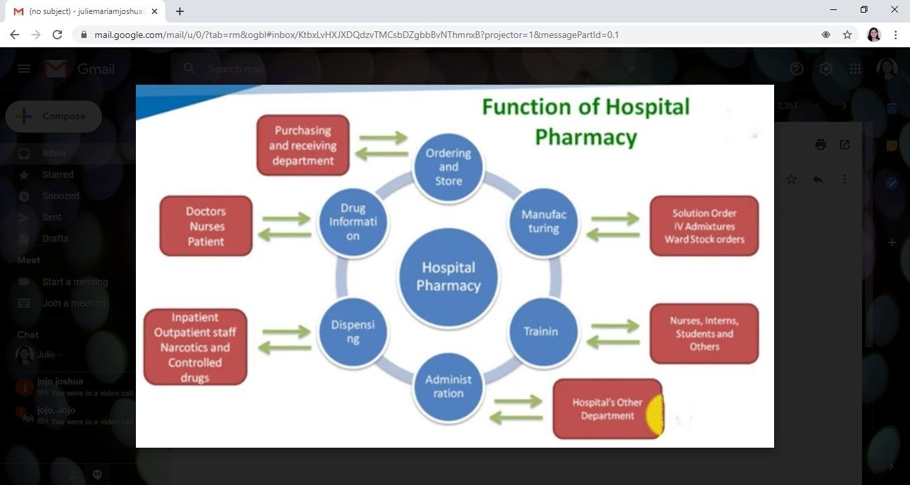

Slide 9
Objectives of Hospital Pharmacy
To ensure the availability of right medication, at right time, in the right dose at the minimum possible cost.
To professionalize the functioning of pharmaceutical services in a hospital.
To act as a counseling department for medical staff, nurses and for patient.
To act as a data bank on drug utilization.
To participate in research projects.
To implement decisions of the pharmacy and therapeutics committee.
To co-ordinate and co-operate with other departments of a hospital.
To plan, organize and implement pharmacy policy procedures in keeping with established policies of the hospitals.

Slide 10
LOCATION, LAYOUT, FLOW CHART OF MATERIALS AND MEN

Slide 11
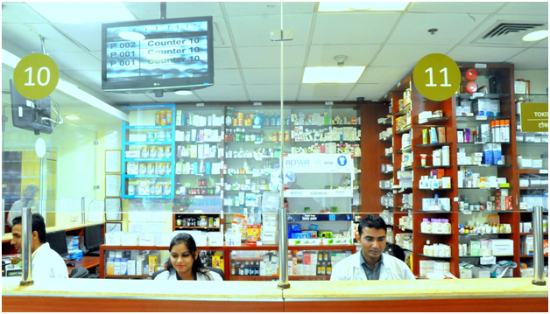
Location of Hospital Pharmacy
The hospital pharmacy should be located in hospital premises so that patients and staff can easily approach it. In multi-storeyed building of a hospital, the pharmacy should be preferably located on ground floor especially the dispensing unit. It should be laid in such a way that there is a continuous flow of men and materials.
OP pharmacy should give a pleasant appearance and must have enough space for seating of patients who have to wait for medicines. OPD’s waiting room should give a professional look. It should have educative posters on health and hygiene and light literature for reading.
Space must be provided for routine manufacturing of stock solution, bulk powders, ointments etc. The manufacturing room should be adjacent to the pharmacy.

Slide 12
Medical stores of a pharmacy should be adjacent to the pharmacy itself or should be directly concerned with pharmacy.
Pharmacy receives materials from two sources:
Medical stores
Manufacturing division of the hospital.
Pharmacy issues materials to in-patients and out-patients. The in-patients are served by nursing stations who receive their materials from the pharmacy.

Slide 13
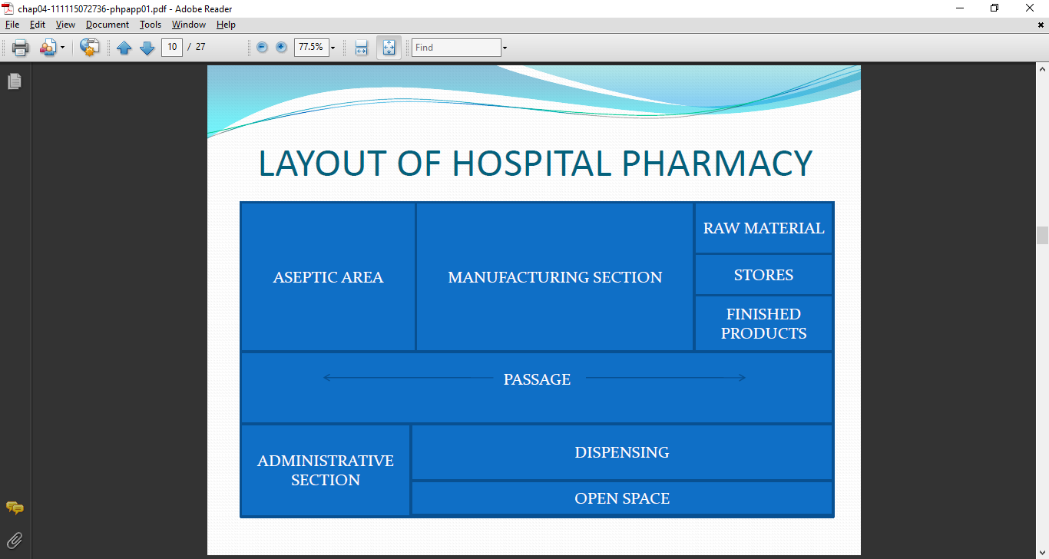
LAYOUT OF HOSPITAL PHARMACY

Slide 14
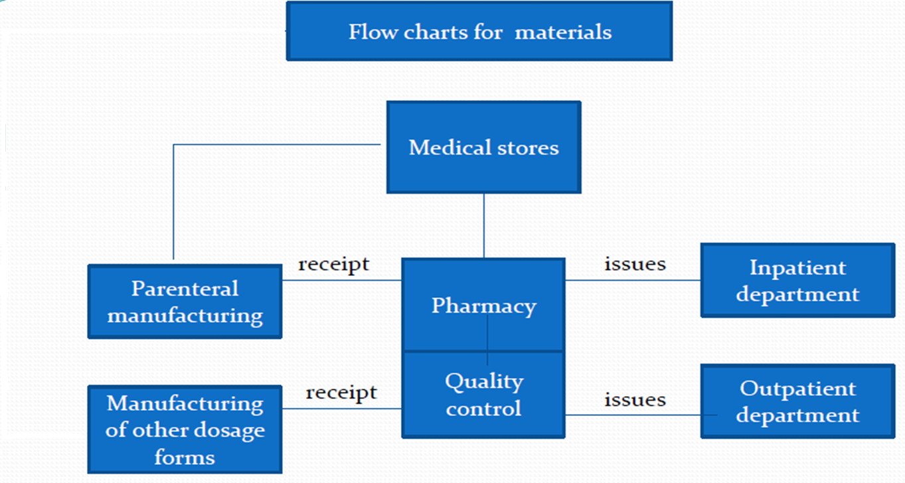

Slide 15
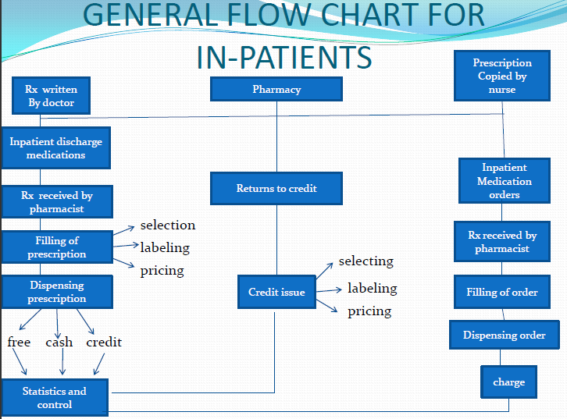

Slide 16
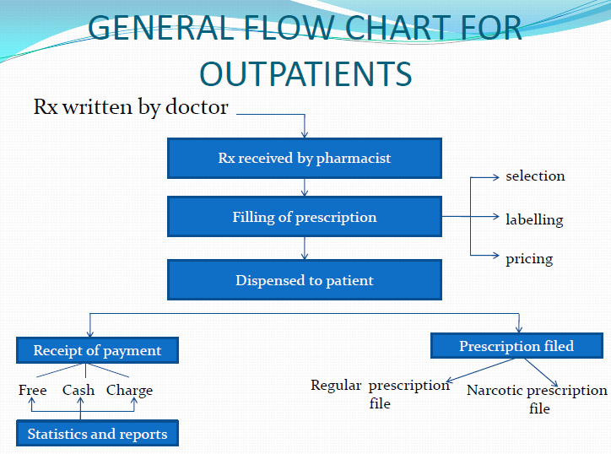

Slide 17
PERSONNEL AND FLOOR SPACE REQUIREMENTS INCLUDING EQUIPMENTS BASED ON INDIVIDUAL BASIC NEEDS

Slide 18
FACILITIES REQUIRED IN HOSPITAL PHARMACY
In smaller hospitals, with one pharmacist only, one room is required for pharmacy, having a combination of dispensing, manufacturing, administrative and all other sections of complete pharmaceutical service. For sterile products there should be a separate room or area.
In large hospitals, with 200 or more beds, departmentalization of pharmacy activities is required. A separate area is required for :-
Inpatient services and unit dose dispensing
Outpatient service
An office for the chief pharmacist

Slide 19
A compounding room
Prepacking and labelling room
A store room
Sterile products room
A separate area for drug information services and space assigned on various nursing units for unit dose drug administration.

Slide 20
FLOOR SPACE REQUIREMENTS
250 sq. feet is the minimum required area for any sized hospital. 10 sq. feet per bed in 100 bedded hospital. Floors of pharmacy should be smooth, easily washable and acid resistant.
In manufacturing sections, drains should be provided, walls should be smooth, painted in light color. Wooden cabinets are laminated. Fluorescent lamps are placed above prescription counter. Counter for Bunsen burner are also required.

Slide 21
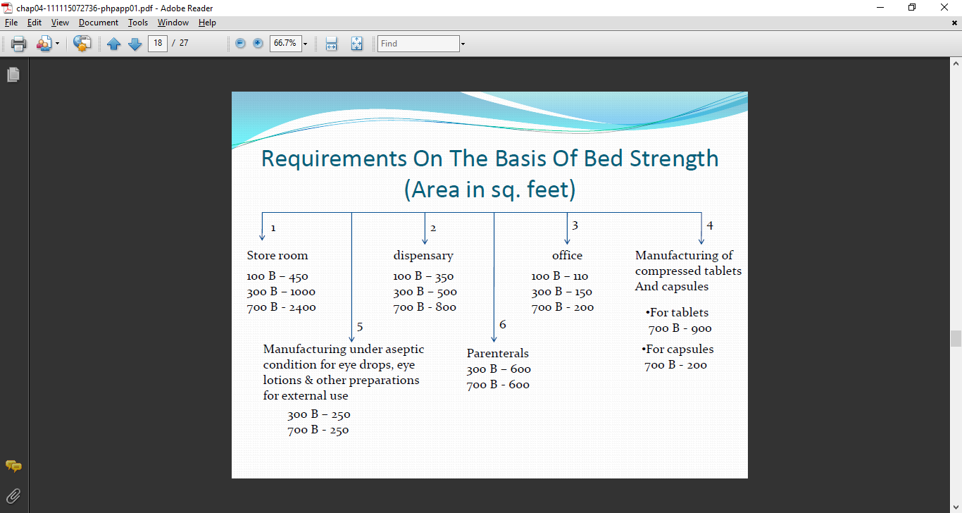

Slide 22
Equipments required in hospital pharmacy includes:
Prescription case
Drug stock cabinets with proper shelves and drawers.
Sectional drawer cabinets with cupboards bases.
Work tables and counters for routine dispensing.
Sink with drain board.
Cabinet to store mortar and pestles.
Cabinet for glass utensils, flasks, funnels and beakers.
Refrigerator of suitable capacity.
Narcotics safe with individually locked drawers.
Office desk with telephone connection and file cabinet.
Dispensing window for nurses and outpatients.

Slide 23
PERSONNEL REQUIREMENT IN HOSPITAL PHARMACY
No standard rules regarding the requirement of personnel for inpatient pharmacy.
Number of pharmacists required for a hospital are calculated on the basis of workload, number of prescriptions received and dispensed and the number of bed available. For a small hospital minimum 3 pharmacist are required. As the number of bed increases, the number of pharmacist also increases.
Pharmacist should possess adequate pharmacy qualification and experience. The overall charge of the in-patient department should remain with the chief pharmacist.
If manufacturing of drugs is involved in pharmacy, adequate number of technicians, assistants, peons etc. required.

Slide 24
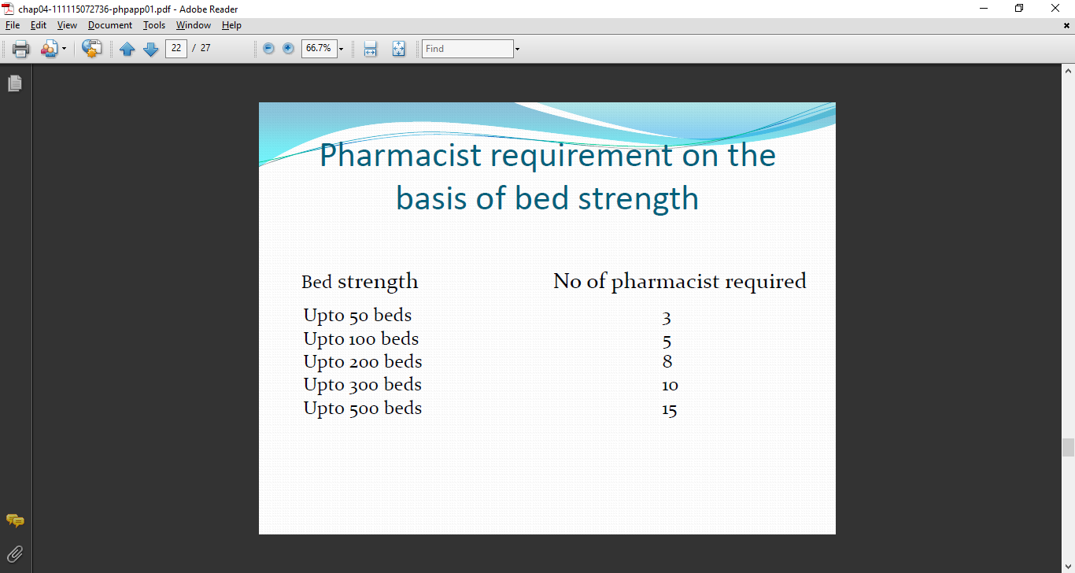
Pharmacist requirement on the basis of bed strength

Slide 25
REQUIREMENTS AND ABILITIES
REQUIRED FOR HOSPITAL
PHARMACIST

Slide 26
REQUIREMENTS
Head of hospital pharmacy department should be a post graduate in pharmacy preferably in pharmaceutics, pharmacology or hospital pharmacy.
He acts as a co-ordinator for the pharmacy and non pharmacy staff.
He reports to the administrator and interacts with other medical departments.

Slide 27
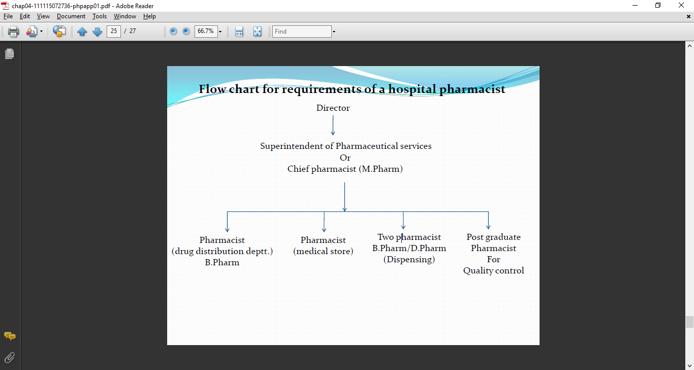
Flow chart for requirements of a hospital pharmacist

Slide 28
ABILITIES REQUIRED FOR HOSPITAL PHARMACIST
Technical Ability: He should have thorough knowledge of basic sciences pharmacology, toxicology, route of administration, stability etc: A hospital pharmacist must provide information regarding proper handling of drugs. As hospital pharmacist is a part of medical team, he must gain confidence amongst his medical colleagues through his technical competence, eg, by providing comparative evaluation of various data on drug actions, dosage, toxicity and relative cost.
Ability to Develop a Manufacturing Section : Manufacturing within a hospital requires control over supply, quality, equipment, and raw material cost. Hospital

Slide 29
pharmacist has to organise manufacturing function by doing proper cost-benefit analysis. Although quality maintenance is essential because considerable quantities of drugs are required for treatment of patients (out-door as well as in door).
Administrative Ability: Hospital pharmacist should be able to plan, organise and control various functions of hospital pharmacy. He should prepare work schedule for his staff. He should frame various policies and procedures to get the work done. He should interact with his staff daily. Hospital pharmacist must maintain the legal and administrative records properly. Where patients are charged for drugs the hospital pharmacist must develop charging policies. Chief pharmacist is usually responsible for interviewing, selecting and evaluating the staff members for work in pharmacy.

Slide 30
Ability to Control Inventory: Chief pharmacist has to exercise his duties which are lying at nursing stations, supply rooms etc. He has to communicate with supplier of drugs. He must check the quality of drugs and other supplies.
Ability to Conduct and Participate in Researches: The pharmacist is required to maintain information of pharmaceutical journals. He must advise about new methods, preservation, preparation and to improve efficacy of preparation. He must have the basic understanding methods so that he can properly evaluate the research datas.
Ability to Conduct Teaching Programmes: The pharmacy staff can act as trainers for the nursing staff must prepare suitable teaching material for the

Slide 31
nursing staff like proper storage of drugs, proper use of drugs etc. Chief pharmacist is also responsible for the practical training of pharmacy students. He should see that they must learn and have sufficient professional skill.

Slide 32

MANAGEMENT OF MATERIALS AND FINANCE of A HOSPITAL PHARMACY

Slide 33
Material management of a hospital pharmacy
Management is a process involving planning, organising, staffing and controlling any organisation.
Hospital is a very complex organisation. So emphasis should be given on management of materials in a hospital pharmacy. Financial management, human resource management and computer application are the other aspects.
Material management is a scientific technique, concerned with Planning, Organizing & Control of flow of materials, from their initial purchase to destination.

Slide 34
Aim of Material Management
Right material,
in right quantities,
at right time,
at right price,
from right sources,
at a least cost.

Slide 35
Objectives of Material Management
To develop a system of supplies where by there will be an adequate stock of items required but at the same time, it shouldn't be too much in quantity to avoid wastage. It should be stored in a manner that, an item can be easily traceable or obtainable and distributed according to the use.
To ensure that the resources available are used most effectively and drugs for the stores should be purchased at most economical price.

Slide 36
Procedures
To achieve these objectives, following procedures can be used,
To determine categories of stock required, estimate the quantity and quality of each item.
To procure the items of good quality from various sources at most economical prices.
To receive the items according to the quantity and quality specified and payments made regularly.
Received items are stored properly so as to prevent deterioration during storage.
To develop a good control on inventory.
To develop a proper distribution system of drugs.

Slide 37
Store management
It is the function of receiving, storing & issuing of materials. Hospital materials require huge investments. It is therefore necessary to ensure accuracy, preservation and safety of materials at all stages of store management.
Functions of store
A store branch is generally responsible for,
Receipt of stores- to receive, check and inspect all supplies.
Storage-To stock all materials properly to avoid damage and pilferage.
Issue of materials-To issue materials against a requisition.
Documentation- To maintain accurate records of materials received, issued and stored.

Slide 38
Inventory control
It means stocking adequate number and kind of stores, so that the materials are available whenever required and whatever required. Scientific inventory control results in optimal balance.
The main function of the inventory control, is to provide maximum supply service, consistent with maximum efficiency and optimum investment.
Various inventory control techniques includes: ABC analysis, VED analysis, EOQ, Lead time, FSN etc.

Slide 39
Management of finance of a hospital pharmacy
Financial management is a vital activity in any organization. It is the process of planning, organizing, controlling and monitoring financial resources with a view to achieve organizational goals and objectives.
The financial management of pharmacies and health systems is a combination of the traditional management of personnel and drug and supply costs with the management of the total costs of care. It includes determining the consequences of less than optimal drug therapy, improving drug therapy, and reengineering pharmacy departments and services across all patient care settings to deliver optimal pharmacotherapy.

Slide 40
In hospital pharmacy, managers are responsible for planning, organizing, and controlling resources so that the organizations in which they are employed meet their goals.
Pharmacist managers face many such decisions: how much inventory to carry, which sources of supply to use, how to set prices, which third-party prescription plans to participate in, which drugs to include on a formulary, whether a new disease management service will be profitable, whether the hospital should open a pharmacist-managed hypertension clinic.

Slide 41
Goals of Financial Management
The principal goal of financial management is to increase the value of the organization. A major part of achieving this goal is making efficient use of financial resources.
Pharmacies make the most efficient use of cash that is invested in inventories when they carry the smallest amount of inventory necessary to meet consumer demand. Carrying larger inventories is inefficient because it takes cash away from other, more productive uses.

Slide 42
Accounting and Financial Management
A proper understanding of the tools and techniques of financial management requires a basic working knowledge of accounting.
Financial statements facilitate decision making in three areas.
First, financial statements provide information to decision makers. With this information, decision makers can better assess the financial implications of various decisions they must make. For example, bankers are decision makers. Before making loans, they will carefully evaluate the financial statements submitted by applicants to decide whether they can repay the loans. Managers are also decision makers. They use financial statements, for example, to make pricing decisions, to help decide

Slide 43
whether to hire additional personnel, to decide whether to buy new equipment, and to decide which services to offer.
Second, financial statements aid decision makers by reporting the results of past decisions. The prudence of a banker’s past lending decisions will be reflected in his or her current financial statements. Likewise, a manager who makes poor service and pricing decisions will notice, on financial statements, a decrease in profits.
Finally, financial statements keep track of a range of financial items such as cash, debts, and assets. Decision makers need this information to efficiently and effectively manage their organizations.

Slide 44
Financial statements provide decision makers with the following types of information:
Present financial status of the business. The balance sheet, or statement of financial position, indicates what a business owns and what it owes at one point in time.
Past profit performance of the business. The income statement, also called the profit and loss statement, indicates whether the business made a profit or suffered a loss over some period of time.
Where the business is getting its cash and how it is spending it. This is found on the statement of changes in financial position or the cash flow statement.
How the owners investment in the business has changed over some period of time.

Slide 45
Limitations of Financial Management
Financial management is a tool that managers can use to better assess the financial implications of decisions they face. Its use should be limited to deciding among potential courses of action that will help the pharmacy to reach its goals. In most cases, it should not be used to decide what those goals are, nor should most decisions be based solely on financial criteria.
For example, a hospital pharmacy could decrease its expenses, and maintain its revenues, by switching from unit-dose to multiple-dose drug distribution and by cutting out all clinical and educational services. If the pharmacy’s decisions were based solely on financial criteria, a financial analysis might show the advisability of this course of action.

Slide 46
But a hospital pharmacy has a higher and more basic mission than to operate as cheaply and profitably as possible. Its primary mission is to provide pharmaceutical services that improve patient care.
Unit-dose distribution and clinical and educational services substantially improve patient care. Consequently, the decision of whether to offer them should not be made solely on the basis of financial criteria.

Slide 47
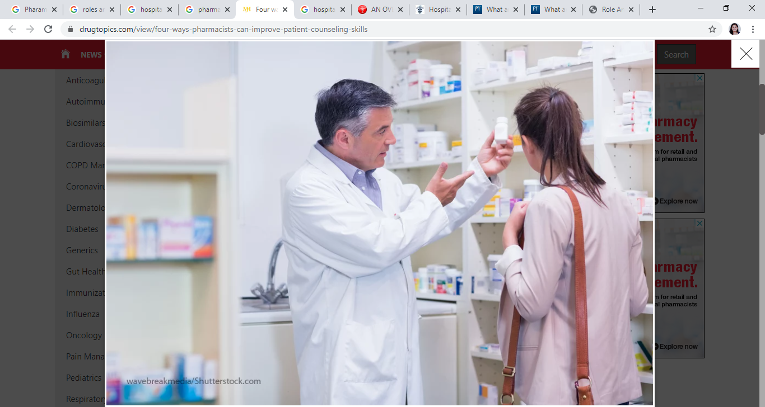
Roles & responsibilities of a Hospital Pharmacist

Slide 48
Pharmacists role in dispensing/supply of drugs
One of the most important duties provided by the hospital pharmacist is the dispensing of drugs after due verification of the prescription.
Patient confidentiality shall be maintained at all times.
Appropriate information shall be provided to the patient or the care giver and when possible, understanding of this information should be checked.
For all prescription handled by the pharmacy,
Patients details shall be checked and confirmed.
Proper documentation shall be maintained.

Slide 49
Assessment of the prescription should include but not be limited to assessment of whether
The prescription is legally valid
The prescription includes an appropriate dosage form and appropriate route of administration.
Prescription is appropriate to the patients condition.
Duration of treatment is correct
Prescription is compatible with other medications.
Possibility of adverse drug reactions exist.
Contraindicated.
Potential for misuse and inappropriate use of the medicines in prescription by patient exist.

Slide 50
Pharmacists role for promotion of rational drug use
To promote rational use of drugs, the pharmacist shall involve himself in activities such as:
Preparation of formularies
Critical assessment of promotional materials prepared by the drug companies.
Updating the knowledge of drugs through continuing education programmes and also to organize educational programmes for health professionals.
Preparation and dissemination of patient information leaflets.

Slide 51
Pharmacists role in patient counselling
Upon receipt of a prescription and following a review of the patients record, a registered pharmacist shall personally initiate discussion of matters that will enhance or optimize drug therapy with each patient or care giver of such patient. It should include appropriate elements such as:
Name and description of drugs
The dosage form, route of administration and duration of drug therapy.
Intended use of the drug and expected action.
Special directions and precautions for the drug.
Common side effects or interactions and therapeutic contraindications.

Slide 52
Techniques for self monitoring drug therapy
Proper storage of the drugs
Actions to be taken in case of missed dose.
Pharmacies providing patient counselling shall have regard to the following:
Only Registered Pharmacist are involved in counselling.
Patient information leaflets are provided.
Proper documentation is made.
Unnecessary counselling should be avoided.
Facilities are provided for confidential conversation and patient confidentiality is maintained.

Slide 53
Pharmacist role in health promotion
The pharmacist should be involved in health promotion campaigns, on health topics. Pharmacists should be involved in particularly drug related-topics (alcohol use, tobacco use, poison prevention etc).
Pharmacists role in improving medication adherence
Reviewing how patients are using medications can result in suggestions for changes in medication, dosing, or additional therapies that improve patient adherence.
Pharmacists role in providing drug information
To provide for in service education & training for pharmacists, pharmacy students and other health care professionals

Slide 54
Pharmacist role in managing pharmacy store
Management of the stores which include: Purchase of drugs and medicines and other allied stores as per the recommendations of the pharmacy and therapeutics committee(PTC).
Providing instructions for proper storage of such drugs and medicines. Maintenance of proper records of the drugs purchased and the distribution thereof. Storage and dispensing of narcotic and biological products.
Supply and storage of ancillary products and articles required in the hospital.

Slide 55
Inpatient or indoor Pharmacists Responsibilities
Central Dispensing Area
To ensure that all drugs are stored correctly
To check the accuracy of the dosages prepared especially of (a) intravenous admixtures and (b) Unit doses.
To keep proper records and preparation of bills, if any
To co-ordinate the over all pharmaceutical needs of the “patient care” areas with the central dispensing area.
To ensure that the established policies and procedures laid down are followed.
To communicate with all pharmacy staff regarding new developments in the area.

Slide 56
To maintain professional competence- Keep update with information regarding drugs in current use in the hospital, with special reference to their side effects, drug interactions, therapeutic efficacy etc., as well as their incompatibilities and stability.
Patient Care Areas (Wards, Operation Theatres and other departments of the hospital where drug of special categories are used)
To maintain a liasion with nurses who are involved in the drug administration.
Reviewing of drug administration in each patient periodically to ensure that all doses are being administered and charted accordingly.

Slide 57
University questions
Describe the hospital pharmacy’s structure, organization and management. (10)
Roles and responsibilities of hospital pharmacist. (5)
Management of materials and finance in hospital pharmacy. (5)

Slide 58


