Slide 1
DRUG SUPPLY MANAGEMENT

Slide 2
CHAPTER ONE
INTRODUCTION

Slide 3
Objective
Explain the importance of drug supply management
Explain the need to worry about drugs and their management

Slide 4
Why drug supply management (DSM)?
Lack of access to medication
Irrational drug use
DSM is needed as it is concerned with practical ways in which high quality essential drugs are available, affordable and used rationally.

Slide 5
Why worry about drugs and their management?
Drugs save lives and improve health.
Drugs promote trust and participation in health services.
Drugs are costly for individuals, households, government health institutions, country.
Drugs are different from other consumer products.
Substantive improvements in the supply and use of drugs are possible.

Slide 6
Important lessons in drug management
National drug policy provides a sound foundation for managing drug supply
Wise drug selection underlies all other improvements
Effective management saves money and improve performance
Rational drug use requires more than drug information
Systematic assessment and monitoring are essential

Slide 7
Challenges for drug management
Achieving financial sustainability
Improving efficiency in public drug supply
Changing the perceptions and behaviors of providers, patients and the public
Reorienting the role of government
Regulating safety, efficacy and quality

Slide 8
CHAPTER TWO
ESSENTIAL MEDICINE CONCEPT

Slide 9
Objective
Explain essential medicine concept

Slide 10
2.1. Historical Background
During and soon after WWII “Miracle”
However, the miracles were for the minority
  there was gap in access to drugs
  Series of drug-induced disasters
Some of the complaints in the early nineteen seventies were:
  No links between drugs and health needs
  No access to most needed drugs
  Rising costs of pharmaceuticals
  Uneven rural-urban distribution
  Protests against industry marketing practice

Slide 11
WHO adopted the concept with the view that essential medicines should be given priority.
In 1975- WHO defined essential medicines
In 1977, WHO published the first model list of essential drugs
    List is revised every 2-3 years by WHO expert committee
  In 1978, historic goal of ‘health for all by 2000’ essential medicines were recognized as one of the eight elements of primary health care.
Against this background:
Birth of essential drug concept

Slide 12
2.2. Essential medicine concept and its principles
Concept:
A limited range of carefully selected medicines leads to better health care, better drug management and lower costs.
Principles:
  The vast majority of health problems can be treated with a small, carefully selected number of drugs.
  Most practitioners routinely use fewer than 200 drugs.
  Supply activities can be carried out most efficiently for a limited number of pharmaceutical products.
  Patients can be better informed when confronted with limited drugs.

Slide 13
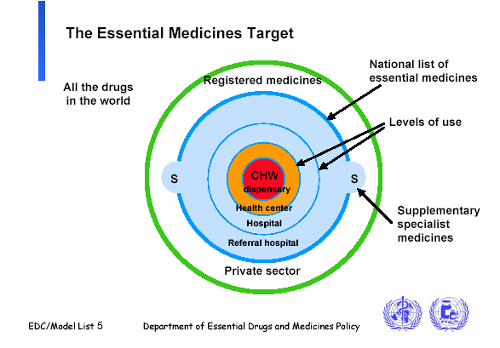

Slide 14
1. Rational
selection
3. Sustainable
financing
ACCESS
4. Reliable
health and
supply
systems
2. Affordable
prices

Slide 15
CHAPTER THREE
DRUG MANAGEMENT CYCLE

Slide 16
Objectives
Discuss components of drug management cycle (selection, quantification, procurement, distribution and drug use)

Slide 17
3.1. Overview
Managing drug supply is organized around the following basic functions:
  Selection
  Quantification
  Procurement
  Distribution and
  Use

Slide 19
3.2. Drug Selection
is a process of deciding the type of needed drug products.
Enforcing reasons for drug selection:
  Up to 70% of pharmaceuticals in the world market are duplicate and non-essential
  Availability of so many drugs is confusing for professionals and leads to inconsistency in practice
  Large number of non-essential drugs decrease purchasing power

Slide 20
Drug selection can lead to:
  Better supply
  More rational prescribing and dispensing
  Lower cost
  More rational patient use
So careful selection of drugs has:
  Cost implications
  Clinical implications

Slide 21
Criteria for drug selection
  Relevance to the pattern of prevalent diseases
  Facilities (diagnostic facilities, treatment facilities, physical facilities for distribution and facilities)
  Training and experience of available personnel
  Drug products only for which sound and adequate scientific data on efficacy, safety, quality, bioavailability and stability are available;

Slide 22
  Possibilities of easy and prompt procurement and local manufacture
  Drug products with widest possible coverage for the prevailing diseases
  Drugs with affordable cost by considering total cost of treatment not only the unit cost of drug(s)
  Single ingredient drug products
When two or more drugs seem similar in the above respects selection can be based on:
  The most thoroughly investigated drug
  Drug(s) which offers better patient compliance
  Drug(s) which are locally available

Slide 23
Basic steps in drug selection
Establish Drug Selection Committee
Determine the prevalent health problems and patient characteristics
Decide which health problems may be treated at the level of drug selection
Choose the drugs to be used for the health problems
Structure the list
Introducing the list of drugs to health professionals of institution and other concerned bodies
Updating the list of drugs

Slide 24
Very important:
Paralleling preparation of drug list with development of formulary and standard treatment guideline

Slide 25
Source of drug information
Primary
Secondary
Tertiary

Slide 26
3.3. DRUG QUANTIFICATION

Slide 27
It is the process of determining the amount of drug products needed for the purpose of procurement.
Appropriate drug quantification can avoid:
  Shortage of (out of stock) of drugs as well as
  Overstock of drugs.

Slide 28
Indicators of poor quantification:
Shortage of drugs
Overstocking of drugs
Irrational prescribing
Inefficient budget use
Suppression or distortion of demand

Slide 29
Quantification Methods
The four general methods for quantification are:
Consumption method
Morbidity method
Proxy consumption/adjusted consumption method
Service level projection of budget requirements

Slide 30
Selection of the appropriate quantification method requires considering:
Advantages and disadvantages
The conditions under which each method can be applied
The sets of data required
The organization of the drug supply system
Additional purposes

Slide 31
A. Consumption method
Involves using records of past consumption on individual medicines
It can be used under the following conditions:
  Adequate fund
  Acceptable pattern of prescribing
  Adequate and uninterrupted drug supply
  Good stock management
  Low level of wastages and loses

Slide 32
Data sets needed:
  Consumption data
  Drug list
  Pharmaceutical budget

Slide 33
Steps in quantification:
Prepare/review a list of drugs with order pack size and price data
2. Select the period
3. Determine consumption of each drugs
Recorded consumption = (opening stock + drug received)- (closing stock)

Slide 34

4. Adjust consumption for different reasons
  For stock out:
  Other reasons: wastages/losses, expected changes in consumption pattern, ….
5. Compile decentralized quantification (if applicable)
6. Convert the quantity obtained to the required pack size

Slide 35
7. Estimate the cost of drug quantities required
8. Finalize cost needed
9. Compare cost needed (demand) with budget allocated and make adjustment (reconciliation)
Approaches to make rational adjustment are:
  VEN analysis
  ABC analysis
  Therapeutic category analysis

Slide 36
Additional points
Consumption method
  Alternatively drug quantity can be calculated by using average monthly consumption, lead time and safety stock
    Quantity to order= average monthly consumption x (lead time + procurement period) + safety stock
    Considering Stock on hand and Stock on order
    Quantity to order= average monthly consumption x (lead time + procurement period) + safety stock – (stock on hand + stock on order)
  Always consider adjustment for different reasons
    Expected changes, losses……..

Slide 37
Advantages:
First choice for quantification, given reliable data
Requires less detailed calculation
Useful for facilities where health problems are numerous and drug treatment is complex
Identifies stock management problems and encourages improvement
No morbidity data and treatment schedule needed

Slide 38
Disadvantages:
Reliable consumption data may not be found
Can perpetuate irrational use
May not be helpful for reviewing prescribing/drug use
Less appropriate if there have been long stockouts/ high drug wastages or loses
Doesn’t encourage good morbidity recording

Slide 39
B. Morbidity method
Estimates the need for specific medicines based on:
  expected number of attendances,
  the incidence of common diseases and
  standard treatment patterns for the diseases considered.
Assumption: service providers will adhere to established treatment guidelines.

Slide 40
Conditions:
  Available consumption data are incomplete or unreliable
  Prescribing patterns are inappropriate
  The budget is insufficient
  The health facilities or services concerned are new, or expanding or contracting rapidly.

Slide 41
Data sets needed:
  Drug list with pack size and price data
  Complete patient morbidity profile
  Standard drug treatment schedules
  Pharmaceutical budget

Slide 42
Steps for quantification:
Specify the list of health problems
2. Establish the list of drugs to be quantified with pack size and price data
3. Establish standard or average drug treatment schedule for each health problems
4. Select the period to review morbidity data

Slide 43
5. Determine the number of treatment episodes for each health problems
Treatment episode is a patient contact which a standard contact for which a standard course of drug treatment is required.
Steps:
  Obtain the total number of patient contact by the health problems defined in the average treatment schedule
  Within the health problems, breakdown the number of patient contacts by age, sex, weight and severity if treatment varies with this variables
  Determine contacts for which a standard treatment schedule is required

Slide 44
6. Calculate the quantity of drugs needed for each health problem
7. Combine the estimates for each drug for various health problems into a master procurement list
8. Adjust quantities to cover for other health problems, for wastages/loses, filling the pipeline, stock order….

Slide 45
9. Convert quantities in to order pack size
10. Estimate cost of the drug quantities required
11. Finalize the cost
12. Reconcile need with budget

Slide 46
Morbidity method- additional tip
Always make adjustment for different reasons
Total number of patients
Children (%)
First line regimen (%)
Alternative Regimen (%)
Adult (%)
First line regimen (%)
Alternative regimen (%)

Slide 47
Advantages:
Does not require consumption data
Can be used for review of drug use and prescribing
Can be used for estimating need in new and scaling-up programs or disaster assistance
Motivates reliable morbidity recording

Slide 48
Disadvantages:
Detailed morbidity data and standard treatment schedule may both present difficulty
Require detailed calculation
Standard treatment may not really be used

Slide 49
C. Proxy/adjusted consumption method
It uses known consumption data from one system called the standard, to estimate the drug needs in a similar or expanded system known as the target.
It can be used when neither consumption method nor morbidity method are feasible.
The adjustment can be based on:
  Population coverage- drug use per 1000 population
  Service-level to be provided- drug use per specified patient case or inpatient admission.

Slide 50
Steps in quantification:
1. Select the standard system for comparison and extrapolation
2. Develop the drug list
3. Establish the time period to be covered in review
4. Review records from the standard system to compile contact or population data
5. Establish the denominator for extrapolation

Slide 51
6. Determine the consumption rate in the standard system
7. Extrapolate the standard system’s consumption rate to the target system
Target consumption = (Standard consumption rate) x (Number of thousands of contact or inhabitants)

Slide 52
8. Adjust for expected losses
9. Estimate costs for each drug and total costs and make adjustments

Slide 53
D. Service-level projection of budget requirements
It uses the average drug procurement cost per attendance or bed-day in different types of health facilities in a standard system to project drug costs in similar types of facilities in the target system.
This method does not estimate quantities of individual medicines rather it is used to estimate financial requirements.

Slide 54
Steps in quantification
Establish the categories of facilities and determine the number in each category
Determine the patient contact denominators for each type of facility and compile or estimate the average number of patient contacts of each type at each category of facility

Slide 55

Calculate the average cost per contact
Calculate the total projected drug costs
  Multiply the average number of patient contact for each facility by the number of facility and average drug cost.

Slide 56
Methods of reconciliation of demand with budget
VEN analysis
It is an approach in which drugs are divided according to their health impact in to:
  Vital,
  Essential and
  Non-essential/normal-use categories

Slide 57
  V (Vital drugs):
    Potentially lifesaving
    have significant withdrawal effect
    Crucial to providing basic health services
  E (Essential drugs):
    Effective against less severe but nevertheless significant forms of illness
    Not absolutely vital to providing basic health services
  N (Nonessential drugs):
    Used for minor or self-limiting illnesses

Slide 58
Steps in conducting VEN analysis:
  Classify all drugs on the list as V, E, or N
  Analyze N items. Where possible, reduce quantities to purchase or eliminate purchases entirely.
  Identify and limit therapeutic duplications, if any
  Reconsider proposed purchased quantities
  Find additional funds if needed or possible

Slide 59
b. ABC analysis
ABC analysis is the method for determining and comparing drug cost.
It identifies three useful tiers for analysis:
  Class A items: highest annual usage ( high volume or high cost)
    Usually accounts for 10-20 percent of items ordered and 70 to 80 percent of funds.

Slide 60
  Class B items: moderate annual usage
    Accounts 10 to 20 percent of items ordered and 15 to 20 percent of funds.
  Class C items: Lowest annual usage
    Accounts for 60-80 percent of items ordered and 5-10 percent of funds.

Slide 61
Steps to perform ABC analysis:
  List all items purchased or consumed and enter the unit cost
  Enter consumption quantities over a defined period of time
  Calculate the value of consumption (utilize acquisition cost)
  Calculate the percentage of total value represented by each item.

Slide 62
  Rearrange the list. Rank items with descending order by total value, staring at the top with the highest value.
  Calculate the cumulative percentage of the total value for each item
  Choose cutoff points or boundaries for A, B, and C drugs

Slide 63
C. Therapeutic category analysis
Its applications are the same as those of ABC analysis.
The focus is on cost-control efforts on the therapeutic categories that show the highest consumption and greatest expenditures.
In this approach, therapeutic categories having the consecutive highest expenditures will be looked for possible interventions.

Slide 64
Example 1: The following table shows stock movement of doxycycline 100mg tablet as obtained from a bin card and stock out recording form in health center “X” for one year (consumption is in tablet).
Date | Received from supplier | Issued/consumed | Balance
1 Sep | - | - | 5000 (opening stock)
5 Sep | - | 4000 | 1000
25 Oct | 5000 | - | 6000
15 Nov | - | 2000 | 4000
20 Dec | - | 2000 | 2000
15 Jan |  | 1000 | 1000
28 Jan | - | 1000 | 0
By 10th February the drug was totally out of stock in the health center
10 March | 6000 | 2000 | 4000
28 April | - | 1000 | 3000
4 June | - | 2000 | 1000
10 July | 3000 | - | 4000
15 July | - | 2000 | 2000
30 Aug | - | - | 2000

Slide 65
Example 2: Drug “X” is available in tablet formulation of 500mg strength. It is used for the treatment of three diseases (A, B and C). The average amount of the drug needed per course of treatment was 20 tablets for disease “A”, 20 tablets for disease “B” and 10 tablets for disease “C” (assume the average treatment schedule is the same for all group of patients). The total number of treatment episodes (number of cases who need drug treatment) per year in a given hospital were 500 (disease “A”), 2000 (disease “B”) and 1000 (disease “C”). If one box contains 100 strips of 10 tablets, calculate:
  The total quantity of the drug needed in box unit (consider 5% allowance).

Slide 66
3.4. Drug Procurement

Slide 67
Procurement is the process of acquiring drug product through purchase, manufacture or donation.
It is a major determinant of drug availability and the total health cost.
An effective procurement process should:
    Procure the right drug in the right time
    Obtain the lowest possible purchase price
    Ensures that all drugs procured meet recognized standard quality
    Arrange timely delivery to avoid shortage and stock out
    Achieve the lowest total cost

Slide 68
Procurement cycle:

Slide 69
Operational Principles of Good Pharmaceutical Procurement
There are operational principles for good pharmaceutical procurement clustered in to four:
  Efficient and transparent management
  Financing and competition
  Drug selection and quantification
  Supplier selection and quality assurance

Slide 70
Efficient and transparent management
Separation of key procurement functions and responsibilities
Transparency, written procedures and using explicit criteria to award contracts.
Planning procurement and monitoring procurement performance

Slide 71
Drug Selection and Quantification
Procurement limited to an essential drugs list or national/local formulary list
Procurement by generic name
Order quantities based on a reliable estimate of actual need

Slide 72
Financing and Competition
Reliable financing for procurement
Procurement in bulk
Competitive procurement methods, except for very small or emergency orders
Sole-source commitment

Slide 73
Supplier Selection and Quality Assurance
Prospective suppliers should be pre-qualified, and selected suppliers should be monitored
  Criteria:
    Price and quality of products
    Delivery times
    Regulations
    Reliability
    Reputation
    Guaranties
Product quality assurance program

Slide 74
Procurement Mechanisms
Based on the responsible body for procurement and distribution:
  Central store system
  Autonomous supply agency system
  Direct delivery system
  Prime vendor system
  Fully private supply

Slide 75
b. Based on the level demand is determined
  Push system (allocation/ration system)
Supply sources at some level determine what type and quantities of drugs will be delivered to the lower levels.
Conditions:
  Lower staff-not competent
  Demand greatly exceeds supply (ration necessary)
  Limited number of products are being handled
  Disaster relief is needed

Slide 76
  Pull system (independent demand/ requisition system
Each level of the system determines what types and quantities are needed and place orders with the supply source.
Conditions:
  Lower level staff-competent
  Sufficient supply is available
  Large range of products are managed
  There is regular supervision and performance monitoring

Slide 77
Procurement Methods
All pharmaceutical procurement methods fall into one of the following four basic categories:
  Open tender
  Restricted tender
  Competitive negotiation
  Direct procurement

Slide 78
Table: Advantages and disadvantages of different procurement methods
Method | Advantages | Disadvantages
Open tender | Many bids, some with low prices New suppliers can be identified | High workload is required in evaluation of bids and selection of suppliers
Restricted tender | Fewer bids (less workload than open tender Quality easier to ensure | More limited options System for prequalification must be set
Competitive negotiation | Suppliers are generally well known Less evaluation work | Higher price
Direct procurement | Easy and quick | Higher price

Slide 79
Purchasing Models
Procurement may proceed under different models:
  Annual purchasing
  Scheduled purchasing
  Perpetual purchasing

Slide 80
Common Procurement Challenges
Absence of a comprehensive procurement policy
Inadequate rules, regulations, and structures
Public sector staff with little experience and training to respond to market situations

Slide 81
Government funding that is insufficient and/or released at irregular intervals
Donor agencies with conflicting procurement regulations
Fragmented drug procurement at provincial or district level
Lack of unbiased market information
Corruption and lack of transparency

Slide 82
3.5. DRUG DISTRIBUTION

Slide 83
Drug distribution is a continuous process of receiving drugs from the supplier and moving them safely/securely, expeditiously to the many point in the health care system at which the drugs will be dispensed to patients.
A well-run distribution system should:
  Maintain a constant supply of drugs
  Keep drugs in good condition

Slide 84
  Minimize drug loses due to spoilage and expiry
  Rationalize drug storage costs
  Use available transport as efficiently as possible
  Reduce theft and fraud
  Provide information for forecasting drug needs

Slide 85
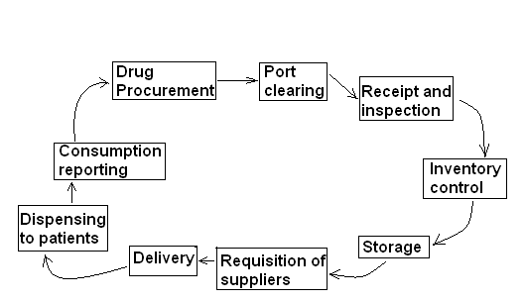
The distribution cycle

Slide 86
A. Visual inspection
Visual inspection is the process of examining products and their packaging to look for obvious problems with product quality.
When to conduct visual inspection
Visual inspection can be conducted during the following circumstances:
Receiving products
Issuing products from one level to another
Dispensing products to patients
Storage

Slide 87
Visual inspection…
Conducting physical inventory
Receiving complaints from lower levels or customers
Products are to expire
Products show signs of damage
Products have been kept under improper storage conditions

Slide 88
Visual inspection…
What to look for in a visual inspection
Mechanical damage
Chemical damage
Packaging
Labeling (product identity, expiry date, lot number…..)
Quantity of products

Slide 89
B. Stock management (storage, handling, arrangement….)
Storage of pharmaceuticals
Proper storage practice is the safe keeping of products until ultimately reaches the consumer
Generally pharmaceuticals should be protected from:
  Moisture
  Heat
  Sunlight
  Physical damage
  Dirt….

Slide 90
Characteristics of a well managed stores operation and good storage guidelines
Clearly defined management structure
Staffs appropriately qualified, trained, disciplined and rewarded
Store divided into zones
Stocks arranged within each zone in some order system
Stocks stored on pallets on the floor or pallet racks or on shelves
Store products based on manufacturer’ specification

Slide 91
Storage….
Good housekeeping- regular cleaning and inspection
Store pharmaceuticals in a dry, well-lit, well-ventilated store room-out of direct sun light
Protect storeroom from water penetration
Keep fire safety equipment available, accessible, and functional, and train employees to use it
Store latex products away from electric motors and fluorescent lights
Maintain cold storage, including a cold chain, as required

Slide 92
Storage….
Limit storage area access to authorized personnel and lock up controlled substances
Stack cartons at least 10 cm off the floor and, 30cm away from the wall and other stacks, and no more than 2.5m high
Store medical supplies away from insecticides, chemicals, old files, office supplies and other materials
Arrange cartons with arrows pointing up, and identification labels, expiry dates, and manufacturing dates clearly visible

Slide 93
Storage….
Liquid and heavy products kept at the lower shelves
Products arranged to facilitate first expiry first out
Damaged/expired products stored separately
Store flammable products separately from other products
Report products with near expiry

Slide 94
Location and design of store
Location
Design
  Size
  Height of the wall
  Roof

Slide 95
Storage conditions
There are two main types of storage conditions:
  Normal storage condition
  Special storage condition
    Cold storage condition
    Separate storage

Slide 96
Storage temperature and environment
  Dry place ……………………. <5% relative humidity
  Protect from heat ……………. not >30ºC
  At room temperature ………… 15ºC – 30ºC
  Cool place …………………… 8ºC – 15ºC
  Cold place (refrigeration)-not >8ºC (usually 2-8 ºC)
  In deep freezer ………………. -20ºC – 0ºC

Slide 97
Arrangement of drugs
Arranging drugs properly enables to control shelf life and simplify accessibility.
Types:
  Pharmaco-therapeutic
  Alphabetic
  Pharmaceutic order/dosage form

Slide 98
Stock rotation
First Expiry First Out (FEFO):
  Involves arranging drugs with the earliest expiration date in front/on top and drugs with the latest expiration date in the back/below so that drugs with near expiry will be issued and/or dispensed first.
Other approaches: First In First Out(FIFO), Last In First Out (LIFO)

Slide 99
C. Inventory Control and Logistic Management Information System( LMIS)
Inventory is the stock on hand at any given time.
Inventory control is the process of maintaining of stock properly at all times.
It is a process of assuring that the right volume and movement are secured in order to ensure that the obtained drugs have reached to the final consumer correctly.

Slide 100
Inventory control system……
Inventory control helps to:
  Maintain appropriate stock
  Avoid over-stocking
  Monitor shortage of drugs
  Check the movement of stocks
  Prevent expiry of drug before being used
  Balance the merits and demerits of inventory keeping

Slide 101
Inventory control system……
An inventory control system informs personnel when to order or issue, how much to order or issue and how to maintain an appropriate stock level to meet the needs of patients.
The most important inventory control systems for health commodities are max-min inventory control systems.

Slide 102
Inventory control system……
Key terms:
Maximum Stock Level: is the level of stock above which inventory levels should not rise, under normal condition.
Minimum Stock Level: is the level of stock at which actions to replenish inventory occur under normal condition. It can also be considered as reorder stock level.
Review Period: this is the interval of time between assessments of stock levels to determine if additional stock is needed.

Slide 103
Inventory control system……
Safety/reserve stock level: is the additional buffer or reserve kept on hand to protect against stockouts caused by delayed deliveries, markedly increased demand, or other unexpected events.
Lead time: is the time between ordering a supply up to receiving and availing it for use.
Lead time stock level: is the level of stock used within the lead time period
Emergency order point (EOP): this is the level of stock that triggers an emergency order. The EOP must be less than the min.

Slide 104
Inventory control system……
There are three types of a max-min inventory control systems that are applicable to health commodity logistic system:
  Forced ordering system
  Continuous review system
  Standard system

Slide 105
Inventory control system……
No matter which inventory control system is used, the formula for calculating the order or issue quantity is the same.
  i.e order/issue quantity= (Maximum stock level/quantity)- (stock on hand)
  if there is stock on order which is not yet received:
    order/issue quantity= (Maximum stock level/quantity)- (stock on order)-(stock on hand
The difference between the above three inventory control systems is the trigger for placing an order or issuing resupply.

Slide 106
Inventory control system……
1. Forced ordering system:
Decision rule: the review period is the trigger for ordering. emergency order point is used to place an emergency order
Advantage:
  Decision rule is simple
  Transportation can be scheduled for specific times
  Unless there is potential for stock out, assessing stock status constantly is not needed
  Every facility orders or is resupplied at the end of every review period
Disadvantage:
  Orders for some items may be for small quantities

Slide 107
Inventory control system……
Forced-ordering delivery truck system:
it is one variation of forced ordering system.
It is sometimes called a topping up or bread truck system.
In this system, a truck is loaded with supplies at the end of the review period.
The truck and delivery team travel to each facility, assess the stock, and leave (top up) an amount of each product that is sufficient to bring stock levels up to the maximum at that location.

Slide 108
Inventory control system……
2. Continuous review system
Decision rule: the trigger for ordering products is the minimum stock level.
Advantage:
  Decision rule is simple
  It is more responsive and flexible
  Small orders are eliminated
Disadvantage
  Transportation resources are harder to schedule
  The workload on the store keeper is high

Slide 109
Inventory control system……
Two bin system:
it is one variation of continuous review system.
Two equal-sized bins (containers, boxes….) will be prepared for each product. When the first bin is empty, the min has been reached and hence an order will be placed

Slide 110
Inventory control system……
3. Standard max-min system
Decision rule:
  It combines the decision rules of both forced-ordering and continuous review.
  The decision when to make an order or issue new stock is based on the min stock level and the review period.
  Review all stock levels at the end of each review period and order quantities up to the maximum level for products that are at or have fallen below the min.
  EOP will be needed to ensure that a stockout does not occur between review periods.

Slide 111
Inventory control system……
Advantage:
  Small orders are eliminated
  There is no need to assess stock status continuously
  Reduce the number of calculations as only products that are at or have fallen below the min will be ordered
  Transportation can be scheduled
Disadvantage:
  The min stock level is higher (higher likelihood of expiry, require more storage capacity and increased cost)
  Decision rule is complex

Slide 112
Inventory control system……
The decision to choose an appropriate max-min system depends on following factors:
Number of items managed
Type of products managed
Transport availability
Level of staff training
Level of reporting
Whether push or pull system is used
Supervision system
Storage space

Slide 113
Inventory control system……
Setting stock levels
One of the tasks in inventory control system is setting different stock levels.
The most important stock levels are
  emergency order point,
  safety stock level,
  minimum stock level and
  maximum stock level.
Considering lead time and review period is mandatory to determine the stock levels.

Slide 114
Inventory control system……
Determine lead time
Lead times are variable. One could calculate the lead time stock level to equal the average of the lead time levels for the past two or three review periods, for the average facility.
Set the review period
The routine interval of time between assessments of stock levels and subsequent order of products should be set. It shouldn’t be too short, nor as infrequent as once a year.

Slide 115

Inventory control system……
Set the safety stock
It depends on the extent of uncertainty of demand and how well the logistic system is functioning.
As a general guideline, the safety stock level should equal at least half of the review period.

Slide 116
Inventory control system……
Set the minimum stock level

Slide 117
Inventory control system……
Set the maximum stock level
Set the emergency order point
EOP could be as high as the lead time stock level if urgent orders take as long to process as routine order.

Slide 118
Inventory control system……
Pharmaceutical stock and consumption analysis
There are three methods of stock or consumption analysis:
Stock turnover ratio (STR)
Consumption to stock ratio (CSR)
Stock status analysis

Slide 119
Inventory control system……
LMIS and its linkage with inventory control:
An LMIS and the inventory control system have a close relationship: the LMIS provides the data required to maintain the inventory control system.

Slide 120
Inventory control system……
Logistics systems for all commodities should include at least three essential data items
Stock on hand: The quantities of usable stock available
Consumption: The quantity of stock dispensed to users or used during a particular time period
Losses/adjustments

Slide 121
Inventory control system……
There are three types of logistics records to track products.
1. Stock keeping records: Holds information about products in storage.
Example: bin card, stock card, inventory control card, stores ledger
2. Transaction records: Holds information about products being moved.
Example: Issue and receipt vouchers
3. Consumption records: Holds information about products being consumed or used.
Example: daily dispensing registers

Slide 122
Inventory/logistics records
Stock records and reports form the foundation of an effective inventory management and overall drug supply management.
Information to be included
  product name/description including the form and strength
  beginning stock balance
  receipts
  issues
  losses/adjustments
  closing/ending balance
  transaction reference (e.g., issue voucher number or name of supplier or recipient).

Slide 123
  special storage conditions
  unit prices
  lot numbers/bin locations
  item codes
  expiry dates
  calculated data items: average monthly consumption (AMC), lead times for ordering/requisition, maximum and minimum stock levels, emergency order point

Slide 124
Standard forms used for inventory control:
  Stock cards
  Bin cards
  Requisition/issue vouchers
  Expired stock disposal forms
  Physical inventory forms
  list of approved medicines and prices

Slide 125
Stock cards: Can be used:
  As the base for requisition and issuing of products
  To know fluctuation of price of drugs
  To control shelf life
Bin cards
  Remain with each item in the store
  Filled by the store keeper
  Are used as an easy reference on stock levels and expiry dates

Slide 126
Physical inventory
It is the process of counting by hand the number of each type of product in a store at any given time
It is used to:
  Know whether the actual quantity on hand balances the recorded stock on the stock keeping records
  Identify surplus, expired and obsolete (outdated) stock
  Promote periodic evaluation of storage conditions and the adequacy of storage facilities, layout and stock management.

Slide 127
There are two kinds of physical inventory:
Complete physical inventory:
  All products are counted at the same time.
  A complete inventory should be taken at least once a year.
  More frequent inventory (quarterly or monthly) is recommended.
  For large warehouses, this may require closing the storage facility for a day or longer.
  It is easier to conduct regularly at facilities that manage smaller quantities of products.

Slide 128
Cyclic or random physical inventory:
  Selected products are counted and checked against the stock keeping records on a rotating or regular basis throughout the year.
  It is usually appropriate at facilities that manage larger quantities of products.

Slide 129
3.6. DRUG USE

Slide 130
Drug use is the process of:
Prescribing
Dispensing
Patient use
Diagnosis/
Follow up
Prescribing
Dispensing
Adherence

Slide 131
The rational use of drugs requires that patients receive:
  medications appropriate to their clinical needs,
  in doses that meet their own individual requirements,
  for an adequate period of time,
  and at the lowest cost to them and to their community

Slide 132
Rational drug use involves:
  Appropriate indication
  Appropriate drug
  Appropriate dosage regimen
  Appropriate patient
  Correct dispensing
  Patient adherence

Slide 133
a. Rational Prescribing
Requires:
  Making accurate diagnosis
  Deciding whether or not the diagnosis requires drug treatment
  Selecting the best drug among available
  Prescribing in accordance with the standard course of treatment
  Following correct prescription writing
  Counseling the patient

Slide 134
What roles can you play as a pharmacist to promote rational prescribing?

Slide 135
b. Rational dispensing
Dispensing: refers to the process of preparing drugs and distributing them to their users with provision of appropriate information.
It may be based on a prescription or an oral request of users (patients or care providers) depending on the type of drugs to be dispensed

Slide 136
Dispensing a prescription
  Receiving and validation of a prescription
  Interpreting a prescription
  Preparing medication/s to be dispensed
  Issuing medication/s with the provision of appropriate and complete instruction

Slide 137
Dispensing a prescription….
A label must contain the following information:
Patient name
Generic name, strength, and dosage form of medicine
Dosage regimen information (dose, frequency and duration of treatment)
quantity dispensed
How to administer medicine
Storage condition
Date dispensed
Name of dispenser

Slide 138
2. Dispensing OTC medications/responding to symptoms
  The following information are relevant before dispensing
    Age, sex, pregnancy status if female, history of allergic reaction, history of renal or hepatic disease and any history of other disease
    Nature, site and severity of symptom/s
    For how long the symptom/s persist
    Whether the patient is taking any medication to relief from the existing complication or for any other purpose

Slide 139
  Based on the above information decide whether the symptom/s are minor or are indication of major illness
  Decide whether the patient need non-drug management, OTC drug or referring
  If the decision is to give OTC drug/s select an appropriate OTC drug considering the above relevant information

Slide 140
c. Appropriate patient use
Proper handling of medications
Adherence to treatment

Slide 141
Irrational drug use
Common types??????

Slide 142
Impact of irrational drug use
???????

Slide 143
Factors underlying irrational drug use
a. Health care provider (prescriber and dispenser)
  Inadequate pre-service training
  Lack of continuing education
  Financial interest
  Lack of role models who practice rationally
  Patient load and pressure on treatment choice
  Unethical promotional activities by pharmaceutical companies

Slide 144
b. Health system
  Pharmaceutical supply system and availability of facilities
    Poor quantification and forecasting
    Inadequate inventory management
    Unreliable supplies
    Inadequate distribution system
    Inefficient management of procurement process
    Lack of adequate laboratory facilities
    Lack of facilities for dispensing

Slide 145
  Legal and regulatory framework
    Non-formal prescribers/dispensers
    Out of date or no-existent standard treatment guideline (STG), drug list, formulary…
    No drug and therapeutics committee (DTC) encouragement
    No pharmacovigilance program
    Inadequate medicine registration and quality assurance system

Slide 146
    Lack of system for continuing medical education
    Lack of financing and reimbursement mechanisms
    Lack of regulation on drug promotion
    Even in the presence of regulations, there may be lack of enforcement

Slide 147
c. Patient/client and community
  Perceived need for medicines
  Perceived need for consulting health workers
  Ideas about efficacy and safety
  Uncertainty resulting in polytherapy
  Cost of medicines
  Absence of social support

Slide 148
  Inability to take time off work
  Low literacy level
  Medicine use culture
  Medicine supply system
  Quality of prescribing and dispensing
  Therapy related factors

Slide 149
Stepwise approach for promotion of rational drug use
Assess current patterns of drug use, identify any problem and recognize the need for action
Identify underlying causes and motivating factors
List possible interventions
Assess resources available for action
Choose and carryout interventions
Monitor the impact and restructure the intervention

Slide 150
Diagnosis (identify problems and causes
Treat (design and implement intervention)
Follow up (measure outcomes)
Examine (measure existing practice)

Slide 151
Interventions/strategies to improve drug use
They can be classified in to three major strategies:
  Educational
  Regulatory
  Managerial
Educational:
Is intended to persuade individuals by providing information
It may include training, provision of printed materials and education

Slide 152
Managerial:
Is used to guide action (decision making)
Example:
  Drug list, STG
  Drug utilization review and feedback
Regulatory:
Aimed to enforce decisions
Example:
  Drug registration regulation
  Generic policy
  Prescribing and dispensing restrictions
  Level of use restrictions

Slide 153
Characteristics of effective interventions:
Identify key influence factors
Target individuals or groups with the worst practice
Use credible information sources
Use credible communication channels
Use personal contact whenever possible
Limit the number of messages using different media
Provide better alternatives

Slide 154
CHAPTER FOUR
INVESTIGATING DRUG USE

Slide 155
objectives
Explain the need to investigate drug use
Describe methods of investigating drug use

Slide 156
Outline
The need for investigating medicine use
Quantitative methods:
  WHO drug use indicators
  Drug use studies based on aggregate data (DDD, ABC, VEN)
  Other drug use studies
Qualitative methods:
  Focused Group Discussion (FGD)
  In-depth Interview
  Structured Observation

Slide 157
Major reasons for investigating drug use:
  To describe current patterns of drug use
  To identify drug use problems and underlying problems
  To monitor drug use over time
Methods for assessing drug use
  Quantitative methods
  Qualitative methods

Slide 158
A. Quantitative Methods
Are used to describe how often certain drug use practices occur

Slide 159
1. WHO drug use indicators
A. Core drug use indicators (12)
  I. Prescribing indicators
  II. Patient-care indicators
  III. Health facility indicators
B. Complementary drug use indicators (7)

Slide 160
  A. Core drug use indicators (12)
I. Prescribing indicators (5)
Average number of drugs per encounter
% of drugs prescribed by generic name
% of encounters with an antibiotic prescribed
% of encounters with an injection prescribed
% of drugs prescribed from drug list/formulary

Slide 161
II. Patient-care indicators (5)
Average consultation time
Average dispensing time
% of drugs actually dispensed
% of drugs adequately labelled
Patients’ knowledge of correct dosage

Slide 162
III. Facility indicators
Availability of copy of essential drug list or formulary
Availability of key drugs

Slide 163
B. Complementary drug use indicators (7)
% of patients treated without drugs
Average drug cost per encounter
% of drug cost spent on antibiotics
% of drug cost spent on injections
Prescription in accordance with treatment guidelines
% of patients satisfied with the care they received
% of health facilities with access to impartial drug information

Slide 164
2. Aggregate data
Defined Daily Dose (DDD) methodology
ABC analysis
VEN analysis

Slide 165
1. Defined Daily Dose (DDD) methodology
Defined daily dose: Is the assumed average daily maintenance dose for the medication’s main indication (adults).
It converts and standardizes readily available product quantity data such as packages, tablets, injections vials etc in to number of daily doses.
It is used to directly compare consumption of drugs irrespective of price and type of formulation

Slide 166



DDD…
Consumption report expressions:
DDDs/1000inhabitant/day
DDDs/inhabitant/year
DDDs/100 bed/day

Slide 167
DDD…
Example:
interpretations:
  4 DDDs/1000 inhabitants/day (DDD of the drug is 1 gm)
  2 DDDs/100 bed-days (DDD of the drug is 250 mg)
2. A district hospital and health centers use 25,000 tablets yearly of methyldopa 250mg and 3, 000 tablets yearly of methyldopa 500mg. This drug usage is for a total population of 2,000,000 people. Calculate consumption in DDD/inhabitant/year

Slide 168
DDD…
2. In a region where 50 million people are said to live, it was reported that 400 million 10 mg tablets of drug A were sold in the past fiscal year. If on the average 4.38% of the people will be using DDD per day, then what is the DDD of drug A?

Slide 169
3. Other drug use studies
Health-problem based
Drug-specific studies

Slide 170
B. Qualitative Methods
Used to determine why things are the way they are or why people behave as they do
Used to find out more about
  People’s ideas
  The reasons why problems occur
  What people see as possible solutions and constrains

Slide 171
The methods include:
  FGD (Focused Group Discussion)
  In-depth interview
  Structured observation

Slide 172
CHAPTER FIVE
NATIONAL DRUG POLICY

Slide 173
Learning Objectives
At the end of this chapter, students will be able to:
Define national drug policy
Narrate the core objectives and key strategies of a National Drug Policy
Discuss the process of National Drug Policy development
identify components of a national drug policy
Review national drug policy of Ethiopia

Slide 174
5.1. Rationale
Health is a fundamental human right. Access to health care, which includes access to essential drugs, is a prerequisite for realizing that right.
Despite the obvious medical and economic importance of drugs there are still widespread lack of access, poor quality, irrational use and waste.

Slide 175
Rationale
1. Lack of access to essential drugs
WHO has estimated that at least one-third of the world’s population lacks access to essential drugs;
in poorer areas of Asia and Africa this figure may be as high as one-half
2 Millions of children and adults die each year from diseases that could have been prevented or treated with cost-effective and inexpensive essential drugs.

Slide 176
Rationale
2. Poor quality
inadequate drug quality assurance systems
substandard and counterfeit products
inappropriate handling, storage and distribution can alter the quality of drugs.

Slide 177
Rationale
3. Irrational use of drugs
No right medicine in the right dosage when needed
Many people buy, or are prescribed and dispensed, drugs that are not appropriate for their needs.
use several drugs (poly pharmacy)
use drugs that carry unnecessary risks.
The irrational use of drugs may unnecessarily prolong or even cause ill-health and suffering, and results in a waste of limited resources.

Slide 178
Rationale
A national drug policy as a common framework to solve problems in pharmaceuticals
A common framework to address the sectors problems comprehensively

Slide 179
5.2. what is a national drug policy
A commitment to a goal and a guide for action:
It expresses and prioritizes the medium- to long-term goals set by the government for the pharmaceutical sector, and identifies the main strategies for attaining them.
It provides a framework within which the activities of the pharmaceutical sector can be coordinated.
It covers both the public and the private sectors, and involves all the main actors in the pharmaceutical field.

Slide 180
A national drug policy is an essential part of health policy
It must fit within the framework of a particular health care system, a national health policy and, perhaps, a programme of health sector reform.
The goals of the national drug policy should be consistent with broader health objectives, and policy implementation should help to achieve those broader objectives.
It is very difficult to implement a health policy without a drug policy(why?)
Notes:
The health policy and the level of service provision in a particular country are important determinants of drug policy and define the range of choices and options. On the other hand, the drug situation also affects the way in which health services are regarded. Services lose their credibility if there is no adequate supply of good quality drugs, or if these are badly prescribed. Thus the implementation of an effective drug policy promotes confidence in and use of health services.
There are also economic arguments. In many countries a large proportion of health care spending is on drugs. Health care financing is therefore closely related to drug financing. It is very difficult to implement a health policy without a drug policy.

Slide 181
5.3. Objectives of a national drug policy
The general objectives of a national drug policy are to ensure:
■ Access: equitable availability and affordability of essential drugs
■ Quality: the quality, safety and efficacy of all medicines
■ Rational use: the promotion of therapeutically sound and cost-effective use of drugs by health professionals and consumers.
The more specific goals and objectives of a national policy will depend upon the country situation, the national health policy, and political priorities set by the government.
In addition to health-related goals there may be others, such as economic goals.

Slide 182
5.4. national drug policy development process
Steps of formulating NDP
Step 1: Organize the policy process:
The ministry of health take the lead role in formulating a national drug policy
decide how to organize the development process that will identify the structure of the policy, major objectives and priority components.
identify all the interested parties that need to be involved, the necessary resources, and how these can be obtained

Slide 183
national drug policy development process
Throughout the policy process there should be consultation, dialogue and negotiations with all interested groups and stakeholders.
These include: other ministries (higher education, trade, industry), doctors, pharmacists and nurses, local and international pharmaceutical industries, drug sellers, academia, nongovernmental organizations (NGOs), professional associations and consumer groups, provincial and district medical and administrative personnel, traditional and herbal medicine practitioners, drug regulatory agency, the media etc…
In general it can be said that the more the existing pharmaceutical system needs to be improved, the more important it is to involve all interested parties in discussing the necessary reforms.(why?)

Slide 184
national drug policy development process
Step 2: Identify the main problem
There are various ways of carrying out an initial situation analysis.
small team of experts from the ministry of health and other disciplines
examine the situation systematically, to identify the main problems, make recommendations.
their recommendations, discussed at one or more multidisciplinary workshops, in order to formulate consolidated advice to the government.
Notes:
Review the slide content

Slide 185
national drug policy development process
Step 3: Make a detailed situation analysis
Further analyse the source of the problems, in order to identify potential solutions, choose the most appropriate strategies, set priorities, and serve as a baseline for future systems of monitoring and evaluation.
Step 4: Set goals and objectives for a NDP
Once the main problems have been defined, goals can be set and priority objectives identified
Broad consultation and careful consideration of conflicting interests and structural constraints are necessary to set achievable objectives

Slide 186
national drug policy development process
Step 5: Draft the text of the policy
Once a thorough analysis of the situation and an outline of the main goals, objectives and approaches have been completed, a draft text of the national drug policy should be prepared
It should set out the general and specific objectives of the policy.
Step 6: Circulate and revise the draft policy
circulated for comments, first within the ministry of health, then in other government, NGOs & to relevant institutions.

Slide 187
national drug policy development process
Step 7: Secure formal endorsement(permission) of the policy
Step 8: Launch the national drug policy

Slide 188
5.5. Key components of a national drug policy
A national drug policy is a comprehensive framework in which each component plays an important role in achieving one or more of the general objectives of the policy
The policy should balance the various goals and objectives, creating a complete and consistent entity.
For example, access to essential drugs can only be achieved through rational selection, affordable prices, sustainable financing and reliable health and supply systems.

Slide 189
Key components of a national drug policy
Selection of essential drugs
Affordability
Drug financing
Supply systems
Drug regulation
Rational use of drugs
Research
Human resource development
Monitoring and evaluation

Slide 190
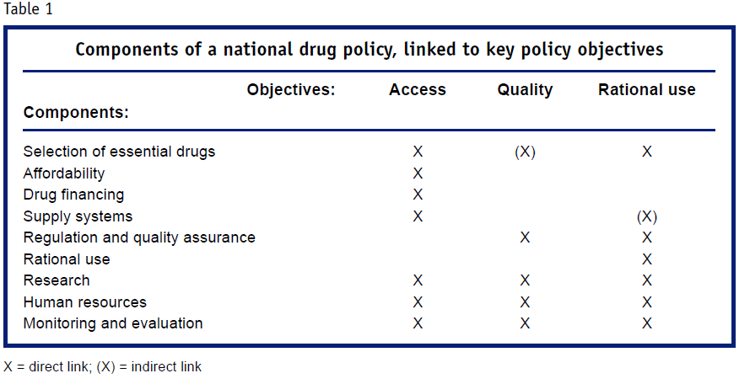
Image source: Jad Davenport

Slide 191
5.6. Ethiopian National Drug Policy 1993 and its implementation
Objectives
To meet the country’s Demand of essential drugs/ and ensure access
To ensure safety, efficacy and quality
To develop domestic manufacturing capacity directed to export
To expand human resource training, Resaerch&Development
To devise ways and means to utilize traditional medicine

Slide 192
Ethiopian National Drug Policy 1993 and its implementation
Create favourable conditions for local manufacturers, importer/distributors
Establish an effective system of drug regulation
Establish system of rational use of drugs
Devise a program for the training of professionals
Conduct a coordinated research on traditional medicine
Create favourable condition for technology transfer
Create favourable condition for export

Slide 193
Ethiopian National Drug Policy and its implementation 1993
Strategies
1.Selection of drugs
Based on the country’s health problems, trained HR, Financial resources and infrastructure
National Drug List (Human and Veterinary)
Categorized list/Zonal/district/health centre
health post
Essential Drug List
Establishment of a National Drug Advisory Committee

Slide 194

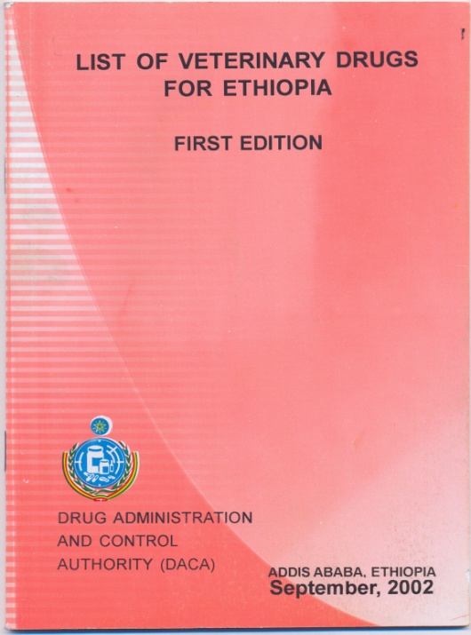


Slide 195
Ethiopian National Drug Policy and its implementation 1993
2. Drug Supply
Favourable conditions for manufacturers-
Government shall establish a drug procurement and distribution enterprise/PFSA
Domestic Drug procurement and distribution shall be carried out by networks established at regional level/PFSA

Slide 196
Ethiopian National Drug Policy and its implementation 1993
3.Drug administration and control -FMHACA
Registration certificate issuance (veterinary drugs registration guidelines)* veterinary drugs registered till to-date
Quality standards setting
Drug information
Inspectors assignment
Registration, classification and licensing to be carried out by responsible body

Slide 197
Ethiopian National Drug Policy and its implementation 1993
4. Human Resource training
Formal pharmacy training/more than 10 Universities
Strategy for upgrading/Diploma to Degree in different Universities
On job training and continuation education- Continuing Professional Development Guideline
5. Drug information and promotion
Monitoring of the content and distribution of DI to professionals and the public/Drug advertisement and promotion directives/
Current and accurate information and reference materials on drugs shall be produced and distributed to practitioners in the field/DICs, Drug information bulletin/Zena Medhanit

Slide 198

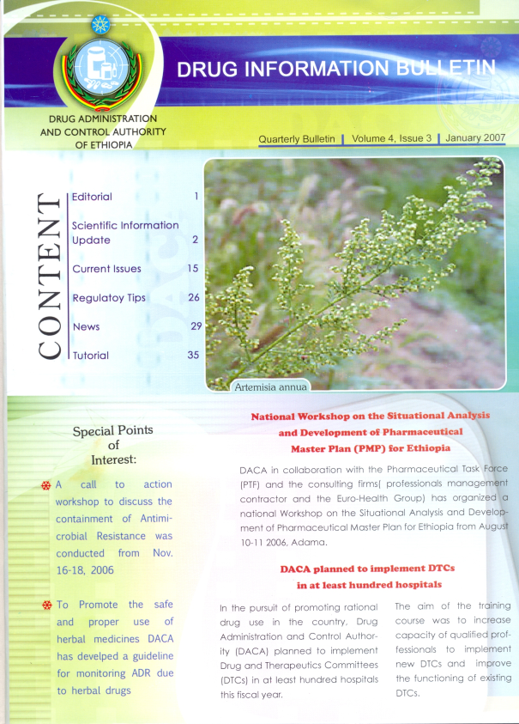


Slide 199
Ethiopian National Drug Policy and its implementation 1993
Drug promotion shall be carried out by trained professionals/Licensing of Medical representatives
Mass media promotion shall\be controlled/Electronics and print media regulation (Cosmetics and medical equipment assisted services)

Slide 200
Ethiopian National Drug Policy and its implementation 1993
7. Drug Use
List OTC drugs
Standard prescription
Generic prescribing encouraged
Generic substitutions for Brand drugs by pharmacists
Public awareness on drug use/Radio/ Tv
STGs ( Both Human &Vet STG in use)
Formularies (Both Human &Vet in use)

Slide 201
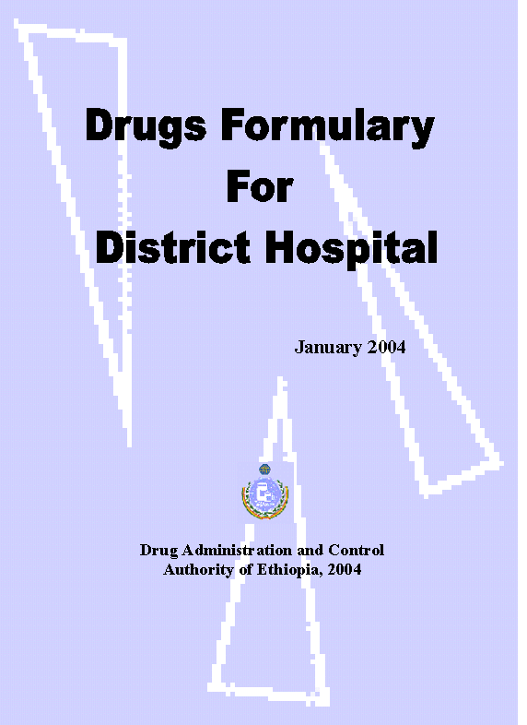




Slide 202
Ethiopian National Drug Policy and its implementation 1993
8. Traditional Medicine
Research and development/Universities, EHNRI,EARI)
Favourable condition to be created for the application of safe and effective TM/Licensing of TM practitioners, Registration of TD, ADR-TM monitoring
9. Research and development
Introduction of appropriate technology and knowledge to vitalize the sector.\The government shall provide incentives and support/Clinical trial guidelines, licenses issued.

Slide 203
Ethiopian NDP revision: the need
The country is still overwhelmingly dependent on importation of drugs
The number and distribution outlets shows mismatch to the needs.
Enforcement capacity is its lowest level to fight illegal drug trade and encourage expansion of legal activities.
Shortage of qualified and experienced management and technical personnel in public health facilities and industry.

Slide 204
Ethiopian NDP revision: the need…
Unsuitable and insufficient distribution and storage facilities.
Inadequate systematic and continuing education coupled with inadequate reference and learning materials.

Slide 205
Ethiopian NDP revision: the need…
Trade-Related Aspects of Intellectual Property Rights/World Trade Organization (TRIPS/WTO) agreement
Shifting in health financing strategies from out of pocket expenditure by patients to health insurance schemes.

Slide 206
Ethiopian NDP revision: the need…
Therefore:
The draft revised policy includes
new areas that were not covered by the previous policy
further elaborates some strategies which were not adequately addressed
pays particular attention to specific items included in the drug definition.

Slide 207
Contents of the Draft Revised NDP
SECTIONS
Goal
General Objectives of the Policy
Components and Strategies
Selection of Drugs
Production and Supply of Drugs
  Production
  Procurement and Distribution
  *Stock Management (correction not Component 3 as it is in the document)
3. Drug Administration and Control
4. Drug Information and Promotion
5. Monitoring Safety of Drugs

Slide 208
Contents of the Draft Revised NDP
6. Rational Drug Use
7. Traditional Drugs
8. Research and Development
9. Affordability and Financing of Drugs
10. National, Regional and International Relations
11. Human Resource Planning, Development and Retention
12. Policy Enforcement and Implementation of the National Drug Policy

Slide 209
CHAPTER SIX
PHARMACEUTICAL SUPPLY AND SERVICE REFORMS IN ETHIOPIA

Slide 210
Objectives
After completion of this section students will be able to:
  Explain Auditable Pharmaceutical Transaction and Services (APTS)
  Explain Integrated Pharmaceutical Logistics System (IPLS)

Slide 211
1. Auditable Pharmaceutical Transaction and Services

Slide 212
The Evolution of APTS
FMOH has been leading sector wide reform to improve the quality and accessibility of health services
Accordingly Ethiopian Hospital Reform Implementation Guideline (EHRIG) was issued in 2010 to implement the reform
EHRIG in the Pharmacy Chapter stated 12 operational standards
  The 4th standard: “All drug transactions and patient medication-related information should be recorded and documented”

Slide 213
Evolution of APTS …
However, there were different challenges to the expected standards of pharmacy services
Lack of transparent systems and tools for medicines transactions and sales management and difficult to audit
Lack of efficient utilization of medicines budgets (high expiry and high stock out at the same time)
Poor pharmacy organization, pharmaceutical management, poor infrastructure & chaotic work flow
Improper human resource mix, number, & deployment
Irrational dispensing practice became a tradition
Absence of legal instruments to enforce good practice

Slide 214
Evolution of APTS …
Debremarkos Referral Hospital took the initiative to implement transparent and accountable and transparent system
Experience taken from community pharmacies and other hospitals
The name “Auditable Pharmaceutical Transactions and Services, APTS” coined
The system scaled-up to other hospitals in Amhara Region and backed by regulation
Recognizing the benefits, other regions and FMOH are adapting the system

Slide 215
Essential Elements of APTS
The essential elements of APTS are:
Preparing tools
Redesigning and using proven methodologies
Pharmacy renovation, reorganization to suit work flow
Workload analysis
Physical inventory and auditing
Prescription evaluation, counseling and dispensing
Legal instruments development and enactment

Slide 216
Essential Elements …
1. Preparing tools that ensure transparency and accountability.
    receiving and issuing vouchers,
    sales tickets,
    dispensing registers,
    daily summary and monthly reporting forms
    Analysis forms
  2. Methodologies for Efficient utilization of budgets :
  Establish effective medicines sales management system:
    price setting,
    daily sales summary as cash, credit and free
  Generating reliable information on product, finance and pharmaceutical service rendered.
  Bin ownership at dispensary to ensure accessibility of medicines and increase work efficiency

Slide 217
Essential elements …
2. Methodologies…
Facility specific drug list segregated as vital, essential and non essential (VEN)
ABC/VEN reconciliation
Threesome analyses (Consumption to stock, stock turnover and stock status analysis)
Registering medicines and supplies with unique identifier codes

Slide 218
Essential Elements …
3. Pharmacy renovation, reorganization, Equipment/Facilities and making suitable work flow
Reorganizing dispensaries
Rearranging the workflow
  Redefining roles of dispensers, accountants and cashiers

Slide 219
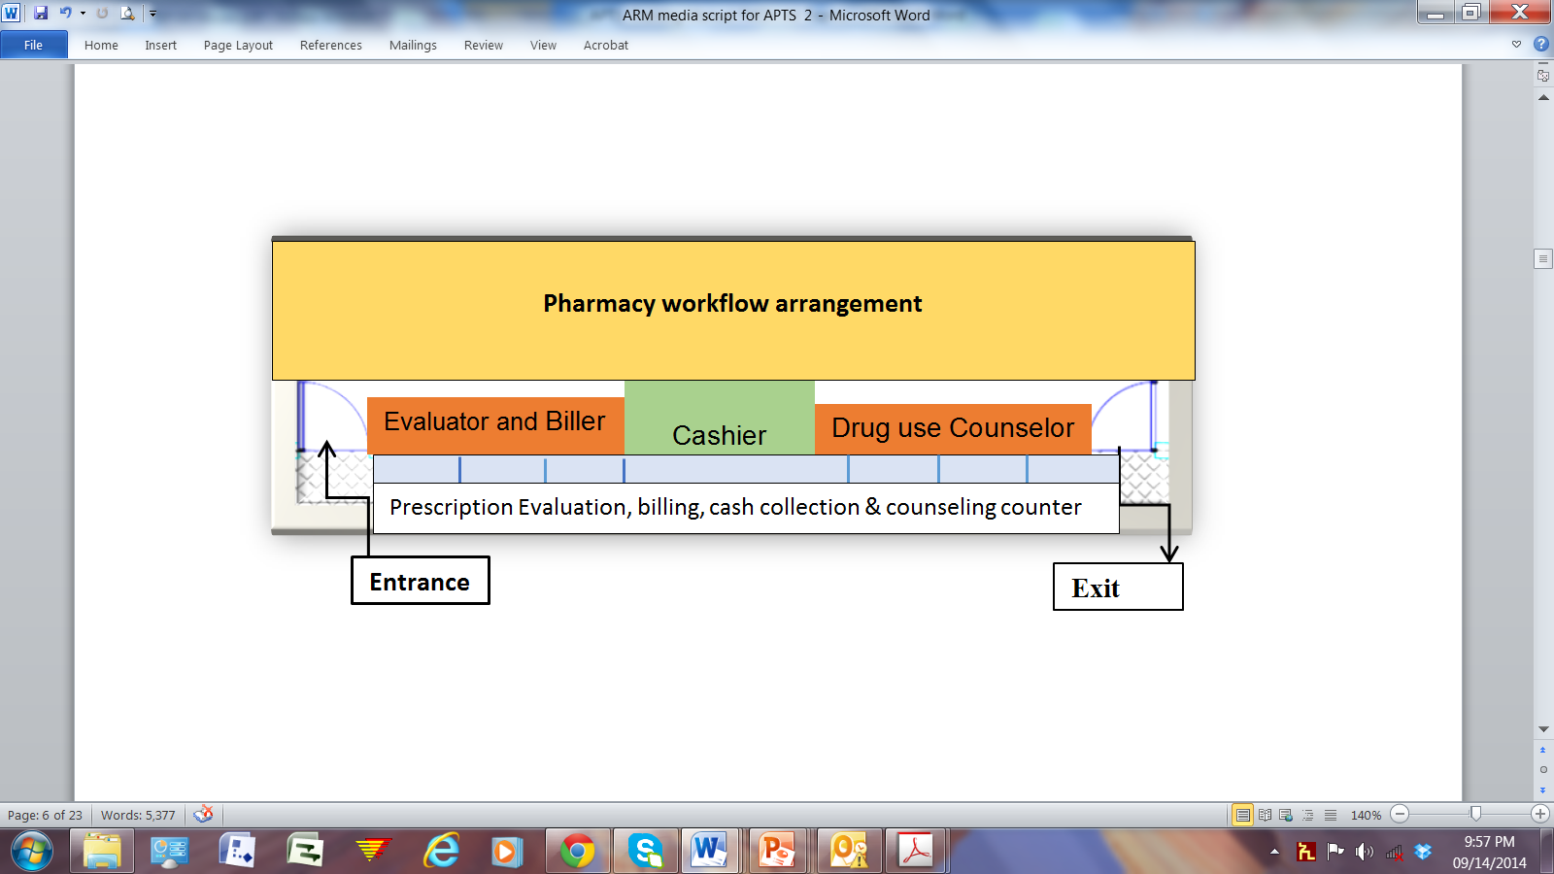
Organization and workflow at dispensaries

Slide 220
Essential elements …
  4. . Workload analysis and proper human resource deployment, performance evaluation and training
Deployment of proper number of pharmacists based on workload
Evaluation of performance based on quantity, quality and transparency of services rendered
  5. Regular physical inventory and auditing to ensure transparency and accountability
6. Prescription evaluation & medicines use counseling to attain proper use of medicines
Training of professionals on dispensing steps, patients handling and counseling to increase patients knowledge on prescribed medicines’ use to improve adherence
7. Legal instruments supporting the implementation
  APTS implementation requires legal backup

Slide 221
Benefits of implementing APTS
Several benefits in improving access to pharmaceuticals and quality of services
  Efficient budget utilization through SSA, ABC/VEN reconciliation
  Informed decision-making
  Increase hospital revenue, minimize wastage
  Improve availability and affordability of medicines
  Identify and prevent loss, theft, pilferage

Slide 222
Benefits …
  Enables allocation of pharmacy workforce based on workload
  Creates transparent, accountable and auditable system
  Enables transparent performance evaluation (BSC)
  Improves patient satisfaction through improved service quality, improved work flow and product availability
  Facilitates the implementation of EHRIG Pharmacy Chapter Operational Standards

Slide 223
Benefits of APTS …
Key result areas of APTS
APTS
Efficient Budget Utilization
Reliable Information
Effective Workforce Deployment & Development
Transparent and Accaountable Transactions
Improved Customer Satisfaction

Slide 224
APTS practical experience
APTS is showing improvement in
  pharmacy workforce allocation,
  improved drug availability,
  budget utilization and patient satisfaction, and
  reduced wastage.
Specific cases of some hospitals that are implementing APTS are presented below

Slide 225
Improved Patient Satisfaction:

Slide 226
Reduced wastage rate

Slide 227
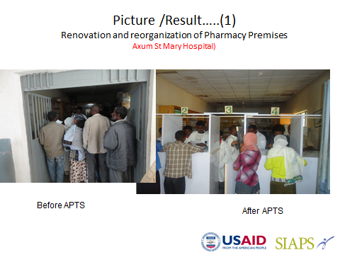
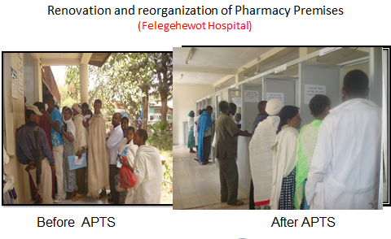

Slide 228
2. Integrated Pharmaceutical Logistic System (IPLS)

Slide 229
IPLS….
Pharmaceuticals Fund and Supply Agency (PFSA) was established in 2007 by Proclamation No. 553/2007 based on the Pharmaceuticals Logistics Master Plan (PLMP).
The Agency is mandated to avail affordable and quality pharmaceuticals sustainably to all public health facilities and ensure their rational use.
So as to execute its mandate in the area of pharmaceuticals supply in an efficient and effective manner, integrated pharmaceuticals logistics system (IPLS) has been developed and implemented since 2010.

Slide 230
IPLS….
IPLS is the term applied to the single pharmaceuticals reporting and distribution system based on the overall mandate and scope of the PFSA.
It aims to ensure that patients always get pharmaceuticals they need.
The IPLS integrates the management of essential pharmaceuticals including the following pharmaceuticals that were used to be managed vertically: HIV/AIDS, Malaria, TB and Leprosy, EPI, MCH and purchased essential drugs

Slide 231
IPLS
It is the primary mechanism through which all public health facilities obtain essential and vital pharmaceuticals.
Products included on the National pharmaceuticals procurement List (NPPL) are supplied and managed through the IPLS.

Slide 232
Information flow in IPLS
hospitals and health centres order Program pharmaceuticals every two months by and delivered by PFSA to these facilities directly or indirectly.
  Direct delivery sites are facilities that receive program pharmaceuticals directly from PFSA hubs
  whereas non-direct delivery sites are health centres that receive products from PFSA hubs through Woreda Health Offices (WoHOs).
Health posts report to health centres monthly and collect pharmaceuticals from those health centres; the health centres use the data in the Health Post report to calculate consumption and re-supply quantities.

Slide 233
Information flow in IPLS
For revolving drug fund (RDF) pharmaceuticals, health centres and hospitals will complete Report and Re-supply form (RRF) as per the facilities review period which can be every two month, every quarter or every six months and collect products from affiliated PFSA branch.

Slide 234
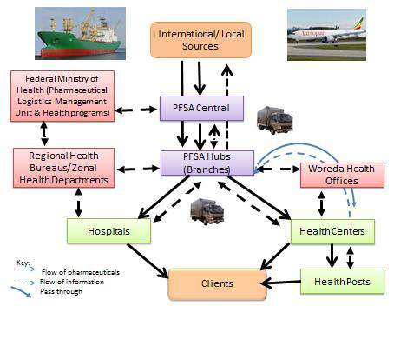
Information flow in IPLS

Slide 235
Stock levels in IPLS
Level | Review period | Maximum months of stock | Minimum months of stock | Emergency order point
Health center, hospital | Every other month | 4 | 2 | 2 weeks
Health post | Every month | 2 | 1 | 1 week

Slide 236
Logistic records in IPLS
Bin Card (BC)
Stock Record Card (SRC)
Health Post Monthly Report and Re-supply Form (HPMRR)
Internal Facility Report and Resupply Form (IFRR)
Report and Requisition Form (RRF) for Program Drugs
Report and Requisition Form (RRF) for RDF Drugs

Slide 237
Thank You!!!

