Slide 1
Actin filament
Actin: A abundant protein 43 kd that polymerises to form cytoskeletal filament.
It is the major cytoskeletal protein for most of the cells.
Actin proteins polymerizes to form actin filaments, which is thin, flexible fibers approximately 7 nm in diameter and up to several micrometers in length.
Actin binding protein has two domains (compact globular structure of protein) that bind actin, allowing them to bind and crosslink two different actin filaments.
Actin filaments are abundant below the plasma membrane, forming a network, that provides the cell the mechanical support, shape, and movement of the cell surface, enabling cells to migrate, engulf particles, and divide.
Actin-bundling proteins: Crosslinks the actin filaments into bundles.
Higher eukaryotes have several distinct types of actin, which are encoded by different members of the actin gene family.
Mammals, have at least six distinct actin genes: Four are expressed in different types of muscle and two are expressed in non-muscle cells.
All of the actins, however, are very similar in amino acid sequence and have been highly conserved throughout the evolution of eukaryotes.

Slide 2
Individual actin molecules are globular proteins (43 kda) which consists of 375 amino acids.
Each actin monomer (globular [G] actin) has tight binding sites that mediate head-to-tail interactions with two other actin monomers, so actin monomers polymerize to form filaments (filamentous [F] actin.
Each monomer is rotated by 166º in the filaments, which therefore have the appearance of a double-stranded helix. Because all the actin monomers are oriented in the same direction, actin filaments have a distinct polarity and their ends (called the plus and minus ends) that are distinguishable from one another.
This polarity of actin filaments is important both in their assembly and in establishing a unique direction of myosin movement relative to actin,
The assembly of actin filaments can be studied in vitro by regulation of the ionic strength of actin solutions. In solutions of low ionic strength, actin filaments depolymerize to monomers. Actin then polymerizes spontaneously if the ionic strength is increased to physiological levels. The first step in actin polymerization (called nucleation) is the formation of a small aggregate consisting of three actin monomers.
Actin polymerization is coupled to the hydrolysis of adenosine triphosphate (ATP) into adenosine diphosphate (ADP) and inorganic phosphate (Pi).

Slide 3
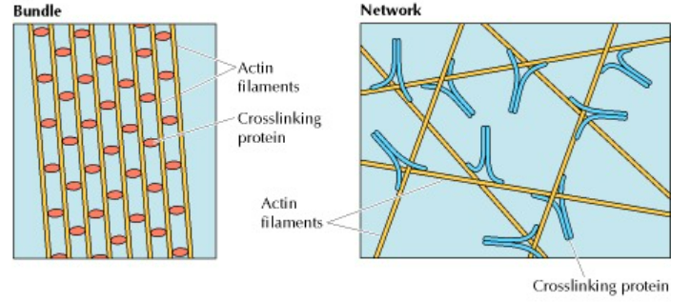
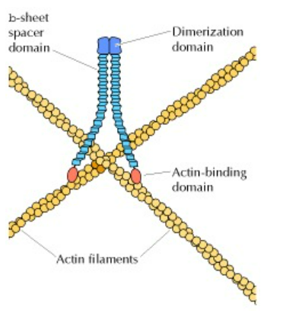
filamin
Filamin crosslinks the actin filament.
Filamin is a dimer of two large (280-kd) subunits, forming a flexible V-shaped molecule.
The carboxy-terminal dimerization domain is separated from the amino-terminal actin-binding domain by repeated β-sheet spacer domains.

Slide 4
Actin filaments are made up of identical actin proteins arranged in a long spiral chain. Like microtubules, actin filaments have plus and minus ends, with more ATP-powered growth occurring at a filament's plus end.
barbed
two ends of an actin filament grow at different rates, with monomers being added to the fast-growing end (the plus end) five to ten times faster than to the slow-growing (minus) end.
This difference can result in the phenomenon known as treadmilling, which illustrates the dynamic behavior of actin filamentsTreadmilling requires ATP, with ATP-actin polymerizing at the plus end of filaments while ADP-actin dissociates from the minus end. Although the role of treadmilling in the cell is unclear, it may reflect the dynamic assembly and disassembly of actin filaments required for cells to move and change shape
F-actin can exist in multiple states, in general, an actin filament has a total rise of 27.3 Å between subunits on adjacent strands and a rotation of 166.15° around the axis.
https://youtu.be/jthDiRSZwA4

Slide 5
The polarity of an actin filament is visualized by the binding of the myosin subfragment (S1) to the filament, which creates barbed (+) and pointed (-) ends on the filament.
When all actin subunits are bound by myosin S1, the filament appears coated with arrowheads that all point towards one end of the filament.
The barbed end (pointed) structure with bound capping protein has been determined and polarity ascertained by novel single-particle image analysis methods applied to electromicrographs of in vitro protein preparations. The (+) end of filaments generally have a high concentration of F-actin-ATP and denotes the growing end of an actin filament, the (-) end generally has a high concentration of F-actin-ADP and denotes the shrinking end of an actin filament.
Most actin filaments are arranged with the barbed end toward the cellular membrane and the pointed end toward the cellular interior. The length of actin filaments can be adjusted by the activity of actin binding proteins and by altering the rate of actin treadmilling.

Slide 6
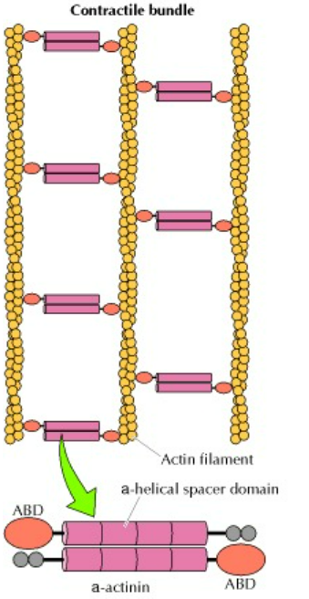
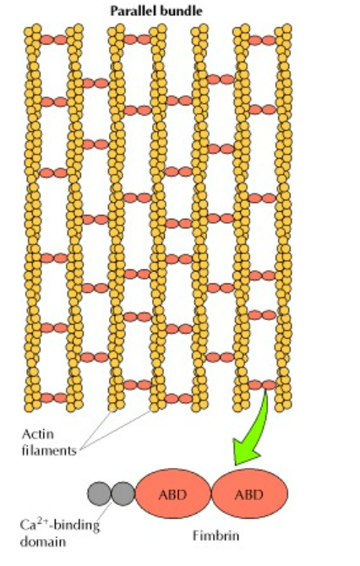

Slide 7
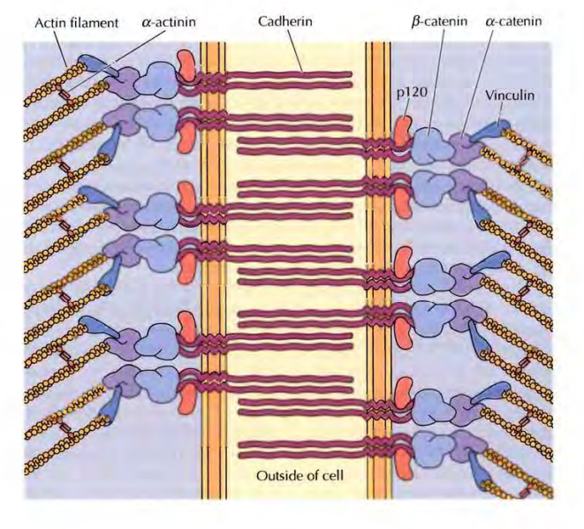
Adherens junctions In adherens junctions, cadherins link to actin filaments. j3-catenin (an armadillo family protein) binds to the cytosolic tails of the cadherins. j3-catenin also binds a-catenin, which binds both actin filaments and vinculin. This forms a direct link between the transmembrane cadherins and the actin cytoskeleton. A second armadillo family protein, p120, also binds the cytosolic tails of cadherins and regulates the stability of the junction.

Slide 8
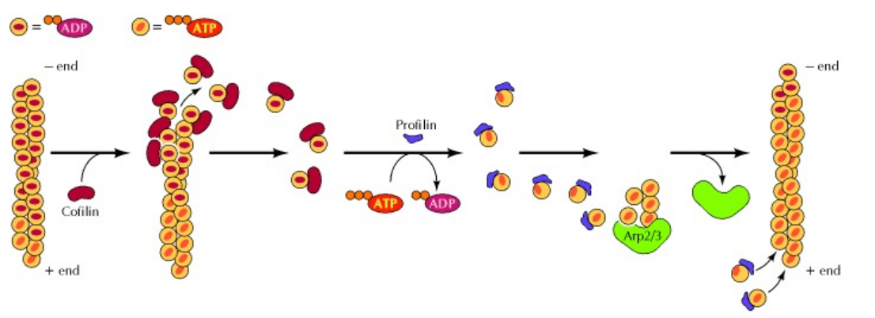
Cofilin binds to actin filaments and increases the rate of dissociation of actin monomers (bound to ADP) from the minus end. Cofilin remains bound to the ADP-actin monomers, preventing their reassembly into filaments.
However, profilin can stimulate the exchange of bound ADP for ATP, resulting in the formation of ATP-actin monomers that can be repolymerized into filaments, including new filaments nucleated by the Arp2/3 proteins.
Cofilin is one of the most affluent and common actin-binding proteins and plays a role in cell motility, migration, shape, and metabolism.
Profilin is an actin-binding protein involved in the dynamic turnover and reconstruction of the actin cytoskeleton. It is found in all eukaryotic organisms.

Slide 9
The extracellular matrix (ECM) is an intricate network composed of an array of multidomain macromolecules organized in a cell/tissue-specific manner. Components of the ECM link together to form a structurally stable composite, contributing to the mechanical properties of tissues.

Slide 10
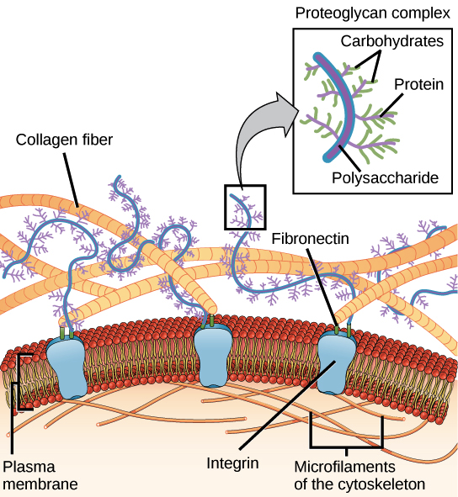
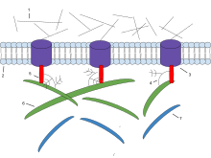

Slide 11
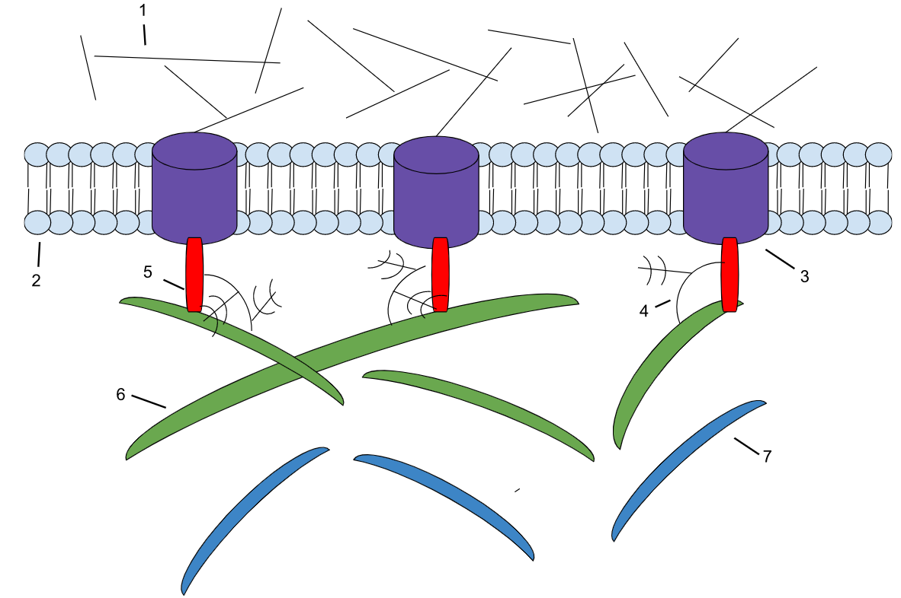
Microfilaments
Phospholipid bilayer
Fibronectin
1: Microfilaments
2: Phospholipid Bilayer 3: Integrin
4: Proteoglycan
5: Fibronectin
6: Collagen
7: Elastin
Proteoglycan
Integrin
Collagen
Elastin
Model to depict the role of components of ECM

Slide 12
The ECM is also a reservoir of growth factors and bioactive molecules. It is a highly dynamic entity that is of vital importance, determining and controlling the most fundamental behaviors and characteristics of cells such as proliferation, adhesion, migration, polarity, differentiation, and apoptosis.
Major ECM elements
The “core matrisome”³ comprises approximately 300 proteins. ECM-associated proteins
The human matrisome comprises 1027 genes, encoded by 4% of the human genome, and the murine matrisome 1110 genes.
Collagen is composed of 3 polypeptide α chains that form a triple helical structure.
In vertebrates, 46 distinct collagen chains assemble to form 28 collagen types.
2. Fibril-forming collagens (e.g., types I, II, III, V and XI)
are the most extensively characterized fibrillar collagens both structurally and functionally.
Collagens I, III, and V are found in many tissues.
Collagen II is mainly restricted to cartilage in association with collagen XI.
Collagen XI also regulates collagen fibril assembly, organization and functional properties in tendon.

Slide 13
Collagen XXIV is a specific marker for osteoblast differentiation and bone formation, promotes osteoblastic differentiation and mineralization through TGFβ/Smads signaling pathway.
Covalent cross-linking of fibrillar collagens is initiated by the enzymes of the LOX
(lysyl oxidase) family.
3. Network-forming collagens: the basement membrane collagen type IV)
4. fibril-associated collagens with interruptions in their triple helices, or FACITs (e.g., types IX, XII), others (e.g., type VI)

Slide 14
Proteoglycans
consist of a core protein to which glycosaminoglycan (GAG) side chains are attached. GAGs are linear, anionic polysaccharides made up of repeating disaccharide units.
4 groups of GAGs are there: hyaluronic acid, keratan sulfate; chondroitin/dermatan sulfate; and heparan sulfate. All are sufated, except hyaluronic acid.
The highly negatively charged GAG chains allow the proteoglycans to sequester water and divalent cations, conferring space-filling and lubrication functions
Secreted proteoglycans include large proteoglycans (Aggrecan, versican)
Small leucin rich proteoglycan (decorin, lumican)
basement membrane proteoglycans (perlecan)
Syndecans are cell-surface-associated proteoglycan
Serglycin is an intracellular proteoglycan.
The molecular diversity of proteoglycans provides structural basis for a multitude of biological functions
Example: Presence of aggrecan in cartilage generates elasticity and high biomechanical resistance to pressure.
Collagen fibril assembly; Decorin and lumican play their role
Proteoglycans also interact with growth factors and growth factor receptors and are utilized for cell signaling of biological processes, including angiogenesis.
Proteoglycans: key players in ECM organization and cell properties

Slide 15
Proteoglycans are ubiquitously expressed by all cell types and ECMs and can sometimes be a dominant component (i.e., in the vertebrate cartilage matrix).
Given that PGs are present in multicellular animals and in all mammalian ECM phenotypes, it is not surprising that PGs possess an array of functions.
PGs are rapidly emerging as dynamic modulators of normal states (i.e., ECM hydration, supramolecular assembly, homeostasis, development, wound healing, tissue repair, and senescence) and pathobiological conditions (i.e., inflammation, autophagy, fibrosis, osteoarthritis, atherosclerosis, and cancer).

Slide 16
Laminin: 20 glycoproteins, which are interwoven to form the network in basement membranes.
Laminins are heterodimers (alpha, beta and gamma chains)
Many laminins self-assemble to form networks and remain closely associated with cells through interactions with cell surface receptors.
Laminins are essential for early embryonic development and organogenesis.
Fibronectin: essential for the attachment and migration of cells, functioning as “biological glue”.
The fibronectin monomer (~250 kDa) comprised of three types of repeats: I, II, and III).
Fibronectin is secreted as dimers linked by disulfide bonds and has binding sites to other fibronectin dimers, collagen, heparin, and cell surface receptors.
Elastin
imparts elasticity to tissue subjected to repeated stretch, such as vascular vessels and the lung.
Elastin is secreted as tropoelastin monomer. Tropoelastin, with the assistance of fibulins, associates with microfibrils to form elastic fibers.
tropoelastin is assembled into small globular aggregates on the cell surface (microassembly).
The cross-linking results in a loss of positive charges on the molecule, enabling the release of tropoelastin from the cell and assisting globular fusion in the presence of microfibrils (macroassembly).
Fibulin-4 has a role in early stages of elastin assembly and fibulin-5 acts to bridge elastin between the matrix and cells

