Slide 1
Module-II
Cell growth, Cell adhesion, cell junctions and extra cellular matrix organelles

Slide 2
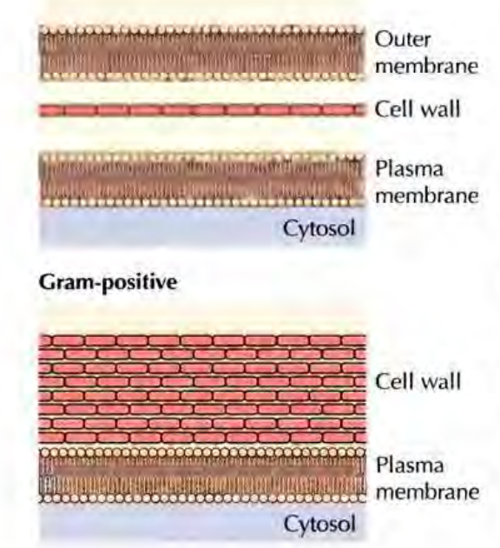
Cells of (bacteria, fungi, algae, and higher plants are surrounded by rigid cell walls)
Animal cells are not surrounded by cell walls, but are embedded in an extracellular matrix composed of secreted proteins and polysaccharides.
Gram-negative
Gram-positive and Gram-negative bacteria cell walls are peptidoglycan, which is a linear polysaccharide chains, that are cross linked with strong covalent bond.
Because of thjs cross-linked structure, the peptidoglycan forms a strong covalent shell around the entire bacterial cell.
Antibiotics works by disrupting the cell membrane and prevents it from synthesizing.
β-Lactam antibiotics: are a broad class of antibiotics, which are bacteriocidal, inhibits the synthesis of cell wall
Penicillin derivatives (penams), cephalosporins (cephems), monobactams, and carbapenems
Glycopeptide antibiotics: Vancomycin, teicoplanin, telavancin, bleomycin, ramoplanin, and decaplanin.

Slide 3
Penicillin spheroplast generation:
Diagram depicting the failure of bacterial cell division in the presence of a cell wall synthesis inhibitor
(e.g. penicillin, vancomycin)
Cell wall integrity is further hampered, as it increases in size, but unable to pinch off to form two daughter cells, as the it fails to synthesize new cell wall.
The cell wall is shed entirely, forming a spheroplast, vulnerable relatively to original cells, as it has double the genetic material, hence homeostasis is broken, leading to cell death.
The cell begins to grow, but is unable to synthesize new cell wall to accommodate the expanding cell
As cellular growth continues, cytoplasm covered by plasma membrane begins to squeeze out through the gap(s) in the cell wall.
Penicillin (or other cell wall synthesis inhibitor) is added to the growth medium with a dividing bacterium

Slide 4
Bacteria often develop resistance to β-lactam antibiotics by synthesizing a β-lactamase, an enzyme that attacks the β-lactam ring. To overcome this resistance, β-lactam antibiotics are often given with β-lactamase inhibitors such as clavulanic acid.
The second class of antimicrobial drugs, are the glycopeptide antibiotics, inhibits the synthesis of cell walls in by inhibiting peptidoglycan synthesis, by binding to the amino acids within the cell wall to prevent the addition of new units to the peptidoglycan.
beta lactamase and inhibition of beta lactamse synthesis.
Penicillin, prevents the final cross-linking step, or transpeptidation, in assembly of this macromolecule, and the cell wall, killing the bacterium. No harm comes to the human host because penicillin does not inhibit any biochemical process that goes on within us (Human cells do not make or need peptidoglycan).
Another kind of antibiotic--tetracycline--also inhibits bacterial growth by stopping protein synthesis.
Tetracycline: binds to a single site on the 30 S ribosome the 30S -ribosomal subunit--and blocks a key RNA interaction, which shuts off the lengthening protein chain.
In human cells, however, tetracycline does not accumulate in sufficient concentrations to stop protein synthesis.

Slide 5
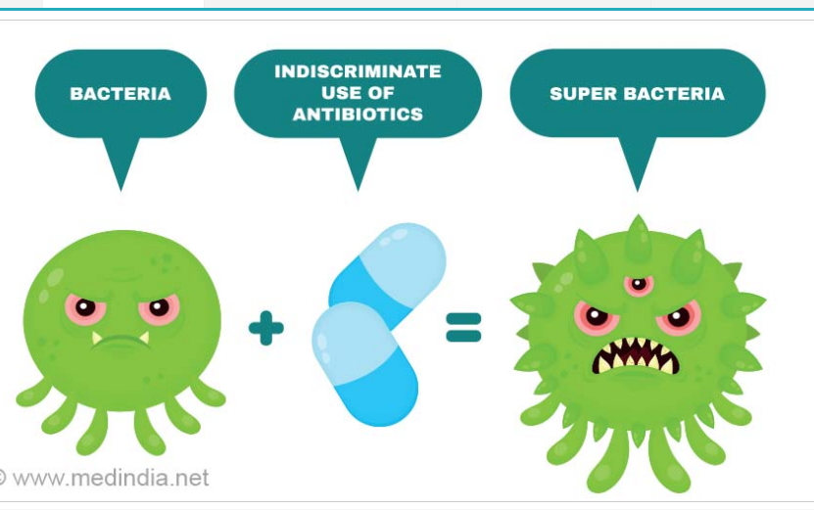
Antibiotic resistance genes are often located on plasmids or transposons and can be transferred from cell to cell by conjugation, transformation, or transduction. This gene exchange allows the resistance to rapidly spread throughout a population of bacteria and among different species of bacteria.
Antibiotic resistance occurs when bacteria continues to grow in the presence of antibiotics. Overuse of antibiotics is the most common cause of antibiotic resistance.

Slide 6
Eukaryotic Cell Walls
Plant Cell Walls (Fungi, algae, higher plants)
Fungal cell walls is chitin which is made up polysaccharide. Chitin is a linear polymer of N-acetylglucosamine residues, can also be found in the shells of crabs and the exoskeletons of insects and other arthropods.
The cell walls of most algae and higher plants are composed principally of cellulose, which is the most abundant polymer on earth.
Cellulose is a linear polymer of glucose residues
Cellulose microfibrils can extend for many micrometers in length.

Slide 7
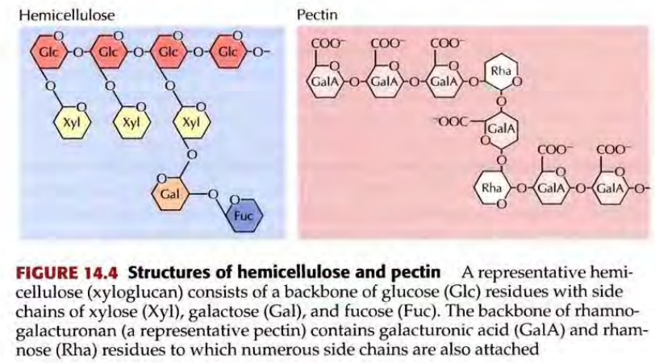
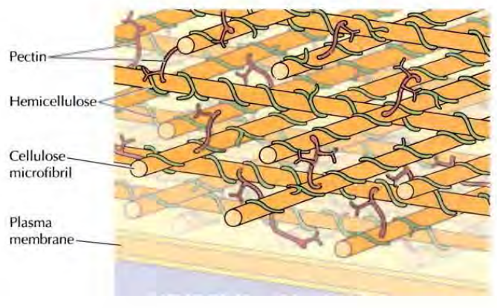
Within the plant cell wall, cellulose microfibrils are embedded in a matrix consisting of proteins and two other types of polysaccharides: hemicelluloses and pectins.
Hemicelluloses are highly branched polysaccharides that are hydrogen-bonded to the surface of cellulose microfibrils. This stabilizes the cellulose microfibrils into a tough fiber, which is responsible for the mechanical strength of plant cell walls. The cellulose microfibrils are cross-linked by pectins, which are
Plant cell wall Cellulose is organized into microfibrils that are oriented in layers. Hemicelluloses (green) are tightly associated with the surface of cellulose microfibrils, which are cross-linked by pectins (red).

Slide 8
Primary cell walls: cellulose, hemicelluloses, and pectins, cellulose fibres are randomly arranged
Secondary cell walls: Contains 50 to 80% cellulose, highly ordered strengthened by lignin, complex polymer of phenolic residues (complex polymer), responsible for strength and density of wood.
The orientation of cellulose microfibrils also differs in primary and secondary cell walls. The cellulose fibers of primary walls appear to be randomly arranged, whereas those of secondary walls are highly ordered (see Figure 14.6). Secondary walls are frequently laid down in layers in which the cellulose fibers differ in orientation, forming a laminated structure that greatly increases cell wall strength

Slide 9
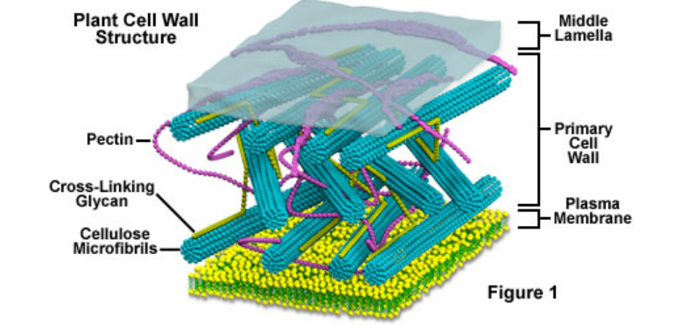
Primary cell walls: a complex carbohydrate made up of several thousand glucose molecules linked end to end. In addition, the cell wall contains two groups of branched polysaccharides, the pectins and cross-linking glycans. Organized into a network with the cellulose microfibrils, the cross-linking glycans increase the tensile strength of the cellulose, whereas the coextensive network of pectins provides the cell wall with the ability to resist compression. A small amount of protein can be found in all plant primary cell walls, which increases mechanical strength and part of it consists of enzymes, which initiate reactions that form, remodel, or breakdown the structural networks of the wall.

Slide 10
Secondary plant cell wall: Made up of complex carbohydrate, several thousand glucose molecules linked end to end.
It contains two groups of branched polysaccharides, the pectins and cross-linking glycans, organized in a network with the cellulose microfibrils, the cross-linking glycans increase the tensile strength of the cellulose, whereas the coextensive network of pectins provides the cell wall with the ability to resist compression.
In addition to these networks, a small amount of protein can be found in all plant primary cell walls. Some of this protein is thought to increase mechanical strength and part of it consists of enzymes, which initiate reactions that form, remodel, or breakdown the structural networks of the wall.
Middle lamella: a specialized region associated with the cell walls of plants, are rich in pectins, is shared with theneighboring cells and cements them firmly together.

Slide 11
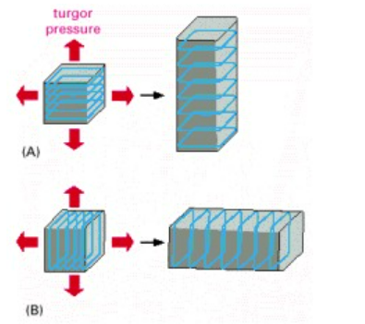
How the orientation of cellulose microfibrils within the cell wall influences the direction in which the cell elongates
The cells in (A) and (B) start off with identical shapes (shown here as cubes) but with different orientations of cellulose microfibrils in their walls. Although turgor pressure is uniform in all directions, cell-wall weakening causes each cell to elongate in a direction perpendicular to the orientation of the microfibrils, which have great tensile strength. The final shape of an organ, such as a shoot, is determined by the direction in which its cells expand.
Molecular Biology of the Cell,Alberts B, Johnson A, Lewis J, et al.
New York: Garland Science; 2002

Slide 12
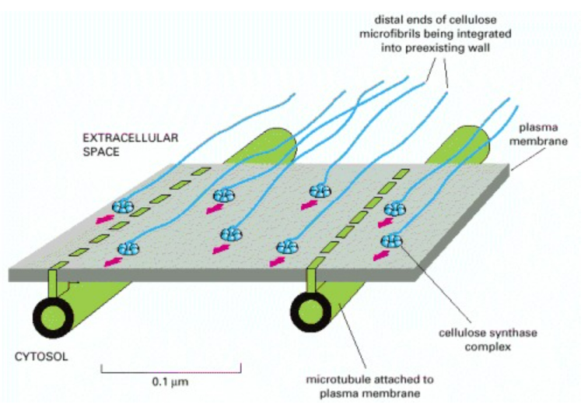
The large cellulose synthase complexes are integral membrane proteins that continuously synthesize cellulose microfibrils on the outer face of the plasma membrane.
The distal ends of the stiff microfibrils become integrated into the texture of the wall, and their elongation at the proximal end pushes the synthase complex along in the plane of the membrane.
Since the cortical array of microtubules is attached to the plasma membrane, the orientation of these microtubules determines the axis along which the new microfibrils are laid down
One model of how the orientation of newly deposited cellulose microfibrils might be determined by the orientation of cortical microtubules

Slide 13
The de novo cell wall is initiated by a specific structure called the phragmoplast during division.
Phragmoplast generates a new cell wall after separation of duplicated DNA during cytokinesis.
An intermediate form of the new cell wall, called the cell plate, is constructed prior to the completion of cytokinesis.
Generation and expansion of the cell plate are accompanied by coordinated vesicle trafficking and fusion as well as changes in cell wall composition.
The phragmoplast, which contains short actin filaments, forms as an antiparallel array of microtubules, with their plus-ends facing the middle of the cell.
The microtubules within the phragmoplast are assembled from spindle microtubules followed by phragmoplast expansion mediated by microtubule-dependent microtubule nucleation.
These microtubules are then disassembled as the cell plate expands.
The phragmoplast contacts the cortex in a defined location known as the division site or cell plate fusion site.
Therefore, microtubules and microfilaments and proteins that affect cytoskeletal dynamics.
Cell wall modification and construction are dynamic processes during which secretion and endocytosis are tightly controlled.
Gu et al, The Plant Cell, 2022, 34: 1: 103–128

Slide 14
Cell adhesion
Cell–cell adhesion is a fundamental feature of multicellular organisms.
To ensure multicellular integrity, adhesion needs to be tightly controlled and maintained.
All living organisms are exposed to physical stresses such as tension and compression, that are experienced during growth and development.
Living organisms have evolved mechanisms to continuously respond and adapt to these mechanical forces to ensure the maintenance of their cellular and supracellular integrity.
In turn, cell–cell adhesion not only enables adjacent cells to stick to each other in a passive manner, but it is also dynamically controlled and maintained over time during growth and development.

Slide 15
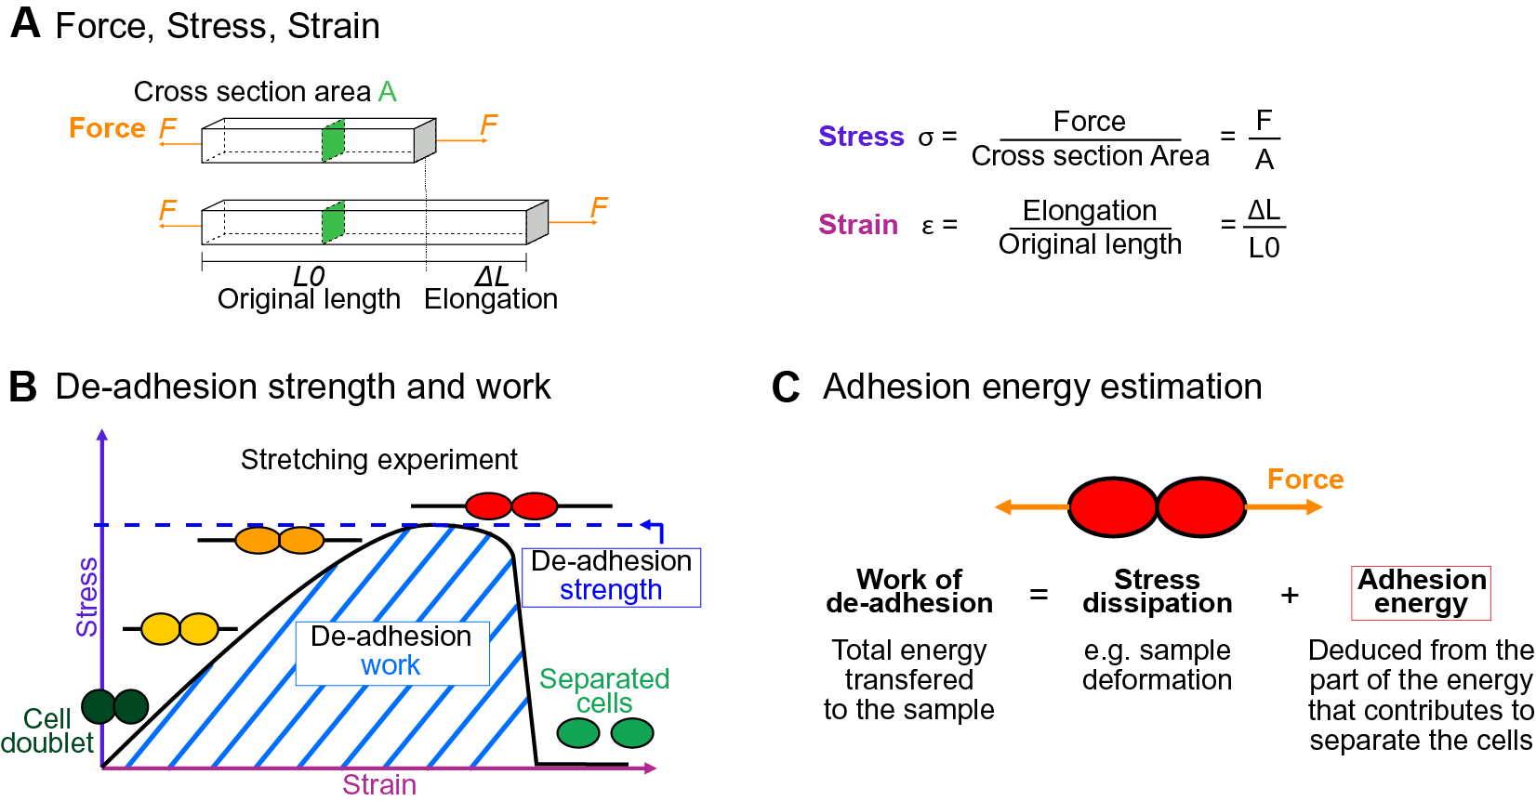
Application of force

Slide 16
Mechanics of cell adhesion.
Force, stress and strain. When a force (orange arrow) is applied on an object, it generates a mechanical stress and a strain (deformation).
The stress corresponds to the ratio of the force F applied to the cross-sectional area A of the object on which the force is applied. The strain is the ratio of the elongation ΔL of the object to the original length L ₀ of the object.
(b) De-adhesion strength and work.
When a doublet of cells is stretched apart, the cells are deformed (strain) and the stress in the sample increases until the stress is high enough to break the links between the cells. The maximal amount of stress applied before the cells detached from each other corresponds to the de-adhesion strength. The area under the stress–strain curve is measured as the de-adhesion work. After separation, the cell shape can be changed due to their plasticity.
(c) Adhesion energy can in principle be deduced from the work of de-adhesion by considering stress dissipation.

Slide 17
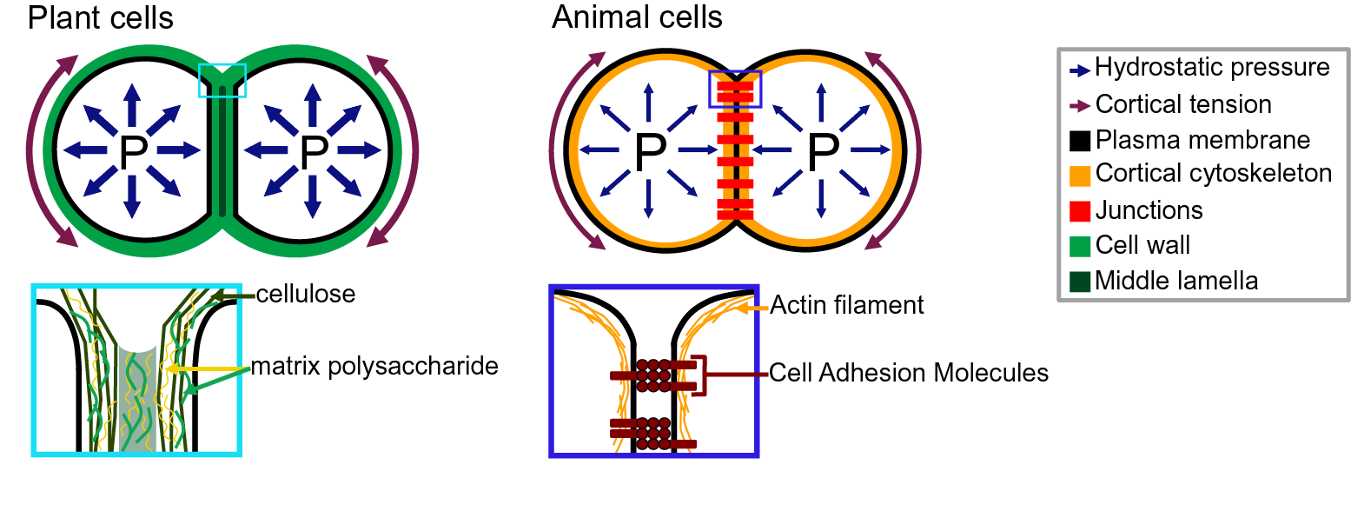
Adhesion in plant and animal cells.
cell doublets
Plant cells, the cell shape is governed by an equilibrium between the internal hydrostatic pressure and the cortical tension.
The plant cell adhesion is mediated by a cell wall mostly composed of cellulose and matrix polysaccharides.
The middle lamella is enriched in pectins and believed to play an important role in adhesion.
Pectins

Slide 18
which are the main constituents of the middle lamella, are generally considered to be the main determinant of cell adhesion in the early stage of tissue growth and development
Pectins are, in fact, a complex set of polysaccharides mainly composed of homogalacturonans (HGs), rhamnogalacturonans I, and rhamnogalacturonans II.
Cross linking of cell adhesion
The HG is a linear chain of galacturonic acids (GalAs), synthesised in a highly methyl esterified form, and that can be de-esterified after secretion to the cell wall by proteins called pectin methylesterases.
The de-esterification process leaves negatively charged residues on the GalAs, and if more than 9 consecutive de-esterified GalAs are available, they can form calcium-mediated bridges with another de-esterified HG under the so-called egg-box conformation, effectively cross-linking independent HG chains potentially coming from adjacent cells

Slide 19
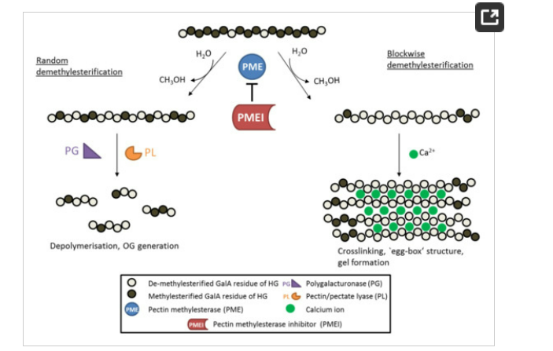
Schematic diagram showing the de-methylesterification of HG and the effects on its structure
HG is highly methylesterified when deposited into the cell wall. PME, can de-methylesterify HG in a block-wise fashion, leading to several consecutive GalA residues without methylester groups. These HG backbones are negatively charged and can therefore form crosslinks with cations like calcium ions, leading to so called ‘egg-box‘ structures responsible for gel formation. On the other hand, PMEs can de-methylesterify single GalA residues leading to a random methylesterification pattern. Low-methylesterified HG is depolymerized by pectin-degrading enzymes such as polygalacturonases (PG) and pectin/pectate lyases (PL), which leads to the formation of oligogalacturonides (OG). PME activity is inhibited by its proteinaceous inhibitor PMEI.
Atakhani, A., Bogdziewiez, L., & Verger, S. (2022). Characterising the mechanics of cell–cell adhesion in plants. Quantitative Plant Biology, 3, E2. doi:10.1017/qpb.2021.16

Slide 20
The degree and pattern of methylesterification of HG determine the biomechanical properties of the cell wall.
When several consecutive GalA residues are de-methylesterified (block-wise de-methylesterification).
The negatively charged carboxyl groups can form calcium bonds with other HG molecules, leading to so-called ‘egg-box’ structures, that underlie the formation of pectin gels.
De-methylesterified, calcium cross-linked HG increased the amount of bound water maintaining wall hydration, and the hydration state was shown to affect biomechanical properties of the cell wall, such as its rigidity.
In addition, the strength of pectin gels is highly dependent on the amount of free calcium ions in the apoplast, as stiffness of the gel is reduced by disassociation of calcium crosslinks

Slide 21
The degree of methylesterification (DM) of HG, which is controlled by the activity of large PME families, has vast consequences on the mechanical properties of the cell wall.
It affects the developmental processes such as stomata opening, cell adhesion, organ initiation and anisotropic cell growth.
In addition, hydrolysis of partially de-methylesterified HG can lead to the formation of signaling molecules (oligogalacturonides), during plant-pathogen interactions.
The PME activity is tightly regulated at:
(a) the transcriptional level
(b) by protein processing and degradation
(c) by the pH of the cell wall environment and (d) by endogenous inhibitor proteins called pectin methylesterase inhibitors (PMEI)
The first PMEI was identified in kiwi fruit (Actinidia deliciosa) and to date several PMEIs have been investigated in different plant species.

Slide 22
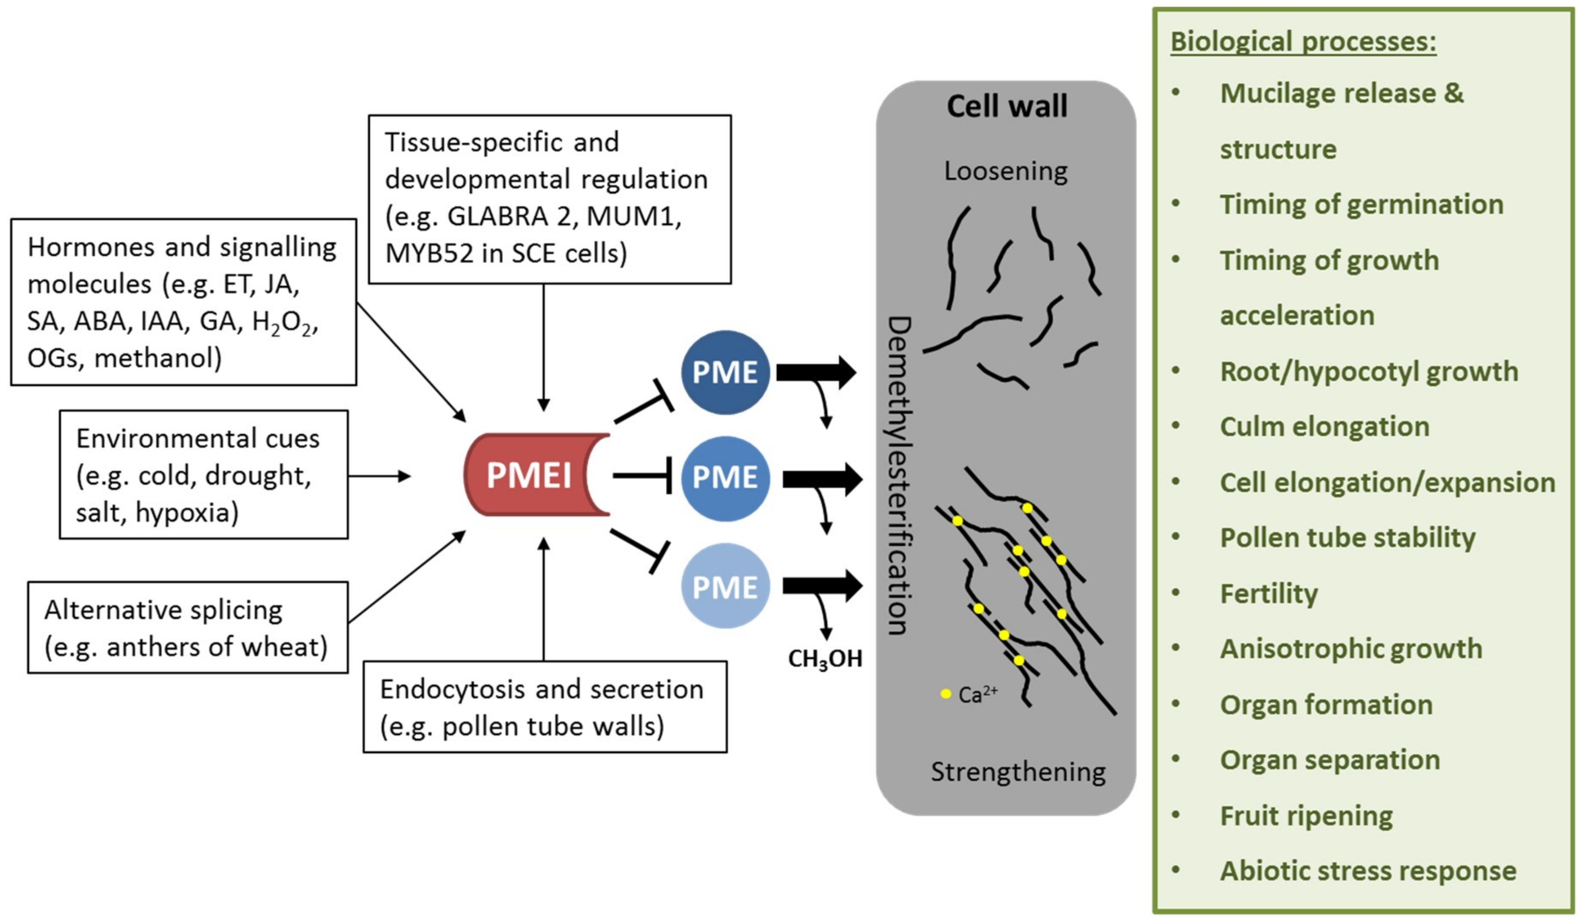
Effect of PMEI regulation on cell wall properties and biological processes
Atakhani, A., Bogdziewiez, L., & Verger, S. (2022). Characterising the mechanics of cell–cell adhesion in plants. Quantitative Plant Biology, 3, E2. doi:10.1017/qpb.2021.16

Slide 23
PMEIs are transcriptionally regulated in a tissue-specific and development-dependent manner.
PMEI gene expression can be activated by the environmental stresses, several plant hormones and signaling molecules.
Alternative splicing and directed endocytosis and secretion regulate the level of active PMEIs in the cell wall.
PMEI can inhibit several PME enzymes, thereby regulating de-methylesterification of HG.
This in turn modulates cell wall properties such as loosening or strengthening, which is required for several biological processes.
Wormit A and Usadel B. Int. J. Mol. Sci. 2018, 19(10), 2878; https://doi.org/10.3390/ijms19102878

Slide 24
Animal cells, the cell shape is governed by an equilibrium between the internal hydrostatic pressure and the cortical tension.
The animal cell adhesion is mediated via proteins located at the plasma membrane.
Cell-adhesion molecules are linked to the actin cytoskeleton which contributes to the cortical tension.

Slide 25
Cell adhesion links cells in different ways and can be involved in signal transduction for cells to detect and respond to changes in the surroundings.
Other cellular processes regulated by cell adhesion include cell migration and tissue development in multicellular organisms.
Cell-cell adhesion is a selective process, cells adhere only to other cells of specific types.
This selectivity was first demonstrated in classical studies of embryo development, which showed that cells from one tissue (e.g., liver) specifically adhere to cells of the same tissue rather than to cells of a different tissue (e.g., brain).

Slide 26
Such selective cell-cell adhesion is mediated by transmembrane proteins called cell adhesion molecules.
Which can be divided into four major groups:
Selectins Carbohydrates (ligand)
Integrins Extracellular matrix
Immunoglobulin (lg) superfamily Integrins
Cadherins Other cadherins
Nectins
Cell adhesion is mediated by the selectins, integrins, and most cadherins.
Most adhesive interactions between cells are divalent cation-dependent (
Ca2+, Mg2+ or Mn2+ )

Slide 27
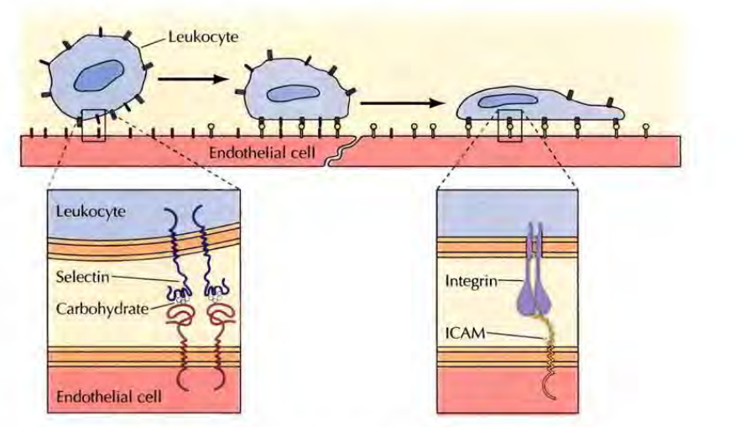
Adhesion between leukocytes and endothelial cells
binding
heterophilic
Leukocytes leave the circulation at sites of tissue inflammation by interacting with the endothelial cells of capillary walls. The first step in this interaction is the binding of leukocyte selectins to carbohydrate ligands on the endothelial cell surface. This step is followed by more stable interactions between leukocyte integrins and members of the Ig superfamily (ICAMs) on endothelial cells.

Slide 28
Heterophilic interaction: two different cell adhesion takes place
Adhesion molecule on the surface of one cell (e.g., an ICAM) recognizes a different molecule on the surface of another cell (e.g., an integrin).
Homophilic interactions: An adhesion molecule on the surface of one cell binds to the same molecule on the surface of another cell
nerve cell adhesion molecules (N-CAMs), belongs to the lg superfamily, expressed on nerve cells,
homophilic binding between N-CAMs contributes to the formation of selective associations between nerve cells during development.
There are more than 100 members of the Ig superfamily, which mediate a variety of cell-cell interactions.

