Slide 1
Types of cells and their organelles
Prokaryotic cells
Eukaryotic cells
Prokaryotic: 1-10 μm
(1 μm = .001 mm)
Eukaryotic: 10 - 100 μm
A cell is chemical system that is able to maintain its structure and reproduce. Cells are the fundamental unit of life. All living things are cells or composed of cells.

Slide 2
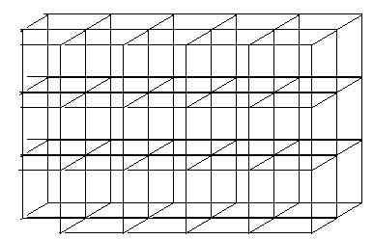
Robert Hooke - 1665 - using an early microscope viewed cork and saw many repeating box-like structures and called them “cells.”
What he saw there were spaces surrounded by walls that once contained living
cells.
Cytoplasm is a thick solution that fills each cell and is enclosed by the cell membrane. It is mainly composed of water, salts, and proteins. In eukaryotic cells, the cytoplasm includes all of the material inside the cell and outside of the nucleus.

Slide 3
Cell Theory
Cells are the fundamental unit of life - nothing less than a cell is alive.
All organisms are constructed of and by cells.
All cells arise from preexisting cells. Cells contain the information necessary for their own reproduction. No new cells are originating spontaneously on earth today.
Cells are the functional units of life. All biochemical processes are carried out by cells.
Groups of cells can be organized and function as multicellular organisms
Cells of multicellular organisms can become specialized in form and function to carry out subprocesses of the multicellular organism.

Slide 4
A prokaryote is a single-celled organism that lacks a nucleus, and other membrane-bound organelles. The word prokaryote comes from the Greek word (pro, 'before') and (karyon, 'nut' or 'kernel’).
Prokaryotes were classified within the empire Prokaryota.
Based upon molecular analysis, prokaryotes are divided into two domains:
Bacteria (formerly Eubacteria)
and Archaea (formerly Archaebacteria).
Bacteria are very diverse, ranging from disease-causing pathogens to beneficial photosynthesizers and symbionts
Archaea are also diverse, but none are pathogenic and many live in extreme environments

Slide 5
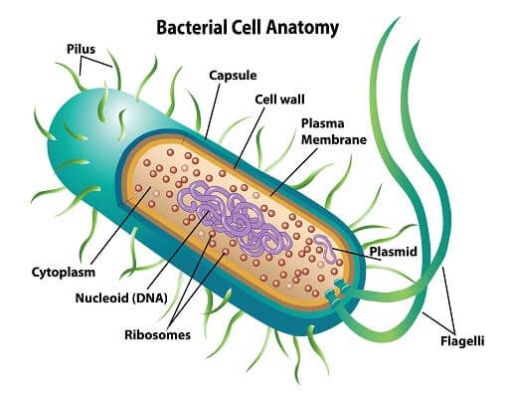
Nucleoid: the irregularly-shaped region within a prokaryote cell where the genetic material is localized
Plasmid: a circle of double-stranded DNA that is separate from the chromosomes, which is found in bacteria and protozoa
Osmotic pressure: the hydrostatic pressure exerted by a solution across a semipermeable membrane from a pure solvent
The cytoplasm of prokaryotic cells has a high concentration of dissolved solutes. Therefore, the osmotic pressure within the cell is relatively high.
The cell wall is a protective layer that surrounds some cells and gives them shape and rigidity. It is located outside the cell membrane and prevents osmotic lysis (bursting due to increasing volume).
The chemical composition of the cell walls varies between archaea and bacteria. It also varies between bacterial species.
Features of a prokaryotic cell (bacteria)

Slide 6
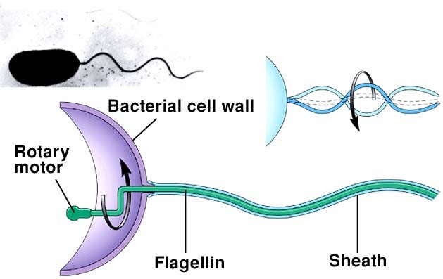
Bacteria often have flagella with a single protein core (flagellin) that they can use to move in a rotary corkscrew like fashion
The rotary motor of prokaryotic flagella is powered by proton flow through the cell membrane.
Rotating structures are rare in nature

Slide 7
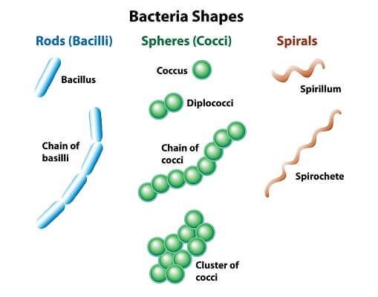
Different shapes of a prokaryotic cell

Slide 8
Prokaryotic cells lack a defined nucleus, but have a region in the cell, termed the nucleoid, in which a single chromosomal, circular, double-stranded DNA molecule.
Prokaryotes can be further classified based on the composition of the cell wall in terms of the amount of peptidoglycan present.
Gram-positive organisms typically lack the outer membrane found in gram-negative organisms and contain a large amount of peptidoglycan in the cell wall, roughly 90%. They are stained purple colour under the microscope with crystal violet dye.
Gram-negative bacteria have a relatively thin cell wall composed of a few layers of peptidoglycan (10 % of cell envelope) lipid content is high, so do not retain the purple stain and are counter-stained pink by safranin.
Archaeal membranes have replaced the fatty acids of bacterial membranes with isoprene; some archaeal membranes are monolayer rather than bilayer.

Slide 9
Bacterial Cells
Bacteria are single-celled microorganisms that are found nearly everywhere on Earth, and they are very diverse in their shapes and structures. There are about 5×10³⁰ bacteria living in many different ecosystems on Earth (including in our own bodies).
In the human gut, bacteria outnumber human cells 10:1.
The cell walls of some bacteria contain peptidoglycan, a molecule made of sugars and amino acids that gives the cell wall its structure and is thicker in some bacteria than others.
Bacteria contain certain structures unique to capsule, flagella, and pili. Most bacteria have just one chromosome that is circular, which can range from about 160,000 base pairs (bp) to 12,200,000 bp.
They also contain plasmids, which are small circular pieces of DNA that replicate independently of the chromosome.

Slide 10
The first is a cell membrane. This is a layer of phospholipid molecules that separate the inside of the cell from the outside. While not present in all prokaryotes, many secrete a cell wall used to protect and house the cell in an extra layer of proteins and structural molecules
The second part found in all prokaryotic cells is DNA. DNA is the basic blueprint for all life and is found within all cells. In prokaryotes, the DNA often takes the form of a large circular genome. This can be compared to the organized chromosomes which are typically found within eukaryotes. This large circle of DNA directs which proteins the cell creates, and regulates the actions of the cell.
DNA and RNA as their genetic material, ribosomes that make proteins, and cytosol that contains a cytoskeleton that organizes cellular materials.
However, prokaryotic organisms are a very diverse group of organisms and come in many different shapes and sizes. These changes in structure typically represent changes in function, and these many different organisms occupy very different niches.

Slide 11
Bacteria can form endospores, which are tough, dormant structures to overcome tough environmental condition such as starvation enough nutrients, extreme temperatures, UV rays, and chemicals. When environmental conditions become favorable again, the endospore can reactivate.
Archaeal Cells
Archaea are similar in size and shape to bacteria, and they are also unicellular. Since bacteria and archaea are the two types of prokaryotes, this means that all prokaryotes are unicellular. Some archaea are found in extreme environments, such as hot springs, but they can be found in a variety of locations, such as soils, oceans, marshlands, and inside other organisms, including humans.

Slide 12
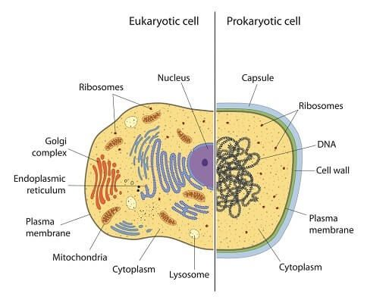

Slide 13
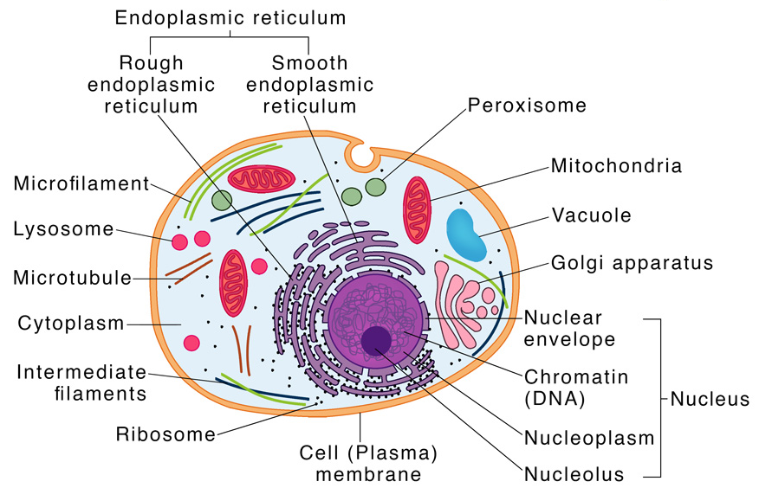
Eukaryotic cell
Eukaryotic cells are located in plants, animals including humans, fungi, and protozoa.
They are together classified under the kingdom Eukaryota.

Slide 14
The basic characteristic features of a eukaryotic cell are:
They contain membrane-bound organelles and a well-defined nucleus. A complex nuclear membrane surrounds the nucleus
Their cell wall consists of cellulose and some other carbohydrates
The genetic material is DNA, which is linear and has multiple origins of replication. The DNA is complexed with histone proteins

Slide 15
They contain cytoskeletal structural elements (microtubules, microfilaments, and intermediate filaments) that provide structural support to the cell
Cilia and flagella are the locomotory organs
Reproduce either asexually by mitosis or fission or sexually, involving two partners

Slide 16
Components
The four main components that make up a eukaryotic cell are:
Cell (Plasma) Membrane
True Nucleus
Membrane-bound organelles like mitochondria, chloroplast (in case of plant), endoplasmic reticulum, and Golgi apparatus
Rod-shaped chromosomes

Slide 17
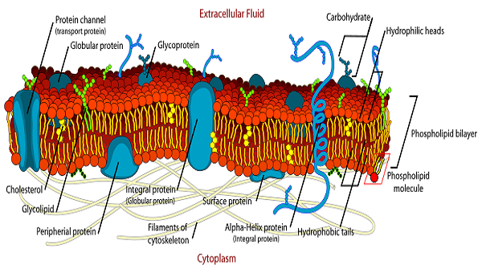
Plasma membrane
S.J. Singer and Garth L. Nicolson proposed the fluid mosaic model , which is widely used.
The fluid mosaic model of the plasma membrane structure describes the plasma membrane as a fluid combination of phospholipids, cholesterol, proteins, and carbohydrates.

Slide 18
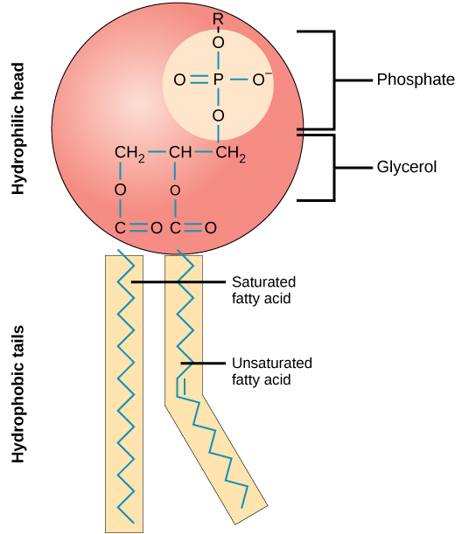
The fluid mosaic model was proposed by S.J. Singer and Garth L. Nicolson.
This model explains the structure of the plasma membrane of animal cells as a mosaic of components such as phospholipids, proteins, cholesterol, and carbohydrates. These components give a fluid character to the membranes
The fundamental building blocks of all cell membranes are phospholipids.
Amphipathic molecules, two hydrophobic fatty acid chains linked to a phosphate-containing hydrophilic head group
phospholipid bilayers form a stable barrier between two aqueous compartments and represent the basic structure of all biological membranes.

Slide 19
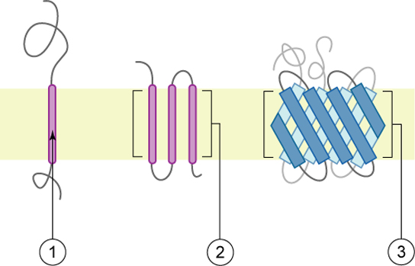
Proteins make up the second major component of plasma membranes. Integral proteins (some specialized types are called integrins) are, as their name suggests, integrated completely into the membrane structure, and their hydrophobic membrane-spanning regions interact with the hydrophobic region of the the phospholipid bilayer.
Structure of integral membrane proteins: Integral membrane proteins may have one or more alpha-helices that span the membrane (examples 1 and 2), or they may have beta-sheets that span the membrane (example 3).

Slide 20
The main fabric of the membrane is composed of amphiphilic or dual-loving, phospholipid molecules.
Integral proteins, the second major component of plasma membranes, are integrated completely into the membrane structure with their hydrophobic membrane-spanning regions interacting with the hydrophobic region of the phospholipid bilayer.
Carbohydrates, the third major component of plasma membranes, are always found on the exterior surface of cells where they are bound either to proteins (forming glycoproteins ) or to lipids (forming glycolipids).

Slide 21
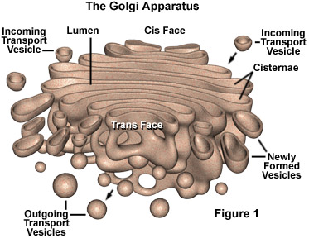
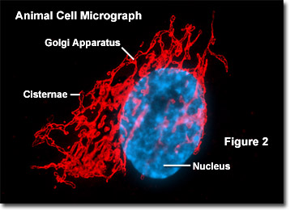
The Golgi apparatus, also called Golgi body or Golgi complex and found universally in both plant and animal cells,
It is comprised of a series of five to eight cup-shaped, membrane-covered sacs called cisternae.
Similarly, the number of Golgi bodies in a cell varies according to its function.
Each Golgi stack has two distinct ends, or faces.
The cis face of a Golgi stack is the end of the organelle where substances enter from the endoplasmic reticulum (ER) for processing,
while the trans face is where they exit in the form of smaller detached vesicles.
The cis face is found near the endoplasmic reticulum, where it receives comes most of the material.
Trans face is positioned near the plasma membrane of the cell, where substance can be modified are shipped

Slide 22
What Does the Golgi Apparatus Do?
The Golgi apparatus functions as a molecular assembly line in which membrane proteins undergo extensive post-translational modification.
Many Golgi reactions involve the addition of sugar residues to membrane proteins and secreted proteins.
The carbohydrates that the Golgi attaches to membrane proteins are often quite complex, and their synthesis requires multiple steps
Vesicles that bud off from the ER fuse with the closest Golgi membranes, called the cis-Golgi. Molecules then travel through the Golgi apparatus via vesicle transport until they reach the end of the assembly line at the farthest sacs from the ER — called the trans-Golgi.
At each workstation along the assembly line, Golgi enzymes catalyze distinct reactions.
Later, as vesicles of membrane lipids and proteins bud off from the trans-Golgi, they are directed to their appropriate destinations — either lysosomes, storage vesicles, or the plasma membrane

Slide 23
Proteins, carbohydrates, phospholipids, and other molecules formed in the ER are transported to the Golgi apparatus, biochemically modified during their transition from the cis to the trans poles of the complex.
The Golgi apparatus manufactures a variety of macromolecules on its own, i.e polysaccharides.
In plant cells:The Golgi complex produces pectins and other polysaccharides for plant structure and metabolism.
Golgi apparatus is to sort the wide variety of macromolecules produced by the cell and target them for distribution to their proper location. Specialized molecular identification labels or tags, such as phosphate groups, are added by the Golgi enzymes to aid in this sorting effort.

Slide 24
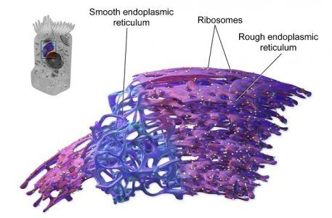
Endoplasmic reticulum
The endoplasmic reticulum membrane system can be morphologically divided into two structures–cisternae and sheets.
Cisternae are tubular in structure and form a three-dimensional polygonal network.
They are about 50 nm in diameter in mammals and 30 nm in diameter in yeast.
ER sheets, on the other hand, are membrane-enclosed, two-dimensional flattened sacs that extend across the cytoplasm. They are frequently associated with ribosomes and special proteins called translocons that are necessary for protein translation within the RER.
The high-curvature of ER tubules is stabilized by the presence of proteins called reticulons and DP1/Yop1p
The SER is involved in lipid metabolism and acts as the calcium store for the cell. This is particularly important in muscle cells that need Ca²⁺ ions for contraction. The SER is also involved in the synthesis of phospholipids and cholesterol. It is often located near the periphery of the cell
Reticulons are membrane-associated proteins encoded by four genes in mammals (RTN1-4).

Slide 25
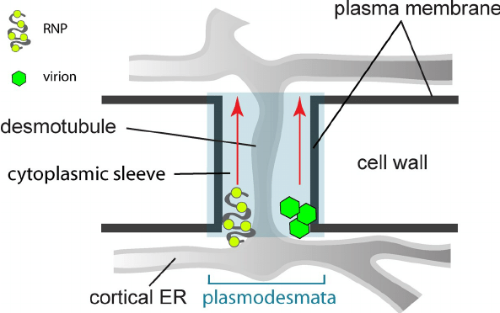
ER is budded off from the Nuclear membrane
Structure of ER:
ER has three dimensional structure, which are networked intracellularly
It has cisternae, Tubules, Vesicles
Cisternae are flattened , unbranched sac like element.
The scas are positioned parallel to each other
The presence of ribosome make is rough
They contains glycoproteins (ribophorin-I and ribophorin-II
ER may pass from one cell to other through plasmodesmata in the form of desmotubule

Slide 26
Smooth Endoplasmic Reticulum Function:
Smooth ER is responsible for the synthesis of essential lipids such as phospholipids and cholesterol.
Smooth ER is also responsible for the production and secretion of steroid hormones.
It is also responsible for the metabolism of carbohydrates.
The smooth ER store and releases calcium ions. These are quite important for the nervous system and muscular systems.
Rough Endoplasmic Reticulum Function:
The majority of the functions of rough ER is associated with protein synthesis.
The rough endoplasmic reticulum also plays a vital role in protein folding.
Also ensures quality control (regarding correct protein folding).
The second most important function after protein synthesis and protein folding is protein sorting.

Slide 27
Rough ER functions Facilitate protein folding
Only properly folded proteins are transported from the RER to the Golgi complex
Transport of proteins, i.e. secretory proteins
Insertion of ER proteins, i.e. integral proteins
Glycosylation
Disulfide bond formation and rearrangement

Slide 28
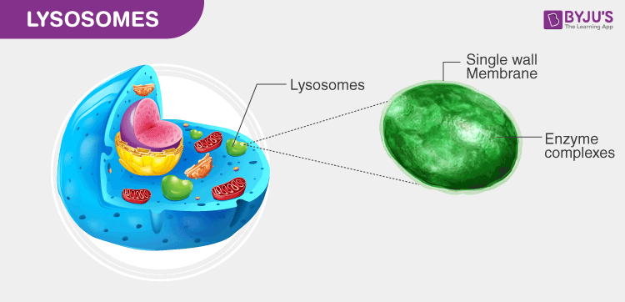
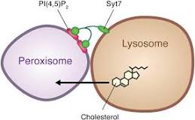
Lysosomes
Lysosome single-membrane compartments found inside the cell. Lysosomes are found only in animals while peroxisomes are found in all eukaryotes. Lysosomes are large in size but peroxisomes are comparatively small. Both lysosomes and peroxisomes are enzyme compartments.
Lysosomes are sphere-shaped sacs filled with hydrolytic enzymes that have the capability to break down many types of biomolecules.”
The sizes of lysosomes vary, with the largest ones measuring in more at than 1.2 μm. But they typically range from 0.1 μm to 0.6 μm
The pH level of the lumen lies between 4.5 and 5.0, which makes it quite acidic. It is almost comparable to the function of acids found in the stomach.
lysosomes are also involved in various other cell processes such as counting discharged materials, energy metabolism, cell signalling, and restoration of the plasma membrane.
They are called as suicidal bags of the cell.
The digestive enzymes, damages the lysosomes themselves, and this can cause the cell to die. This is termed as autolysis, where “auto” means “self” and “lysis” means “the disintegration of the cell by the destruction of its cell membrane“.

Slide 29
Function of lysosomes
The key function of lysosome is digestion and removal of waste. Cellular debris or foreign particles are pulled in to the cell through the process of endocytosis.
On the other hand, discarded wastes and other substances originating from within the cell is digested by the process of autophagocytosis or autophagy.
The process of autophagy involves disassembly or degradation of the cellular components through a natural, regulated mechanism.
Where Lysosomal Enzymes are made?
Lysosomes are comprised of over 50 different enzymescalled hydrolases that can digest proteins, nucleic acids, lipids, and complex sugars. They are synthesized in the rough endoplasmic reticulum.
Once synthesized, the enzymes are brought in from the Golgi apparatus in tiny vesicles or sacs, which then merges with bigger acidic vesicles.
The enzymes produced especially for lysosomes are mixed with the molecule mannose 6-phosphate making them get fixed appropriately up into acidified vesicles.

Slide 30
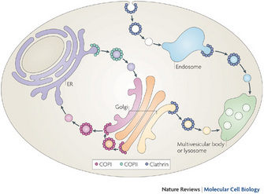
Pathways of vesicular transport by the specific vesicle-coating proteins
A protein called coat protein II (COPII; green) forms vesicles that transport from the endoplasmic reticulum (ER) to the Golgi. A different protein called coat protein I (COPI; red) forms vesicles for transport in the other direction, from the Golgi to the ER. COPI also forms vesicles for intra-Golgi transport. Clathrin (blue) forms multiple complexes based on its association with different adaptor proteins (APs). Clathrin that is associated with AP1 and AP3 forms vesicles for transport from the trans-Golgi network to the later endosomal compartments, and also for transport that emanates from the early endosomal compartments. Clathrin that is associated with AP2 forms vesicles from the plasma membrane that transport to the early endosomes
Hsu, V. W., Lee, S. Y., & Yang, J. S. The evolving understanding of COPI vesicle formation. Nature Reviews Molecular Cell Biology 10, 360-364 (2009).

Slide 31
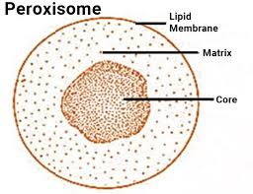
Peroxisome
Peroxisomes are small vesicles, single membrane-bound organelles found in the eukaryotic cells. They contain digestive enzymes for breaking down toxic materials in the cell and oxidative enzymes for metabolic activity.
Peroxisomes vary in shape, size and number depending upon the energy requirements of the cell. These are made of a phospholipid bilayer with many membrane-bound proteins.
The enzymes involved in lipid metabolism are synthesised on free ribosomes and selectively imported to peroxisomes. These enzymes include one of the two signalling sequences- Peroxisome Target Sequence 1 being the most common one.
The phospholipids of peroxisomes are usually synthesised in Smooth Endoplasmic Reticulum. Due to the ingress of proteins and lipids, the peroxisome grows in size and divides into two organelles.
Peroxisomes do not have their own DNA. Proteins are transported from the cytosol after translation.

Slide 32
Peroxisome Function
The main function of peroxisome is the lipid metabolism and the processing of reactive oxygen species.
Other peroxisome functions include:
They take part in various oxidative processes.
They take part in lipid metabolism and catabolism of D-amino acids, polyamines and bile acids.
The reactive oxygen species such as peroxides produced in the process is converted to water by various enzymes like peroxidase and catalase.
In plants, peroxisomes facilitate photosynthesis and seed germination. They prevent loss of energy during photosynthesis carbon fixation.

Slide 33
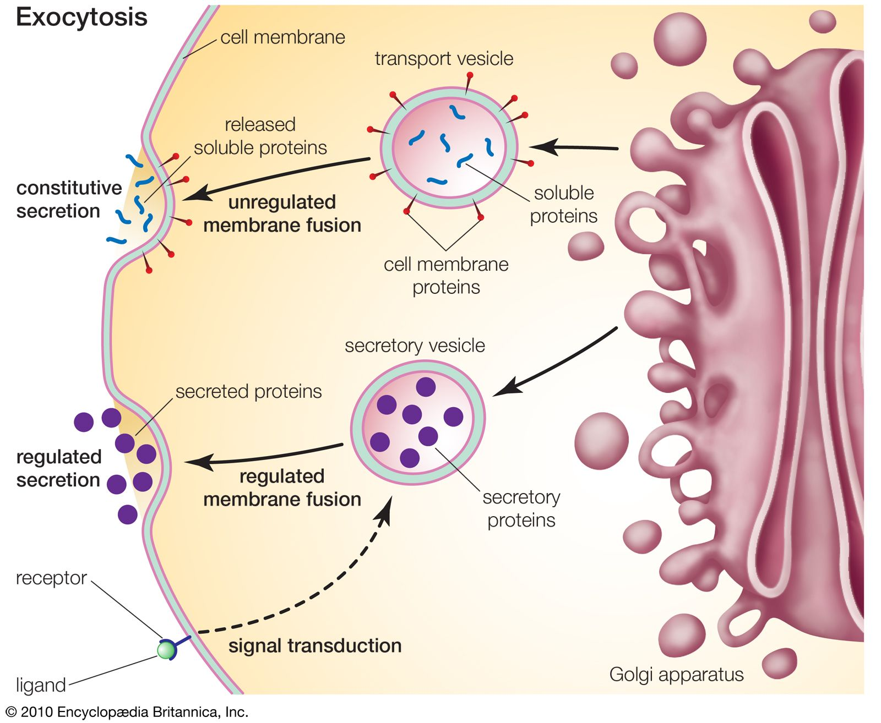

Slide 34
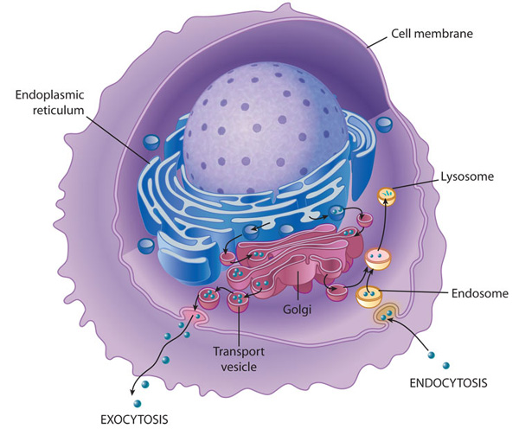
Membrane transport into and out of the cell
Transport of molecules within a cell and out of the cell requires a complex endomembrane system. Endocytosis occurs when the cell membrane engulfs particles (dark blue) outside the cell, draws the contents in, and forms an intracellular vesicle called an endosome. This vesicle travels through the cell, and its contents are digested as it merges with vesicles containing enzymes from the Golgi.
The vesicle is then known as a lysosome when its contents have been digested by the cell. Exocystosis is the process of membrane transport that releases cellular contents outside of the cell. Here, a transport vesicle from the Golgi or elsewhere in the cell merges its membrane with the plasma membrane and releases its contents. In this way, membranes are continually recycled and reused for different purposes throughout the cell. Membrane transport also occurs between the endoplasmic reticulum and the Golgi.
2010, Nature Education

Slide 35
How Are Organelle Membranes Maintained?
The ER, Golgi apparatus, and lysosomes are all members of a network of membranes, but they are not continuous with one another.
Therefore, the membrane lipids and proteins that are synthesized in the ER are transported through the network to their final destination in membrane-bound vesicles.
Cargo-bearing vesicles pinch off of from one set of membranes and travel along microtubule tracks to the next set of membranes, where they fuse with these structures.
Trafficking occurs in both directions; the forward direction takes vesicles from the site of synthesis to the Golgi apparatus and next to a cell's lysosomes or plasma membrane.
Vesicles that have released their cargo return via the reverse direction.
The proteins that are synthesized in the ER have, as part of their amino acid sequence, a signal that directs them where to go, much like an address directs a letter to its destination.

Slide 36
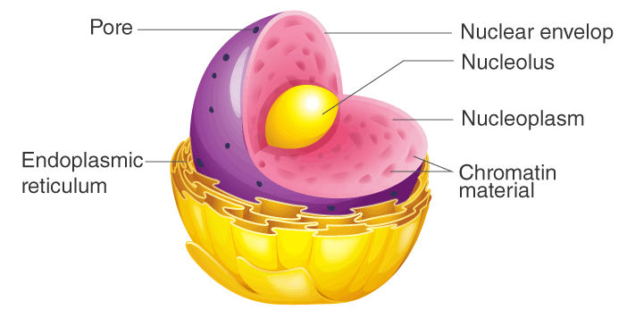
Nucleus
Structure Of Nucleus
Typically, it is the most evident organelle in the cell.
The nucleus is completely bound by membranes.
It is engirdled by a structure referred to as the nuclear envelope.
The membrane distinguishes the cytoplasm from the contents of the nucleus
The cell’s chromosomes are also confined within it.
DNA is present in the Chromosomes, and they provide the genetic information required for the creation of different cell components in addition to the reproduction of life.

Slide 37
Nucleus Function
It contains the cell’s hereditary information and controls the cell’s growth and reproduction.
The nucleus has been clearly explained as a membrane-bound structure that comprises the genetic material of a cell.
It is not just a storage compartment for DNA, but also happens to be the home of some important cellular processes.
First and foremost, it is possible to duplicate one’s DNA in the nucleus. This process has been named DNA Replication and produces an identical copy of the DNA.
Producing two identical copies of the body or host is the first step in cell division, where every new cell will get its own set of instructions.
Secondly, the nucleus is the site of transcription. Transcription creates different types of RNA from DNA. Transcription would be a lot like creating copies of individual pages of the human body’s instructions which may be moved out and read by the rest of the cell.
The central rule of biology states that DNA is copied into RNA, and then proteins.

Slide 38
Highlight the functions of the nucleus.
The nucleus has 2 primary functions:
It is responsible for storing the cell’s hereditary material or the DNA.
It is responsible for coordinating many of the important cellular activities such as protein synthesis, cell division, growth and a host of other important functions.

Slide 39
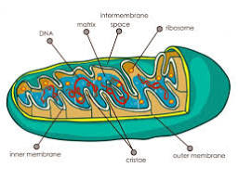
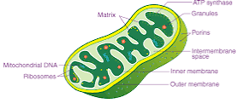
Mitochondria are membrane-bound cell organelles (mitochondrion, singular) that generate most of the chemical energy needed to power the cell's biochemical reactions. Chemical energy produced by the mitochondria is stored in a small molecule called adenosine triphosphate (ATP)

Slide 40
Structure of Mitochondria
The mitochondrion is a double-membraned, rod-shaped structure found in both plant and animal cell.
Its size ranges from 0.5 to 1.0 micrometre in diameter.
The structure comprises an outer membrane, an inner membrane, and a gel-like material called the matrix.
The outer membrane and the inner membrane are made of proteins and phospholipid layers separated by the intermembrane space.
The outer membrane covers the surface of the mitochondrion and has a large number of special proteins known as porins.
Cristae
The inner membrane of mitochondria is rather complex in structure. It has many folds that form a layered structure called cristae, and this helps in increasing the surface area inside the organelle. The cristae and the proteins of the inner membrane aid in the production of ATP molecules. The inner membrane is strictly permeable only to oxygen and ATP molecules. A number of chemical reactions take place within the inner membrane of mitochondria.
Mitochondrial Matrix
The mitochondrial matrix is a viscous fluid that contains a mixture of enzymes and proteins. It also comprises ribosomes, inorganic ions, mitochondrial DNA, nucleotide cofactors, and organic molecules. The enzymes present in the matrix play an important role in the synthesis of ATP molecules.

Slide 41
Functions of Mitochondria
The most important function of mitochondria is to produce energy through the process of oxidative phosphorylation. It is also involved in the following process:
Regulates the metabolic activity of the cell
Promotes the growth of new cells and cell multiplication
Helps in detoxifying ammonia in the liver cells
Plays an important role in apoptosis or programmed cell death
Responsible for building certain parts of the blood and various hormones like testosterone and oestrogen
Helps in maintaining an adequate concentration of calcium ions within the compartments of the cell
It is also involved in various cellular activities like cellular differentiation, cell signalling, cell senescence, controlling the cell cycle and also in cell growth.

