Slide 1
JavaScript

Slide 2
Content
Introduction​
JS Variables
JS Data Types
JS Operators
JS Functions
​Summary​

Slide 3
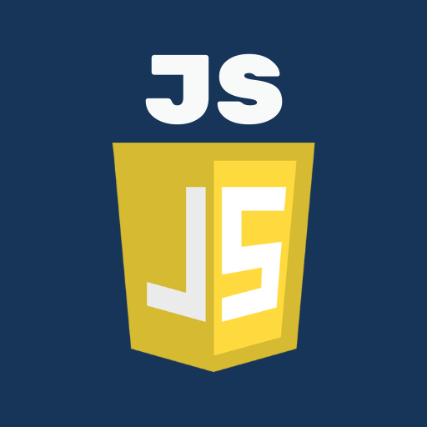
Introduction
JavaScript is a high-level, interpreted programming language that is primarily used for enhancing the interaction of websites with its users. It was created in 1995 by Brendan Eich and was initially designed to be a lightweight language for adding interactivity to web pages. Since then, it has evolved into a versatile and powerful language used not only in web development but also for creating desktop and mobile applications.
One of the key features of JavaScript is its ability to manipulate and modify content within web pages, enabling developers to create dynamic and interactive elements. It is commonly used to add functionality to web forms, create animations, validate data, and perform various tasks on the client-side.

Slide 4
JS Variables
JavaScript
JavaScript variables are containers that are used to store values. They can hold various types of data such as numbers, strings, arrays, objects, and more. Variables in JavaScript are declared using the "var", "let", or "const" keyword followed by a name. Here's an example:
```JavaScript
var x = 5; // Declaring a variable named x and initializing it with the value 5
let y = "Hello"; // Declaring a variable named y and initializing it with the string "Hello"
const z = [1, 2, 3]; // Declaring a constant variable named z and initializing it with an array [1, 2, 3]
```
Variables can then be used to perform operations, manipulate data, or store values for later use within the JavaScript program.

Slide 5
JS Data types
JavaScript has several built-in data types, including:
Number: Represents numeric values. It includes `integers`, `floats`, and `NaN` (Not-a-Number).
String: Represents a sequence of characters. Strings are enclosed in single or double quotes.
Boolean: Represents two values - `true` or `false`, indicating logical true or false values.
Undefined: Represents a variable that has been declared but has not been assigned a value.

Slide 6
Continue
JavaScript
Null: Represents the intentional absence of any object value.
Object: Represents a collection of related data and functionality. Objects can have properties and methods.
Array: Represents an ordered list of values. Arrays are enclosed in square brackets `[ ]` and can contain elements of any data type.
Symbol: Represents a unique identifier. Symbols are often used as keys for object properties to prevent naming conflicts.
These are the basic data types in JavaScript, but there are also specialized data types such as functions and dates.

Slide 7
Js operators
JavaScript operators are symbols used to perform operations on values or variables. Some common JavaScript operators include:
Arithmetic Operators: Used to perform mathematical calculations.
- Addition (+)
- Subtraction (-)
- Multiplication (*)
- Division (/)
- Modulus (%)
- Increment (++)
- Decrement (--)
Assignment Operators: Used for assigning values to variables.
- Assignment (=)
- Addition assignment (+=)
- Subtraction assignment (-=)
- Multiplication assignment (*=)
- Division assignment (/=)
- Modulus assignment (%=)

Slide 8
Continue
JavaScript
Comparison Operators: Used to compare values and return a boolean result.
- Equal to (==)
- Not equal to (!=)
- Equal value and equal type (===)
- Not equal value or not equal type (!==)
- Greater than (>)
- Less than (<)
- Greater than or equal to (>=)
- Less than or equal to (<=)
Logical Operators: Used to combine or modify logical conditions.
- Logical AND (&&)
- Logical OR (||)
- Logical NOT (!)

Slide 9
Continue
String Operators:
- Concatenation (+)
Conditional (Ternary) Operator:
- Ternary operator (condition ? expression1 : expression2)
Type Operators:
- typeof operator (typeof)
- instanceof operator (instanceof)
These are some commonly used JavaScript operators, but there are many more operators available in JavaScript.

Slide 10
JS Functions
JavaScript
Functions in JavaScript are blocks of reusable code that can perform a specific task or set of tasks. They provide a way to organize and reuse code, making it easier to maintain and understand.
In JavaScript, functions are defined using the `function` keyword followed by a name (optional) and a pair of parentheses. Inside the parentheses, you can specify parameters which act like variables that the function can use. The function body, enclosed within curly braces `{}`, contains the code that will be executed when the function is called.
Here is the basic syntax for defining a function:
```javascript
function functionName(parameter1, parameter2) {
// function code here
}
```

Slide 11
SUMMARY
JavaScript is a high-level programming language that is primarily used for building interactive and dynamic web pages. It is often referred to as the "language of the web" as it is supported by all modern web browsers.
JavaScript allows developers to add behavior and interactivity to web pages by manipulating the Document Object Model (DOM), which represents the structure of the HTML elements on a webpage. It can be used for tasks like validating user input, creating animations, and interacting with server-side databases.

Slide 12
THANK YOU

