Slide 1
Web Development

Slide 2
Content
Introduction
Internet
Internet Protocols
HTTP (Hypertext Transfer Protocol)
World Wide Web (WWW)
Search Engine
Client Server Architecture
Websites and Webservices
Summary

Slide 3
Introduction
Web development is the process of building and maintaining websites and web applications. It involves a combination of programming languages, frameworks, and tools to create the structure, design, and functionality of a website.
There are two main components of web development:
Front-end development
Back-end development

Slide 4
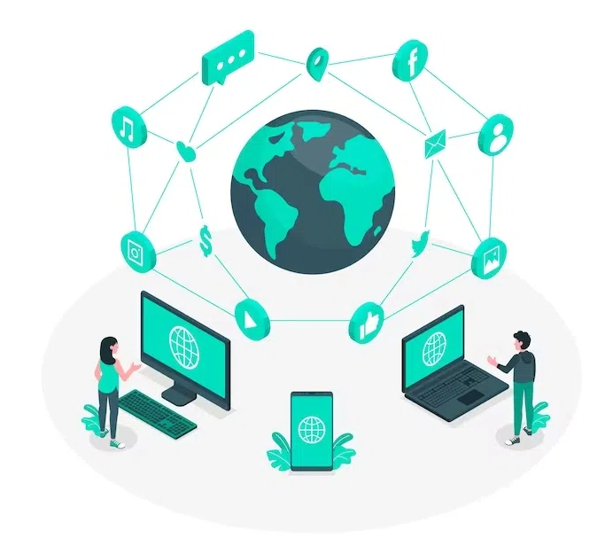
Internet
The internet is a global network of interconnected computer networks, allowing individuals and organizations to share and access information and services across the world. It is a vast network infrastructure that provides various means of communication, such as email, instant messaging, video conferencing, and social media. The internet enables users to browse and access websites, search for and retrieve information, and exchange data through various protocols like HTTP, FTP, and TCP/IP. It also supports online transactions, e-commerce, online gaming, and cloud computing, among many other functionalities. In short, the internet is a powerful and ubiquitous tool that has revolutionized communication, information sharing, and access to resources on a global scale.

Slide 5
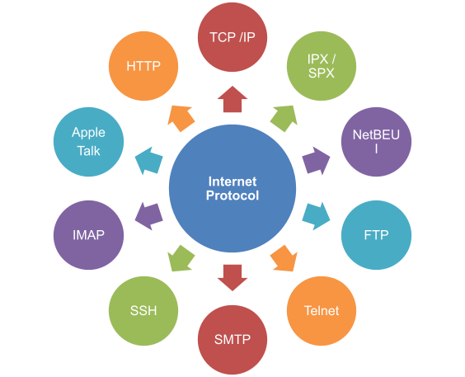
Internet Protocols
Internet protocols are a set of rules and standards that specify how devices in a computer network should communicate and exchange data over the internet. These protocols define the format, structure, and sequencing of messages, as well as the methods of data transmission and error detection.

Slide 6
HTTP (Hypertext Transfer Protocol)
HTTP stands for Hypertext Transfer Protocol. It is an application protocol primarily used for transmitting hypermedia documents, such as HTML files, over the internet. It is the foundation of data communication for the World Wide Web.
HTTP allows communication between a web server and a client, typically a web browser. When a user types a website's URL into their browser, a request is sent to the server using HTTP. The server then responds to the request, usually by sending back the requested web page or resource.

Slide 7
World Wide Web (WWW)
The World Wide Web (WWW), or simply the web, refers to a system of interconnected documents and resources that are accessible over the internet. It is a global information medium which enables users to access and share various types of data, including text, images, videos, and other multimedia content.

Slide 8
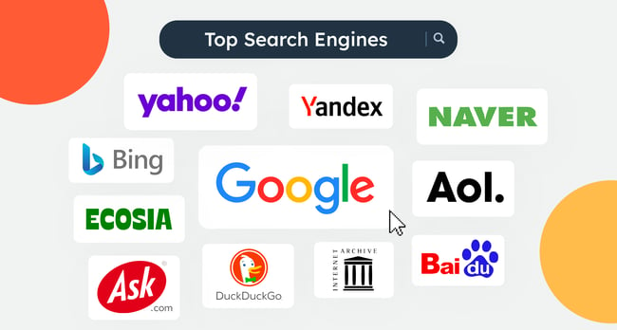
Search Engine
A search engine is an online tool or program designed to help users find specific information or websites on the internet. It works by scanning and indexing web pages and other online content, and then retrieving and displaying relevant results based on user queries or keywords.
When a user enters a search term or query into a search engine, the engine rapidly searches through its vast database of indexed web pages, looking for content that matches the specified keywords.

Slide 9
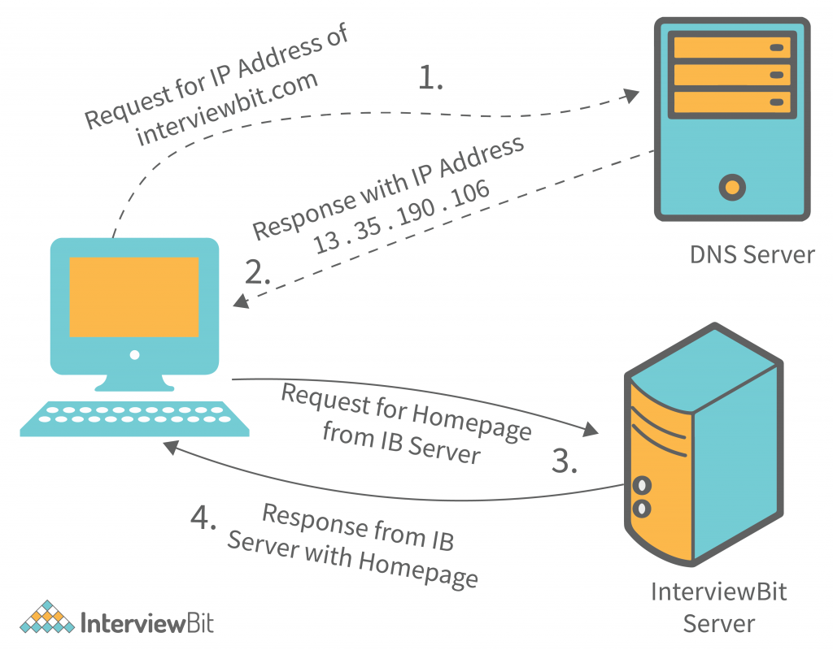
Client Server Architecture
Client-server architecture is a common model in computing that allows multiple individual computers, known as clients, to access and use resources or services from a central server. It is based on the idea of dividing the work between the client and the server, where the client initiates requests for resources or services, and the server provides responses by processing and executing those requests.

Slide 10
Websites and Webservices
A website is a collection of web pages that are interconnected and accessible through a web browser. It is usually hosted on a web server and can be accessed by typing a specific URL (Uniform Resource Locator) in the address bar of a web browser. Websites can contain various types of content, such as text, images, videos, and interactive elements. They are used for various purposes, including personal blogs, e-commerce platforms, news portals, and corporate websites.
On the other hand, web services are software systems that provide functionality over the internet. They allow different software applications to communicate and interact with each other through a common set of protocols and standards. Web services usually operate based on the client-server model, where a client application sends a request to a server application, which then processes the request and sends back a response.

Slide 11
Summary
Web development generally refers to the process of creating websites or web applications. It involves many different aspects, such as designing the user interface, coding the functionality using programming languages like HTML, CSS, and JavaScript, and integrating with databases to store and retrieve information. The goal of web development is to create an engaging and interactive online experience for users. It also involves troubleshooting, testing, and maintaining the website or application to ensure its functionality and usability. Web development can range from simple static websites to complex dynamic platforms with advanced features and functionalities.

Slide 12
Thank you

