Slide 1
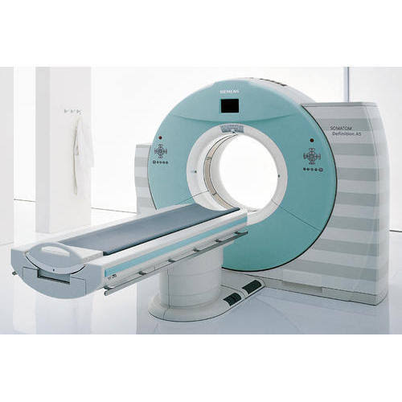
CT scan By S.S.Siva Sagar M.Sc RIT 200513001 SGT UNIVERSITY
CT scan Physics by S.S.Siva Sagar Assistant professor Department of Radiology Centurion University

Slide 2
Introduction
At the annual Congress of British institute of radiology , in April of 1972 , Godfrey Newbold Hounsfield, a senior research scientist At EMI limited (Electric and Musical Industries), middlesex, England , announced the revolutionary imaging technique called computerized axial Transverse Scanning. He considered as a Father of Ct scan.
Allan MacLeod Cormack developed the mathematics used to reconstruct the images in 1963.
Noble prize was given to the discovery in 1979, for both GN hounsfield (UK) and Alan coremack (USA).
Perhaps the first significant technical development came in 1974 when Dr. Robert Ledley, a professor of radiology, physiology, and biophysics at Georgetown University, developed the first whole-body CT scanner. (Hounsfield’s EMI scanner scanned only the head.)

Slide 3
In 1989, Dr. Willi Kalender has made significant contributions to the introduction and development of volume spiral CT scanning.

Slide 4
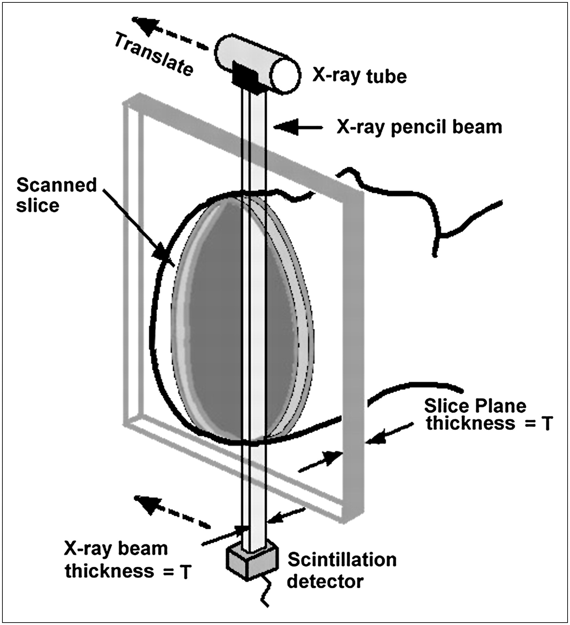
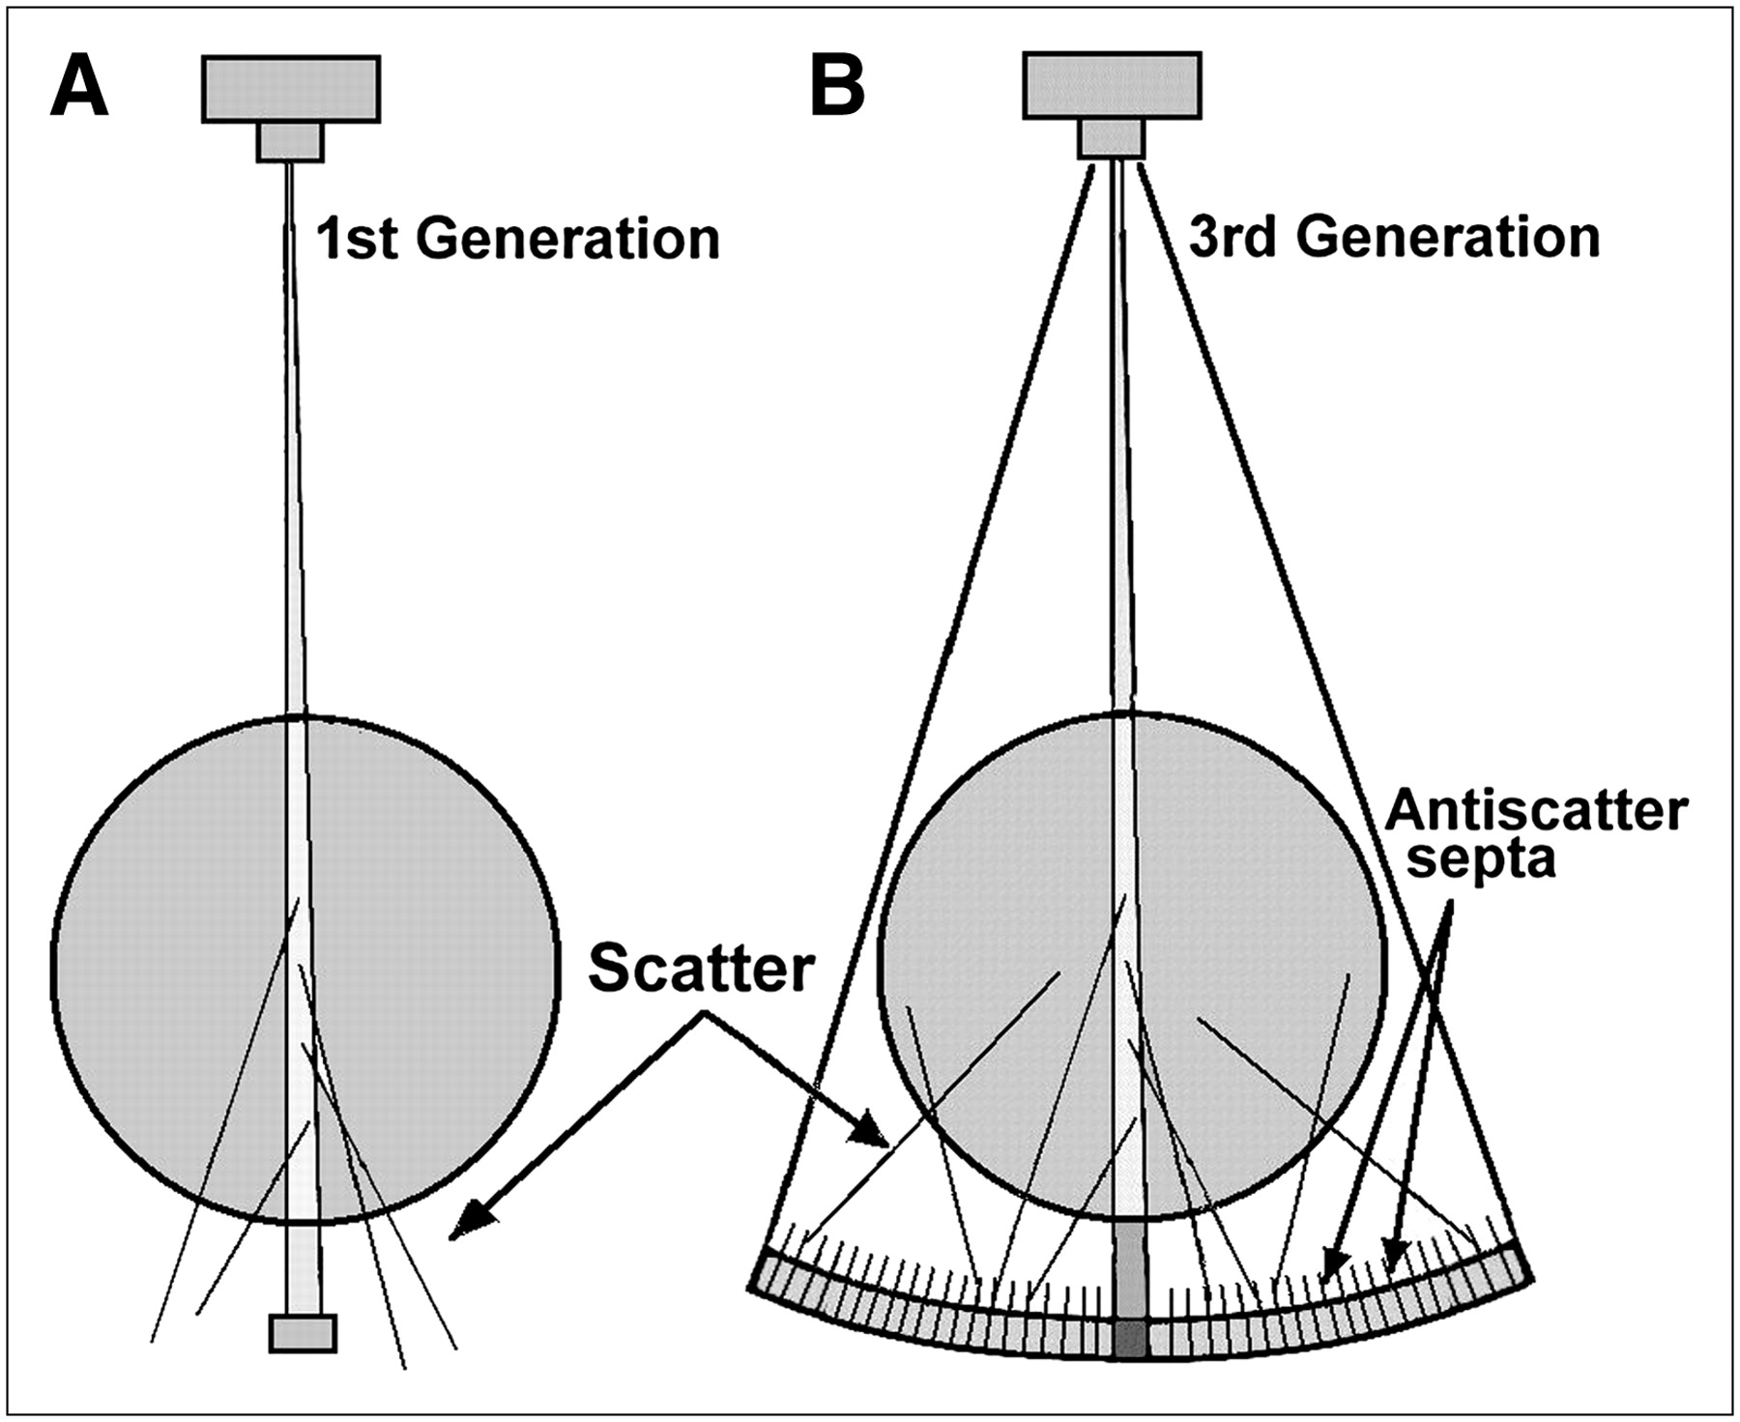
Terminology
Translation is the linear movement of X ray tube and detector.
Rotation is the rotatory movement of X ray tube and detector.
Ray refers single transmission measurement.
Projection refers series of X rays passes through the patient at the same orientation.

Slide 5
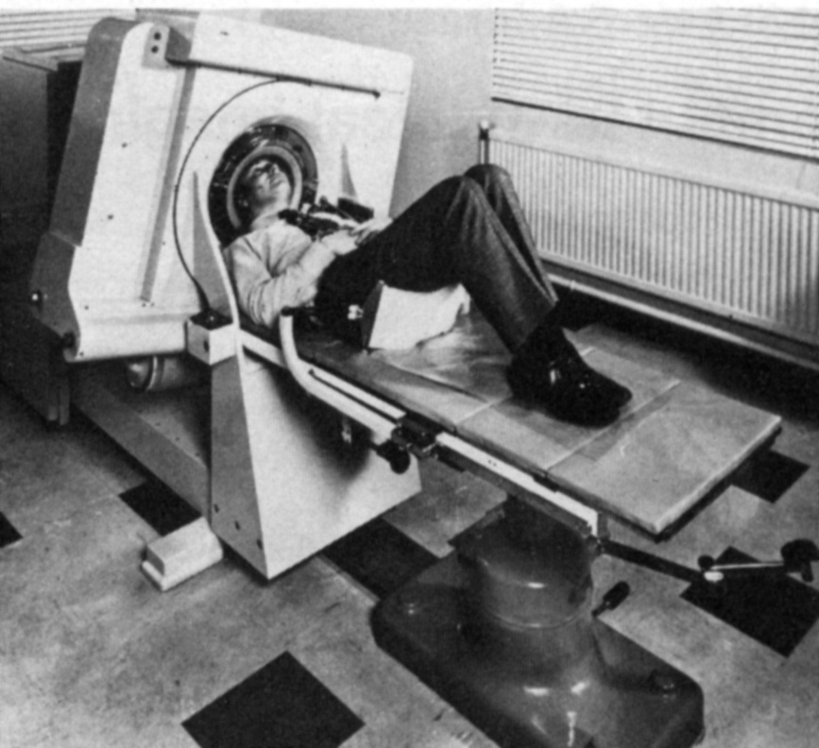
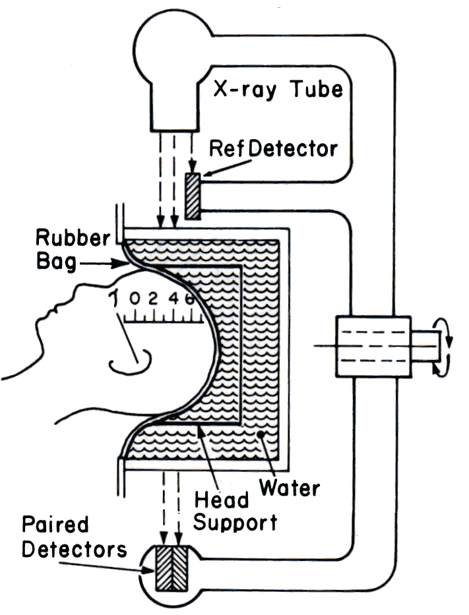

Slide 6
Pitch = table movement per axial scan(table feed) / slice thickness.
If pitch increases Radiation dose, Image quality and Scanning time decreases.
If increment increases No of images decreases and If increment decreases no of images increases.
CT number or hounsfield unit :

Slide 7
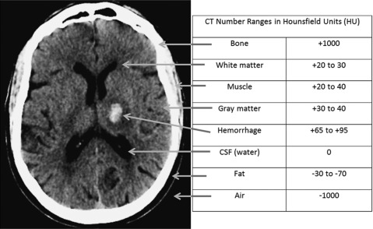
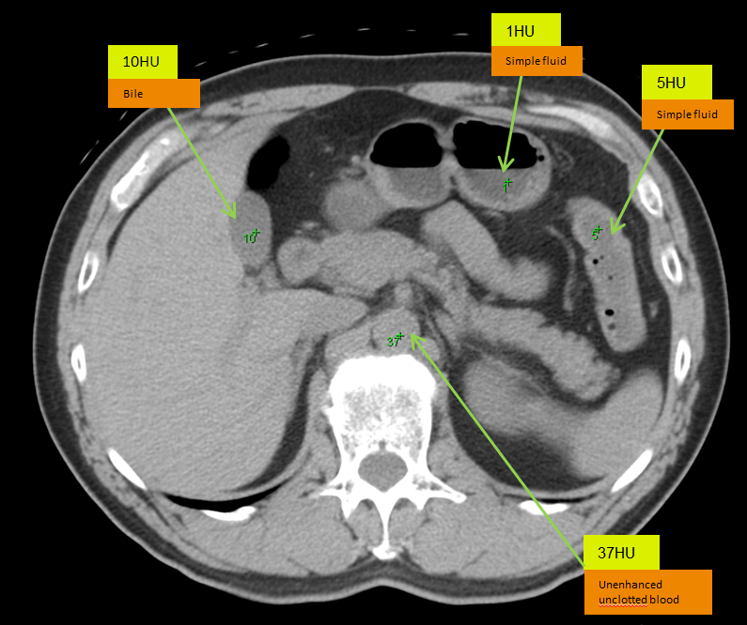
SUBSTANCE | HU
Air | -1000
Lung | -500
Fat | -100 to -50
Water | 0
CSF | 15
Kidney | 30
Blood | +30 to +45
Muscle | +10 to +40
Grey matter | +37 to +45
White matter | +20 to +30
Liver | +40 to +60
Soft tissue | +100 to +300
Bone | 1000

Slide 8
In CT, a high-kilovolt technique (about 120 kV) is generally used for the following reasons:
1. To reduce the dependence of attenuation coefficients on photon energy.
2. To reduce the contrast of bone relative to soft tissues.
3. To produce a high radiation flux at the detector.

Slide 9
Basic principle Of CT
The fundamental concept is the internal structure of an object can be reconstructed from multiple projections of the object.
Computerized tomography means A method Of producing three dimensional images Of internal body structure by two dimensional images (axial images)
The Ray projections are formed by scanning a thin cross section of the body with a narrow x ray beam and measuring the transmitted radiation with a sensitive radiation detector.
The detector does not form the image.
It adds up the energy of all the transmitted photons.
The numerical data ray sums are then computer processed to reconstruct an image.
Human body is imagined as a matrix and is divided into number of columns and rows.
In general, CT scanners used 512 x 512 and 1024 x 1024 columns and rows.
Each matrix element is named as picture element ( pixel) in a 2- dimensional concept.

Slide 10
Pixel size is 0.625 mm, Detector size – 0.625 mm and minimal slice thickness called pixel size.
Volume element (voxel) represents a volume of tissue in the patient and it is three dimensional concept.
Voxels are scanned in different directions.
Each pixel on the monitor display represents a voxel in the patient.
When the voxel dimensions of length, width, and height are equal, that is, describe a perfect cube, the imaging process is referred to as Isotropic imaging.
Finally, each pixel in the CT image can have a range of gray shades. The image can have 256 (2⁸), 512 (2⁹), 1024 (2 10), or 2048 (2 11) different grayscale values.
Because these numbers are represented as bits, a CT image can be characterized by the number of bits per pixel.
CT images can have 8, 9, 10, 11, or 12 bits per pixel.
The image therefore consists of a series of bit planes referred to the bit depth.

Slide 11
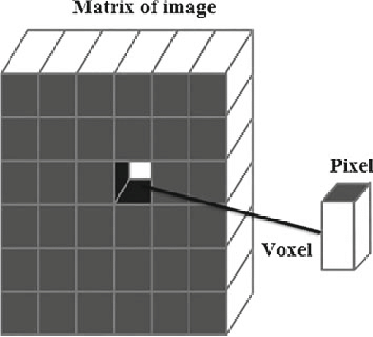

Slide 13
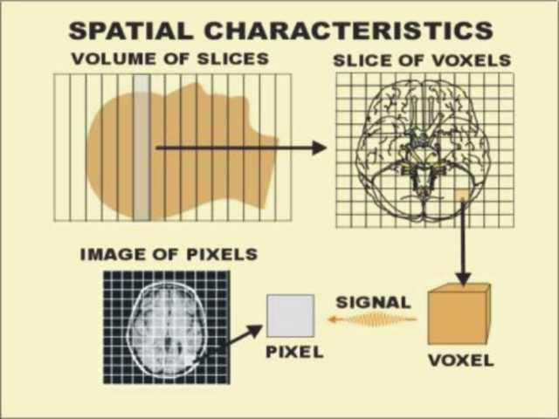

Slide 14
Windowing :
The CT image is composed of a range of CT numbers (e.g., +1000 to 1000, for a total of 2000 numbers) that represent varying shades of gray.
The range of CT numbers is referred to as the window width (WW), and it controls the contrast.
The center of the range is the window level (WL) or window center (C), and it controls image brightness.
Both the WW and WL are located on the control console. With a WW of 2000 and a WL of 0, the entire gray scale is displayed and the ability of the observer to perceive small differences in soft tissue attenuation will be lost because the human eye can perceive only about 40 shades of gray.
The WL or C increases the image goes from white (bright) to dark (less bright); and the image contrast changes for different values of WWs.
The image contrast is optimized for the anatomy under study, and therefore specified values of WW and WL or C must be used during the initial scanning of the patient.

Slide 16
Why Is a CT Scan Performed ?
A CT scan has many uses, but it’s particularly well-suited for diagnosing diseases and evaluating injuries.
The imaging technique can help your doctor:-
Diagnose infections, muscle disorders, and bone fractures
Pinpoint the location of masses and tumors (including cancer)
Study of the blood vessels and other internal structures.
Assess the extent of internal injuries and internal bleeding.
Guide procedures, such as surgeries and biopsies
Monitor the effectiveness of treatments for certain medical conditions, including cancer and heart disease. etc.

Slide 17
Advantages
It is minimal invasive procedure.
Relatively inexpensive compared with MRI , PET and SPECT scanning.
Rapid acquisition of data and no need for patients to remain for planning process.
Better resolution .
Minimum time taking procedure compared with MRI, PET etc.
To overcome superimposition of structures.
To improve contrast of the image.
To measure small differences in tissue contrast.

Slide 18
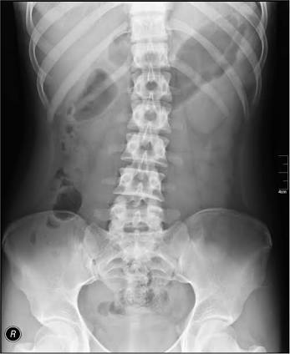
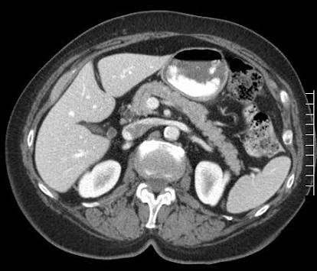
The special features of CT image includes
Images are crosssectional.
Eliminates the superimposition of structures.
Sensitivity of CT to subtle difference in x ray attenuation is at least factor 10 higher than x ray film.
Higher contrast due to elimination of scatter

Slide 19
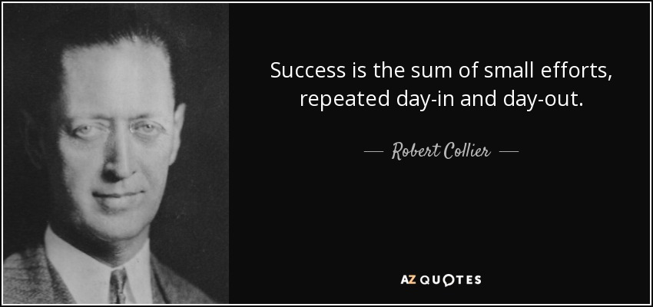

Slide 20
TUBE WARM UP PROCEDURE
The purpose of an X-ray tube’s warm-up procedure is to avoid damage to the X-ray tube and avoid any artifacts in the images acquired.
If a cold anode is exposed to high-powered energy, anode damage often occurs.
A general recommendation is proposed by all manufacturers for warming of the X-ray tubes by different series of low energy exposures to prevent such type of damage.
The X-ray tube’s heating procedure is performed by carefully increasing the tube current and voltage, leading to the slow burning of any oxygen molecules present before reaching a safe level for high-powered operation of the tube.
The tube is warmed up gradually in a controlled manner, so the tube can reach its operating temperature before scanning a patient.

Slide 21
The CT manufacturers have recommended in the respective CT manuals.
Never to perform scanner calibration, scanner testing, or tube heating when a patient or other personnel are present in the CT room.
The system operates most efficiently within certain parameters. These parameters are established by warming the tube using a preset group of exposures.
When you perform a tube warmup at least once every 24 hours and at any system prompt, it reduces the possibility of image artifacts, and may aid in prolonging the life of the tube.
When you start the scan, a series of air scans are performed as part of the tube warm up scans.

Slide 22
HOW CT SCANNERS WORK
To enhance understanding of the early experiments and current technology, the technologist must be familiar with the way a CT scanner works.
The technologist first turns on the scanner’s power and performs a quick test to ensure that the scanner is in good working order.
The patient is in place in the scanner opening, with appropriate positioning for the particular examination.
The technologist sets up the technical factors at the control console. Scanning can now begin.
When X rays pass through the patient, they are attenuated and subsequently measured by the detectors.
The x-ray tube and detectors are inside the gantry of the scanner and rotate around the patient during scanning.
The detectors convert the x-ray photons (attenuation data) into electrical signals, or analog signals, which in turn must be converted into digital (numerical) data for input into the computer.

Slide 23
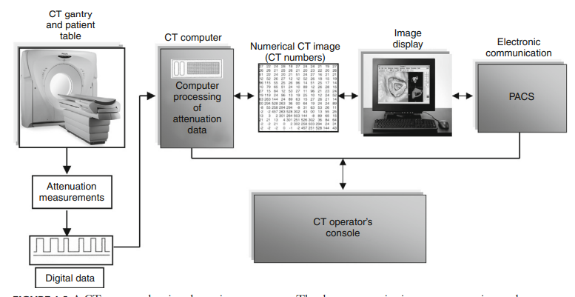
The computer then performs the image reconstruction process. The reconstructed image is in numerical form and must be converted into electrical signals for the technologist to view on a television monitor.
The images and related data are then sent to the PACS, where a radiologist will be able to retrieve and interpret them.
Finally, the image can be stored on magnetic tapes or optical disks

Slide 24
System components in ct
CT scan contains following components.
Control console.
Computer.
Couch .
Gantry.

Slide 25
Control console
There are 3 consoles in ct, one for the technologist to operate the imaging system, one for the technologist to post process images and the other for the physician to view images.
Ex : GE CT scan.
The operating console is provided with meters , controls for selection of technique factors , movement of Gantry and table couch, image reconstruction commands, selection of kvp and mAs and slice thickness.
The Radiologist in control console is used to see the images and write reports. In some institutions, work station provided for reporting of patient scans.

Slide 26
Computer
The computer is used to solve more than 2,50,000 equations with the help of microprocessor.
The computer system performs image manipulation and various image processing operations such as windowing, image enhancement, image enlargement and measurements, multiplanar reconstruction, three-dimensional (3D) imaging, an quantitative measurements.
The computer system generally includes input output devices, central processing units, array processors, interface devices, back-projector processors, storage devices, and communications hardware.
The computer system also includes software that allows each hardware component to perform specific tasks.
The software includes plot of CT numbers, mean and standard deviation of CT values, ROI subtraction techniques , reconstruction of images in coronal, saggital and oblique.

Slide 27
Couch
The couch supports the patient comfortably and it is made up of low Z material like carbon fiber material.
It has a motor for smooth patient Positioning.
It moves longitudinally through Gantry aperture , indexed automatically and the table top can be removable.
The vertical movement should provide a range of heights to make it easy for patients to mount and dismount the table This feature is especially useful in the examination of geriatric, trauma, and pediatric patients.
Horizontal or longitudinal couch movements should enable the patient to be scanned from head to thighs without repositioning.
Industry standard table weight limits for CT is usually 450 Ibs (205 kg). Newer larger CT scanners are currently available which can accommodate patients weighing up to 680 Ibs (308.4 kg).

Slide 28
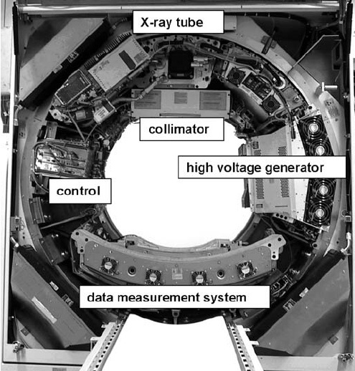
Gantry
The gantry is a mounted framework that surrounds the patient in a vertical plane. It contains a rotating scan frame onto which the x-ray generator, X ray tube, and other components are mounted.
The generator in the gantry is usually a small, solid-state, high-frequency generator mounted on the rotating scan frames.
The gantry houses imaging components such as the slip rings, x-ray tube, high-voltage generator, collimators, detectors, and the data acquisition system.
Because it is located close to the X-ray tube, only a short high-tension cable is required to couple the x-ray tube and generator.
This design eliminates external x-ray control cabinets and long high-tension cables as was typical of the older CT imaging systems.

Slide 29
Gantry cooling is a prime consideration because the ambient air temperature affects several components.
In the past, air conditioners were placed in the gantry. Modern cooling systems circulate ambient air from the scanner room throughout the gantry.
Most scanners have a 70-cm aperture that facilitates patient positioning and helps provide access to patients in emergency situations.
The gantry also includes a set of laser beams to aid patient positioning.
Other gantry characteristics include
Scan control panels - controls gantry tilt and patient table elevation
Scan control box - controls emergency stop, intercom, and scan enable and pause functions
Slice position indicator
Radiation indicator, and
Intercom systems with multilingual autovoice to facilitate communication with the patient in one of several languages.

Slide 30
CT Gantry has the following gadgets.
X-ray tube.
Collimators.
Filters .
Detectors.
High voltage generator.

Slide 31
X ray tube
Ideally , the radiation source for CT should supply a monochromatic x ray beam. With monochromatic x ray beam image reconstruction is simpler and more accurate.
Kvp : 80 to 140 kvp – Usually operated at 120kV
mA : 50 to 1000 mA.
Tubes are operated for prolonged exposure time at high mA.
There are two focal spot sizes . Hrct uses small focal spot size
High speed rotors in tubes for best heat dissipation.
The Multislice CT tube is large in size; anode disc is larger in diameter and thickness. The anode heat capacity 8 MHU and the anode cooling is about 1 to 2 MHU.

Slide 32
Collimators
Collimation in CT serves to ensure good image quality and to reduce unnecessary radiation doses for the patient.
Collimators are present
1. Between the X - ray source and the patient (tube or pre - patient collimators) .
2. Between the patient and the detectors (detector or post - patient collimators).
The tube collimator is used to shape the X - ray fan beam before it penetrates the patient.
it consists of a set of collimator blades made of highly absorbing materials such as tungsten or molybdenum.
The opening of these blades is adjusted according to the selected slice width and the size and position of the focal spot.

Slide 33
Filteration
The X - ray photons emitted by the X - ray tube exhibit a wide spectrum.
The soft, low - energy X - rays, which contribute strongly to the patient dose and scatter radiation but less to the detected signal should be removed.
To achieve this goal, most CT manufacturers use X - ray filters.
The Inherent filtration of the X-ray tube, typically 3 mm aluminum equivalent thickness, is the first filter.
In addition, flat shaped filters can be used. Flat filters, made of copper or aluminum, are placed between the X - ray source and the patient. They modify the X - ray spectrum uniformly across the entire field of view.

Slide 34
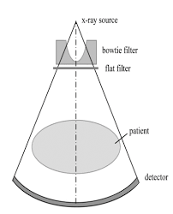
The cross - section of a patient is mostly oval - shaped, so Bowtie filters have an increased thickness from center to periphery, allowing them to attenuate radiation hardly at all in the center but strongly in the periphery.
They are made from a material with a low atomic number and high density, such as Teflon.

Slide 35
High voltage generator
It is mounted on the Gantry which takes 0.3 secs for 360 degrees rotation.
The generator is a high frequency generator with the capacity of 60 KW
It provides stable tube current and voltage is controlled by microprocessor.
The generator can give a tube current of about 800 mA and 125 KV with pulse duration of 2 to 4 Milliseconds.

Slide 36
Detectors
The requirements of CT scan detector are as follows –
Small in size with good resolution
High detection efficiency
Fast Response and Negligible after glow.
Wide dynamic range
Decrease the Noise.
There are two types of detectors used in ct scanners. These are
Scintillation detectors used in Multi Slice scanners
Xenon gas ionization Chambers used in Single Slice Scanners

Slide 37
Scintillation detectors
Scintillation crystals are extremely large number of materials that produce light as a result of some external influence.
When ionizing radiation reacts with scintillation crystals that produce light (scintillate).
The number of light photons proportional to the energy of incident x ray photon.
This is just what intensifying screen does.
Some of these light photons will be emitted promptly and produce the desired signal.

Slide 38
Some light photons will be delayed and produce produce afterglow.
This process done by photomultiplier tubes.
The first two generations used thallium - activated sodium iodide scintillation crystals attached to photomultiplier tubes.
Sodium iodide crystals have some disadvantages. They are
PM tubes are big and not easily fit into the large array of detectors .
NaI is hydroscopic and requires air tight container and it has a long afterglow.

Slide 39
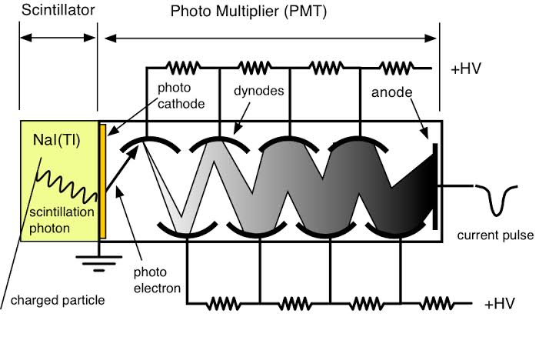

Slide 40
There are several possibilities for replacing nai.
These include cesium iodide , bismuth germinate and cadmium tungstate.
Photomultiplier tubes have been replaced with silicon photodiodes .
A photo diode convert a light signal into an electric current or signal..
Photo diodes offer the advantage of smaller size, greater stability and lower cost.

Slide 42
Xenon gas ionization Chambers
Any gas filled detector contains
An anode and cathode.
A counting gas ( inert gas ).
A voltage between the anode and cathode.
Walls that separate the detector from the rest of the world.
A window for the radiation photon to enter the detector.

Slide 44
The photon enters into detector through a window.
The photon intercts with a gas atom by ionizing the atom into electron pair.
The voltage between the anode and cathode will cause the electron to move toward the anode and the positive ion move towards the cathode.
When the electrons reach the anode , they produce small current in the anode.
This small current is the output signal from the detector.

Slide 45
Gas filled detectors may operate in one of three modes.
For low voltage, only the negative ions produced by the photon are collected by the anode. A gas filled detector operating in this mode is called ionization chamber. The important characteristicis that the current is directly proportional to the intensity of the incoming radiation.
At the voltage increases, the ions moving under the influence of the voltage acquire sufficient energy to produce secondary ionization of the gas atoms. In this mode gas filled detector is called proportional counter. It's main characterstic is that output signal is proportional to the energy of photon.

Slide 46
With high voltage , the secondary ionization is so large that the energy proportionally is lost and all incoming photons register the same size pulse. In this mode, the gas filled detector is called Geiger Muller counter.
It's main characterstic is large signals that are easily recorded.
Hand carried survey meters are this type of detector.
The disadvantage of xenon gas detector is a reduced efficacy .
The overall detection efficacy is approximately 50 %.

Slide 47
The efficacy can improved by three ways
By using xenon , the heaviest of the inert gases. ( Z=54)
By compressing the xenon 8 to 10 atmospheric pressure to increase it's density.
By increasing the length of the chamber to increase the number of atoms along the path of x ray beam.

Slide 48
ADVANCEMENTS

Slide 49
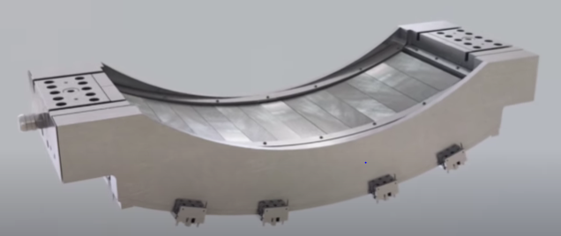
1) GEMSTONE DETECTOR(GE)
100 times faster than GOS(0.03µs)
245mm/s scan speed
Isotropic ceramic with a highly uniform and translucent cubic structure.
Faster light emission and shorter after-glow
Clarity DAS enables 25% reduction in electronic noise

Slide 50
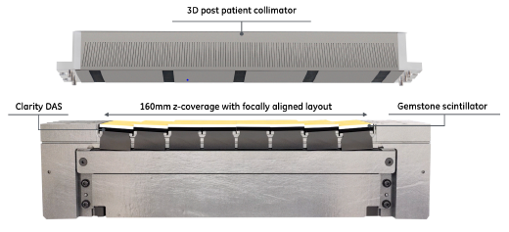
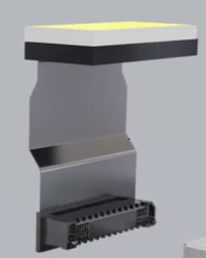
DETECTOR
NEW INTEGRATED MODULE

Slide 51
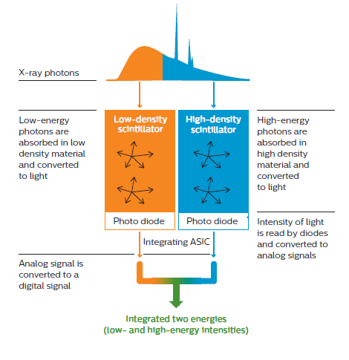
2) Nano-Panel Prism Detector (PHILPS)
Consists of 3 main components
Scintillators -Top-layer Yttrium-based garnet scintillator for detection of lower energies. Bottom-layer Gadolinium oxysulphide (GOS) scintillator for detection of higher energies
Thin front-illuminated photodiode (FIP)-maintains overall geometric efficiency of the detector
Application Specific Integrated Circuit (ASIC) –for analog-to-digital conversion

Slide 52
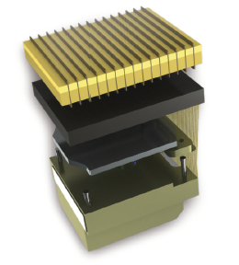
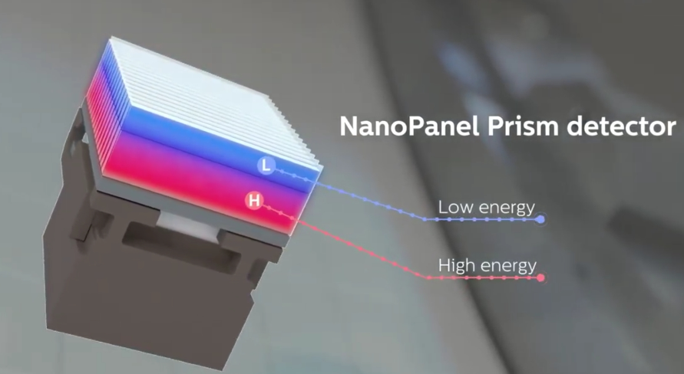
3D Tile Patterned Arrangement

Slide 53
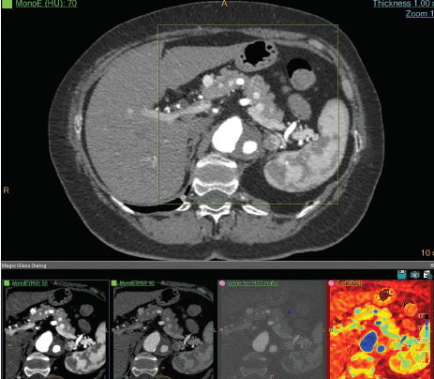
ADVANTAGES
Wide dynamic range and low noise
4 centimeters of detector coverage
Minimum slice thickness of 0.625 mm
Supports rotation time as fast as 0.27s
The FIP usage allow 25% higher light output and 30% less cross talk than previous detectors.
Delivers color quantification and the ability to characterize structure based on material content

Slide 54
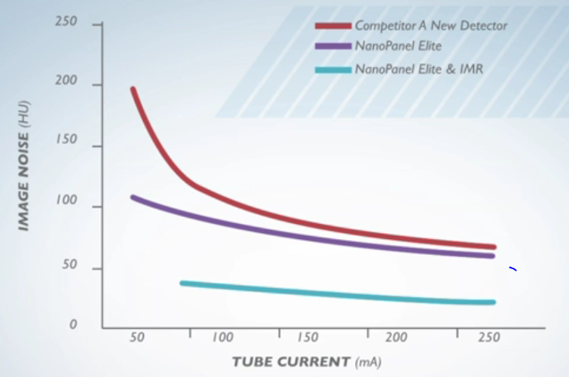

Slide 55
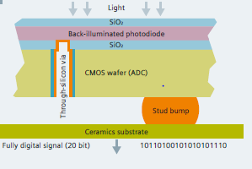
3) STELLAR DETECTOR(SIEMENS)
Siemens Healthineers’ first fully integrated detector
Ultra Fast Ceramics (UFC), the detector offers
High X-ray absorption
Short decay times
Extremely low afterglow

Slide 56
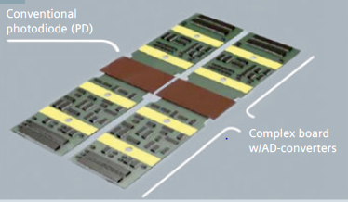
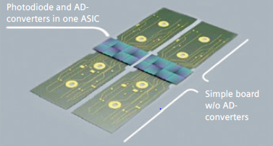
ADVANTAGES OF STELLAR DETECTOR
Combines the photodiode and ADC in one ASIC (application specific integrated circuit)
Reduces electronic noise
Low Power consumption (70%)
Good Heat dissipation
CONVENTIONAL
STELLAR

Slide 57
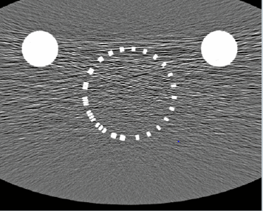
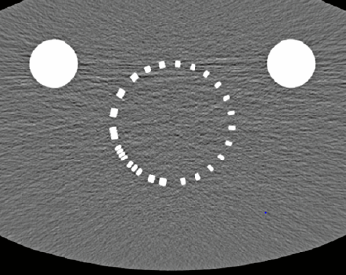
COMPARISION BETWEEN CONVENTIONAL AND STELLAR DETECTOR
A) CONVENTIONAL
B) STELLAR DETECTOR

Slide 58
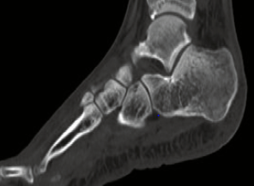
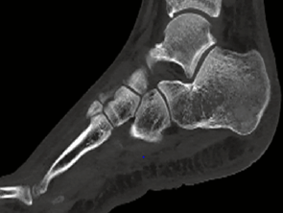
A) CONVENTIONAL
B) STELLAR DETECTOR

Slide 59
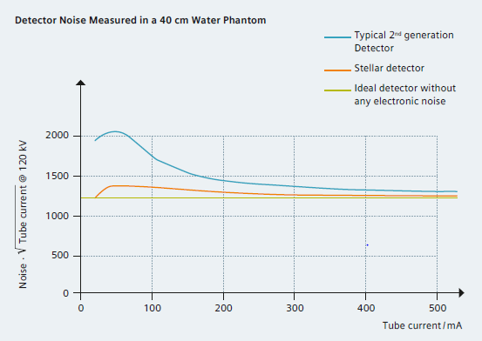

Slide 60
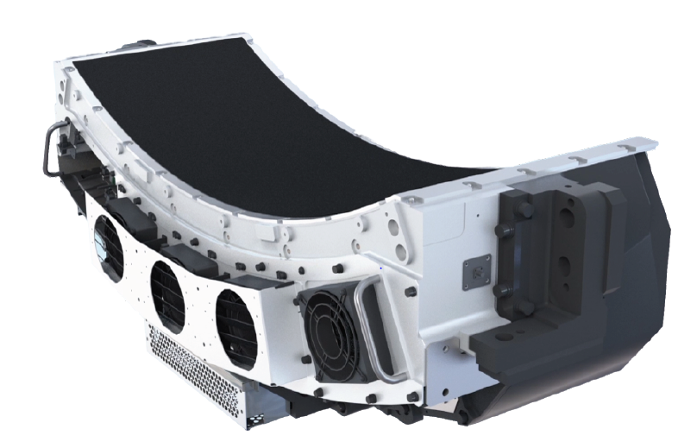
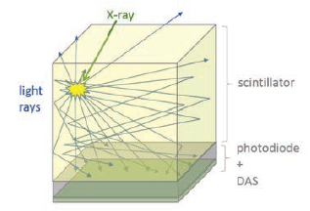
4) PURE VISION (TOSHIBA)
3 main goals :-
lower image noise for low dose acquisitions
faster scan times
improved image quality

Slide 61
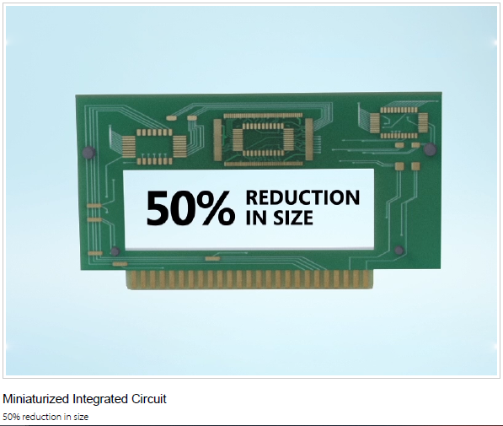
ADVANTAGES
Scintillator array of solid ceramic ingot
Microblade cutting technology
Maintain straight, smooth edges
Maximum X-ray absorption surface area
Minimum septa
0.5mm thickness
Miniaturized integrated circuit(50%)

Slide 64
GENERATIONS OF CT SCAN
Since the development of the very first CT scanner in the 1970s, the industry has seen a variety of changes applied to the CT scanner instrumentation leading to the evolution of seven different generations of CT scanners.
Each generation of scanner is unique and varies based on the arrangement of the x-ray tube and detectors.
AIM OF EVOLUTION
To provide faster acquisition time
Provide better spatial resolution
To shorten the image reconstruction time

Slide 65
FIRST GENERATION CT SCANNER/EMI SCANNER
(ROTATE/TRANSLATE, PENCIL BEAM)
Godfrey Newbold Hounsfield developed the first CT scanner with the help of a company called Electric and Musical Industries.
In order to produce such a narrow beam of x-ray photons, the first generation scanner used a pinhole collimator to ensure that only a single beam of x-ray was interacting with the patient.
It was made up of only one X Ray tube and two x-ray detectors and both were located just opposite to each other
The first generation CT scanners were used for head scans in which head was enclosed in water bath.
A five-view study of the head took about 25 to 30 minutes.

Slide 66
EMI SCANNER

Slide 67
The two detectors were capable of measuring the amount of x-rays that successfully passed through the patient for only two slices of that body part.
In order to acquire every slice across a part of the body, the x-ray tube and detectors had to be moved linearly, before rotating the position of the x-ray tube to acquire images at a different projection angle.
So, gantry moved through two different types of motion linear as well as rotatory.
Gantry used to rotate about 180^{o.}
It required 30 minutes to complete the head scan.
Pixel size was 3x3 mm
Voxel size was 3x3x13 mm

Slide 69
ADVANTAGES
Decrease in the amount of scatter radiation which was interacting with the detectors.
DISADVANTAGES
It was designed only for head.
Poor spatial resolution.
Scan time was more.
Tl activated NaI detectors were used.
Low efficiency.

Slide 70
SECOND GENERATION
(ROTATE/TRANSLATE, NARROW FAN BEAM)
The angle of the fan beam was not large and still required the linear movement of the x-ray tube and detectors at each projection angle.
It included a linear array of upto 30 detectors.
The acquisition time of scan was decreased by two to three minutes per slice.
This generation of CT scanners was measured to be fifteen times faster than the first generation, which was a massive improvement.
Gantry used to rotate about 180^{o.}
Each slice went from taking 5 minutes on 1st generation to as low as 20 seconds on 2nd generation.

Slide 72
ADVANTAGE
Scan time was reduced.
DISADVANTAGE
More scatter radiation.
Poor spatial resolution.
Tl activated NaI detectors were used.
Low efficiency.

Slide 73
THIRD GENERATION
(ROTATE/ROTATE, WIDE FAN BEAM)
In third generation CT, X-Ray tube and detectors both were rotated, so tube and detectors were rotating around the patient.
There were arch shaped detectors used in third generation CT.
Upto 750 detectors were used in this generation, so there were improvement in detector data acquisition technology.
In this slip ring technology was used.
With the use of wide aperture fan beam the x-ray tube and the detectors could now rotate freely through each of the projection angles without stopping to collect multiple slices per projection angle.
Third generation CT acquired the images by the gantry rotation of 360^{o.}
The scan time was 4.9 sec.

Slide 74
Third generation CT: Rotate/Rotate

Slide 75
ADVANTAGE
Time of scan was reduced.
Continuous rotation.
Xenon detectors were used.
DISADVANTAGE
There was more scatter radiation produced in third generation.
Low efficiency.
There was appearance of ring artifact due to the failure of detectors.

Slide 76
FOURTH GENERATION
(ROTATE/STATIONARY, FAN BEAM)
In this generation X Ray tube was rotated and detectors were stationary, which were in ring shape
Because the tube used to rotate inside the detector ring a large ring diameter 170-180 cm was needed to maintain tube skin distance.
There was a fixed ring of detectors (upto 4800), which completely surrounded the patient in a full circle within the gantry.
It was mainly developed to eliminate the ring artifact
This generation CT acquired the images by the gantry rotation of 360º
Scan time was lessthan 1 sec.

Slide 78
ADVANTAGE
Scanning time was less
Higher efficiency
CsI, BGO, CdWO4 detectors were used
Elimination of ring artefact
DISADVANTAGE
More patient dose
More scatter radiation

Slide 79
FIFTH GENERATION (STATIONARY/STATIONARY)
Also called EBCT ( Electron beam CT) or CVCT (Cardiovascular CT)
In this X Ray tube was not present
There were three main components
1. Electron gun
2. Tungsten target
3. Detector ring
It did not require any mechanical motion to acquire the images.
In this magnetic focusing and deflection of electronic beam replaced the X-ray tube motion.

Slide 80
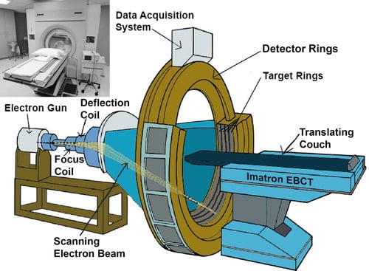
Working
Electrons ejects from the electron gun.
These electrons strike on to the target that surrounds the patient and is made of tungsten (180 cm diameter).
After that X-rays are produced and passes through the patient.
Partially attenuated beam then interacts with the stationary array of detectors.

Slide 81
ADVANTAGE
Fifth generation CT was used in cardiac tomographic imaging
The scan time to acquire a single slice was 50ms and could produce 16-17 slices per second.
CsI, BGO, CdWO4 detectors were used
DISADVANTAGE
Equipment cost was high.

Slide 82
SIXTH GENERATION CT: HELICAL
This generation essentially combine the principles of both third and fourth generations with the slipping technology to create a system that rotates continuously around the patient without being limited by electrical wires.
PRINCIPLE
As examination begins the X Ray tube rotates continuously without reversing.
When gantry rotates the table moves simultaneously, taking spiral scan and data is collected.
This data can be reconstructed at any desired z axis position along the patient.
Raw data from helical data sets are interpolated to approximate the acquisition planner reconstruction

Slide 83
Spiral or helical CT

Slide 84
ADVANTAGE
Improve lesion detection
Multi planer images can obtain
Improved 3d imaging
Reduced scan time
Avoid motion artefact
CsI, BGO, CdWO4 detectors are used
DISADVANTAGE
Increase image noise
Radiation dose is high
Equipment cost is high

Slide 85
SEVENTH GENERATION
It is Multi slice detector CT
It was introduced in 1998
In this there are multiple array of detectors which are made up of CsI+TFT
Cone beam and multiple rows of detectors, up to 8 rows of detector are used
The collimator spacing is wider and more of the x-rays that are produced by the tube are used in producing image data.
With multiple detector array scanner, slice thickness is determined by detector size, not by the collimator.

Slide 86
Seventh generation

Slide 87
ADVANTAGE
Imaging time is less
High resolution images can be obtain
Ultrathin slices can be obtain
Reduction in motion artefact
Patient breath hold is less demanding
Less contrast medium is required
DISADVANTAGE
Data overload
More radiation dose
Equipment is expensive

Slide 88
Comparison of CT generations
GENERATION | SOURCE | DETECTOR | SOURCE COLLIMATION | SOURCE-DETECTOR MOVEMENT
1st | Single X Ray tube | A pair of detectors | Pencil beam | Rotate/Translate
2nd | Single X Ray tube | Multiple | Narrow Fan beam | Rotate/Translate
3rd | Single X Ray tube | Arch shaped detectors | Wide Fan beam | Rotate/Rotate
4th | Single X Ray tube | Stationary ring of detectors | Fan beam | Rotate/Stationary
5th | Tungsten anode | Stationary semicircular detector | Fan beam | Stationary/Stationary
6th | Single X Ray tube | 3G/4G | Fan beam | 3G/4G plus linear patient table motion
7th | Single X Ray tube | Multiple array of detectors | Cone beam | 3G/4G/5G

Slide 89
Topics
LINEAR ATTENUATION COFFICIENT
MASS ATTENUATION COFFICIENT
IMAGE RECONSTRUCTION
TYPES OF IMAGE RECONSTRUCTION

Slide 90
The basic principle behind CT that the internal strecture of an object can be reconstructed from multiple projections of an object.
To carry out the reconstruction , the linear attenuation cofficient of the object is considered as a base.
Attenuation cofficients defined for uncharged particle.
Two types of attenuation cofficients are there.
Linear attenuation cofficient.
Mass attenuation cofficient.

Slide 91
Linear attenuation cofficient
Linear attenuation coefficient is a constant that describes the fraction of attenuated incident photons in a monoenergetic beam per unit thickness of a material.
It includes all possible interactions including coherent scatter, Compton scatter and photoelectric effect.

Slide 93
The mass attenuation coefficient is a normalization of the linear attenuation coefficient per unit density of a material producing a value that is constant for a given element or compound.
It is independent of the density of the material.
It is expressed in cm²/g (square centimeters per gram).

Slide 94
Image reconstruction
In CT , cross sectional layer of body is divided into many tiny blocks already shown in the figure.
Each block is assigned a number proportional to the degree that the block attenuated the x ray beam.
The individual blocks called voxels.
Their composition and thickness along with quality of beam determines the degree of attenuation.
The linear attenuation coefficient is used to quantitate the attenuation.

Slide 95
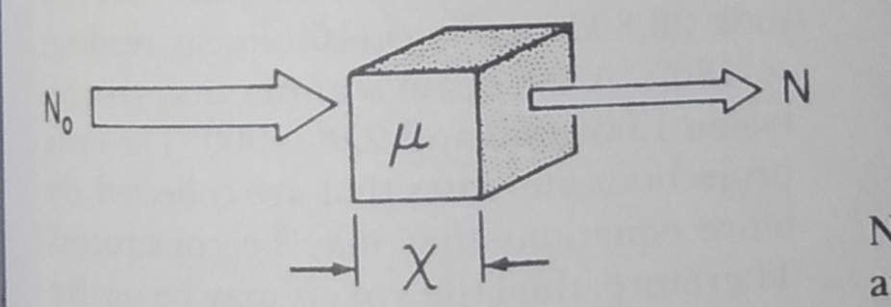
Per example , a single block of homogeneous tissue ( voxel) and a monochromatic x ray beam of x rays:
The value of linear attenuation cofficient is calculated by

Slide 96
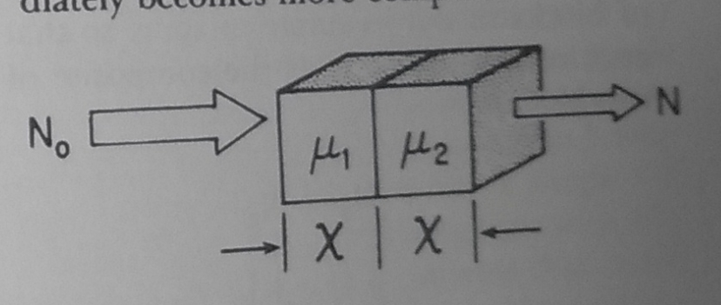
If two blocks of tissue with two different linear attenuation cofficients are placed in path of the beam and it is calculated by
Now the equation has a two unknowns and it is written as

Slide 97
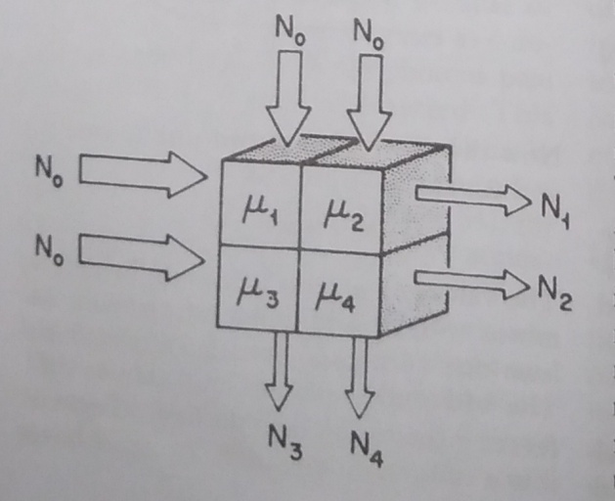
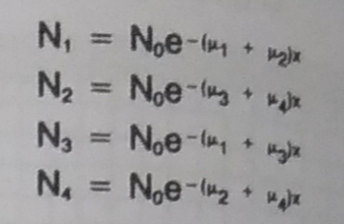
If the number of blocks increased to four, so that each reading represents the composition of two blocks.
Then the equations or readings are

Slide 98
For example, the original emi scanner , the matrix in the computer contained 80 x 80 , or 6400 pixels.
The number of separate equations and unknowns now be comes at least 6400.
The original emi scanner took 28,000 readings .
A fan beam scanner may take between 1,00,000 to 2,00,000 reading.
In a typical commercial CT system, an image is
reconstructed from 106 independent projection
samples.

Slide 99
Methods of Reconstruction
The CT scan results in the acquisition of A projection set for each CT slice.
The computer hardware and software convert the raw data into CT images through the process called image reconstruction.
There are three mathematical methods of image reconstruction used in ct
Iterative reconstruction.
Simple back projection.
Analytical method.
Filtered back projection.
Fourier reconstruction.

Slide 100
Iterative reconstruction
Iterative method is the original method used by G. N. Hounsfield.
This technique uses series of calculations that run repeatedly.
After each run , the resulting image appears more and more like the actual object.
After a certain number iterations, the image converges with the image of the the actual object.
The errors between the measured and calculated CT projections are used update the image for next iteration.

Slide 101
Simple back projection
Back projection is a mathamatical process , based on trigonometry , which is designed emulate the acquisition process in reverse.
In this method, required projections of an object are obtained by multiple scans.
Then, the projections are back projected image receive density contribution from neighboring strectures and creates noise.
Hence the image quality is very poor and large number of projection are required to improve the image quality.
The disadvantage of the method is the blurred image of the object and hence not used today.

Slide 102
Filtered back projection
It is similar to back projection, but the raw data are mathematically filtered by convolution kernel before being back projected .
The various types convolution kernel includes
Lak filter .
Sheppe Logan filter.
Hamming filter.
Bone filter.
Soft tissue filter.

Slide 103
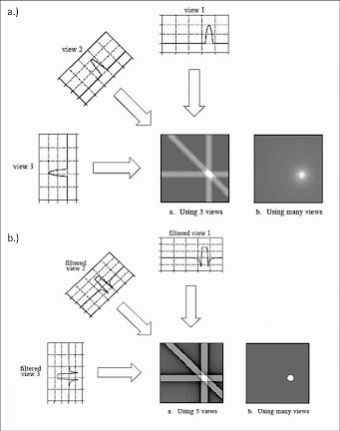
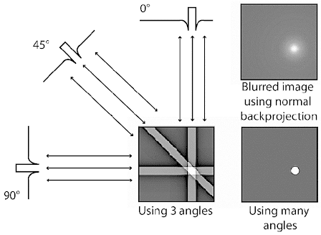

Slide 104
Fourier transform
Fourier transform is a mathematical operation which converts a time domain signal into a frequency domain signal.
Fourier transform is integral to all modern imaging, and is particularly important in MRI. The signal received at the detector (receiver coils in MRI, piezoelectric disc in ultrasound and detector array in CT) is a complex periodic signal made of a large number of constituent frequencies (i.e., bandwidth).
This can be visualized as multiple sine and or cosine waves along a time-axis.

Slide 106
CT ARTIFACTS
Artifacts can degrade image quality, affect the perceptibility of detail, or even lead to misdiagnosis.
This can cause serious problems for the radiologist who has to provide a diagnosis from images obtained by the technologist.
Therefore it is mandatory that the technologist understand the nature of artifacts in CT.
A CT image artifact is defined as ‘‘any discrepancy between the reconstructed CT numbers in the image and the true attenuation coefficients of the object’’.
In CT, artifacts arise from a number of sources, including the patient, inappropriate selection of protocols, reconstruction process, problems relating to the equipment such as malfunctions or imperfections, and fundamental limitation of physics.

Slide 107
TYPES OF ARTIFACTS
Patient Motion artifacts.
Streak artifacts.
Metal artifacts.
Beam hardening or Cupping artifacts.
Aliasing artifacts.
Noise artifacts.
Partial volume artifacts.
Ring artifacts or band artifacts
Truncation artifacts.
Cone beam artifacts.
Spiral artifacts.
Rod artifacts.

Slide 108
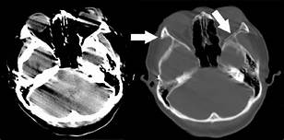
Patient Motion artifacts
Patient motion can be voluntary or involuntary.
Both voluntary and involuntary motions appear as streaks that are usually tangential to high-contrast edges of the moving part.
Additionally, motion artifacts can arise from movement of oral contrast in the gastrointestinal tract.
For patient movements such as breathing and swallowing, it is important to immobilize patients and use positioning aids to make them comfortable and to ensure that patients understand the importance of remaining still and following instructions during scanning and other is reducing scan time.
Involuntary movements decreased by Respiratory techniques like ECG gating.

Slide 109
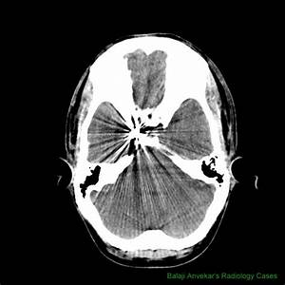
Streak artifacts
Streak artifacts due to absence of transmitted X rays to the detector and it appears as dark and light lines.
Most streak artifacts occur near materials such as metal or bone, primarily as a result of beam hardening and scatter.
These phenomena produce dark streaks between metal, bone, iodinated contrast, barium, and other high-attenuation materials.
Streak artifacts can be reduced using newer reconstruction techniques or metal artifact reduction software.

Slide 110
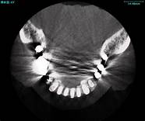
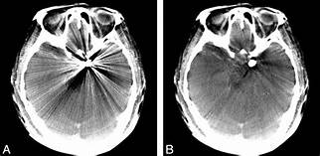
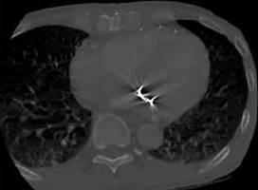
Metal artifacts
The presence of metal objects in the patient also causes artifacts.
Metallic materials such as prosthetic devices, dental fillings, surgical clips, and electrodes give rise to streak artifacts on the image.
the metal object is highly attenuating to the radiation, which results in significant error in projection profiles.
The error is the combined effects of signal under range, beam hardening, partial volume, and limited dynamic range of the acquisition and reconstruction systems.
The loss of information leads to the appearance of typical star-shaped streaks.
Metal artifacts can be reduced by the removal of all external metal objects from the patient. Software such as the metal artifact reduction (MAR) program can be used to complete the incomplete profile through interpolation.

Slide 111
Beam hardening artifacts.
These are caused by polychromatic nature of x ray beam.
As the beam passes through the patient, a low energy absorbed and the mean energy increases.
As the result the beam become hardened that causes underestimation of Ա and HU. It is poosible to minimize the beam hardening effect by suitable correction algorithm.
Because of the beam-hardening effect, errors in CT numbers increase gradually from the periphery to the center of the object, as depicted by the present in the beam path, dark shading artifacts can result because the beam-hardening correction applied to soft tissue does not work well for bones.
Eg : bones and iodinated contrast media.

Slide 112
Aliasing artifacts.
Aliasing artifact, otherwise known as undersampling, in CT refers to an error in the accuracy proponent of analog to digital converter (ADC) during image digitization.
Image digitization has three distinct steps: scanning, sampling, and quantization.
When sampling, the brightness of each pixel in the image is measured, and via a photomultiplier, creates an output analog signal that is then due to undergo quantization.
The more samples that are taken the more accurate the representation of the signal will be, hence if a lack of sampling has occurred the computer will process an inaccurate image resulting in an aliasing artifact.

Slide 113
Noise artifacts
Noise is influenced partially by the number of photons that strike the detector.
More photons mean less noise and a stronger detector signal, whereas fewer photons result in more noise and a weaker detector signal.
When it is combined with the electronic noise and the logarithmic operation, photon starvation often leads to severe streak artifacts.
The technologist should optimize patient positioning, scan speed, and exposure technique factors to correct streak artifacts.

Slide 114
Partial volume artifacts.
If the voxel contains only one tissue type, the calculation will not be problematic.
For example, if the tissue in the voxel is gray matter, the CT number is computed at around 43.
If the voxel contains three similar tissue types in which the CT numbers are close together—for example, blood (CT number 40), gray matter (43), and white matter (46)—then the CT number for that voxel is based on an average of the three tissues. This is known as partial volume averaging.
Partial volume artifacts can be reduced with thinner slice acquisitions and computer algorithms

Slide 115
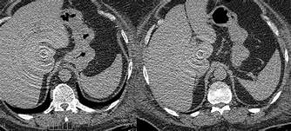
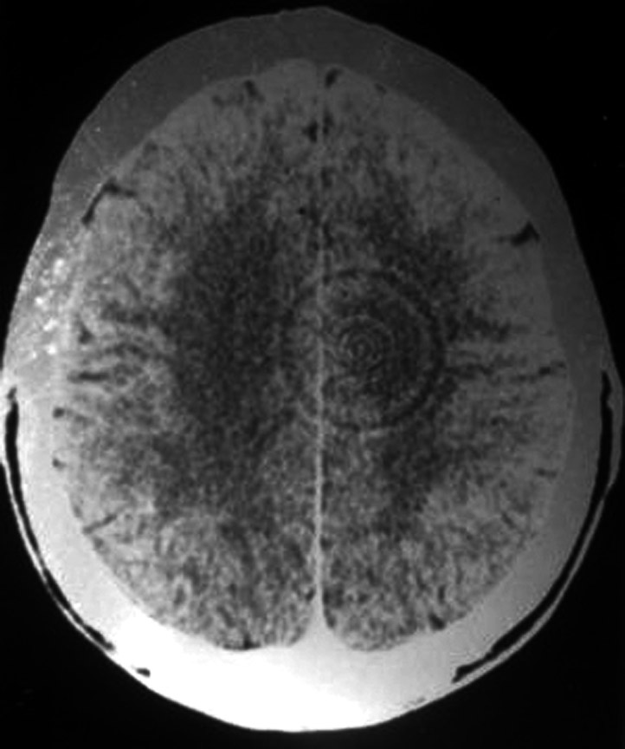
Ring artifacts or band artifacts
Ring artifacts are a CT phenomenon that occurs due to miscalibration or failure of one or more detector elements in a CT scanner.
Less often, it can be caused by insufficient radiation dose or contrast material contamination of the detector cover .
They occur close to the isocenter of the scan and are usually visible on multiple slices at the same location. They are a common problem in cranial CT.
Recalibration of the scanner will usually rectify the artifact. Occasionally detector elements need replacing which can be costly.

Slide 116
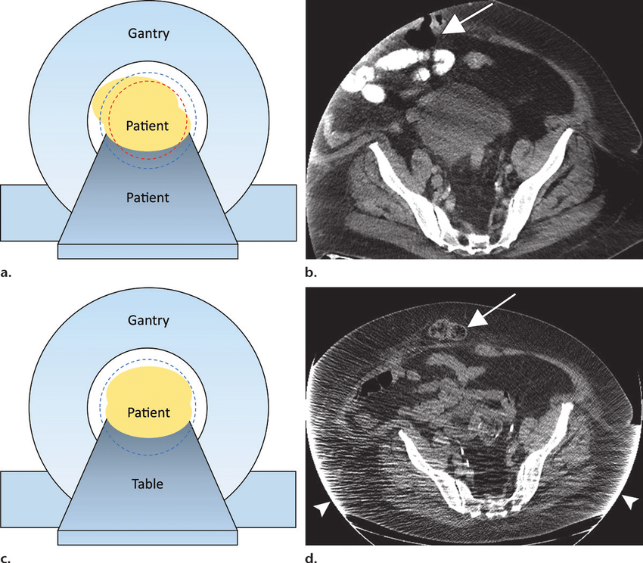
Truncation artifacts.
Truncation artifact in CT is an apparently increased curvilinear band of attenuation along the edge of the image.
This artifact is encountered when parts of the imaged body part remain outside the field of view (e.g. due to patient body habitus), which results in inaccurate measurement of attenuation along the edge of the image.
The artifact can be reduced - if possible - by using an extended FOV reconstruction of the affected region .

Slide 118
Image quality
In CT, image quality is directly related to its usefulness in providing an accurate diagnosis.
Types of image quality
Contrast resolution.
Spatial resolution.
Temporal resolution.
Noise
Image blur or Unsharpness
1. Contrast resolution:
It is the ability to distinguish between multiple densities in the radiographic image.
Its depends on matrix size.
This two types : Subject contrast and Display contrast.
CT subject contrast is determined by different attenuation. This is depend on HU.
Display contrast is Arbitrary ( depending only on window level & window width selected. Nothing but windowing (LUNG AND SOFT TISSUE)

Slide 119
2. Spatial resolution
It is the ability of imaging system to differentiate between two near by objects.
it is depend on the size of the pixel.
It is measured in linepairs per millimeter (lp/mm). A line pair is a pair of equal-sized black-white bars. Therefore, a bar pattern representing 10 lp/cm is a set of uniformly spaced combshaped bars with 0.5-mm wide teeth.
3. Temporal resolution
It is the ability to see the fast moving objects.
It is the minimal time necessary to compile all X-ray data that are required to calculate or reconstruct one cross-sectional CT data set.
A high temporal resolution is required in coronary CTA to ensure motion-free image quality of the fast-moving coronary arteries.
Dual CT scan improved temporal resolution.

Slide 120
4. Noise(Quantum mottle): Unwanted change in the pixel values that shows grainy appearance on cross-sectional image.
It is a random process due to fluctuations in the number of photons reaching the detector from point to point.
Noise in CT measured via SNR : comparing the level of desired signal to level of background noise.
Higher the SNR, less noise on image.
5. Image blur or Unsharpness :
The distortion of objects in an image, resulting in poor spatial resolution.
In order to determine the image quality the image must be sharp. Blurring will reduce the image quality.
Types of blur:
Geometric blur – limited by focal spot size.
detector blur – limited by detectors.
motion blur – caused by voluntary/involuntary movements of patient.
absorption blur – blurring at edge of round/tapperd stricture.

